Slide 1


VISVESVARAYA TECHNOLOGICAL UNIVERSITY BELAGAVI-590018 A PROJECT REVIEW ON
DESIGN AND FABRICATION OF LUNAR LANDER AND ROVER MODEL
Submitted by,
ABHILASH GS 1MV20ME001
BHASKAR ML 1MV20ME009
BHUVANESHWARA P 1MV20ME010
KUBER 1MV20ME021
Under the Guidance of
Mr. HALESH SB
Associate professor, Department of Mechanical Engineering
SIR M .VISVESWARAYA INSTITUTE OF TECHNOLOGY, BENGALURU
Academic year 2023-2024

Slide 2
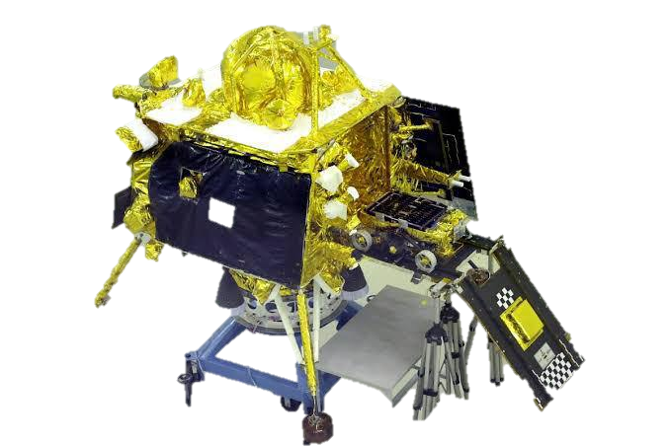
Introduction
The design and fabrication of a lunar lander and rover is driven by the goal of enabling human or robotic exploration and scientific research on the lunar surface.
The lunar lander and rover are deployed to conduct experiments, collect data, and further our understanding of the Moon's geology, environment, and potential for future human exploration.
We are controlling the rover through RF technology & Designing and fabricating a model of a lunar lander and rover involves several key steps to ensure accuracy and functionality.
1
Notes:
Image source: https://www.coolfiresolutions.com/blog/smart-street-lights/

Slide 3
The rover having temperature sensor , Humidity sensor ,water sensor and metal sensor and send to WIFI ,IOT we can monitor all the data through the cell phone
The lander system it has solar and battery , Bluetooth controlling system
lunar-exploration missions developed by the Indian Space Research Organisation (ISRO). Launched on 14 July 2023, the mission consists of a lunar lander named Vikram and a lunar rover named Pragyan similar to those launched aboard Chandrayaan-2 in 2019.
Also it has WIFI camera ,through the camera we can view all the things
In our rover project we are using solar power with battery storage system
The controllers are used Microcontroller, ESP32, Arduino Nano etc..
2

Slide 4
Literature Survey
1. From the works of Ahmed Abu-Abed. [1], its observed that, mechanical design, including methodologies, tools, and applications. It covers topics like design theory, optimization, computer-aided design, and innovative design techniques..
2. From the works of Om Prakash Narayan Calla, Vishwa Sharma. [2], it’s observed that,"Remote Sensing of Lunar Surface" is a specialized journal focusing on the utilization of remote sensing techniques to study the Moon's topography, geology, and physical properties.
3. From the works of Anurag Talekar, Ajinkya Dabholkar, Ajinkya Thombe.[3], it’s observed that,The design and analysis of a lunar lander's landing system involves creating a precise, reliable mechanism to ensure a safe and controlled descent to the Moon's surface. Engineers use simulations and rigorous testing to optimize the landing gear, propulsion, and navigation systems, considering factors like gravitational pull, terrain, and dust conditions.
4. From the works of Santosh Kosambe. [4], it’s observed that, Chandrayaan-2 was India's second lunar exploration mission, launched in July 2019. It included an orbiter, a lander (Vikram), and a rover (Pragyan). While the orbiter continues to study the Moon, the lander failed to make a soft landing. Chandrayaan-2 aimed to explore the Moon's south pole, study its composition, topography, and water ice.5. From the works of Richu Sam Alex. [5], its observed that, This reduce the power consumption of the street lighting system about 20-35 %compared to conventional design. This system is fully automated and is using ZIGBEE so that the control station can analyze all the performance of the system.
3
Notes:
Image source: http://www.allenshariff.com/news-and-blogs/light-emitting-diodes-leds-green-technology/

Slide 5
Importance of Fabrication of Lunar lander & Rover model
Technological Advancement: Prototyping encourages innovation and the development of new technologies. Engineers may discover novel solutions to challenges faced during prototyping, which can lead to advancements in lunar exploration and other fields.
Cost Savings: While building prototypes incurs initial costs, it ultimately saves money by preventing costly mistakes in the final design. Identifying and resolving issues early in the development process avoids expensive modifications and failures during the mission.
Testing and Validation: This helps identify any potential flaws or issues that need to be addressed before the final version is constructed.
4
Notes:
Image source: http://circuit-diagramz.com/simple-automatic-street-light-circuit-diagram/

Slide 6
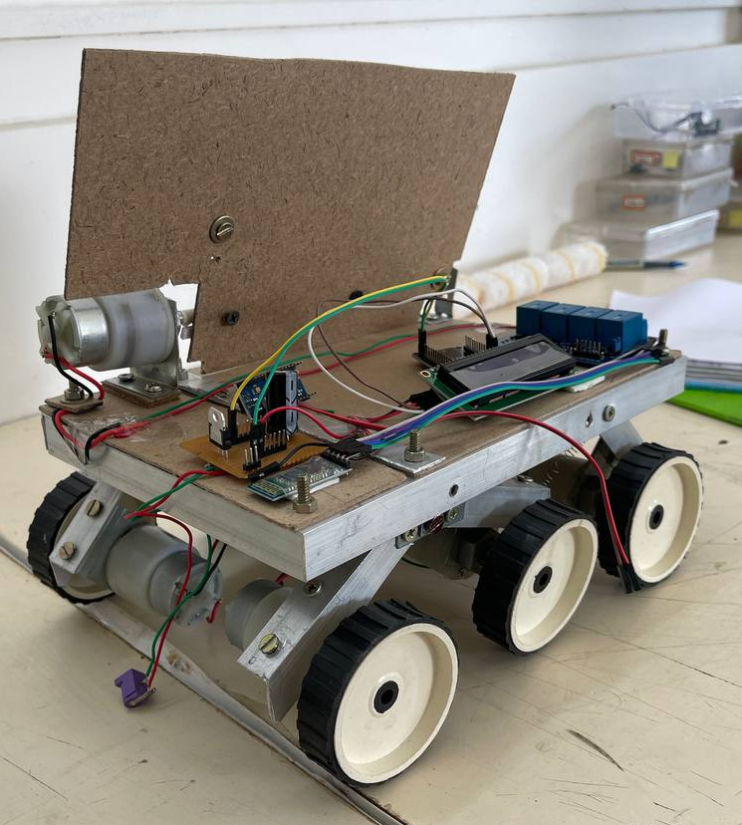
DESIGN AND FABRICATION OF LUNAR LANDER AND ROVER MODEL
The rover is control by the RF technology it has WIFI connectivity for IOT purpose.
Advanced software tools, such as computer-aided design (CAD), are used to develop comprehensive models.
It has all the four sensor to read and upload in IOT. also it has WIFI camera for monitor and view of objects.
Integration of sensors, microcontrollers, and power management units is essential for automated functionality.
Careful assembly and testing ensure the quality and reliability of the fabrication.
5
Notes:
Image source: https://www.youtube.com/watch?v=UonqU9gul-o

Slide 7
1. Functionality: Ensure that the model accurately represents the functional aspects of a lunar lander and rover, including landing, mobility, communication, and scientific instrumentation.
2. Durability: Fabricate the model using materials that are durable and suitable for handling and transportation, ensuring that it can withstand repeated use and demonstrations.
3. Accessibility: Make the model accessible for educational purposes, allowing students, researchers, and the public to learn about lunar exploration and space technology.
4. Education: Use the model as an educational tool to teach concepts related to space exploration, engineering, physics, and robotics, fostering interest and understanding among learners of all ages.
5. Scale: Design the model to an appropriate scale to accurately reflect the size and proportions of the actual vehicles, providing a sense of perspective and realism.
6. Demonstration: Enable the model to demonstrate key aspects of lunar missions, such as landing procedures, mobility on simulated lunar terrain, and data transmission..
Objectives
6
Notes:
Image source: https://www.youtube.com/watch?v=foabU1WOJ4w

Slide 8
Sensor Technologies & Control Systems
RF receivers a electric device that separate radio signals from one another and convert specific signals into audio, video or data formats.
Environmental sensors, including temperature, rain sensors, metal sensors, humidity sensors, helps to know us changing weather conditions.
Microcontrollers, such as Arduino, Esp 32, RF receivers are used to process sensor inputs and control the operation of the Lunar Lander and Rover model.
Programmable logic controllers (PLCs) enable advanced control functionalities and remote monitoring capabilities.
Wireless communication modules, like Wi-Fi or GSM, allow for real-time data exchange and remote control of the Lunar Lander and Rover model.
7
Notes:
Image source: https://modernroboticsinc.com/product/light-sensor/

Slide 9
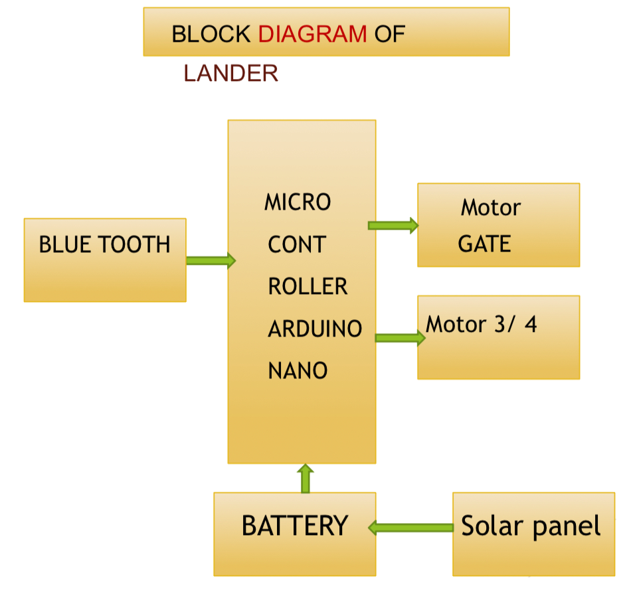
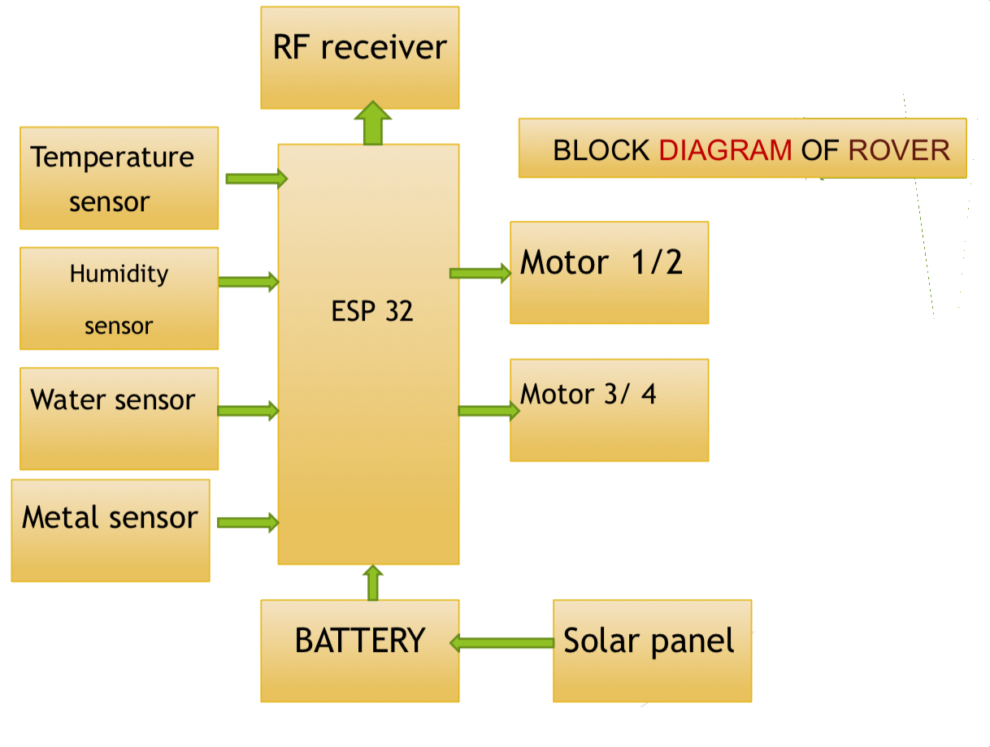
LANDER SIZE
Size = 24” x 12 “ x 24 “
Light Weight Plastic Pipe
Solar panel 12 volt .5 watts
Gate 10”x 24”
Rechargeable battery 9 volt
Specification of ROVER
DC geared motor
Speed = 40 rpm
Power = 12 volt 10 watt
Rover Size = 12” X 10” X 6”
Rechargeable battery 9 volt
8

Slide 10
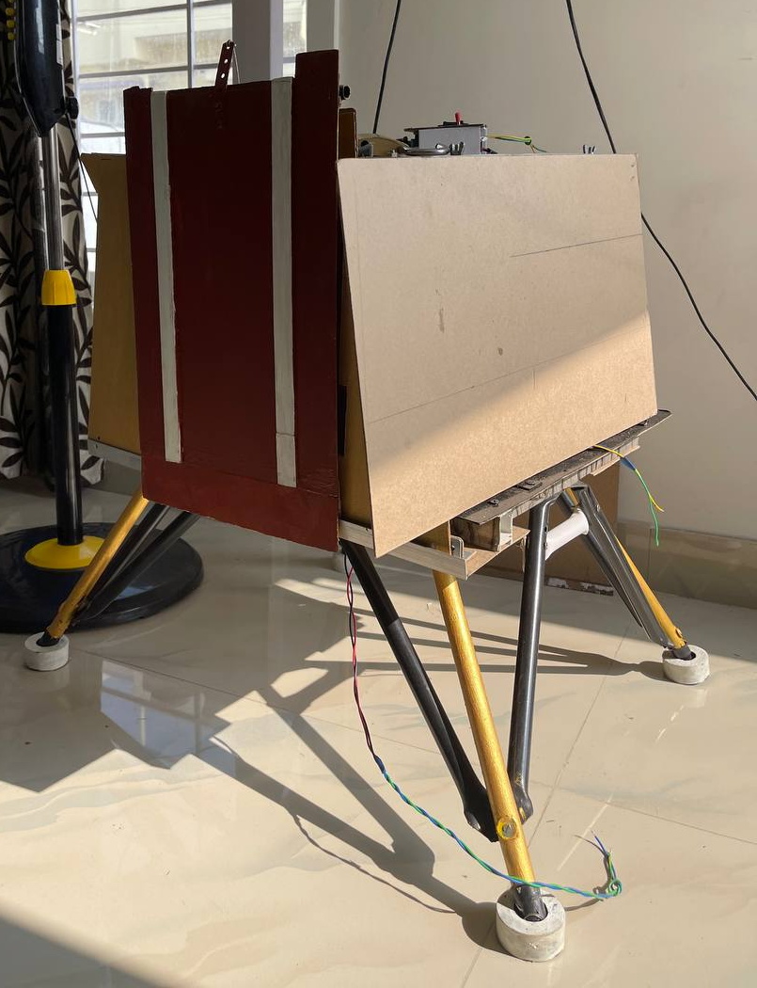
Benefits of Design and Fabrication of Lunar Lander and Rover Model
Models inspire creativity, innovation, and imagination by showcasing the possibilities of lunar exploration and colonization. They encourage individuals to envision a future where humanity expands its presence beyond Earth, sparking ideas for future missions and technological developments.
Models generate public interest and excitement about space exploration by providing a tangible representation of cutting-edge technology and scientific advancements. They contribute to outreach efforts aimed at raising awareness and support for space exploration initiatives.
9
Notes:
Image source: https://starofmysore.com/install-automatic-street-light-controllers-to-save-energy-and-money/

Slide 11
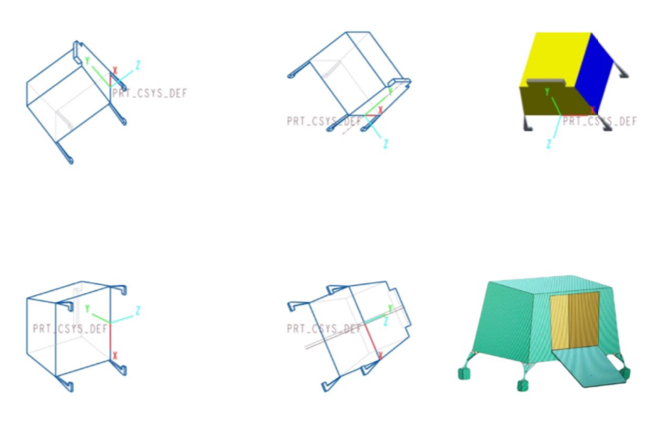
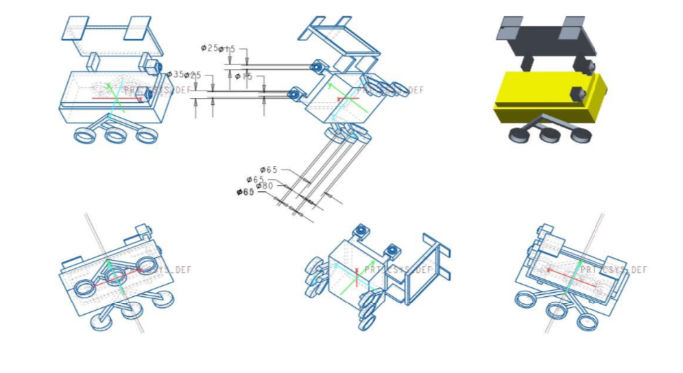
DESIGN OF THE LANDER AND ROVER
ROVER
LANDER
10

Slide 12
THEORETICAL DESIGN CALCULATION AND TESTING
In the numerical simulation, a model was implanted with unlimited variations to produce complex scenarios. These capabilities allow the analysis and understanding of the interaction of each element in the system. Firstly, the design of the model must be developed. The model represents the system itself, whereas the simulation represents the operation of the system overtime. To conduct a simulation and fabrication, a design calculation is introduced and applied.
W = mg
DC Motor
The motor is being used at 12V and 20 Watts. Since the motor is of 20 Watts and from the battery it is required the power of 20 Watts hence the battery can deliver the power to the motor.
11

Slide 13
Motor speed=N= 60rpm Power=20 watts
P =2𝜋NT/60 ∴T = 𝑃 x 60/( 2 x 𝜋 x 60) T = 20 x 60/2 x 𝜋 x 60 T = 3.18471 N-m
Machine speed:
Diameter of the wheel = 9 inch = 228.6mm Motor speed = 60 rpm = 1 rps Machine speed = (2πr) x (motor speed in rps) = (2 x π x 228.6 /2 ) x (1) = 717.804 mm/sec = 2.584 kmph
12

Slide 14
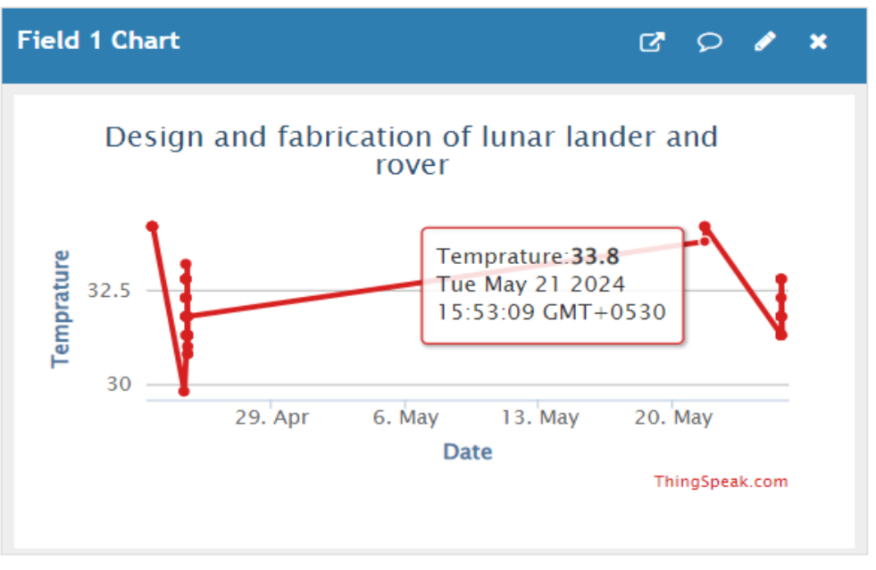
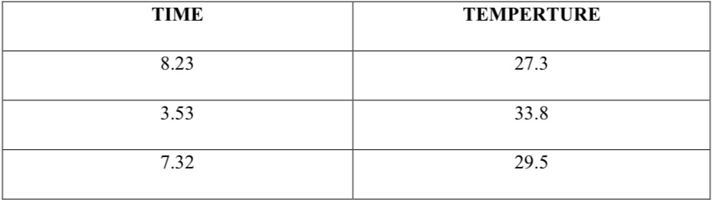
Result:
This testing shows the moisture content, temperature, humidity and voltage reading take by the rover.
Temperature reading:
DAY (THURSDAY - 21/04/2024)
13

Slide 15
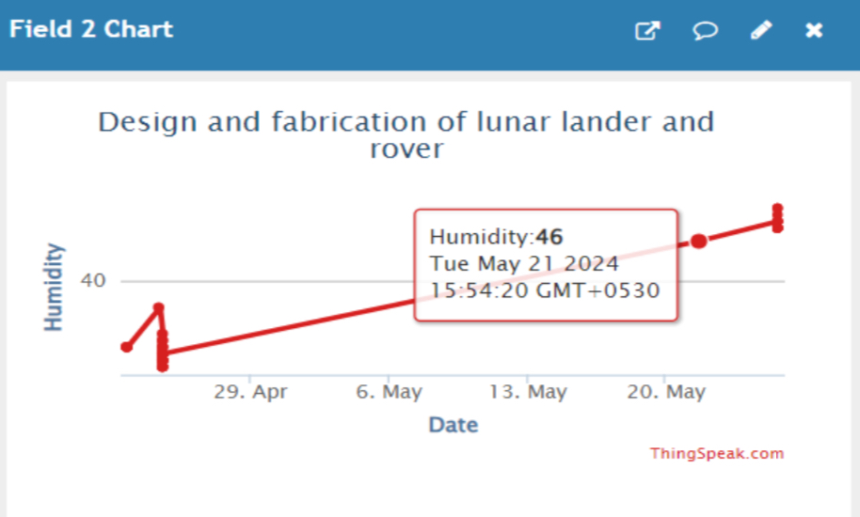
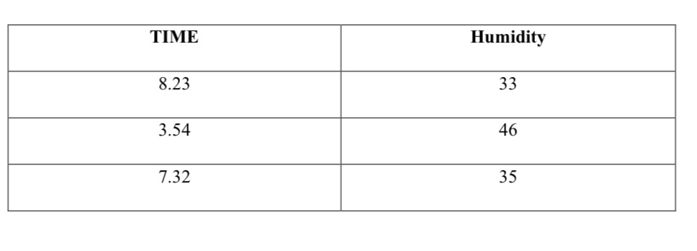
Humidity reading:
DAY (THURSDAY - 21/04/2024)
14

Slide 16
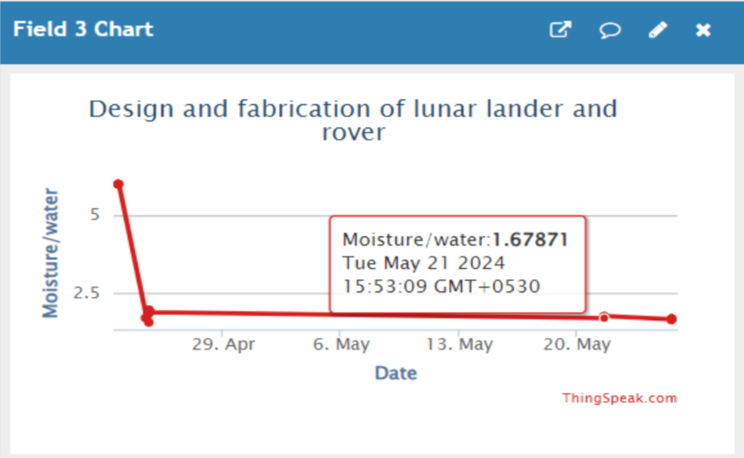
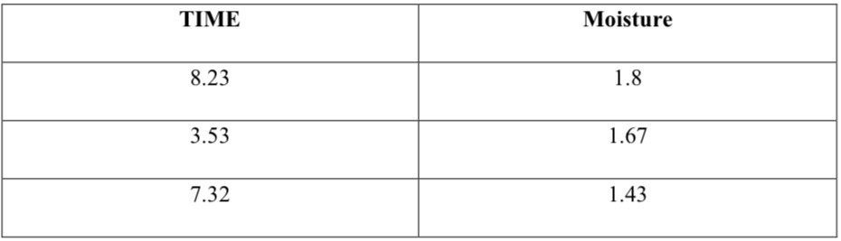
Moisture reading:
DAY (THURSDAY - 21/04/2024)
15

Slide 17
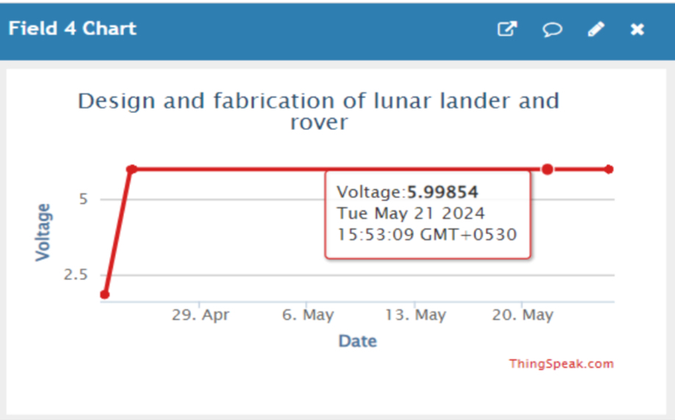
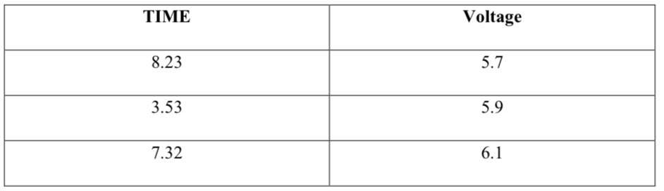
Voltage reading
DAY (THURSDAY - 21/04/2024)
16

Slide 18
Challenges and Future Developments
Accessibility and Affordability; Making lunar lander and rover models accessible and affordable to educational institutions, museums, and outreach organizations can be challenging, particularly for institutions with limited resources. Future developments may involve the development of low-cost fabrication methods and open-source design platforms to democratize access to lunar exploration simulations and demonstrations..
Durability and Reliability: Ensuring the durability and reliability of lunar lander and rover models, especially for repeated use in educational and outreach activities, is essential. Future developments may involve the use of advanced materials and construction techniques to enhance durability while maintaining cost-effectiveness.
Scale and Size: Scaling down the size of lunar lander and rover models while maintaining functionality and detail can be challenging. Future developments may focus on miniaturization technologies and techniques to create smaller yet highly accurate models suitable for educational and outreach purposes.
17
Notes:
Image source: https://www.electrical-blog.com/a-review-of-smart-grid-and-renewable-energy-technology/

Slide 19
Conclusion
The design and fabrication of lunar lander and rover models represent a critical intersection of technology, education, and outreach in the field of space exploration. These models serve as invaluable tools for simulating, visualizing, and communicating the complexities of lunar missions, inspiring curiosity and engagement among students, educators, policymakers, and the public.
Despite the challenges posed by achieving accuracy, scalability, mobility simulation, communication integration, durability, affordability, feature integration, and sustainability, ongoing advancements in modeling techniques, materials, manufacturing processes, and simulation technologies continue to drive innovation in this field. Continued advancements and research in this field will pave the way for smarter, greener, and more intelligent cities.
18
Notes:
Image source: https://techatronic.com/automatic-street-light-with-ir-sensor/

