Slide 1
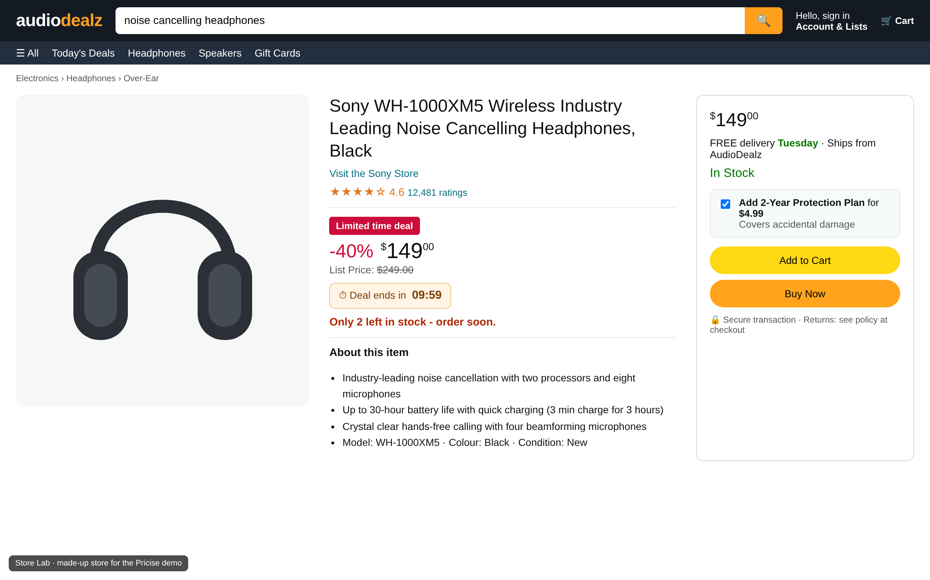
Notes:
SLIDE 1 (screenshot only).
SAY: “Hey, I want you to remember the last time you found a sketchy website,”
>>> NEXT SLIDE.

Slide 2
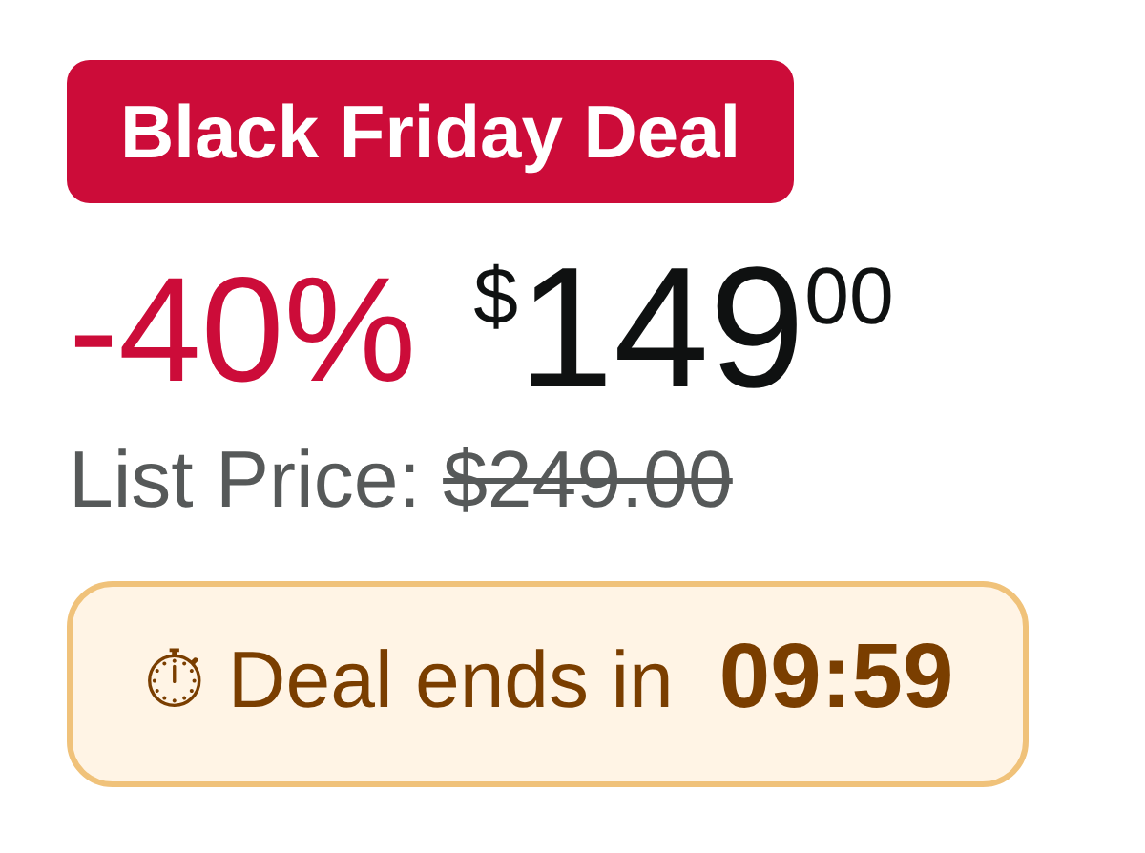
Notes:
SLIDE 2 (screenshot only).
SAY: “a faulty deal,”
>>> NEXT SLIDE.

Slide 3
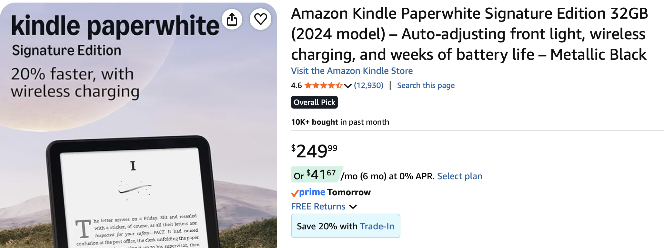

Notes:
SLIDE 3 (screenshots only).
SAY: “and bought a product only to find out that you could get it for much cheaper later on. Like this Kindle: $249.99 on Amazon, and a Paperwhite for $199.99 somewhere else.”

Slide 4

Pricise
Shop safe? Honest deal? Best safe price?
A Chrome extension whose agents check every product page before you buy, challenge each other’s findings, and show the proof.
ChallengeX · Team Hat’s Off: Shriganesh, Abel, Josh, Emmanuel
Notes:
SLIDE 4.
SAY: “Hi, we’re team Hat’s Off, and this is Pricise, a Chrome extension that checks a product page before you buy. It answers three questions: is the store safe, is the deal real, and can you get the same item cheaper from a store you can trust?”

Slide 5
Online shopping is expensive
WHY IT MATTERS
SCAMS
FAKE DISCOUNTS
HIDDEN FEES
$15.9B
52%
$11B
lost to fraud reported to the FTC in 2025. Online shopping is the 2nd most reported fraud type.
of US consumers say brands regularly advertise fake discounts.
the FTC expects shoppers to save over 10 years once hidden fees on tickets and stays are banned.
Source: FTC, Mar 2025 and Mar 2026
Source: YouGov, Feb 2024
Source: FTC junk fees rule, Dec 2024
Every one of these is decided on a single product page, in seconds, before you click Buy.
Notes:
SLIDE 5.
SAY: “Shopping online without checking is expensive. $15.9 billion was lost to fraud reported to the FTC in 2025, and online shopping is the second most reported type. 52% of US shoppers say brands regularly advertise fake discounts, according to YouGov. And the FTC expects its junk-fees rule to save shoppers $11 billion over ten years. Let me show you Pricise on a real Amazon page.”
>>> SWITCH TO: Chrome, Amazon JBL page (keep the delivery location out of view).
1. Refresh. “As soon as the page loads, Pricise checks it. It’s yellow: check before you buy, because the same speaker is $24.96 cheaper at Best Buy.”
2. Open the side panel. “The store is low risk: a secure site, a domain that’s 32 years old, and it tells me this is a third-party seller, not Amazon.”
3. Click Go to Best Buy. “Here’s the same speaker, new, for $89.99.”
4. Switch to the AudioDealz tab. “Now here’s AudioDealz, a made-up store we built to test Pricise.” Point at the verdict and read the top reasons on screen. “Pricise flags it straight away.”
>>> SWITCH BACK TO: PowerPoint, slide 6.

Slide 6
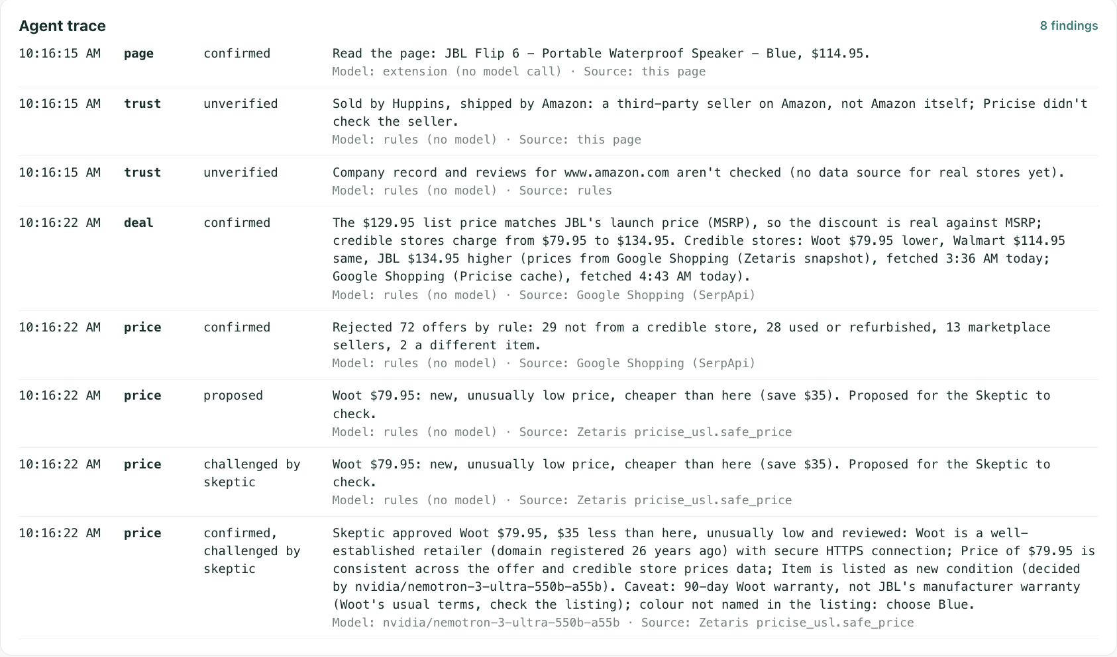
The agents check each other’s work
AGENT WORKFLOW
Trust Agent Is the store safe?
Checks HTTPS, domain age, return policy and who really sells it.
Found: Secure · domain 32 years old · third-party seller
Deal Agent Is the discount real?
Compares the “was” price with the maker’s price and looks for fake urgency.
Found: 12% off is real: $129.95 is JBL’s list price
Price Agent Is it cheaper somewhere safe?
Reads offers through Zetaris and keeps only the same item, new, from a trusted store.
Real trace: every decision is logged with the model that made it.
Found: Best Buy $89.99, new: $24.96 less
Skeptic Agent Is it too good to be true?
Hard rules the AI can’t override
Double-checks unusually low offers with NVIDIA Nemotron Ultra before you see them.
Throws out used, open-box, unknown-seller and wrong-colour offers.
Found: Approves or rejects, with reasons you can read
Notes:
SLIDE 6.
SAY: “So how does Pricise decide? It uses four agents. The Trust Agent checks the store, the Deal Agent checks the discount, and the Price Agent looks for better prices. The Skeptic double-checks them: when an offer looks too good to be true, it reviews it with NVIDIA Nemotron Ultra before it’s recommended. Fixed rules the AI can’t override throw out used, open-box and look-alike offers, and every decision is logged.”

Slide 7
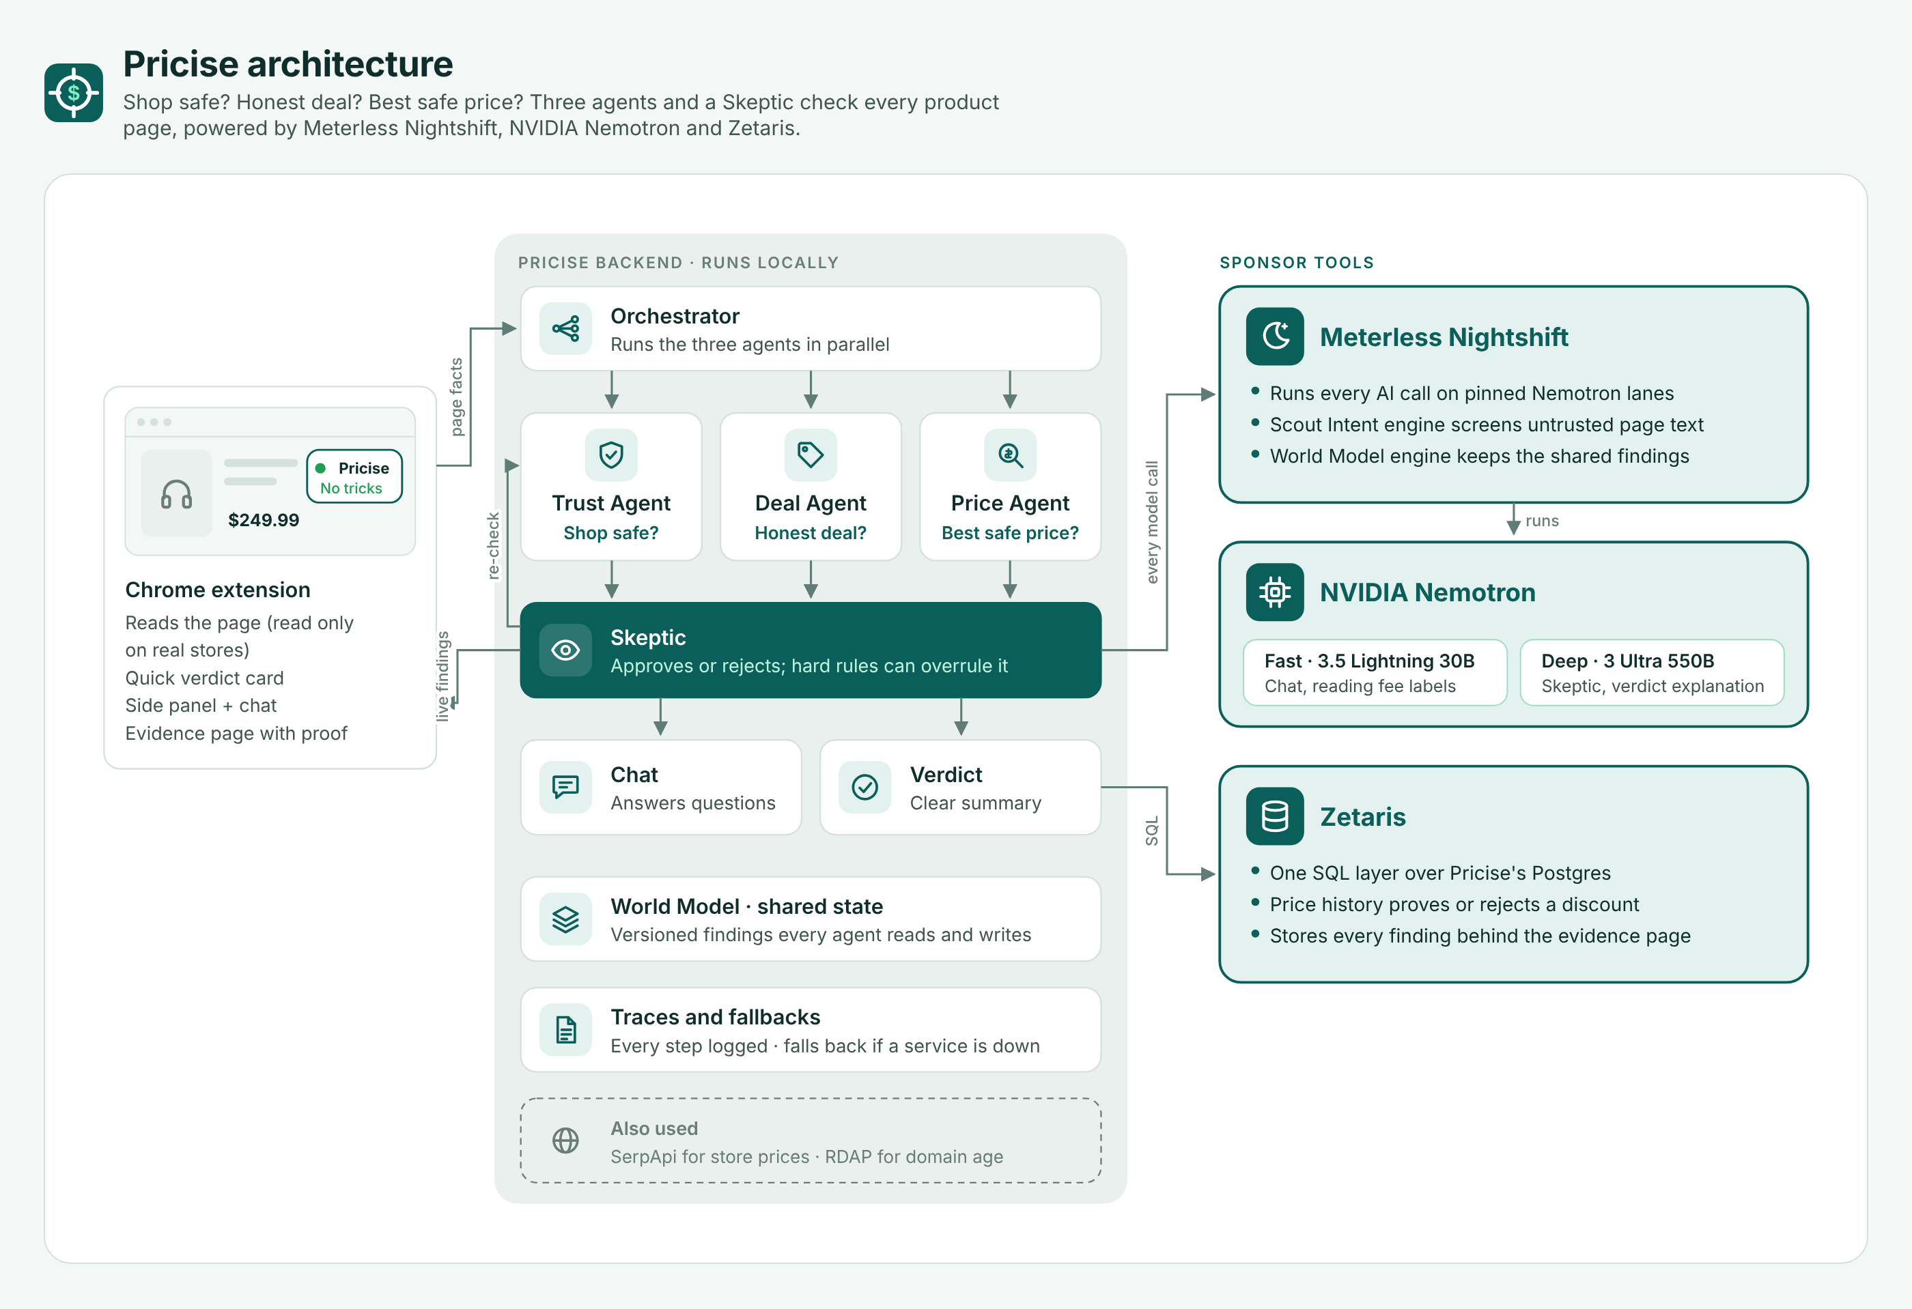
How Pricise fits together
ARCHITECTURE
Browser
Extension reads the page, read-only
Backend
Orchestrator, 3 agents and the Skeptic, on the laptop
Sponsors
Nightshift runs every model call; Zetaris is the data layer
Notes:
SLIDE 7.
SAY: “Here’s how it fits together. The extension sends the page to a backend on the laptop, the agents run in parallel and share what they find, Meterless Nightshift runs every AI call, and Zetaris supplies the data: our price history, how old each store’s website is, and current Google Shopping prices, all in one table.”

Slide 8
The model decides. Rules keep it honest.
WHAT’S UNIQUE
A second opinion on every deal
Cheapest and safe, in one answer
Stores can’t trick the AI
Before you see a deal, our Skeptic agent checks it with NVIDIA Nemotron Ultra, and hard rules make sure it can’t be fooled.
Zetaris combines current prices, price history and store age, so a lower price never comes from a risky store.
Store pages are treated as untrusted. Hidden instructions are removed before any AI reads them.
And it never clicks, adds to cart or buys. You stay in control.
Notes:
SLIDE 8.
SAY: “What makes Pricise different? Every deal gets a second opinion from the Skeptic on Nemotron Ultra, with rules it can’t break. Cheapest and safe come in one answer, thanks to Zetaris. And stores can’t trick the AI: hidden instructions on a page are removed before any AI reads them. Pricise never clicks or buys anything. You stay in control.”

Slide 9
Thank you for this experience
Before you buy, be Pricise.
github.com/ganeshskr101-net/Pricise
Team Hat’s Off · Shriganesh, Abel, Josh, Emmanuel · ChallengeX
Notes:
SLIDE 9.
SAY: “Pricise checks the store, checks the deal, and finds you the best safe price, with proof, before you pay. Thank you. Our code is on GitHub at the link on screen. Before you buy, be Pricise.”
STOP RECORDING.

