Slide 1
Week 1
Introduction to Data Science – Data and Spreadsheets
COMM741/767 Introduction to Data Science A/B
Mark Pogson
mark.pogson@liverpool.ac.uk

Slide 2
Module lecturers
This module is taught jointly between 2 lecturers:
  Dr Kamila Gorska (K.Gorska@liverpool.ac.uk)
  Dr Mark Pogson (mark.pogson@liverpool.ac.uk)
Mark will teach the first half of the module (up to reading week)
Kamila will teach the second half of the module
Marking and moderation of your work will be shared
Each can offer guidance on your assignments, but Mark will lead assignment 1 (in-class test), and Kamila assignment 2 (blog)
Mark is the module leader

Slide 3

Introduction to Data Science
Module
Overview
Week | Content
1 | Block 1: Data and coding Spreadsheets
2 | Coding
3 | More advanced coding
4 | Coding with data
5 | Data sources and visualisation
6 | Assessment 1: In-class test
7 | Reading week
8 | Block 2: Analysis and interpretation Collecting and processing data
9 | Analysis methods
10 | Reporting and evaluating results
10 | Coursework support
12 | Assessment 2: Coursework submission

Slide 4

Assessment
There are 2 items of assessment for this module
In-class test (20% for COMM741, 40% for COMM767)
  50 minute closed-book test
  Short questions on data and coding
Coursework (80% for COMM741, 60% for COMM767)
  Self-directed analysis of a digital media dataset, written up as a blog post with figures and annotated code
  1400 words for COMM741, 800 words for COMM767 (excluding code and references)
Further details are available on Canvas and in the module handbook
You should use standard academic refencing, e.g. Harvard or APA, but be consistent. If you use a website as a source, you must provide its URL and the date you accessed it. You must also reference all the sources for the data you use - see https://www.citethemrightonline.com/

Slide 5
Module Approach
Our aim is to gain practical experience and understanding of the fundamentals of Data Science with relevance to Communication and Media
We will learn how to write computer code, which may be a little daunting if it’s new to you. However, we will begin by using Excel, which you will hopefully find more familiar. We will then use similar ideas in Python.
Each week, we will have a 2-hour lecture and a 1-hour computer workshop, including time to work through examples and exercises. Workshops are timetabled into 2 smaller groups.
Given the nature of the material, you may find some parts hard to follow at first, but things will make a lot more sense over time. Please remember to:
  Revisit earlier content
  Work through the exercises
  Follow the recommended further reading and materials
  Talk to each other about the work
  Keep up to date with materials (the content each week will build on previous ones)
  Ask questions!
You are expected to spend an average per week of around 20 hours for COMM741 or 10 hours for COMM767 on independent study. We may therefore skip through some slides in the taught sessions to allow us more time to focus on practical skills, but it’s important that you go through the remaining slides in your own time and ask any follow up questions in a later class.

Slide 6
Generative artificial intelligence
We're trying to teach you how to do things yourself, not ask a computer to generate answers for you
Therefore, use of ChatGPT and other forms of generative artificial intelligence is not permitted in assessed work
Please read guidance on the Canvas page for more information
More guidance will also be given as the module progresses, particularly in Week 5 and Week 8
Talk with us if you have any questions about this

Slide 7
Changes in response to student feedback
Student feedback is really important, both during the module and in the Module Evaluation Questionnaire at the end of the semester
Based on feedback from previous years' students, lecturers will endeavour to:
Learning community
  Give time at the end of classes for group reflection, including to discuss areas of difficulty
Delivery
  Lecturer to use own laptop instead of computer in classroom
  Test code before class and provide this in a separate text file for students to run without formatting issues
  Spend more time on core skills at start of module, and make the transition less abrupt to more advanced materials
  Pay close attention to the different backgrounds and expectations of students who are taking the module as an option
Assessment
  Ensure all students receive 1-to-1 feedback at an early stage
  Give clear guidance on the Blog assignment as soon as possible
Employability, citizenship and professional development
  Highlight these aspects of the module more clearly throughout
Please remind us of these during the module if you feel we haven't addressed them fully, or if you have any other feedback or requests for us

Slide 8
Learning Objectives – Week 1
Know what data are, including different scales of measurement
Know what is meant by data science, and the main stages of the data lifecycle
Use spreadsheets to view data and perform basic analysis (flipped classroom!)

Slide 9
Key aspects of data science for communication
Coding skills
Know how to program a computer to perform operations and calculations
This is important for a range of applications, e.g. gathering and formatting data, performing quantitative analysis
Data literacy
Data science for communication
Know how to handle and interpret different types of data, e.g. data sources, percentages, averages, distributions
This is important for a range of areas, e.g. working with audience figures, market shares, data journalism
Know suitable types of analysis and how to use them, e.g. regression, classification
This integrates data literacy and coding skills to provide detailed understanding of data, e.g. predicting trends, recommending content
Data analysis
Data visualisation
Graphically represent data and the results of data analysis
This is so important, it is covered in a separate module (COMM740), but we will also touch on it in this module

Slide 10
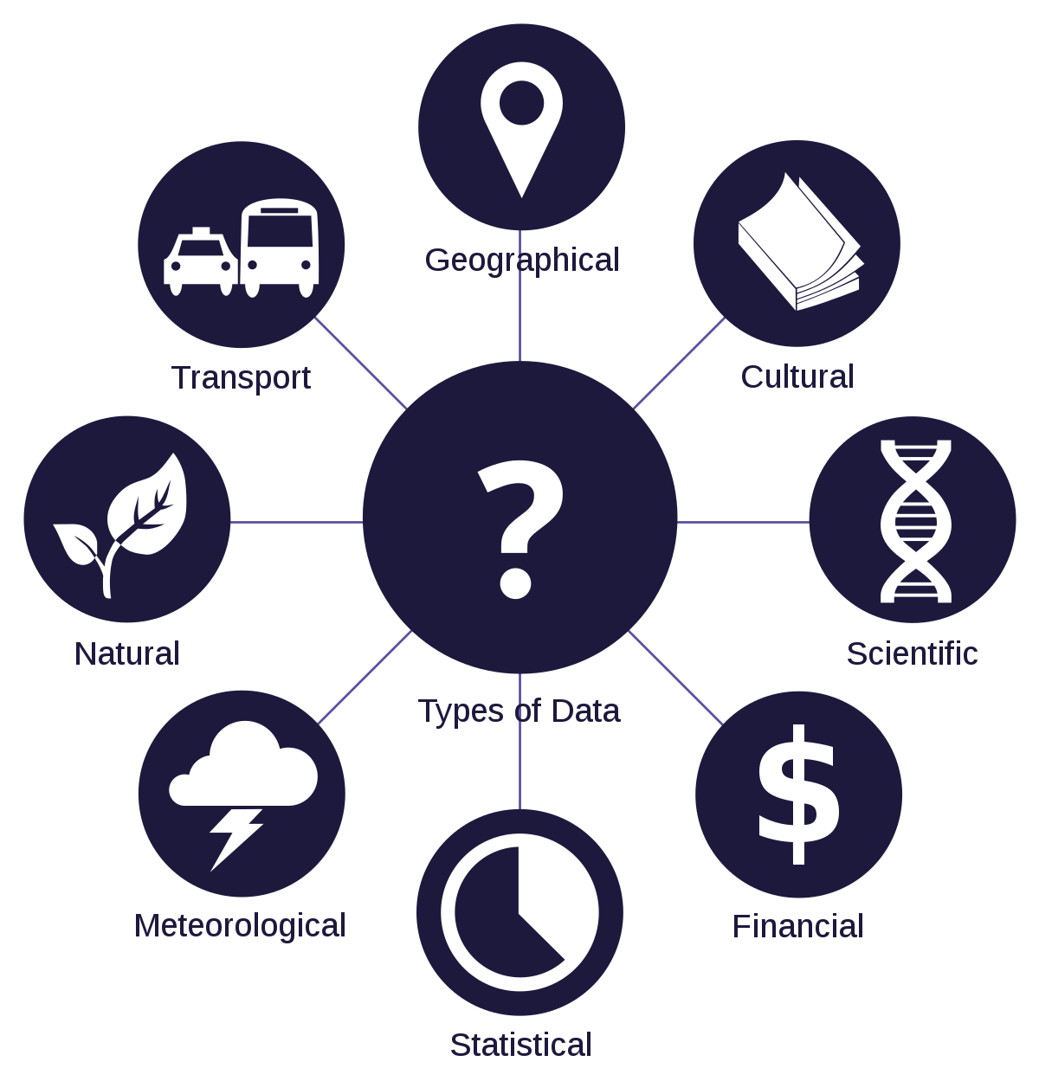
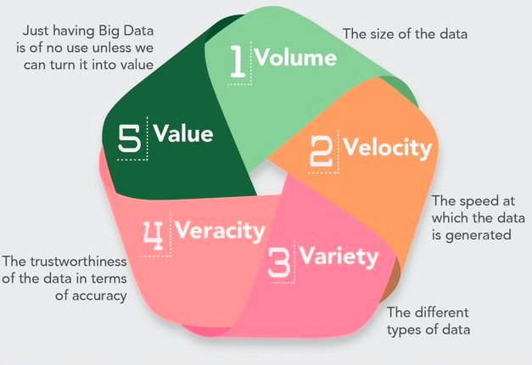
What are data? Where do they come from?
Data is/are collections of values, generally numbers, words, audio or visuals, which contain information
  Information is generally considered distinct from data, i.e. information is obtained from data, through analysis and interpretation
Data come from many sources
  Traditionally, this was based on surveys, observations, and measurements
  The internet is an ever-growing source of data, including:
    Web content, e.g. text, images, videos, other types of files
    User-generated content, e.g. posts, comments
    Interactions with content, e.g. traffic, links, likes, shares
  Other digital data sources include:
    Direct user-to-user messaging, mobile networks, sensors

Slide 11
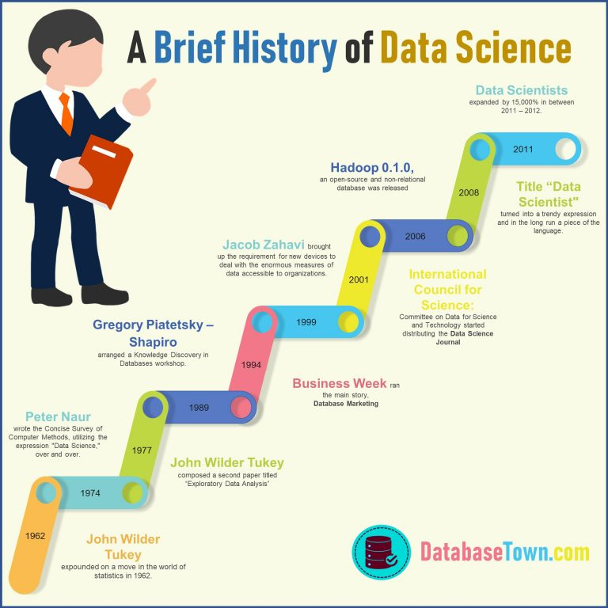
What is Data Science?
Streaming services
Netflix (2007)
It is the study of extracting meaning and insights from data
It combines elements of computer science, statistics, mathematics and technology
The term is relatively new, only entering common usage around 2010
‘Big data’ is central to data science, facilitated by shifts toward digital storage and transmission
Artificial intelligence (AI) and machine learning are major elements of data science, which have risen sharply since 2011 – we will consider these more as the module progresses, and in Semester 2 with Artificial Intelligence and Communication (COMM718/766)
Postal DVD rentals
Netflix (1997)
Early internet
ARPANET (1969-90)
USENET (1980-)
Smartphones
iPhone (2007)
Social Media
Facebook (2004)
YouTube (2005)
Twitter (2006)
Internet
World Wide Web (1991)
Personal Computer
IBM (1981)

Slide 12








The Data Lifecycle
The data lifecycle describes key stages in how data are used
Retrieving data from its source, e.g. download
Putting data in a suitable location, e.g. shared folder
Extracting information from the data, e.g. statistics
Making sense of the information, e.g. applying to policies
Generation → Collection → Processing → Storage → Management → Analysis → Visualisation → Interpretation
An action that creates data, e.g. liking a social media post
Putting the data in a more useful form, e.g. cleaning anomalies
Maintaining usefulness of data, e.g. augment with new data
Presenting information to an audience, e.g. graphs

Slide 13
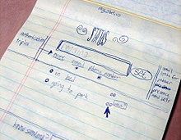
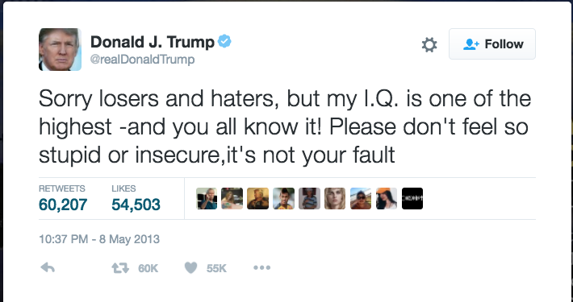
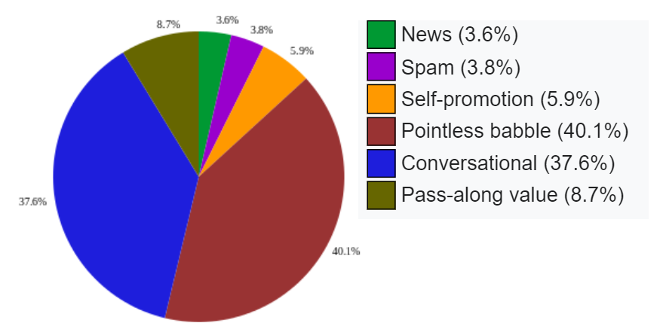
Data in communication
Data is fundamental to all modern communication, but perhaps the biggest example is social media, which is all about data
  E.g. users, posts, interactions
Social media companies use data and algorithms to make money in two main steps:
  Curate content to keep users online
  Sell and target adverts
By 2020, Twitter had over 300 million active users (almost 5% of the world)
  Valued at over $30 billion (roughly GDP of Estonia)
  Vast majority of revenue is from adverts, but direct sales of data also contributed around 10%
Twitter data include:
  Tweet contents, dates, users, followers, retweet count, etc
This slide was made while Twitter still existed. What has changed since (and hasn't!) is interesting to consider

Slide 14

Ethical considerations with data
Data are very powerful, which means they can also have damaging effects, both to individuals and groups
  E.g. fraud, doxing, exploitation, algorithmic bias
Ethical considerations include:
  Informed consent: people know, understand and agree to how their data are used
  Privacy: people control who they allow to access their data
  Confidentiality: people keep other people’s data safe
  Personal data: data that could be used to identify an individual
For academic research, you may use any publicly available data, so long as you fully cite it and, where appropriate, anonymise it
On this module, you must not solicit any data from people at all (e.g. questionnaires, surveys, conversations). To do this, you would need approval from the University Ethics Committee, which is beyond the scope of this module.
Social media data may or may not need ethical approval – please see Week 8 materials and check with us if in doubt

Slide 15
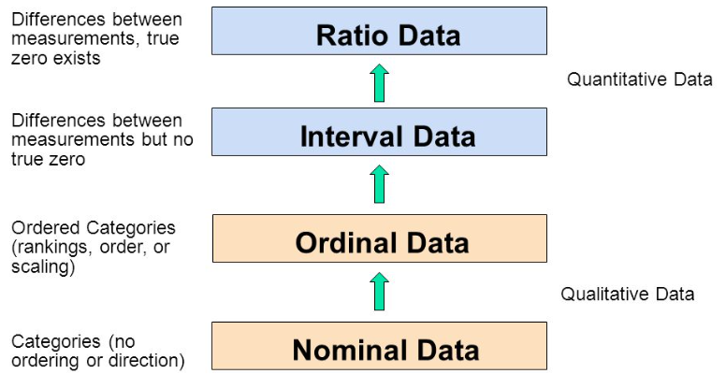
Scales of measurement
e.g. distance
(discrete or continuous,
always numerical)
e.g. IQ score
Data are either:
  Qualitative (e.g. descriptions)
  Quantitative (e.g. amounts)
We can distinguish these further, to help us identify what kinds of analysis to use
  See table on right for major forms of analysis
  We will revisit this when we start using Excel and more
  You should remember these different scales as you may be tested on them
e.g. Likert scale
(discrete,
generally not numerical)
e.g. text font
Able to obtain: | Nominal | Ordinal | Interval | Ratio
Frequency distribution | Yes | Yes | Yes | Yes
Median and percentiles | No | Yes | Yes | Yes
Add or subtract | No | No | Yes | Yes
Mean, standard deviation, standard error of the mean | No | No | Yes | Yes
Ratios, coefficient of variation | No | No | No | Yes

Slide 16
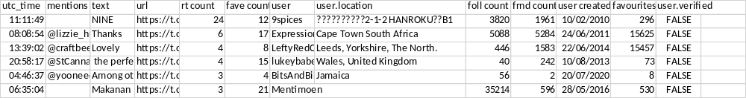
Exercise
Categorise the data columns as either nominal, ordinal, interval or ratio
Also categorise them as discrete or continuous
Explain your reasoning

Slide 17
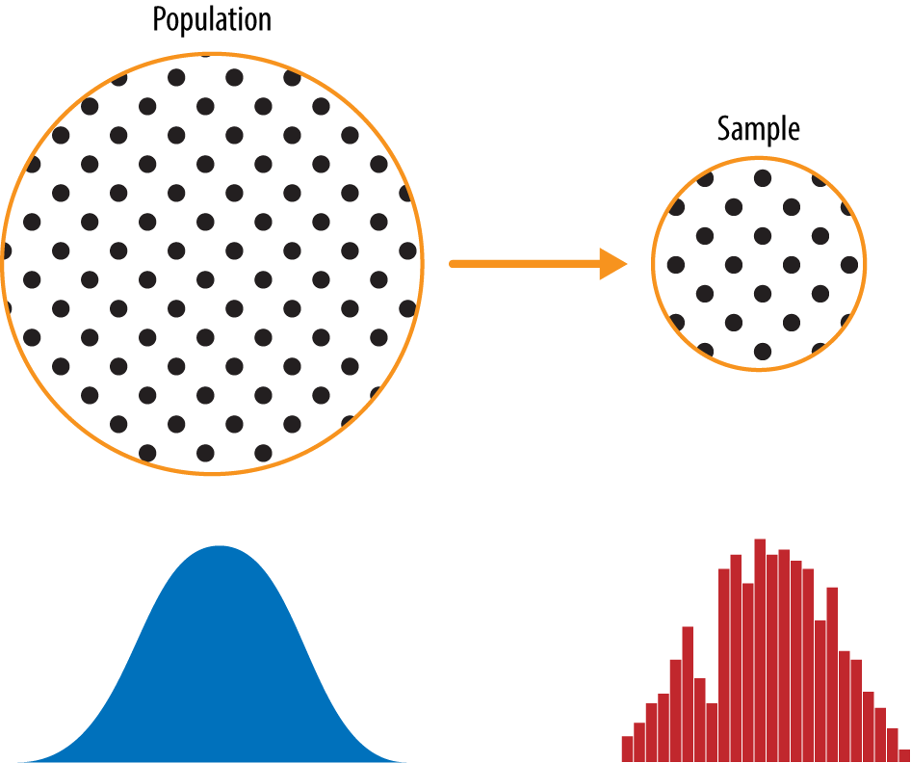
Data collection terminology
Generally, we are only interested in data if we have more than one of them (you rarely hear anyone talk about the singular ‘datum’)
We are also generally interested in more than one thing at a time, e.g. height, weight, age (linking these for each person tells us much more than if we had these measurements separately)
For example, to investigate social media usage, you might ask 100 people a few questions, e.g.
  Age, Location, Income, Time spent using social media per day
Each person you ask is termed an ‘observation’ (or sometimes an ‘instance’, ‘replicate’, ‘sample point’ or ‘sample unit’)
Each question you ask would be an ‘attribute’ of the data (or sometimes a ‘feature’, ‘parameter’ or ‘variable’)
The collection of observations is termed the ‘sample’, and the number of observations is termed the ‘sample size’ (i.e. 100 in the above example)
The way the people are selected is termed the ‘sampling strategy’, which needs careful consideration to make sure it is ‘representative’ of the wider ‘population’. Using lots of data doesn’t mean it is necessarily representative of society in general, e.g. demographic bias
These are important concepts, which will make more sense when we start using data in Excel, and will build on throughout the module

Slide 18
Flipped classroom!
To allow us to spend more time in class discussing fundamental ideas around data, and to work on practical exercises, please go through the following slides ahead of class, and refer back to earlier slides where necessary
We will go through the earlier slides in class, but spend less time on the following slides
A video will also be uploaded to Canvas ahead of class. Please watch this before attending.

Slide 19
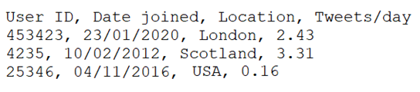
Data formats and csv files
To make use of data, we need to know how they are 'formatted'
Perhaps the most common and easy-to-use format is a ‘csv’ file
  This is a plain text file (see annotated example below)
  csv means comma-separated values, but other ‘delimiters’ can also be used (e.g. tabs)
The csv format is useful because:
  Everything is in a single file with a straightforward layout
  It is human-readable without needing specialist software
  It is widely used, across different computer platforms and applications
‘Attributes’ are columns
Header row
User ID | Date joined | Location | Tweets/day
0453423 | 2020-01-23 | London | 2.43
0004235 | 2012-02-10 | Scotland | 3.31
0025346 | 2016-11-04 | USA | 0.16
Corresponding raw csv data
‘Observations’ are rows

Slide 20
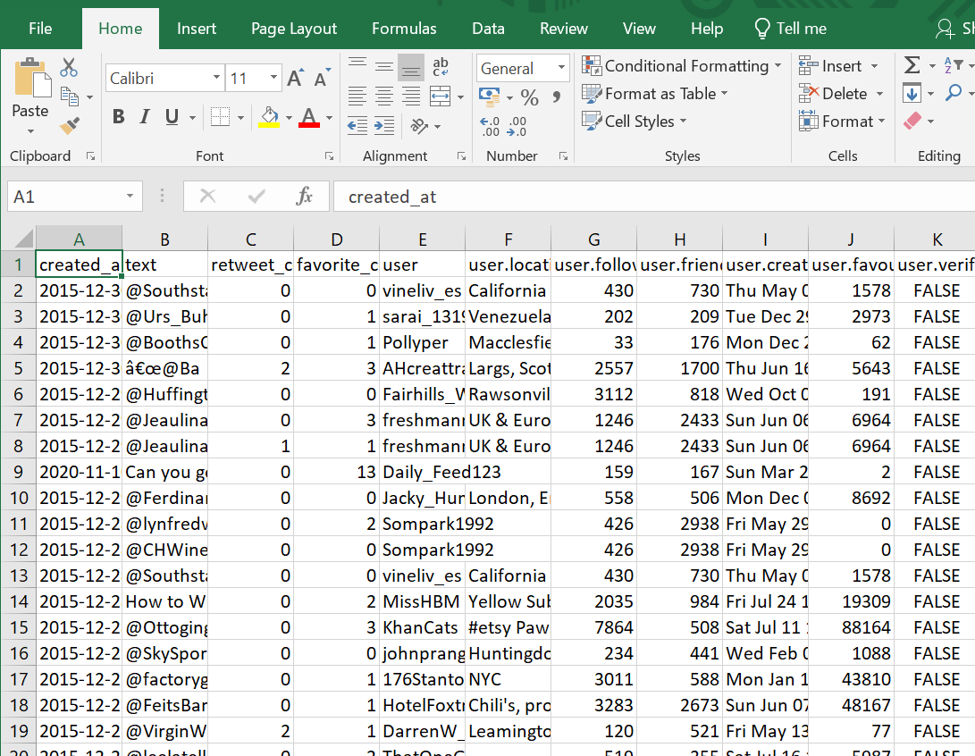
Twitter data example
To learn how to use Excel, we’re going to make use of data obtained from Twitter, showing every Tweet that mentioned beer and curry in 2020.
In the data file, each row (i.e. observation) is a Tweet, and each column (i.e. attribute) gives information about the Tweet, such as the text, date and retweet count.

Slide 21
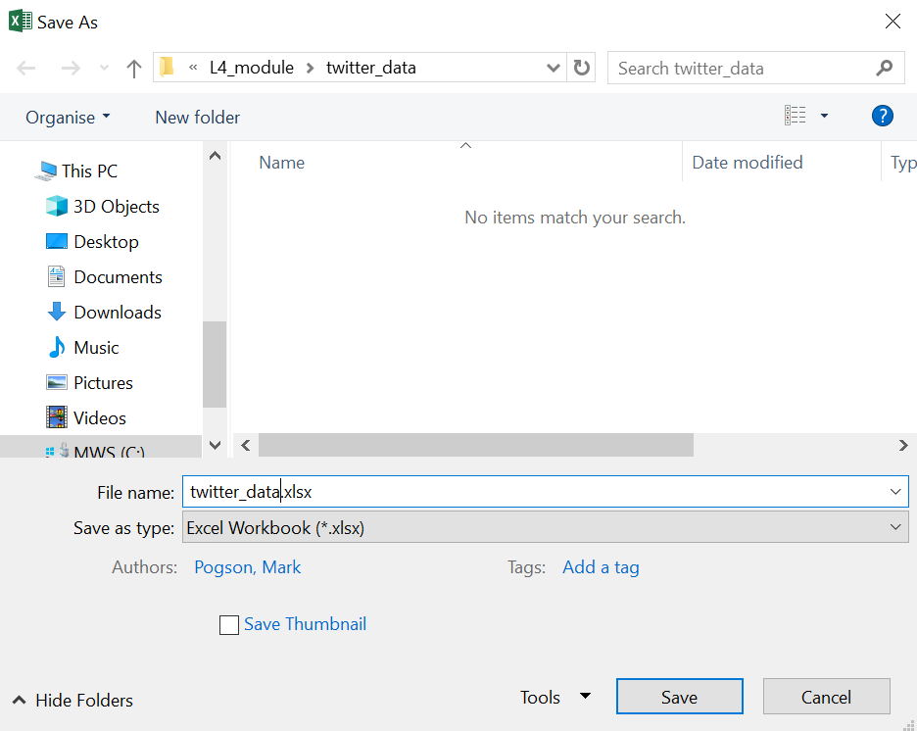
Using csv files
You can open csv files in a text editor, but more usefully, you can also open them in a spreadsheet
  We’re going to use Microsoft Excel in this module (you can use the online app with your University login at www.office.com)
Download ‘beer_and_curry.csv’ from Canvas and follow the instructions below
Once you’ve opened the csv, the first thing you should do is resave it using:
  A different name so you can always retrieve the original data
  Excel Worksheet format (xlsx) so you won’t lose any analysis you do – because csv files only allow plain text, they can’t store things like plots
  Use ‘version control’ in file naming – each time you perform some work, give the file a new version number, so you can restore old versions if anything goes wrong (good practice with all files)

Slide 22
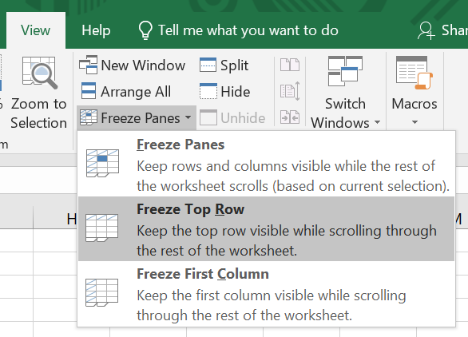
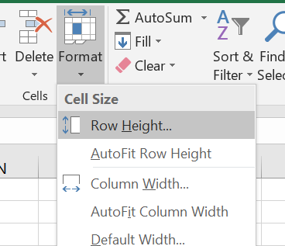
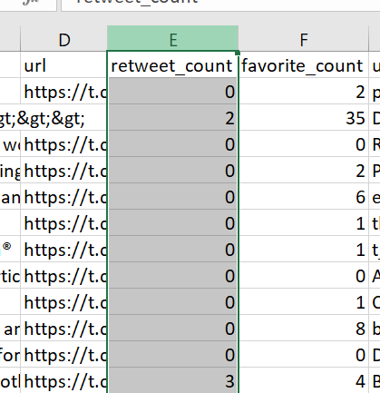
Getting started
Keep header row visible
  View > Freeze Panes > Freeze Top Row
Stop cell heights from playing up
  Home > Format > Row Height > 14
Select data
  By column or row – click labels
  Specific cells – click and drag, or (ctrl)+shift+arrow

Slide 23
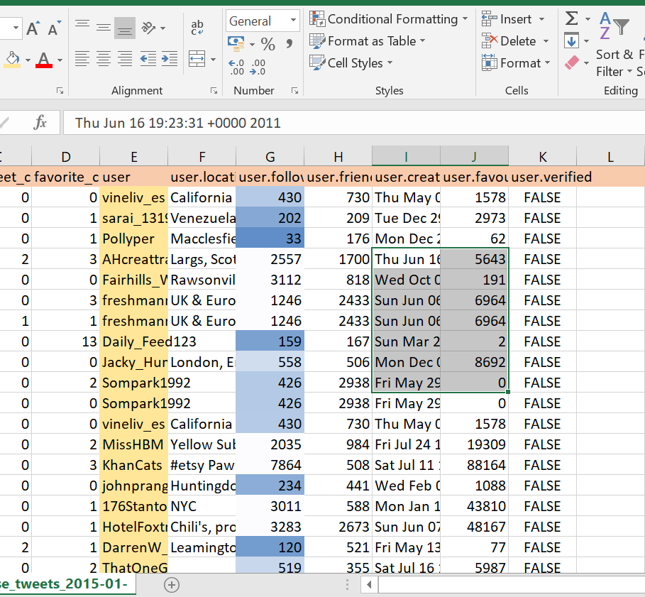
Basic operations
Colouring cells can make the data easier to view and navigate
  To highlight selected cells:
  Home > Cell Color
  To highlight cells with specific properties:
  Home > Conditional Formatting
Put the data in order:
  Home > Sort & Filter > Sort
  or: Data > Sort
Keep only data with specific properties:
  Home > Sort & Filter > Filter
  or: Data > Filter
  Be careful when working with filtered data! To avoid confusion, you should copy the filtered data into a new worksheet as raw values.

Slide 24
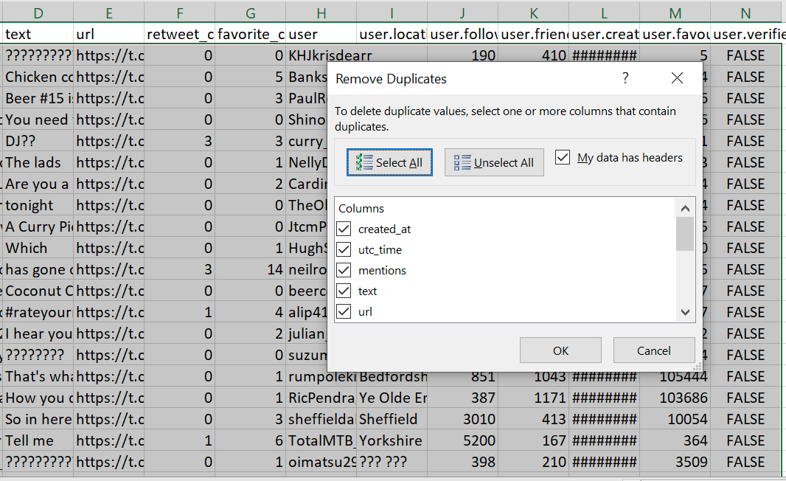
Data cleaning
Highlight duplicates:
  Home > Conditional Formatting > Highlight Cells Rules > Duplicates
Remove duplicates:
  Data > Remove Duplicates

Slide 25
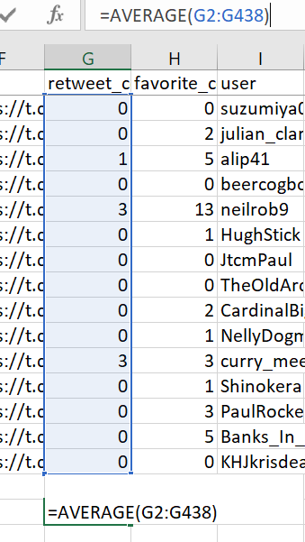
Functions
‘Functions’ allow you to perform calculations on data
E.g. To calculate the average number of retweets, we first select any blank cell and type =AVERAGE()
  This will also be shown in the formula bar at the top
With the text cursor inside the brackets we’ve just typed, we then select the data we want to average, and press enter
  This is called a ‘summary statistic’. It summarises the data with a single number
We can also calculate the standard deviation in a similar way, by using =STDEV()
  The standard deviation tells us how spread out the data are – the bigger it is, the larger the spread

Slide 26
Exercise
Refer back to the 'scales of measurement' slide, and use this to identify what scale of measurement is represented by the retweet_count column
With this in mind, apply a suitable function to it

Slide 27
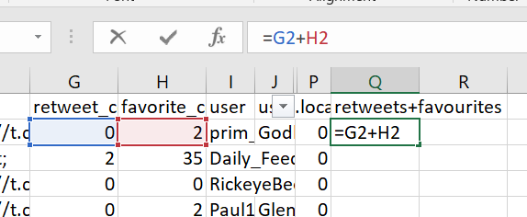
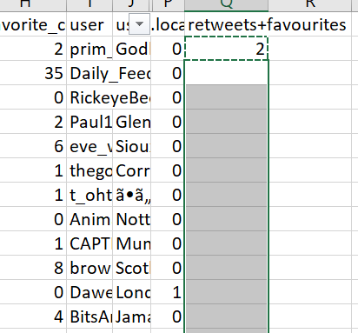
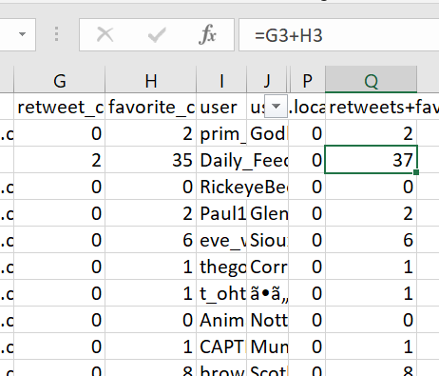
Summing columns
We can do lots of other things with functions
E.g. We can sum favourites and retweets to find the combined engagement count
  To do this, we first perform the calculation for a single row by typing the calculation into a blank cell in the same row
  We then copy and paste this into the corresponding cells for all other rows, and Excel will automatically perform the equivalent calculation for them
    Notice that the copied cell has a dashed line moving around it until you paste the formula into the other cells
  Once you’ve done this, if you click on any of the newly calculated cells, you’ll see they contain the formula, not just the result
    This means that if you make any changes to the original data, it will automatically update the calculated values

Slide 28
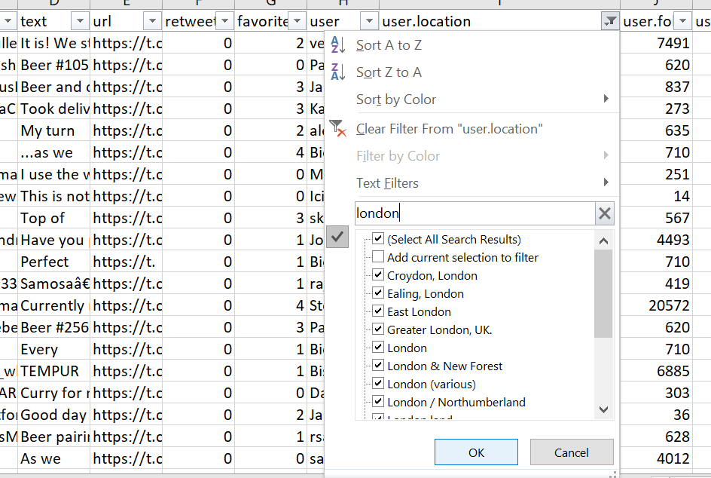
Selecting cells with keywords
Use Filter and search for any keywords you want to select entries for, e.g. a specific location, username, or tweet content
This can be useful to compare different categories within the data, e.g. do tweets from London get more engagement than tweets from other cities?

Slide 29
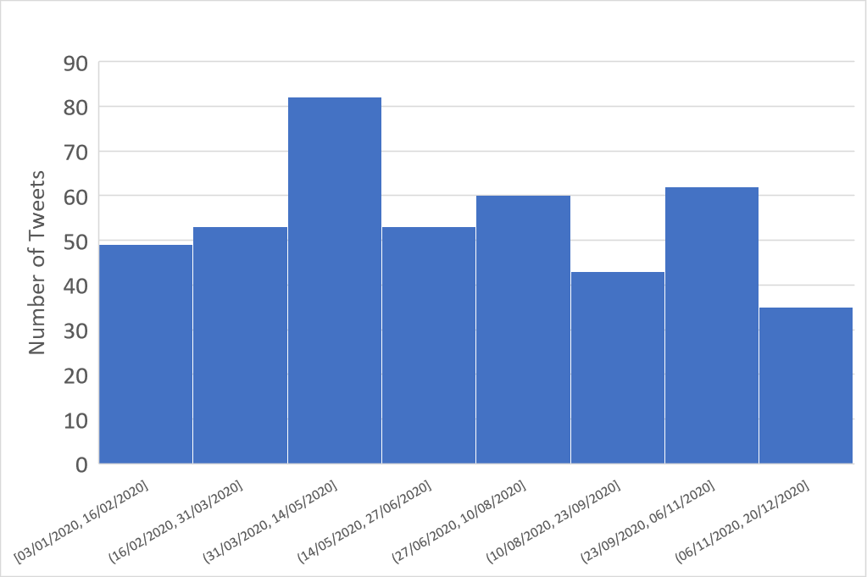
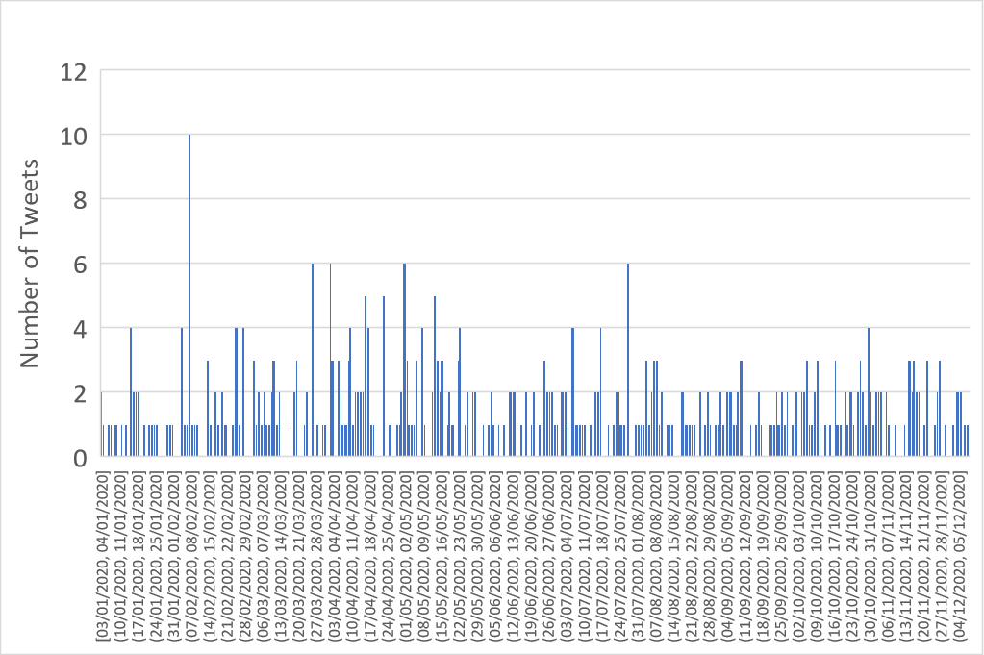
Histograms
Histograms tell us about properties of a single attribute (e.g. retweet count of each tweet, or number of tweets sent in different time periods)
  They count the frequency of data in different ranges, to show the ‘distribution’ or ‘spread’
E.g. Select the date column and click Insert > Charts > Histogram
  You will see the number of tweets over different periods
  If you right-click the date axis, select Format Axis, and change ‘Bin width’ to 1, this will show the number of tweets each day
  Bin width is the data range that each bar is counting over, e.g. Bin width = 7 would count the number of tweets each week

Slide 30
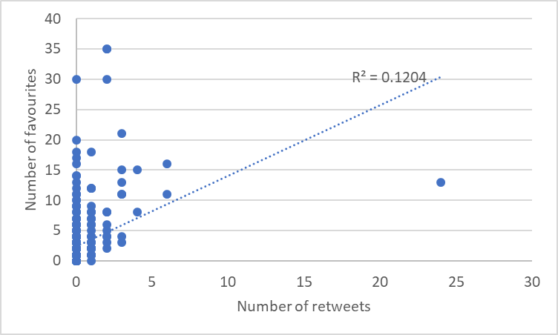
Scatter plots and linear regression
Scatter plots show the relationship between 2 attributes
E.g. we can plot the number of favourites versus the number of retweets by selecting the two columns and clicking Insert > Plot > Scatter
Each datapoint represents a single tweet. Its horizontal position shows how many retweets it has, and its vertical position shows the number of times it was favourited.
In this case, there is a small upward trend, which shows that in general, more retweets means more favourites (and vice versa). This is called ‘positive correlation’, which we’ll discuss more in later weeks.
We can quantify the strength of correlation by right- clicking the plot, adding a trend line, and selecting ‘Display R-squared value on chart’. This gives a number between 0 and 1, where 1 shows complete correlation, and 0 shows no correlation at all.
We will look more at plotting in Weeks 5 and 11. I also teach COMM740 Data Visualisation as a semester 2 option

Slide 31
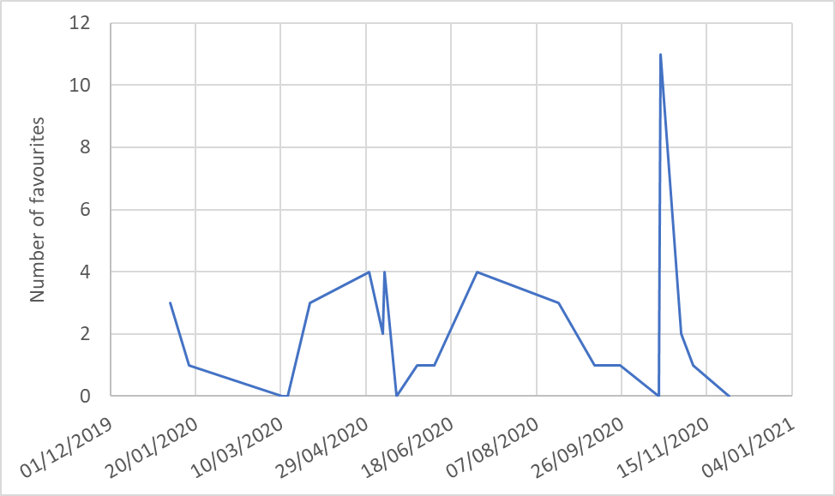
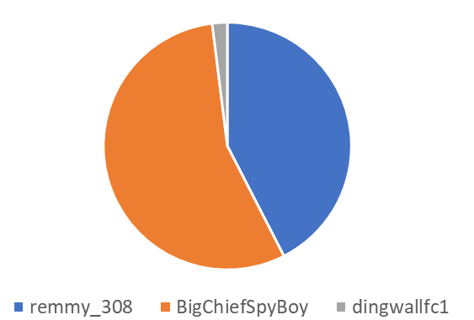
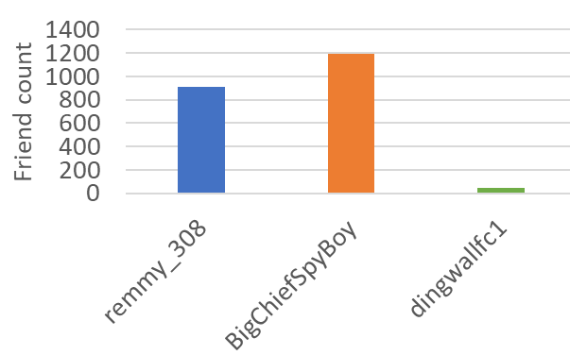
Line plots, bar charts, pie charts and editing plots
Line plots are a type of scatter plot where it makes sense to join up the data points with lines, e.g. plotting the number of favourites against date (shown here for users in London) – your data must be sorted ascendingly to avoid a zig-zagging line
Bar charts show the value of one discrete (categorical) attribute against another, e.g. friend count for each user in Liverpool – see demo in class
Pie charts show similar information to bar charts, but using proportions instead of totals
You can change or add data to a plot by right-clicking on the plot and clicking Select Data…
  E.g. Show both favourites and retweets versus date on the same plot
You can change the appearance of a plot by right-clicking on an element and selecting the option to Format {Element Name}…, e.g. colour of bars, rotation of axis labels

Slide 32

Exercises, using beer_AND_curry.csv
Which user had the most retweeted tweet?
How many tweets came from Liverpool?
How many tweets mentioned chips?
Plot how many tweets were sent each week
Plot how many tweets were sent in each hour of the day
On average, how long had users been on Twitter when they tweeted about beer and curry?
Repeat this, but just using tweets that mentioned bhajis. Then repeat with just tweets that didn’t. Compare these.
Find the correlation between the number of retweets and how long users had been on Twitter
Pick something you’re interested about in the data. Try to come up with your own result and visualisation
Search online for a csv file of social media data. Apply the same methods to answer similar questions for that data

Slide 33
Recap Learning Objectives – Week 1
Know what data are, including different scales of measurement
Know what is meant by data science, and the main stages of the data lifecycle
Use spreadsheets to view data and perform basic analysis (flipped classroom!)

Slide 34
Further Reading
Background to the internet
  https://www.theguardian.com/technology/2018/oct/22/what-is-the-internet-13-key-questions-answered
  https://hostingfacts.com/news/internet-facts-stats/
Data ethics
https://news.mit.edu/2020/seeing-values-behind-numbers-data-action-1208
Data journalism
https://datajournalism.com/
Excel training
https://support.microsoft.com/en-gb/office/excel-video-training-9bc05390-e94c-46af-a5b3-d7c22f6990bb
Basic statistics
  https://www.bbc.co.uk/bitesize/topics/znjqtfr
  https://www.bbc.co.uk/bitesize/guides/znhsgk7
  https://www.bbc.co.uk/bitesize/topics/ztwx4j6

