Slide 1
Week 2-3
Computer Coding
COMM741/767 Introduction to Data Science A/B
Mark Pogson
mark.pogson@liverpool.ac.uk

Slide 2
Learning Objectives – Week 2-3
Know what computer coding is and its importance to data science
Know what computer variables, functions, 'if/elif/else statements' and ‘for loops’ are (flipped classroom!)
Write simple computer programs in Python, including functions (flipped classroom!)

Slide 3
Overview of coding
Computer coding simply means writing instructions for a computer to carry out
‘Coding’ and ‘programming’ are often used interchangeably, as are ‘code’ and ‘program’. ‘Scripting’ and ‘script’ may also be used in a similar way (there is a subtle distinction to these that we don’t need to worry about).
You’ve already written computer code in Excel, when using formulas. However, we’re now going to start using a dedicated programming language, which is far more powerful, and in many ways easier to use, once you get over the initial hurdles.
There are lots of programming languages, which all have their own benefits and drawbacks, depending what you want to do. However, most have a lot in common, so learning one language will give you skills that are widely transferable.
We’re going to use Python, which is very widely used, particularly for data science.
We'll only scratch the surface of everything you can do in Python, but once you’ve learned the basics, you’ll be in a position to learn lots more independently

Slide 4
Flipped classroom!
Please watch the video ahead of class to help you with the following slides. We will use class to allow you to ask questions and work through the exercises.

Slide 5
Coding and data science
There are two main approaches to working with data:
  Using computer packages with ‘graphical interfaces’ (i.e. how most of us are used to using computers, e.g. Excel, SPSS, etc.)
  Writing computer code (i.e. what we’re going to do)
Although writing computer code might initially seem like we’re making life harder for ourselves, there are lots of good reasons to do it, including:
  It’s easier than it looks
  It allows you to do things you would find difficult or impossible otherwise, including many data collection, analysis and visualisation tasks
  Because code is written as a clear sequence of steps, it is often easier to find and correct mistakes than with a graphical interface like Excel
  It lets you repeat a process as many times as you want, using different data without extra work
  Knowing how to code gives you a much better understanding of how algorithms work
  We can connect up different bits of code to do new things, which lets us build more complicated methods relatively easily
Take a look at www.codecademy.com/learn/learn-how-to-code. It is an interactive tutorial introducing key concepts in coding. It’s also worth returning to this as we cover new topics.

Slide 6
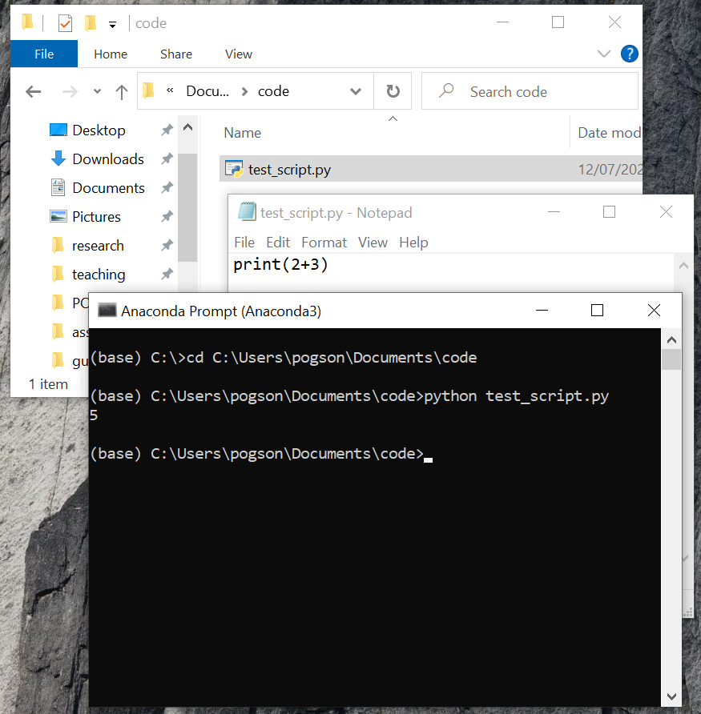
Getting started with Python
A Python script is just plain text (e.g. like you’d write in Notepad) where you write instructions for the computer to carry out, e.g.
  print(2+3)
  Instead of saving the file with a .txt extension, if we change this to .py, then if Python is installed on the computer, it will know this is a Python script.
  We can then run the script from a command prompt, and we’d see the number 5 displayed
The application you use to write your code in is called a ‘coding environment’. There are lots of coding environments available, most of which make life a lot easier than using Notepad. (I’ve just used Notepad as an example here to try to demystify things a little.)
There are lots of good Python guides online. www.w3schools.com/python is an excellent reference, with tutorials on a range of topics. It’s definitely worth returning to this throughout the module. Please spend lots of time on w3schools

Slide 7
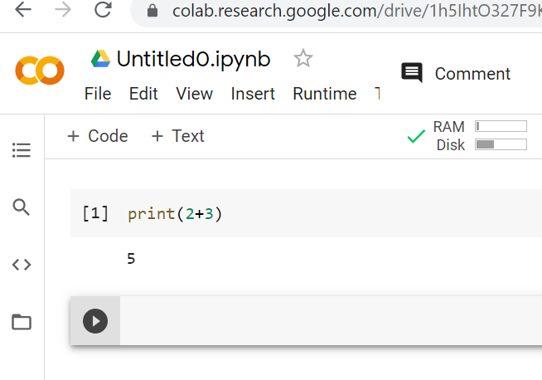
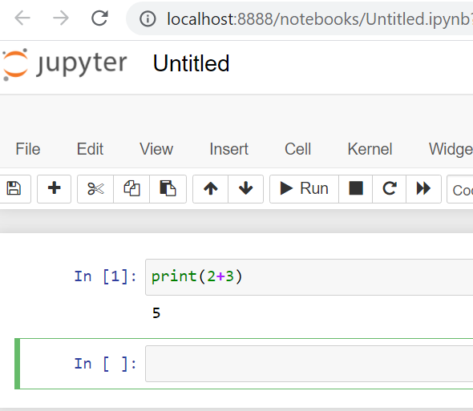
Jupyter Notebook / Colab
We’re going to use an Interactive Python Notebook as our coding environment
  Write and run code in one place
  Plots are displayed inline with your code
  Ability to write normal text too – will use to make blog!
There are two options for this, both of which use your web browser (e.g. Chrome):
  If you’re happy to use a Google account and run your code online, then use Google Colab (colab.research.google.com). This has the advantage of cloud backups, processing power, automatic updates and remote access
  Alternatively, you can install Anaconda (www.anaconda.com), which includes Jupyter Notebook
Note that we’ll use Python3 (it’s the default with both of the above). Python2 is still sometimes used, but there are subtle differences and it’s best avoided nowadays.
Click ‘File > New notebook’ to get started in Colab

Slide 8
Coding basics and assigning variables
You write your code in ‘cells’ in Colab/Jupyter. Cells will be ‘executed’ when you run them.
Within each cell, the lines of your code will be executed in the sequence you’ve written them, e.g.
  print(2+3)
  print(2*3)
  The output will be 5 then 6.
We use ‘operators’ to perform operations on values in the code (e.g. +, -, *, /)
We can store values as computer ‘variables’, which lets us reuse them later, a bit like the memory button on a calculator, e.g.
  var1 = 2*3
  var2 = var1 + 10
  print(var2)
  The output will be 16 (i.e. 6+10).
To ‘assign’ a variable (i.e. give it a value), you need to give it a name in front of an equals sign (which is the ‘assignment operator’), as shown above. You can name a variable anything you want in Python, but:
  It must start with a letter or underscore
  It can only include letters, numbers and underscores (you can’t include spaces or any punctuation marks)
  It is case sensitive (e.g. var1 is not the same as VAR1)
  You need to avoid certain keywords that already mean something else in Python (e.g. if, for, else, list)
  You need to be careful if you choose to reassign a value to the same variable name – it will overwrite the previous value (see below)
We can update a value for a variable by reassigning it, e.g. var1=var1+2 adds 2 to var1, then stores this new value
N.B. computer variables are different to data variables, which are generally called ‘attributes’ to avoid confusion.

Slide 9
Laying out and commenting code
We write code primarily for a computer to understand. However, it’s just as important that we can understand it too:
  Blank lines and blank spaces between operators help to present code more clearly, and do not affect calculations
  Comments (as shown on right) are very important, both to remind us what we’ve previously coded when we come back to it, and for other people to make sense of it too.
You can add comments by using a # sign. Everything after the # is a comment, e.g.
  print(2+3) # this will show the result 5
In comments, you should describe the important details while avoiding stating the obvious
Sometimes we want to write multiple lines of comments. We could put a # at the start of each line, but another option is to use 3 quotation marks (or inverted commas, they do the same thing) to start and end the comment block (see examples on right).
Blank lines have no effect on the code, and can help presentation. This is also true for blank spaces between variables, operators and any other syntax.
  """
  Everything here
  is a comment
  which Python will ignore
  """
  print(2+3) # this gives 5
  '''
  This is also a
  comment
  '''

Slide 10
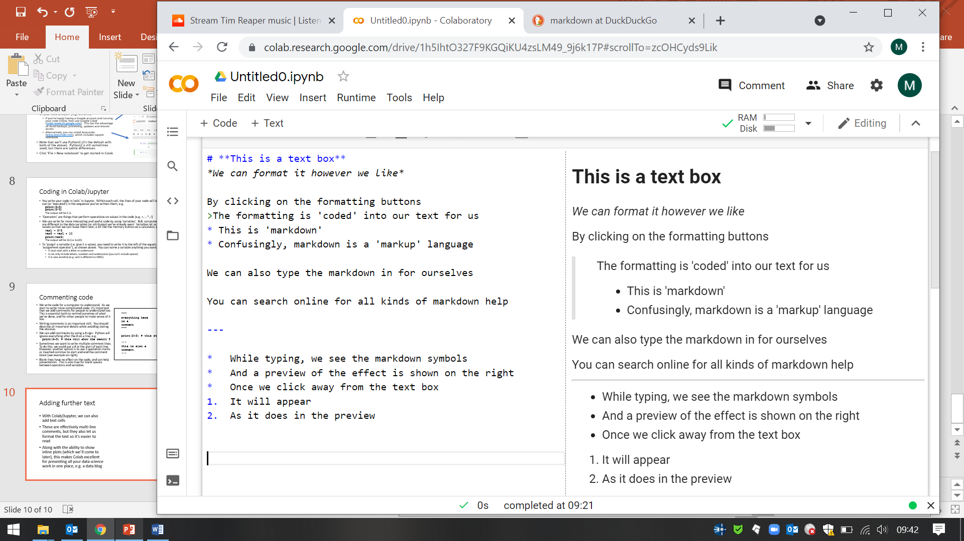
Adding further text
In addition to commenting, with Colab/Jupyter, we can add text cells (i.e. cells with no computer code)
These let us format the text so it’s nicer to read than comments in the code
  If using a Juypter Notebook, you’ll have to ‘run’ the cell to apply the formatting
Along with the ability to show inline plots (which we’ll come to later), this makes Jupyter an excellent way to present all your data science work in one place, e.g. as a blog
See www.markdownguide.org/cheat-sheet for further formatting options

Slide 11
Data types
Before writing code, it will help if we consider different types of values we might want to use, termed 'data types'. These include:
  int Integers (i.e. whole numbers), e.g -375
  float Floats (i.e. decimal numbers), e.g. 4.738
  str Strings (i.e. text), e.g. "this is a string", 'this is a string', 'this "is" a string', '3.34'
  list Lists (i.e. ordered collections of values), e.g. [43, 6.32, "hi"]
  dict Dictionaries (i.e. labelled collections of values), e.g. {'a': 43, 'b': 6.32, 'c': “hi”}
  bool Booleans (i.e. True or False), e.g. 5>6 # this will be False
There are lots of other data types, some of which we will also consider
Python will guess the data type based on the variable definition, but these can also be declared explicitly, e.g. a=int(-2) or a=float(-3), or converted, e.g. a=int('98')
While we don’t always need to think too much about data types, it’s often an important consideration in terms of both the operations we can perform (remember scales of measurement!) and what the operator actually does. This is particularly true when reading in data, which we'll start doing soon

Slide 12
Exercise
Define your name and height as variables, with suitable variable names and comments
Make these have suitable data types
Describe them using the scales of measurement from last week, and state whether they are discrete or continuous

Slide 13
Functions
Sometimes we want to repeat a calculation using different values each time, e.g.
  To calculate the engagement rate (ER) of a social media post, you could use the engagement count of the post (EC) and the total follower count (FC) and apply the following formula to obtain the percentage of followers who engaged with the post: ER = (EC / FC) * 100
  N.B the brackets force this part is calculated first – they’re not actually necessary here, but they help to make it clearer to the reader
  If we wanted to apply this formula to lots of different posts and users, we could write the same formula lots of times, but with different values for EC and FC
  A better way is to define a function for ER, which lets us store the formula so we can reuse it, similarly to how we can store values with variable names.

Slide 14
Defining a function
To create a function using the example from the previous slide, we can code it as follows:
def calcER(EC, FC):
ER = (EC / FC) * 100
return ER
There are a few important things to note here:
  def is a keyword that tells Python you’re defining a function
  calcER is the name we have chosen for the function, like assigning a variable name
  You always need brackets after the function name (n.b. the brackets have a different purpose to on the previous slide). Inside the brackets, you list the values your formula requires (which should be empty if your formula doesn’t need any values). These values are called function ‘parameters’, which are different to data parameters (or attributes). You also need a colon after the closing bracket.
  The lines following the first line are indented. This tells Python that these lines are part of your function definition. For your indentation, you can use any number of spaces or tabs, but they need to be the same for each line. Most coding environments will take care of this for you, but you should be careful when copying lines of code from a different environment.
  return is a keyword that tells Python what result(s) you want your function to output
  If we execute this code on its own, we won’t see anything – it has just defined the function

Slide 15
Using a function
To calculate ER, we now just ‘call’ the function using whatever values we want for EC and FC, e.g. for a post with 236 engagements for a user with 3467 followers, the engagement rate is:
calcER(236, 3467)
which will output the answer of 6.81
We need to be careful to specify the numbers in the correct order, which must correspond to the order in the function definition
We also need to be careful not to indent the function call, otherwise Python will think it’s still part of the function definition
By defining the ER formula as a function, we have made it easier to calculate lots of different results, because we don’t have to write the whole formula each time
We will shortly see how we can make things even easier by using a ‘for’ loop

Slide 16
Lists and loops
Lists are a very useful data type, as they let us store lots of values (or ‘entries’) together, and are an example of a 'container'. We write lists with square brackets, and we separate values with commas. Lists can contain any data types, including other lists, e.g. t = [4, 8, 2.6, “banana”, [9, 5]]
To access a value in a list, we state the name of the list, and afterwards in square brackets specify the position (or ‘index’) in the list we want. In Python, the index starts at 0, e.g. in the above example, t[0] is 4, t[1] is 8, t[4][0] is 9, etc.
‘For’ loops are one of the most powerful aspects of programming. They let us do lots of operations without having to code them all individually. It’s similar to copying and pasting a formula into multiple cells in Excel.
A for loop steps through all the values in an 'iterable', often a list. Each step is called an ‘iteration’.
For example:
  for val in t:
  print(val)
This prints the values contained by t in sequence. It’s worth noting that
  val is a new variable name we’ve chosen, which updates with each iteration – it is an 'iteration variable'.
  for and in are keywords that Python recognises. They are essential for the loop to work
  The colon and subsequent line indentation are similar to those we saw with function definitions, and are also essential
Strings can be treated as iterables in Python, e.g.:
  for letter in "banana":
  print(letter)

Slide 17
Loop example
The range command is often helpful when using loops. It also gives an iterable, just a slightly different one to a list. It's easiest to demonstrate with an example.
  for i in range(5):
  print(i)
  This would print 0, 1, 2, 3, 4
This gives us a convenient way to step through multiple lists at once. For example, we might have a list of engagement counts, and a separate list of follower counts, e.g.: EC = [23, 5, 345] and FC = [78, 203, 424]
We could then use our previously defined function to calculate all the engagement rates for these pairs of engagement and follower counts:
  for i in range(3):
  print( calcER(EC[i],FC[i]) )
This lets us process lots of data without much effort at all! Imagine reading in millions of data values – all we'd need to do is wait longer for our answers to come

Slide 18
Conditional statements
Along with ‘for’ loops, conditional statements are one of the most important and powerful concepts in computer programming
They let us carry out different operations depending on certain conditions, using the keywords if, else and (optionally) elif (else if), e.g.
if i<5:
print(i)
elif i<10:
print(2*i)
else:
print(3*i)
Try this out by assigning i=2, i=7 and i=20 before the if statement. What do you find?
We can have as many (or as few, including none) elif statements as we want. These are applied in the order they are written (e.g. although 2 is both less than 5 and 10, in the above example, it evaluates 2<5 first, and stops there because it is satisfied.
The else statement will be applied to all conditions not listed in the if or elif statements. You don’t need an else statement if you’ve already specified all possible conditions, or if you don’t want to apply any operations for those not already specified.

Slide 19
More with lists and iterables
We can find the number of entries in a list by using the len() function, e.g. if t = [1, 5, 3, 6] then len(t) is 4.
We can access list values using a reverse index, e.g. t[-1] is 6, t[-2] is 3.
We can join lists by using the + operator, e.g. [1, 5] + [3, 6] gives [1, 5, 3, 6]
Strings can be joined in the same way, e.g. 'hello'+' there' gives 'hello there'
We can replace existing values in a list by specifying their index, e.g. t[2] = 4 would replace 3 with 4 in t
We can insert values to a list by specifying an index followed by the value to insert, e.g. t.insert(2,7) would make t a list containing [1, 5, 7, 3, 6] (assuming t hadn't been updated after it was first assigned above). Note that insert updates t without us reassigning it explicitly – be careful with this!
We can add values to the end of a list by using the append function, e.g. t.append(9) would make t a list containing [1, 5, 3, 6, 9] (assuming t hadn't been updated after it was first assigned above)
It’s sometimes useful to define an empty list as []and then append values to this, e.g. instead of printing engagement rates as we did before, we could obtain a list of them, which we could then do further things with later in our analysis:
ERs = []
for i in range(3):
ERs.append(calcER(EC[i],FC[i]))
We could also do the same thing in a single line by using ‘list comprehension’, which is neat but less clear:
ERs = [calcER(EC[i],FC[i]) for i in range(3)]

Slide 20
Dictionaries and deleting items from iterables
Dictionaries are like lists, but instead of using indexes (or 'indices') to identify values, 'keys' are used instead, which are strings (you can also use numbers, but this would be unusual) associated with the values
A simple way to define a dictionary is to use curly braces, e.g.
d = {'a':1, 'b':5, 'c':3, 'd':6}
Notice that d can still be used as a key within the dictionary with the same variable name
We access values in a dictionary by specifying their key, e.g. d['b'] gives 5
We can use this to replace existing values, e.g. d['c'] = 4 would replace 3 with 4 in d
We can add a new value to a list by using a new key and assigning a value to it, e.g. d['e'] = 9 ; note we don't need any insert or append command
We can find the number of values in a dictionary with the len() function, just as for a list, e.g. len(d) is 4
To delete an item from a dictionary or a list, we can specify the index and use the del command, which also allows us to delete entire variables, e.g.
del d['a'] would remove the item 'a' in dictionary d
del t[1] would remove the 2nd item in list t
del t would remove the entire list t (rarely needed unless memory is limited)
t.remove(5) would remove the first occurrence of 5 in list t
t = [x for x in t if x!=5] would remove all occurrences of 5 in list t (could use for loop)

Slide 21
Exercises
1. Write a function which takes a percentage grade and classifies a piece of work as a pass (>=50%), merit (>=60%), distinction (>=70%) or fail (<50%).
2. Call the function with a for loop to classify the following grades:
[62, 79, 50, 23]
3. Update your function to take an additional input of the number of days late and use this to apply a late penalty of 5 points for each day late, up to 5 days. If more than 5 days late, award 0%.
4. Using the same grades as in question 2, call your function with the following number of days late for each piece of work: [3, 1, 1, 0]
5. Describe some ways your algorithm could be misused or misinterpreted

Slide 22
Recap Learning Objectives – Week 2-3
Know what computer coding is and its importance to data science
Know what computer variables, functions, 'if/elif/else statements' and ‘for loops’ are (flipped classroom!)
Write simple computer programs in Python, including functions (flipped classroom!)

Slide 23
Further reading
Coding concepts:
www.codecademy.com/learn/learn-how-to-code
This is free, but you’ll need to sign in
Work through the Basics of Programming I-III
Python guides and exercises:
www.w3schools.com/python
This is also free, with no need to sign in
Work through:
  Syntax, Comments, Variables, Operators, Lists, Dictionaries, If...Else, For Loops, Functions
  Note there are exercises for you to try, as well as a quiz
Lubanovic, B (2020) Introducing Python: Modern Computing in Simple Packages. Second edition. O'Reilly Media

