Slide 1
Sales Dashboard Analysis
Data Analytics Internship Project
Superstore Sales Dataset

Slide 2
Dataset Overview
• Superstore Sales Dataset
• ~10,000 orders
• Key fields: Order Date, Region, Category, Product, Sales, Quantity, Profit
• Tools Used: Power BI, DAX, Power Query

Slide 3
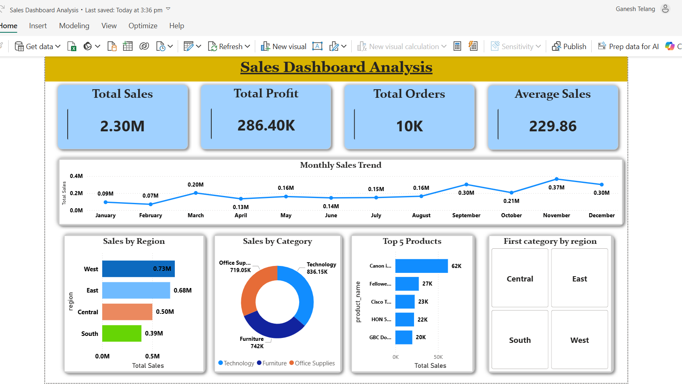
Dashboard
Sales Dashboard Analysis

Slide 4
Key Insights
• West region generated the highest sales (~0.73M).
• Technology was the top-performing category (~836K sales).
• November recorded the highest monthly sales (~0.37M).
• Canon products were among the best-selling products.
• Sales performance was strongest in the West and East regions.

Slide 5
Conclusion
The dashboard provides a clear view of sales performance across regions, categories, products, and time periods. Business users can use these insights to improve decision-making, focus on high-performing categories, and optimize sales strategies.
Prepared and Submitted By Ganesh Telang Data Analytics Intern SkillInfyTech IT Solutions (if applicable)

