Slide 1
Human Activity Recognition
with smart phones
Proposed BY
Bhuwan Kandel(BCT/071/611)
Ganesh raj Tiwari(bct/071/20)
Nitesh kafle(bct/071/030)
Sushil Ghimire (bct/071/647)

Slide 2
Needs
Elderly and Youth Care
Game interaction
Personal biometric signature
Tele-immersion (TI) applications
Security and Surveillance applications.

Slide 3
introduction
Determining the activity of human based on regular pattern

Slide 4
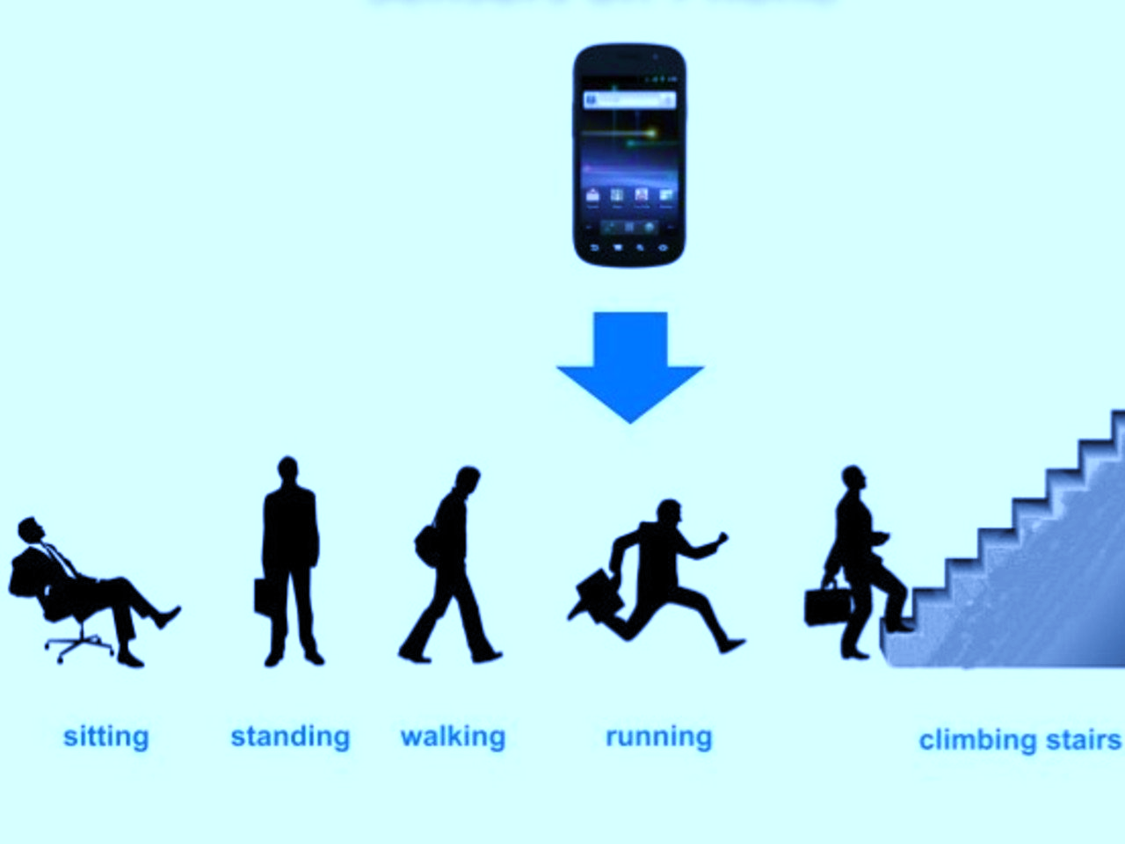
Activities
Walking
Standing
Jogging
sitting
Walking upstairs
Walking downstairs

Slide 5
Recognition method
Sensors on smart phones
- accelerometer(X,Y,Z co-ordinates)

Slide 6
OBJECTIVES
General
- To understand how machine can intelligently react and respond in Realtime data
- To understand the hidden logic. Methods for implementation different machine learning algorithm
Specific
- To design a system that collects data from smart phone sensors and use them to determine different activity of person

Slide 7
Literature survey

Slide 8
Methods used earlier
Sensors placed on different location of body
- Straightforward
-Inconvenient to collect data
Use of camera

Slide 9
Different implementations
Brezmes et al
-Real-time classification system using accelerometer
-Decentralized monitoring
Kwapisz et al.
-Six human activities
-Used smart phone embedded accelerometers
Chiang et al.
-Portable activity pattern recognition system
Kwon et al.
-Unsupervised learning
Subramayana et al.
-Used tri-axial accelerometer, microphones, temperature sensors, barometer
Bao et al.
Mannini et al.

Slide 10
Past work focused on use of multiple sensors on body
Krishnan et al.(2004) used two accelerometers to recognize five activities
Parkka st al. used twenty different sensors to identify Football, croquet, using toilet
Not so practical to wear all those sensors

Slide 11
Software requirements
Java for android
Django(python web framework)
Keras and Theano(deep learning framework on python)
restAPI for communicating mobile to backend

Slide 12
Dataset

Slide 13
UCI machine learning repository
30 participants
Samsung galaxy S2 containing accelerometer and gyroscope
Six activities laying, sitting, standing, walking, walking downstairs and walking upstairs
561 features

Slide 14
Dataset split: 70% training, 30% testing
21/30 participants : Train data
9/30 participants : test data

Slide 15
Dataset visualization

Slide 16
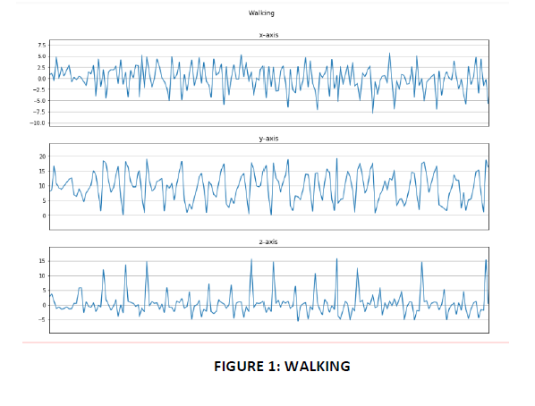
Visualization of dataset frequency curve

Slide 17
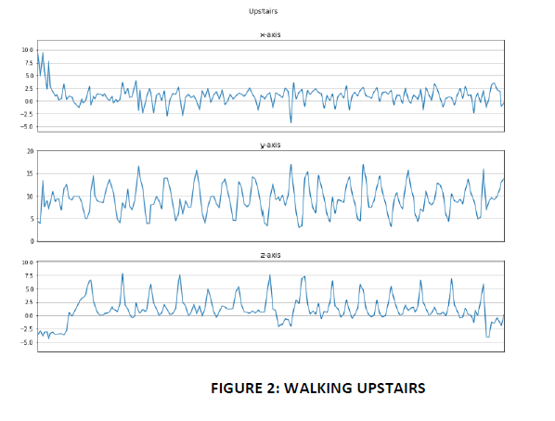

Slide 18
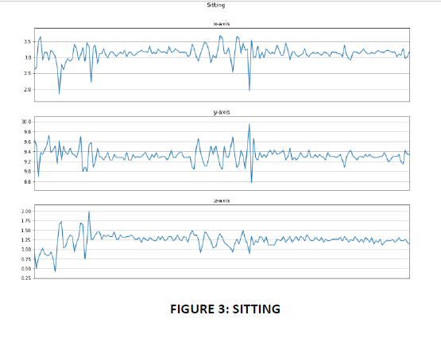

Slide 19
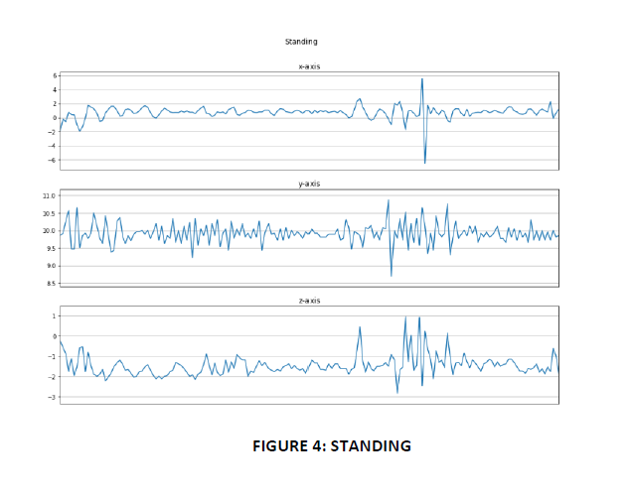

Slide 20
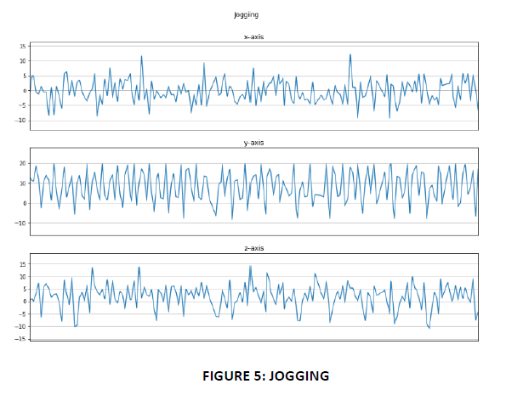

Slide 21
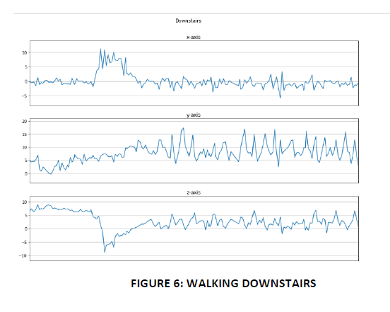

Slide 22
Classification algorithms
KNN(K Nearest Neighbor)
SVM(Support Vector Machines)
CNN(Convolutional Neural Network )

Slide 23
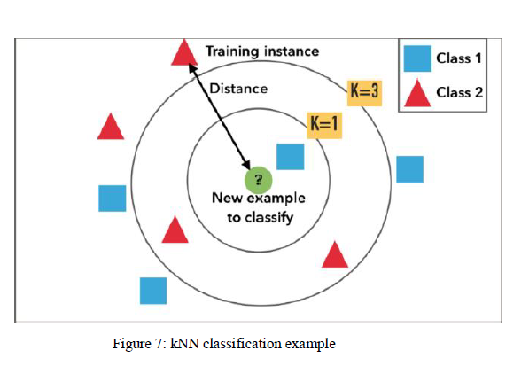
KNN (k – nearest neighbor)
Classifies based on the other points that are nearest to it

Slide 24
different error value at different score vector

Slide 25
prediction of classes observation on test-data using kNN algrothim

Slide 26
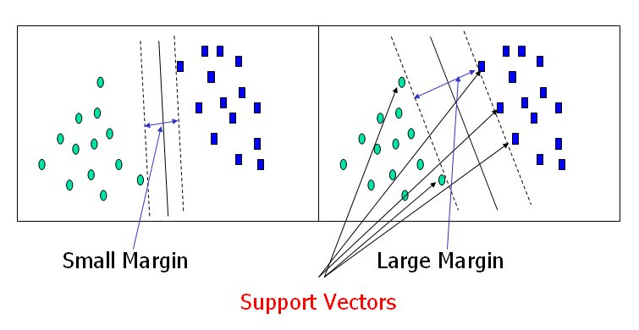
Support vector machines
Support vector machines are binary classifiers (with a response coded as y ∈ {−1, 1}), which attempt to find a vector of parameters α to minimize the regularized loss function

Slide 27
Prediction of classes of observations based on svm algorithm

Slide 28
Deep neural networks

Slide 29
Convolutional neural network
neural network emulates the human brain
Brains cells, or neurons, are connected via synapses. This is abstracted as a graph of nodes (neurons) connected by weighted edges (synapses)

Slide 30
CNN
We can model process of thinking by creating a neural network on a computer

Slide 31
CNN model

Slide 32
Model building using KNN/SVM

Slide 33
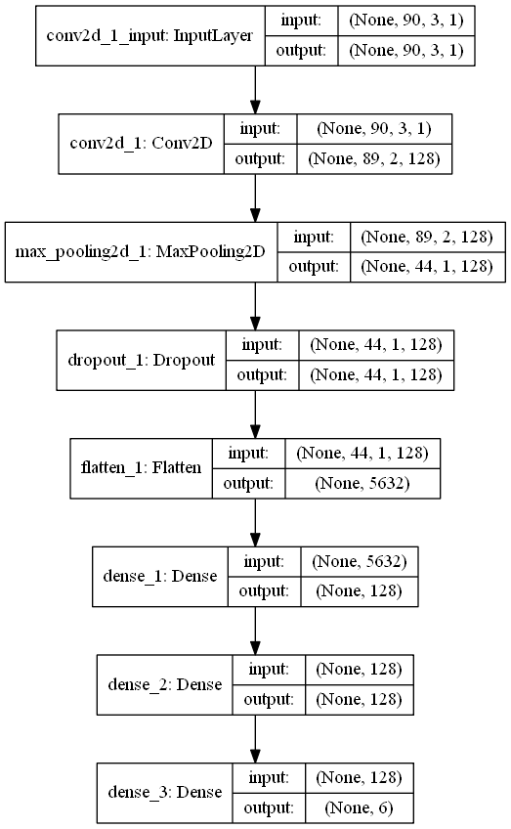
Model building using CNN

Slide 34
Discarded Methodologies
Rest API
Django
Django rest framework
Android sensors

Slide 35
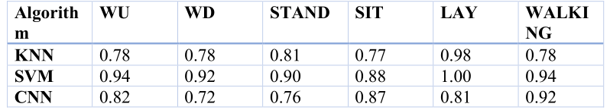
Results & error analysis
Algorithm comparison

Slide 36
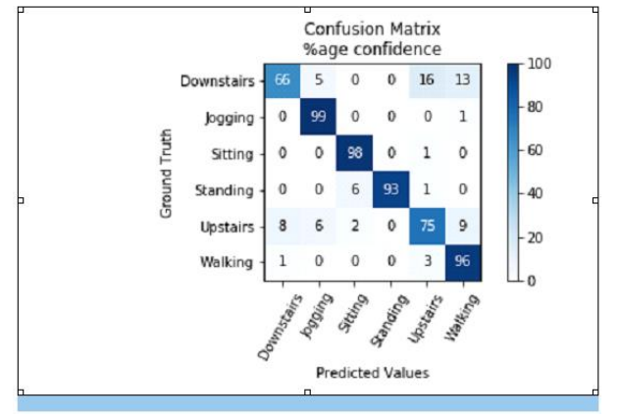
Performance by cnn
Training Accuracy: 86% Test Accuracy: 83%

Slide 37
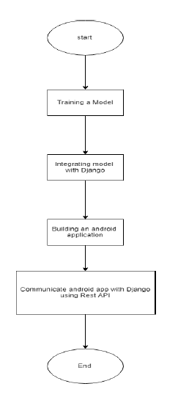
Workflow for project completion

Slide 38
Workflow in users eye

Slide 39
LIMITATIONS
1) we could have implemented more deeper neural network but due to lack of processing power in our commodity device we are bound to use less number of layer.
2) We have more(like 2,3 times) data sample for ‘jogging’ and ‘walking’ than other. So, our model is little bias toward jogging and walking.
3) Android app takes nearly 3-5 seconds to collect required amount of data.
4) We need network to communicate our backend with android app. Any fluctuation in network can affect the result

Slide 40
Thank you

