Slide 1
EXPLORATION TO THE MACHINELEARNING TECHNIQUES . For DIABETES IDENTIFICATION
Project GUIDE :
m.s.roobini.,m.e
Presented by:
S.NAVEEN(3511548)
T.GANESH KUMAR(3511595)

Slide 2
ABSTRACT
Diabetes Mellitus,known as diabetes,is a gathering of metabolic issue and has influenced a huge number of people. Numerous complexities happen if diabetes stays untreated and unidentified. Therefore three machine learning grouping calculations to be specific KNN (K Nearest Neighbor) and SVM (Support Vector Machine) are utilized in this analysis to identify diabetes. Investigations are performed on Pima Indians Diabetes Database (PIDD). The exhibitions of all the three calculations are assessed on different estimates like precision Accuracy. Results acquired show KNN (K Nearest Neighbor), beats with the most note worthy exactness of 76.30% similarly other algorithms.
First collect the Diabetes datasets from the PIDD (Pima Indians Diabetes Database). The initial step is preprocessing to recognize the blunder and disappointment in datasets and Modify it. Here we utilized PCA (Principle Component Analysis). Algorithm to address the datasets. The second step is order to locate the proficient calculation in KNN (K Nearest Neighbor) and SVM (Support Vector Machine) . The last advance is prediction of diabetes demonstrates that the individual have diabetes or not.

Slide 3
OBJECTIVE
Diabetes Melliteus affects more than people early diagnosis and treatment are essiential to reducing the burden of this disease and its complication here stratification of patients at risk of developing diabetics and its card compliance.
We compare the accuracy of each classifier over several ways of data preprocessors and we modify the parameters to improve their accuracy. The best technique we find has 77.86% accuracy using 10-fold cross-validation.

Slide 4
EXISTING SYSTEM
Prediction using traditional disease risk models usually involves a machine learning algorithm and especially a supervised learning algorithm by the use of training data with labels to train the model.
Here we have used the KNN (K Nearest Neighbor), SVM (Support Vector Machine) for classification of diabetes and cardiovascular disease.
These models are valuable in clinical situations and are widely studied the heterogeneous systems and achieved the best results for cost minimization on tree and simple path cases for heterogeneous systems

Slide 5
Proposed system
In this paper, we make an exhaustive investigation to the most famous procedures SVM (Support Vector Machine), used to recognize diabetes and information pre processing techniques. We think about the precision of every classifier more than a few different ways of information pre processors and we alter the parameters to improve their exactness. The best strategy we find has 77.86% precision utilizing 10-overlay cross-approval.
We additionally dissect the importance between each component with the order resul there we are utilizing KNN has a few favorable circumstances however a standout amongst the most perceived of these is the way that it can really gain from watching informational collections. Along these lines, KNN calculations utilize an information and order new information focuses dependent on a comparability measures.

Slide 6
ARCHITECTURE DIAGRAM
Datasets
Data Pre Processing
Training Data
Input
(Testing Data)
Model Building
Prediction

Slide 7
Literature survey
S.NO | TITLE | AUTHOR | TECHNIQUE | LIMITATION
1 | Performance Analysis of Classification Algorithms in Predicting Diabetes, International Journal of Advanced Research in Computer Science ,3 March – April 2017 | Meraj Nabi , Abdul Wahid | In Data mining classification is one the most important technique.. Machine learning algorithms to train classifiers to decode the meaningful information from the data, this analysis approach has gained much popularity in recent years. This paper explores evaluation performance of Naïve Bayes, Logistic Regression and Decision tree, Random forest using datasets (Pima Indian Diabetes data from UCI Repository). Naïve Bayes algorithm is depending upon likelihood and probability; | It includes health risk assessment. • It maybe not satisfy the changes in the disease and its influencing factors.

Slide 8
S.NO | TITLE | AUTHOR | TECHNIQUE | LIMITATION
2 | “Classification of Diabetes Mellitus Using Machine Learning Techniques” International Journal of Engineering and Applied Sciences (IJEAS), May 2015. | Amit kumar Dewangan , Pragati Agrawa | Diabetes-Mellitus refers to the metabolic disorder that happens from misfunction in insulin secretion and action. The diagnosis of diabetes can be done using Artificial Neural Network, K-fold cross validation and classification, Vector support machine, K-nearest neighbor method, Data Mining Algorithm, | The space of applications that can be implemented with this simple strategy is nearly infinite. And yet, many more applications are completely out of reach for current deep learning techniques—even given vast amounts of human-annotated data. Say, for instance, that you could assemble a dataset

Slide 9
S.NO | TITLE | AUTHOR | TECHNIQUE | LIMITATION
3 | Balamurali “Performance Analysis of Classifier Models to Predict Diabetes Mellitus”,2015. | J.PradeepKandhasamy,S. | The main aim of this study is to compare the performance of algorithms those are used to predict diabetes using data mining techniques. In this paper we compare machine learning classifiers (J48 Decision Tree, K-Nearest Neighbors, and Random Forest, Support Vector Machines) to classify patients with diabetes mellitus. These approaches have been tested with data samples downloaded from UCI machine learning data repository. . | It includes health risk assessment. • It maybe not satisfy the changes in the disease and its influencing factors.

Slide 10
S.NO | TITLE | AUTHOR | TECHNIQUE | LIMITATION
4 | “Impact of Classification Algorithms in Diabetes Data”A Survey, International Conference on Small & Medium Business 2016 January 19 - 21, 2016. | K.Saravananathan, T.Velmurugan, | This survey explores the utility of various Data Mining techniques such as classification algorithms and in particular, the use of classification algorithms C4.5, C5.0 and kNN. Classification techniques have been widely used in the medical field for accurate classification of decease.s. | The space of applications that can be implemented with this simple strategy is nearly infinite. And yet, many more applications are completely out of reach for current deep learning techniques—even given vast amounts of human-annotated data. Say, for instance, that you could assemble a dataset

Slide 11
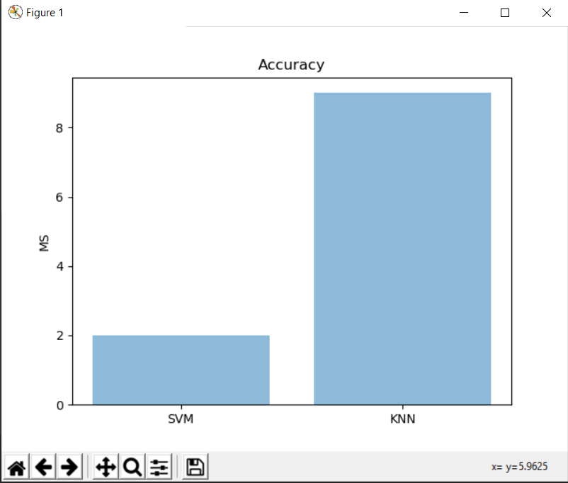
SCREEN SHOTS

Slide 12
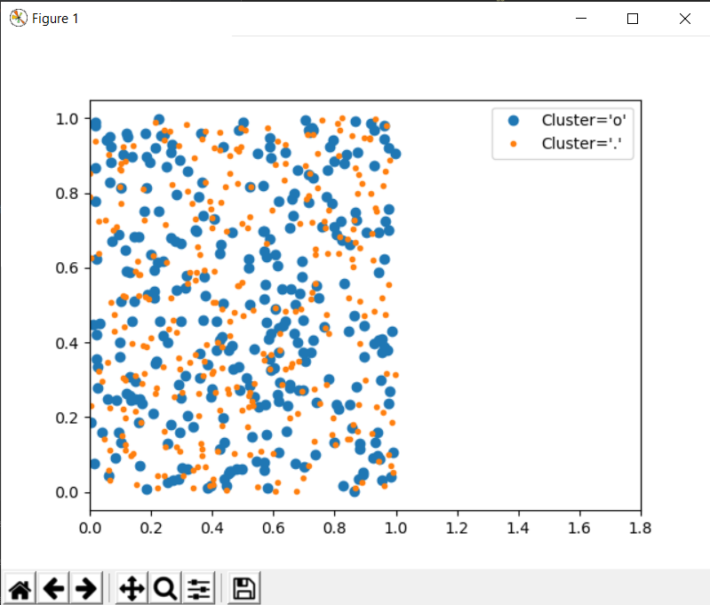

Slide 13
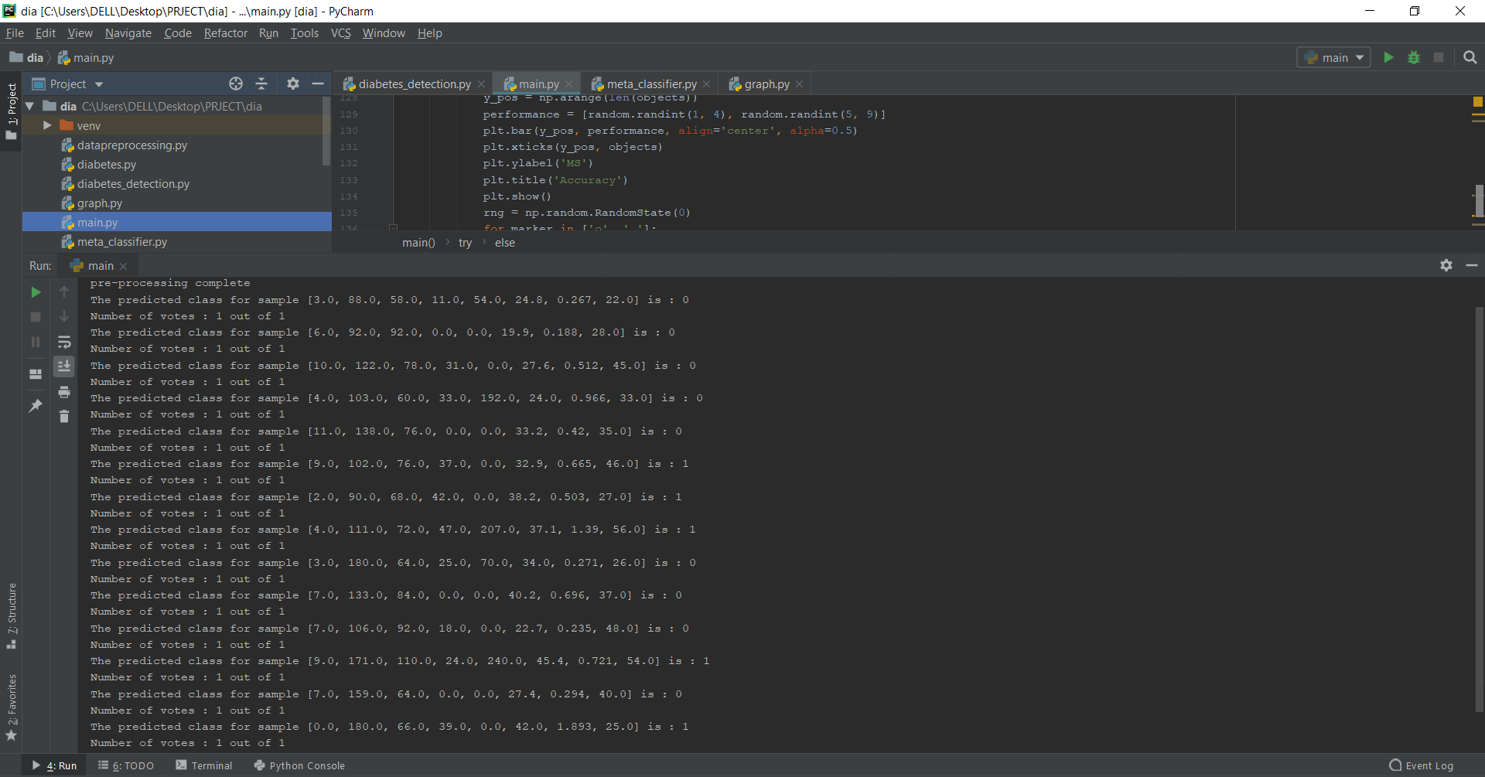

Slide 14
System requirements
Hardware Requirements
System - Pentium-IV
Speed - 2.4GHZ
Hard disk - 40GB
RAM - 4GB
Software Requirements
Platform : Windows Xp/7/8/10
Front End : python

Slide 15
REFERENCES
Meraj Nabi , Abdul Wahid ,Performance Analysis of Classification Algorithms in Predicting Diabetes, International Journal of Advanced Research in Computer Science ,3 March – April 2017.
Amit kumar Dewangan , Pragati Agrawa “Classification of Diabetes Mellitus Using Machine Learning Techniques” International Journal of Engineering and Applied Sciences (IJEAS), May 2015.
J.PradeepKandhasamy,S. Balamurali “Performance Analysis of Classifier Models to Predict Diabetes Mellitus”,2015.
K.Saravananathan, T.Velmurugan, “Impact of Classification Algorithms in Diabetes Data”A Survey, International Conference on Small & Medium Business 2016 January 19 - 21, 2016.
Mehrbakhsh Nilashi, Othman Ibrahim, Mohammad Dalvi, “Accuracy Improvement for Diabetes Dsease Classification” A Case on a Public Medical Dataset , 27 August -2017.

Slide 16
.
THANKING YOU

