Slide 1
NiXNaN Analysis Summary
Top origins of NaN/+Inf and effective mitigations

Slide 2
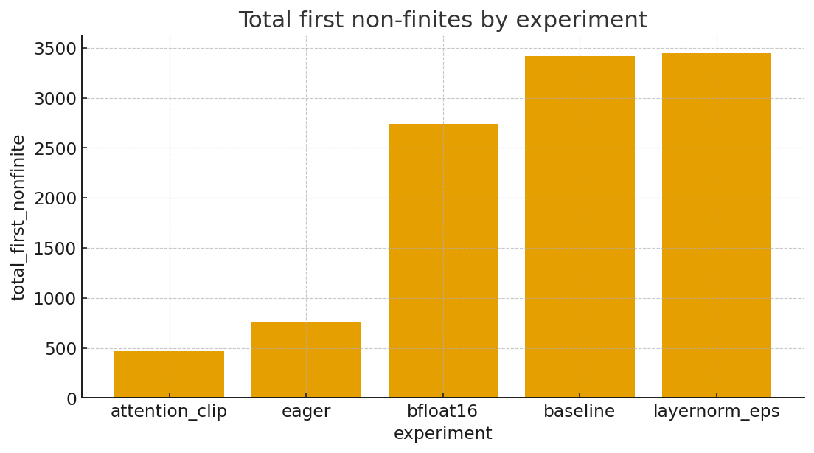
Totals by experiment
Lower is better. 'attention_clip' and 'eager' reduce first-nonfinites significantly vs baseline.

Slide 3
Top kernels by first NaN (overall)
kernel | first_nan
void kgemm_4bit_inference_naive | 5172
void pytorch_flash::flash_fwd_kernel | 2120
void cutlass::Kernel2 | 1720
std::enable_if | 8
void gemv2N_kernel | 0
void gemv2T_kernel_val | 0

Slide 4
Top kernels by first +Inf (overall)
kernel | first_inf
void kgemm_4bit_inference_naive | 1380
std::enable_if | 160
void gemv2N_kernel | 108
void pytorch_flash::flash_fwd_kernel | 77
void cutlass::Kernel2 | 76
void gemv2T_kernel_val | 4

Slide 5
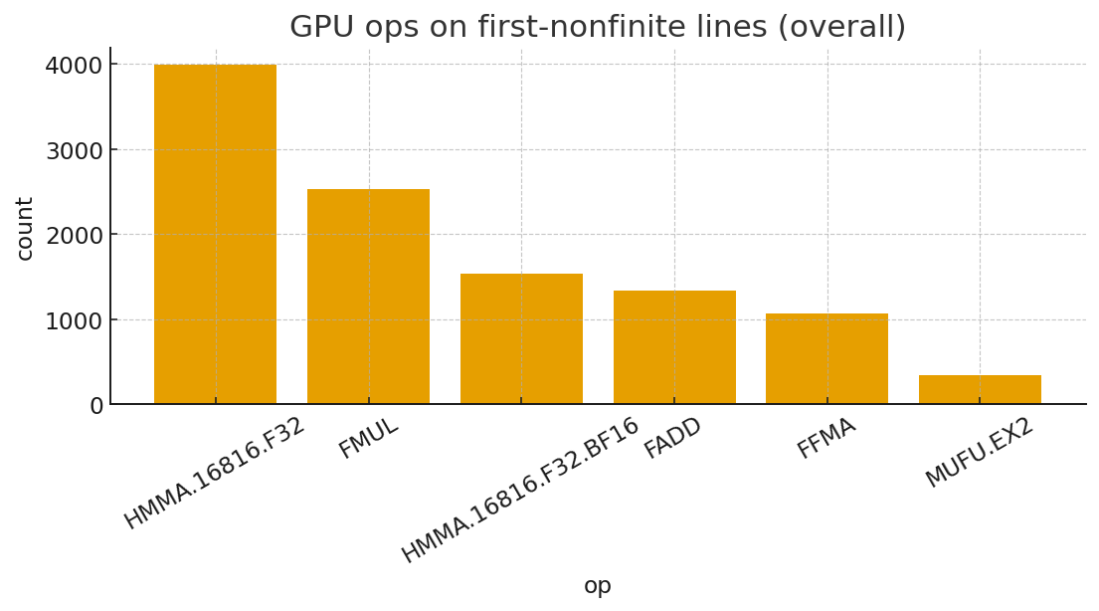
GPU ops on first-nonfinite lines

Slide 6
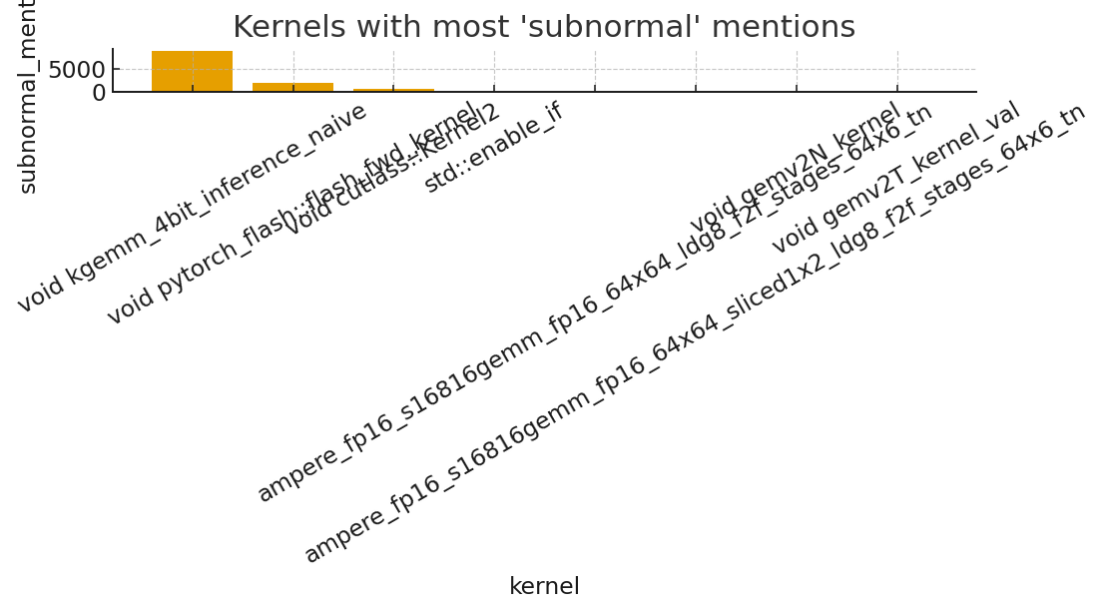
Kernels with most 'subnormal' mentions
High subnormal counts often indicate FTZ/denormal squelching; 4-bit GEMM path dominates.

