Slide 1

CS 5/6110, Software Correctness Analysis, Spring 2023
Ganesh Gopalakrishnan
School of Computing
University of Utah
Salt Lake City, UT 84112

Slide 2
History, Motivations
Historically the first verification approach considered
Recently TimSort was found to be buggy and upgraded
See Wikipedia article on the TimSort bug
Proved by people using the theorem prover called Key
A good intuition about how Hoare Logic verifiers work is important
Will study a Lisp-based verifier in Gordon’s book meanwhile

Slide 3
Good overviews of Hoare Logic
https://www.embedded-testing.de/files/cleancode/site/vortraege2016/kooijmans_sander_How%20invariants%20help%20writing%20loops.pdf
https://www.cl.cam.ac.uk/archive/mjcg/HL/Notes/Notes.pdf

Slide 4
Let’s analyze an XOR-based swap
Basically a trick to swap two variables without a temp
Each following slide builds on the previous

Slide 5
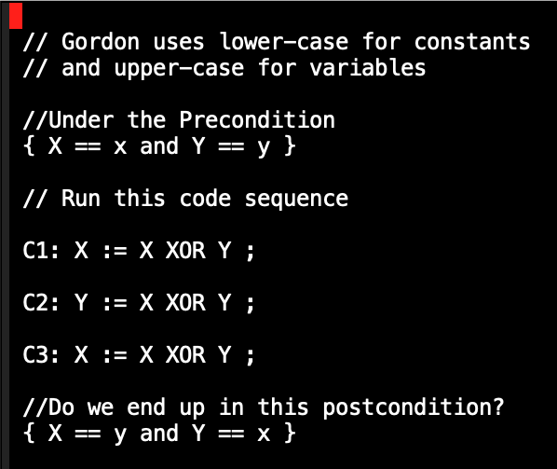

Slide 6
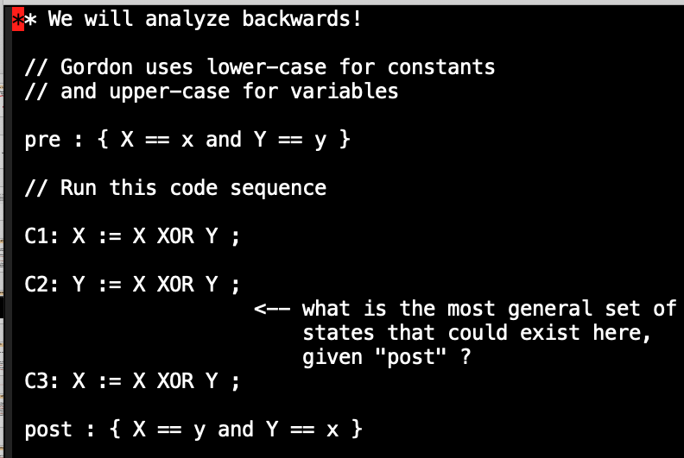

Slide 7
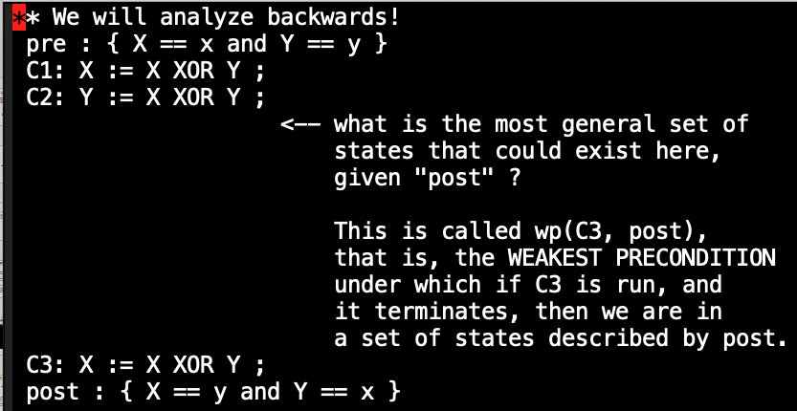

Slide 8
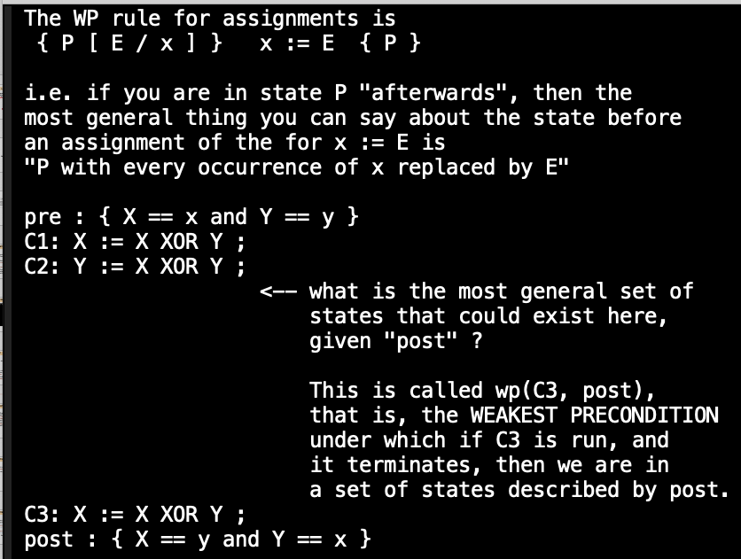

Slide 9
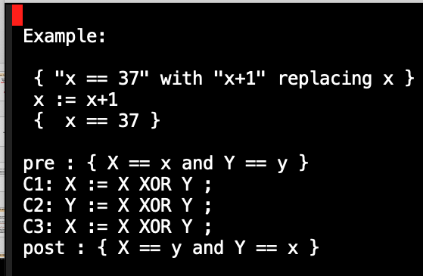

Slide 10
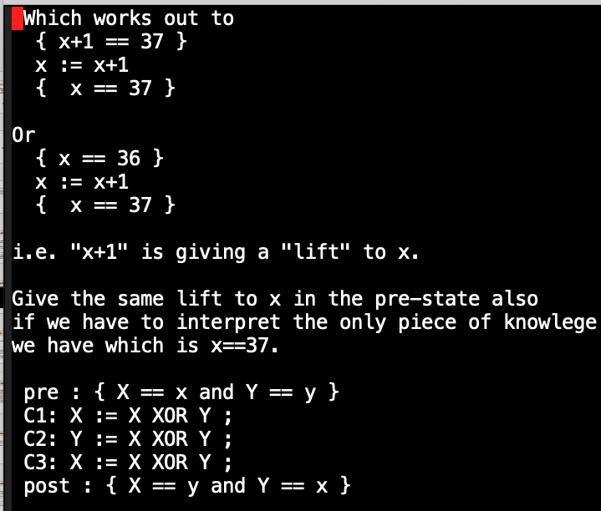

Slide 11
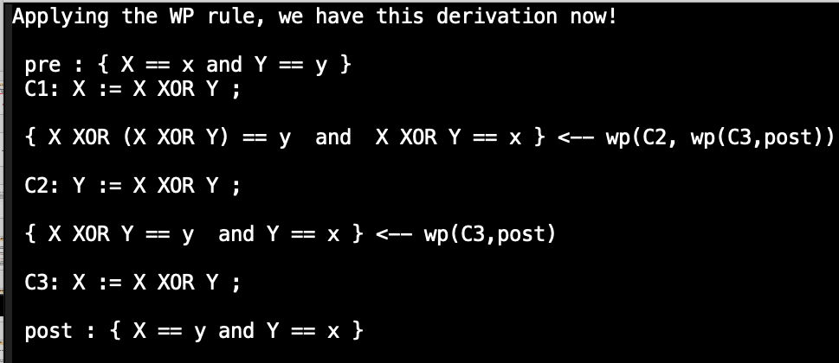

Slide 12
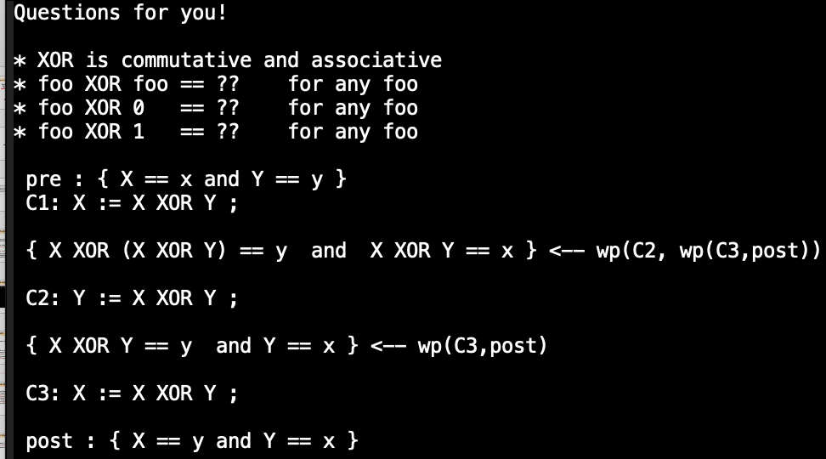

Slide 13
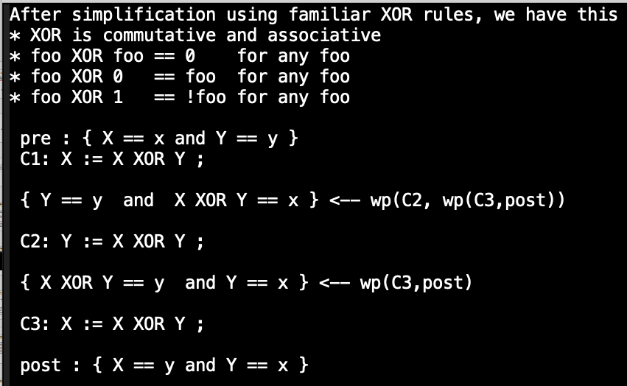

Slide 14
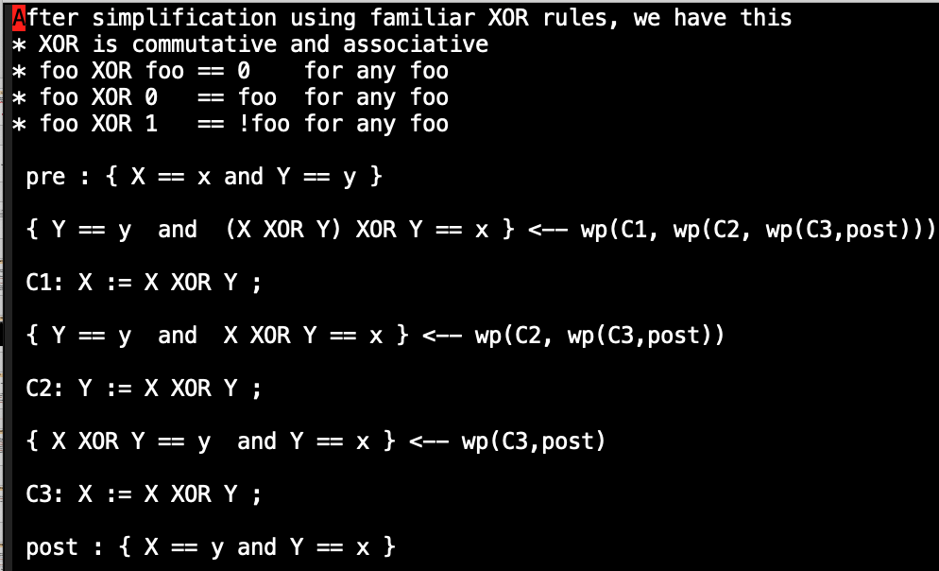

Slide 15
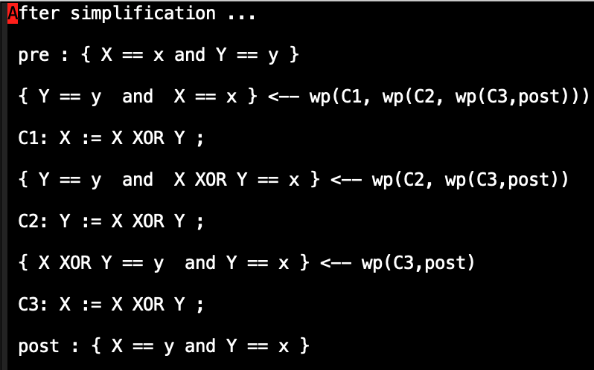

Slide 16
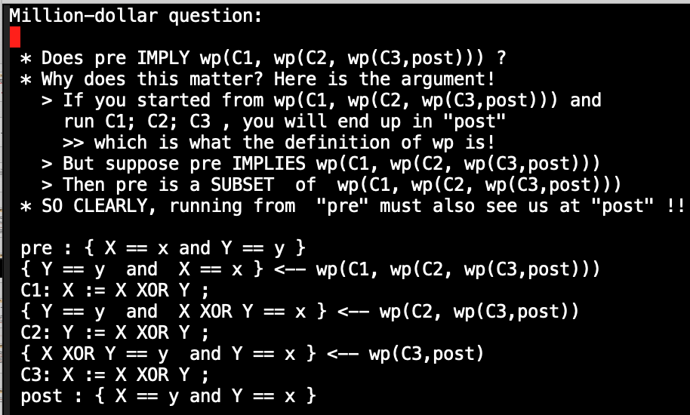

Slide 17
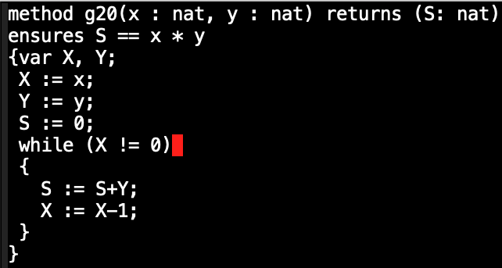
Gordon’s example 20 (in Gordon’s book)
Here is an
“annotated
Program”
The question is
Does the
“ensures”
Clause hold?

Slide 18
Gordon’s example done by hand

Slide 19
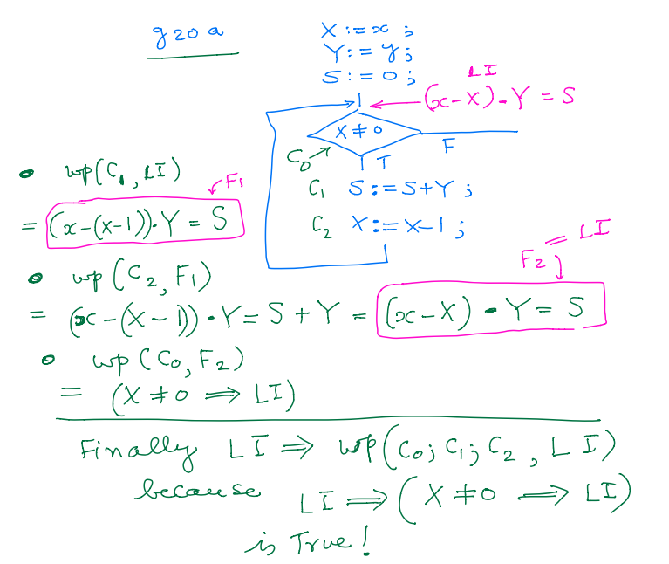
Gordon’s g20 example and its “LI walk-back”
S = x*y at the output

Slide 20
In a Hoare-logic proving approach, one annotates the program
at the “loop head” with a LOOP INVARIANT
It must be true whenever the execution reaches that point
What is it?

Slide 21
In a Hoare-logic proving approach, one annotates the program
at the “loop head” with a LOOP INVARIANT
It must be true whenever the execution reaches that point
What is it?
The “remaining work” is X.
Thus, S + X*y = x*y
OR S = y * (x – X)
Then upon exit, S = y * x

Slide 22
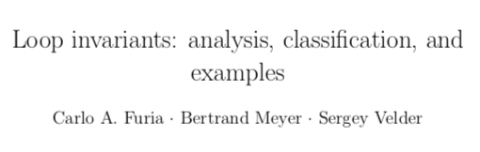
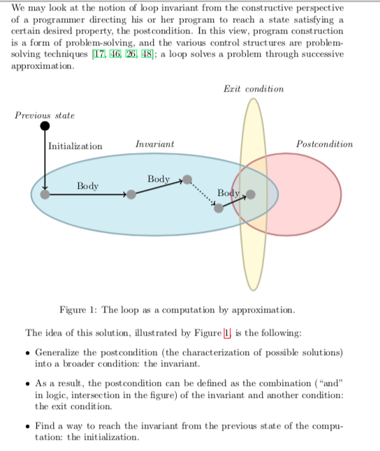

Slide 24
With nested loops, we need more annotations
Here is an “optimized” version
of the same program
Method g20(x,y : nat) returns (S:nat)
Requires x > 0
Requires y > 0
Ensures S == x * y
{ var X,Y;
X := x; Y := y; S := 0;
while(X != 0)
{ while (X % 2 == 0)
{ Y := Y + Y ; X := X / 2; }
S := S+Y;
X := X-1;
}
}

Slide 25
With nested loops, we need more annotations
Here is an “optimized” version
of the same program
Method g20(x,y : nat) returns (S:nat)
Requires x > 0
Requires y > 0
Ensures S == x * y
{ var X,Y;
X := x; Y := y; S := 0;
while(X != 0) [ Loop Invariant Here ? ]
{ while (X % 2 == 0)
{ Y := Y + Y ; X := X / 2; }
S := S+Y;
X := X-1;
}
}

Slide 26
With nested loops, we need more annotations
Here is an “optimized” version
of the same program
Method g20(x,y : nat) returns (S:nat)
Requires x > 0
Requires y > 0
Ensures S == x * y
{ var X,Y;
X := x; Y := y; S := 0;
while(X != 0) [ Loop Invariant Here ? ]
[ Remaining “work” is still measured by X ]
[ If you pretend to do that much more, and add to S,
it should match our goal ]
{ while (X % 2 == 0)
{ Y := Y + Y ; X := X / 2; }
S := S+Y;
X := X-1;
}
}

Slide 27
With nested loops, we need more annotations
Here is an “optimized” version
of the same program
Method g20(x,y : nat) returns (S:nat)
Requires x > 0
Requires y > 0
Ensures S == x * y
{ var X,Y;
X := x; Y := y; S := 0;
while(X != 0) [ Loop Invariant Here ? ]
{ while (X % 2 == 0)
{ Y := Y + Y ; X := X / 2; }
S := S+Y;
X := X-1;
}
}

Slide 28
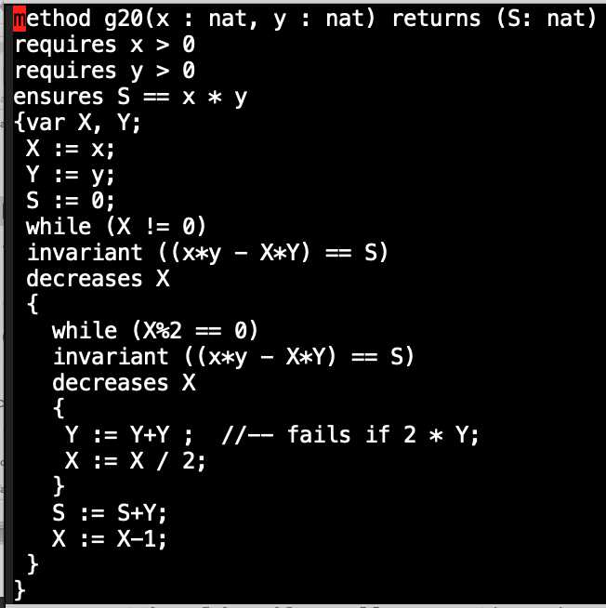
With nested loops, we need more annotations
Here is an “optimized” version
of the same program
The inner loop does “doubling”
of Y each time X is even
The well-founded relation
(to argue termination) is also
given

Slide 29
With nested loops, we need more annotations
Let’s at least get some experience
applying the WP rules
by hand

Slide 30
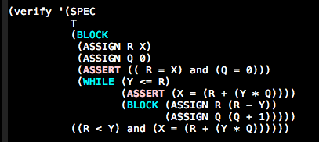
Gordon’s Prover with “proof generation” added by Mantha

Slide 31
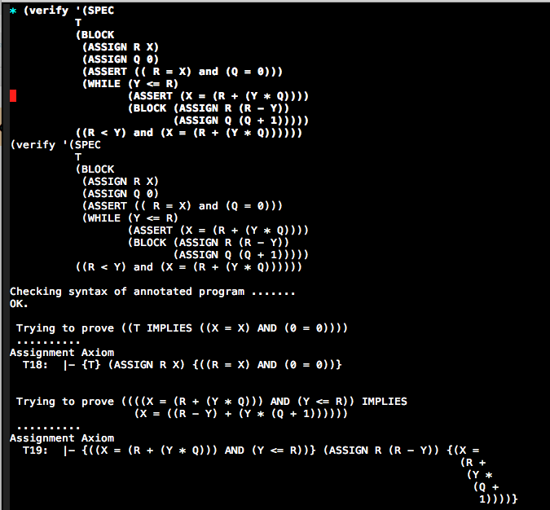
Gordon’s Prover with “proof generation” added by Mantha

Slide 32
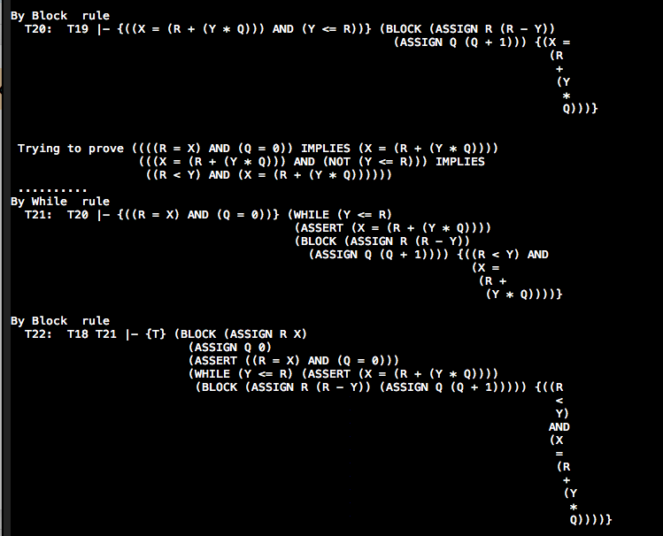
Gordon’s Prover with “proof generation” added by Mantha

Slide 33

Gordon’s Prover with “proof generation” added by Mantha

Slide 34
Gordon’s Prover with “proof generation” added by Mantha
Run using sbcl

