Slide 1
How To Specify and Verify Cache Coherence Protocols:
An Elementary Tutorial
Ching-Tsun Chou
Microprocessor Technology Lab
Corporate Technology Group
Intel Corporation

Slide 2
Overview
Goals:
  To give a flavor of how cache coherence protocols are specified and verified via a simple but complete example
  To share experience with some protocol modeling techniques that have proved useful in practice
  To introduce a simple method of parameterized verification for arbitrary number of nodes
Example: The German protocol
  A simple directory-based message-passing cache coherence protocol devised by Steven German in 2000 as a challenge problem
    German’s challenge was fully automatic parameterized verification, which is not our goal in this talk
Caveats:
  This talk is an elementary introduction and contains very little that is new
    Possible exception: Parameterized verification for arbitrary number of nodes
  More advanced topics are discussed in Steven German’s and Ganesh Gopalakrishnan’s tutorials

Slide 3
Agenda
1-address abstraction
Choosing a model checker
Overview of the German protocol
Using tables to specify state transitions
Generation of executable reference models from formal models
Parameterized verification for arbitrary number of nodes
Issues not addressed in this tutorial

Slide 4
Agenda
1-address abstraction
Choosing a model checker
Overview of the German protocol
Using tables to specify state transitions
Generation of executable reference models from formal models
Parameterized verification for arbitrary number of nodes
Issues not addressed in this tutorial

Slide 5
1-address abstraction
Focus on how a cache coherence protocol handles data belonging to a single, arbitrary address
Why this can be a good idea:
  By focusing on 1 address, protocol instances with more nodes (or other parameters such as buffer entries) can be model-checked
    Often in practice, only 1-address models are tractable by model checking
  Interactions between addresses can often be modeled by nondeterminism
    Example: “Request to address A causes cache line of address B to be victimized” can be modeled by “cache line of address B is nondeterministically victimized”
  In some designs, ordering requirements between addresses is enforced conservatively by processors and not exported to the network
Why this can be a bad idea:
  Correctness requirements do exist between addresses (known as memory ordering or consistency models)
  Modeling by nondeterminism can hide real problems which often manifest themselves as liveness problems
  More aggressive designs may export memory ordering enforcement to the network
Bottom line: 1-address abstraction defines the minimum problem that cache coherence verification should address
  We will use 1-address abstraction in this tutorial

Slide 6
Agenda
1-address abstraction
Choosing a model checker
Overview of the German protocol
Using tables to specify state transitions
Generation of executable reference models from formal models
Parameterized verification for arbitrary number of nodes
Issues not addressed in this tutorial

Slide 7
Choosing a model checker
Explicit state enumeration model checkers
  Represent unexplored state vectors explicitly and store explored states in hash tables
  Can use symmetry reduction and disk storage to increase the number of states that can be explored
  Most widely used model checkers for cache coherence protocols:
    Murphi (http://verify.stanford.edu/dill/murphi.html)
    TLC (http://research.microsoft.com/users/lamport/tla/tlc.html)
  We will use Murphi in this tutorial
Symbolic model checkers
  Use symbolic techniques to represent and explore reachable states
    Ordered binary decision diagrams
    Boolean satisfiability decision procedures
  Experience shows that symbolic model checkers are less effective and robust than explicit state enumeration model checkers on cache coherence protocols

Slide 8
Agenda
1-address abstraction
Choosing a model checker
Overview of the German protocol
Using tables to specify state transitions
Generation of executable reference models from formal models
Parameterized verification for arbitrary number of nodes
Issues not addressed in this tutorial

Slide 9
Overview of the German protocol
Cache 1
Cache 2
Cache 3
Cache 4
S
I
I
I
Home
S(1)

Slide 10
Overview of the German protocol
Cache 1
Cache 2
Cache 3
Cache 4
S
I
I
I
ReqS
Home
ReqS(4)
S(1)

Slide 11
Overview of the German protocol
Cache 1
Cache 2
Cache 3
Cache 4
S
I
I
I
ReqE
GntS
Home
S(1,4)

Slide 12
Overview of the German protocol
Cache 1
Cache 2
Cache 3
Cache 4
S
I
I
S
Inv
Inv
Home
ReqE(2)
S(1,4)

Slide 13
Overview of the German protocol
Cache 1
Cache 2
Cache 3
Cache 4
I
I
I
I
InvAck
InvAck
Home
ReqE(2)
S(1,4)

Slide 14
Overview of the German protocol
Cache 1
Cache 2
Cache 3
Cache 4
I
I
I
I
Home
ReqE(2)
S()

Slide 15
Overview of the German protocol
Cache 1
Cache 2
Cache 3
Cache 4
I
I
I
I
GntE
Home
E(2)

Slide 16
Overview of the German protocol
Cache 1
Cache 2
Cache 3
Cache 4
I
E
I
I
Home
E(2)

Slide 17
Data structures of the German protocol
const ---- Configuration parameters ----
NODE_NUM : 5;
DATA_NUM : 2;
type ---- Type declarations ----
NODE : scalarset(NODE_NUM);
DATA : scalarset(DATA_NUM);
CACHE_STATE : enum {Invld, Shrd, Excl};
CACHE : record State : CACHE_STATE; Data : DATA; end;
MSG_CMD : enum {Empty, ReqS, ReqE, Inv, InvAck, GntS, GntE};
MSG : record Cmd : MSG_CMD; Data : DATA; end;
STATE : record
Cache : array [NODE] of CACHE; -- Caches
Chan1 : array [NODE] of MSG; -- Channels for Req*
Chan2 : array [NODE] of MSG; -- Channels for Gnt* and Inv
Chan3 : array [NODE] of MSG; -- Channels for InvAck
InvSet : array [NODE] of boolean; -- Set of nodes to be invalidated
ShrSet : array [NODE] of boolean; -- Set of nodes having valid copies
ExGntd : boolean; -- Excl copy has been granted
CurCmd : MSG_CMD; -- Current request command
CurPtr : NODE; -- Current request node
MemData : DATA; -- Memory data
AuxData : DATA; -- Auxiliary variable for latest data
end;

Slide 18
Data structures of the German protocol
The original German protocol and
all its incarnations in the research
literature have no data path
const ---- Configuration parameters ----
NODE_NUM : 5;
DATA_NUM : 2;
type ---- Type declarations ----
NODE : scalarset(NODE_NUM);
DATA : scalarset(DATA_NUM);
CACHE_STATE : enum {Invld, Shrd, Excl};
CACHE : record State : CACHE_STATE; Data : DATA; end;
MSG_CMD : enum {Empty, ReqS, ReqE, Inv, InvAck, GntS, GntE};
MSG : record Cmd : MSG_CMD; Data : DATA; end;
STATE : record
Cache : array [NODE] of CACHE; -- Caches
Chan1 : array [NODE] of MSG; -- Channels for Req*
Chan2 : array [NODE] of MSG; -- Channels for Gnt* and Inv
Chan3 : array [NODE] of MSG; -- Channels for InvAck
InvSet : array [NODE] of boolean; -- Set of nodes to be invalidated
ShrSet : array [NODE] of boolean; -- Set of nodes having valid copies
ExGntd : boolean; -- Excl copy has been granted
CurCmd : MSG_CMD; -- Current request command
CurPtr : NODE; -- Current request node
MemData : DATA; -- Memory data
AuxData : DATA; -- Auxiliary variable for latest data
end;

Slide 19
Initial states of the German protocol
var ---- State variables ----
Sta : STATE;
---- Initial states ----
ruleset d : DATA do
startstate "Init"
undefine Sta;
for i : NODE do
Sta.Cache[i].State := Invld;
Sta.Chan1[i].Cmd := Empty;
Sta.Chan2[i].Cmd := Empty;
Sta.Chan3[i].Cmd := Empty;
Sta.InvSet[i] := FALSE;
Sta.ShrSet[i] := FALSE;
end;
Sta.ExGntd := FALSE;
Sta.CurCmd := Empty;
Sta.MemData := d;
Sta.AuxData := d;
end; end;

Slide 20
Desired properties of the German protocol
---- Invariant properties ----
invariant "CtrlProp"
forall i : NODE do forall j : NODE do
i != j ->
(Sta.Cache[i].State = Excl -> Sta.Cache[j].State = Invld) &
(Sta.Cache[i].State = Shrd -> Sta.Cache[j].State = Invld |
Sta.Cache[j].State = Shrd)
end end;
invariant "DataProp"
(Sta.ExGntd = FALSE -> Sta.MemData = Sta.AuxData) &
forall i : NODE do
Sta.Cache[i].State != Invld -> Sta.Cache[i].Data = Sta.AuxData
end;

Slide 21
Agenda
1-address abstraction
Choosing a model checker
Overview of the German protocol
Using tables to specify state transitions
Generation of executable reference models from formal models
Parameterized verification for arbitrary number of nodes
Issues not addressed in this tutorial

Slide 22
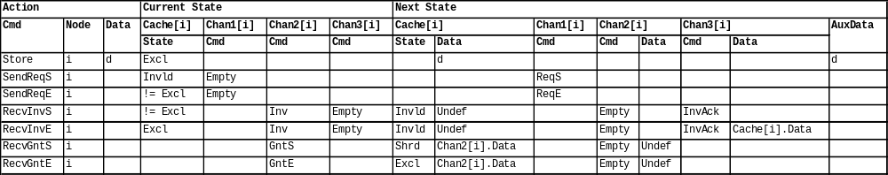
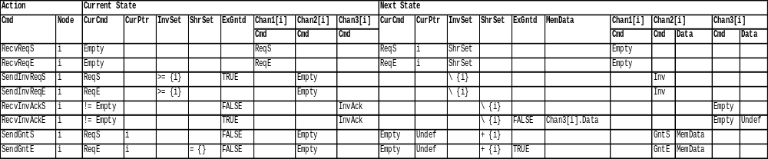
Using tables to specify state transitions
Cache node actions:
Home node actions:

Slide 23
Assigning semantics to tables
COLUMN |Current State|Cache[i]|State|
|Invld| => Sta.Cache[i].State = Invld
|Excl| => Sta.Cache[i].State = Excl
|!= Excl| => Sta.Cache[i].State != Excl
COLUMN |Current State|Chan1[i]|Cmd|
|Empty| => Sta.Chan1[i].Cmd = Empty
COLUMN |Current State|Chan2[i]|Cmd|
|Inv| => Sta.Chan2[i].Cmd = Inv
|GntS| => Sta.Chan2[i].Cmd = GntS
|GntE| => Sta.Chan2[i].Cmd = GntE
COLUMN |Current State|Chan3[i]|Cmd|
|Empty| => Sta.Chan3[i].Cmd = Empty
COLUMN |Next State|Cache[i]|State|
|Invld| => NxtSta.Cache[i].State := Invld
|Shrd| => NxtSta.Cache[i].State := Shrd
|Excl| => NxtSta.Cache[i].State := Excl
COLUMN |Next State|Cache[i]|Data|
|d| => NxtSta.Cache[i].Data := d
|Chan2[i].Data| => NxtSta.Cache[i].Data :=
Chan2[i].Data
|Undef| => undefine NxtSta.Cache[i].Data
COLUMN |Next State|Chan1[i]|Cmd|
|ReqS| => NxtSta.Chan1[i].Cmd := ReqS
|ReqE| => NxtSta.Chan1[i].Cmd := ReqE
COLUMN |Next State|Chan2[i]|Cmd|
|Empty| => NxtSta.Chan2[i].Cmd := Empty
COLUMN |Next State|Chan2[i]|Data|
|Undef| => undef NxtSta.Chan2[i].Data
COLUMN |Next State|Chan3[i]|Cmd|
|InvAck| => NxtSta.Chan3[i].Cmd := InvAck
COLUMN |Next State|Chan3[i]|Data|
|Cache[i].Data| => NxtSta.Chan3[i].Data :=
Cache[i].Data
COLUMN |Next State|AuxData|
|d| => NxtSta.AuxData := d

Slide 24
An example action
ruleset i : NODE do
rule "RecvInvE"
Sta.Cache[i].State = Excl &
Sta.Chan2[i].Cmd = Inv &
Sta.Chan3[i].Cmd = Empty
==>
var NxtSta : STATE;
begin
NxtSta := Sta;
--
NxtSta.Cache[i].State := Invld;
undefine NxtSta.Cache[i].Data;
NxtSta.Chan2[i].Cmd := Empty;
NxtSta.Chan3[i].Cmd := InvAck;
NxtSta.Chan3[i].Data := Sta.Cache[i].Data;
--
Sta := NxtSta;
end; end;
By having a separate NxtSta,
the order of assignments does
not matter any more

Slide 25
Advantages of table-based specification
Tables provide an abstract summary
  Once one becomes familiar with what table entries mean, one can work almost exclusively at the table level of abstraction
Table format is flexible
  There is no restriction on what texts can appear in table entries and what code fragments can be assigned to table entries
  Lots of room for experimentation
Experience shows that even complex protocols can typically be summarized using a small number of tables printable on a few pages
  It is much easier to comprehend and reason about a protocol by staring at a few pages of descriptions than by wading thru 1000’s of lines of code
  Regularities among actions can be more easily observed in tables than in code
Tables are widely used in industry
  Example: Eiriksson & McMillan (CAV 1995)

Slide 26
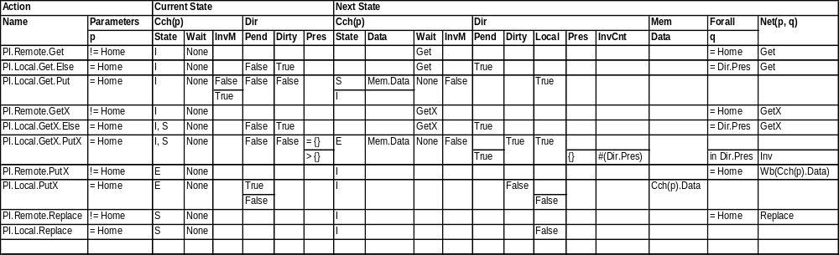
FLASH in tables (1/2)
The Murphi description of FLASH contains >1000 lines of code

Slide 27
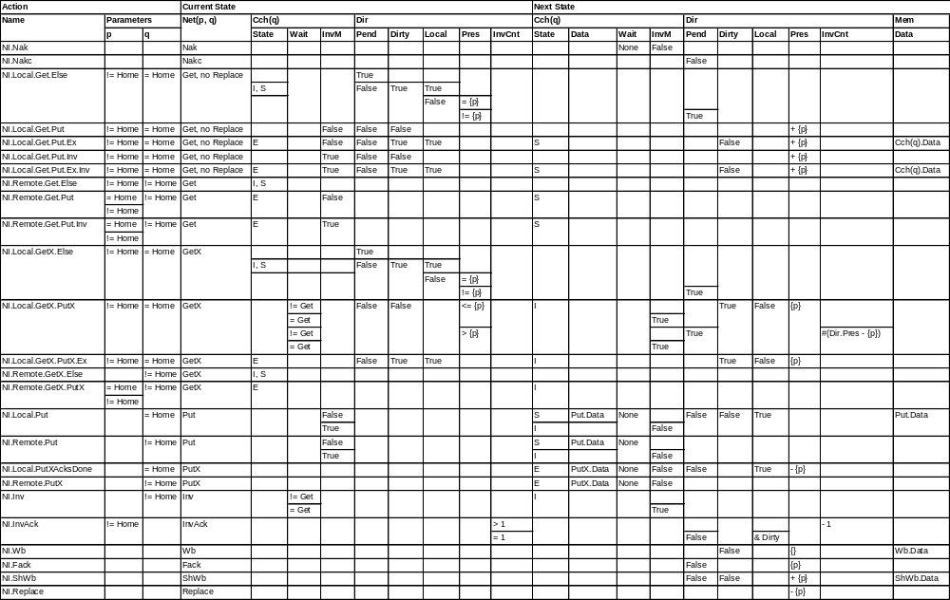
FLASH in tables (2/2)

Slide 28
Agenda
1-address abstraction
Choosing a model checker
Overview of the German protocol
Using tables to specify state transitions
Generation of executable reference models from formal models
Parameterized verification for arbitrary number of nodes
Issues not addressed in this tutorial

Slide 29
Connecting formal model to RTL
In the end, what is implemented in silicon is the RTL, not the formal model
How do we know that the RTL implements the formal model?
  A very large and deep research problem
A partial solution: Use the formal model to check RTL simulation
Ingredients:
  A version of the formal model, called an executable reference model (ERM), that can be used as a checker in RTL simulation
  A program that monitors RTL simulation and extracts protocol actions to drive ERM
Experience shows that this is an effective way to leverage results from formal protocol verification in RTL verification
  Once automated, the cost of generating ERM is zero
  ERM has been verified by FV, at least for small configurations

Slide 30
Generation of ERMs from formal models
Restrictions on the formal model:
  No hidden nondeterminism
    All nondeterministic choices are made thru the selection of actions and their parameters (in Murphi jargon: rulesets and their parameters)
  Simple data structures
    Enumerated types
    Finite integer ranges
    Records of previous defined types
    Arrays over finite integer ranges of previous defined types
Main API of ERM:
VOID Step(INPUT *Inp, OUTPUT *Out, STATE *Sta, STATE *NxtSta);
  Attempts to execute an action (with parameters) specified by *Inp from the state *Sta
  If the action is enabled, then *NxtSta is the next state
  If the action is not enabled, then something is wrong
    Since the action is extracted from RTL simulation, its being disabled in ERM means that RTL and ERM have diverged

Slide 31
Agenda
1-address abstraction
Choosing a model checker
Overview of the German protocol
Using tables to specify state transitions
Generation of executable reference models from formal models
Parameterized verification for arbitrary number of nodes
Issues not addressed in this tutorial

Slide 32
Parameterized verification for arbitrary # of nodes
Typical industrial cache coherence protocols can be model-checked for at most 3~4 (cache) nodes, but they may be deployed in systems with many more nodes
  Protocol designers often have intuitions about why 3~4 nodes suffice to exhibit all “interesting” scenarios, but such intuitions are typically not formalized
So how do we know they will continue to work in large systems? Can there be unanticipated error scenarios that take more than 3~4 nodes to manifest themselves?
Parameterized verification seeks to formally verify the protocol for arbitrary # of nodes
The method presented below is an alternative formulation of McMillan’s compositional model checking method (CHARME 2001)
  We explain our method by applying it to the German protocol
  For theoretical justification of the apparently circular reasoning, please see our paper in FMCAD 2004

Slide 33
Basic idea
Choose any 2 nodes, which WLOG can be taken to be nodes n1 and n2 (because all nodes are symmetric w.r.t. each other)
  Why 2? The intuitive reason is that any basic interaction in German involves at most 2 nodes: {requesting node, invalidated node}
    Note that the home node is not indexed by NODE and always included
    The technical reason is that all quantifications (properties, lemmas, rulesets, etc) in German are nested at most 2 deep
Our goal is to construct an abstraction, called AbsGerman, that contains the home node, n1, n2, and a fictitious node “Other” representing all other nodes, such that:
  AbsGerman permits all possible behaviors in German that n1, n2, and the home node can exhibit (including what “Other” can do to them)
  The behaviors of AbsGerman are sufficiently constrained that they satisfy the desired properties CtrlProp and DataProp
If successful, any safety property satisfied by AbsGerman should be satisfied by German as well

Slide 34
General strategy
Start with an AbsGerman that is obviously more permissive than German
Counterexample-guided discovery of noninterference lemmas:
  Try to prove the desired properties and all noninterference lemmas discovered so far on the current AbsGerman by model checking
  If all properties pass, we are done and all properties and lemmas are true in AbsGerman and hence in German as well
  Otherwise, analyze the counterexample to identify an offending action and formulate a new noninterference lemma to “fix” it
    This step requires human ingenuity and understanding of the protocol
  Instantiate the new noninterference lemma to strengthen the precondition of the offending action in the abstract model
  Go back to step 1.

Slide 35
Data structures of AbsGerman
const ---- Configuration parameters ----
NODE_NUM : 2;
DATA_NUM : 2;
type ---- Type declarations ----
NODE : scalarset(NODE_NUM);
ABS_NODE : union {NODE, enum{Other}};
-- … some type declarations omitted
STATE : record
Cache : array [NODE] of CACHE; -- Caches
Chan1 : array [NODE] of MSG; -- Channels for Req*
Chan2 : array [NODE] of MSG; -- Channels for Gnt* and Inv
Chan3 : array [NODE] of MSG; -- Channels for InvAck
InvSet : array [NODE] of boolean; -- Set of nodes to be invalidated
ShrSet : array [NODE] of boolean; -- Set of nodes having valid copies
ExGntd : boolean; -- Excl copy has been granted
CurCmd : MSG_CMD; -- Current request command
CurPtr : ABS_NODE; -- Current request node
MemData : DATA; -- Memory data
AuxData : DATA; -- Auxiliary variable for latest data
end;

Slide 36
Action abstraction when i ∈ NODE
Concrete action:
ruleset i : NODE; d : DATA do
rule "Store"
Sta.Cache[i].State = Excl
==>
var NxtSta : STATE;
begin
NxtSta := Sta;
--
NxtSta.Cache[i].Data := d;
NxtSta.AuxData := d;
--
Sta := NxtSta;
Abstract action:
ruleset i : NODE; d : DATA do
rule "Store"
Sta.Cache[i].State = Excl
==>
var NxtSta : STATE;
begin
NxtSta := Sta;
--
NxtSta.Cache[i].Data := d;
NxtSta.AuxData := d;
--
Sta := NxtSta;

Slide 37
Action abstraction when i ∈ NODE
Concrete action:
ruleset i : NODE do
rule "SendGntE"
Sta.CurCmd = ReqE &
Sta.CurPtr = i &
forall j : NODE do
Sta.ShrSet[j] = FALSE
end &
Sta.ExGntd = FALSE &
Sta.Chan2[i].Cmd = Empty
==>
var NxtSta : STATE;
begin
NxtSta := Sta;
--
NxtSta.CurCmd := Empty;
undefine NxtSta.CurPtr;
NxtSta.ShrSet[i] := TRUE;
NxtSta.ExGntd := TRUE;
NxtSta.Chan2[i].Cmd := GntE;
NxtSta.Chan2[i].Data := Sta.MemData;
--
Sta := NxtSta;
end end;
Abstract action:
ruleset i : NODE do
rule "SendGntE"
Sta.CurCmd = ReqE &
Sta.CurPtr = i &
forall j : NODE do
Sta.ShrSet[j] = FALSE
end &
Sta.ExGntd = FALSE &
Sta.Chan2[i].Cmd = Empty
==>
var NxtSta : STATE;
begin
NxtSta := Sta;
--
NxtSta.CurCmd := Empty;
undefine NxtSta.CurPtr;
NxtSta.ShrSet[i] := TRUE;
NxtSta.ExGntd := TRUE;
NxtSta.Chan2[i].Cmd := GntE;
NxtSta.Chan2[i].Data := Sta.MemData;
--
Sta := NxtSta;
end end;
NODE = {1, 2, …, N}
NODE = {1, 2}

Slide 38
Action abstraction when i ∈ NODE
Concrete action:
ruleset i : NODE do
rule "RecvReqS"
Sta.CurCmd = Empty &
Sta.Chan1[i].Cmd = ReqS
==>
var NxtSta : STATE;
begin
NxtSta := Sta;
--
NxtSta.CurCmd := ReqS;
NxtSta.CurPtr := i;
for j : NODE do
NxtSta.InvSet[j] :=
Sta.ShrSet[j]
end;
NxtSta.Chan1[i].Cmd := Empty;
--
Sta := NxtSta;
end end;
Abstract action:
ruleset i : NODE do
rule "RecvReqS"
Sta.CurCmd = Empty &
Sta.Chan1[i].Cmd = ReqS
==>
var NxtSta : STATE;
begin
NxtSta := Sta;
--
NxtSta.CurCmd := ReqS;
NxtSta.CurPtr := i;
for j : NODE do
NxtSta.InvSet[j] :=
Sta.ShrSet[j]
end;
NxtSta.Chan1[i].Cmd := Empty;
--
Sta := NxtSta;
end end;
NODE = {1, 2, …, N}
NODE = {1, 2}

Slide 39
Action abstraction when i = Other
Concrete action:
ruleset i : NODE do
rule "SendReqS"
Sta.Cache[i].State = Invld &
Sta.Chan1[i].Cmd = Empty
==>
var NxtSta : STATE;
begin
NxtSta := Sta;
--
NxtSta.Chan1[i].Cmd := ReqS;
--
Sta := NxtSta;
end end;
Abstract action:
rule "ABS_Stutter" end;

Slide 40
Action abstraction when i = Other
Concrete action:
ruleset i : NODE; d : DATA do
rule "Store"
Sta.Cache[i].State = Excl
==>
var NxtSta : STATE;
begin
NxtSta := Sta;
--
NxtSta.Cache[i].Data := d;
NxtSta.AuxData := d;
--
Sta := NxtSta;
Abstract action:
ruleset d : DATA do
rule "ABS_Store"
TRUE
==>
var NxtSta : STATE;
begin
NxtSta := Sta;
--
NxtSta.AuxData := d;
--
Sta := NxtSta;
end end;

Slide 41
Action abstraction when i = Other
Concrete action:
ruleset i : NODE do
rule "RecvInvAckE"
Sta.CurCmd != Empty &
Sta.ExGntd = TRUE &
Sta.Chan3[i].Cmd = InvAck
==>
var NxtSta : STATE;
begin
NxtSta := Sta;
--
NxtSta.ShrSet[i] := FALSE;
NxtSta.ExGntd := FALSE;
NxtSta.MemData :=
Sta.Chan3[i].Data;
NxtSta.Chan3[i].Cmd := Empty;
undefine NxtSta.Chan3[i].Data;
--
Sta := NxtSta;
end end;
Abstract action:
rule "ABS_RecvInvAckE"
Sta.CurCmd != Empty &
Sta.ExGntd = TRUE
==>
var NxtSta : STATE;
begin
NxtSta := Sta;
--
NxtSta.ExGntd := FALSE;
undefine NxtSta.MemData;
--
Sta := NxtSta;
end;

Slide 42
The first counterexample
We first comment out DataProp and focus on proving CtrlProp
  Because data consistency depends on the correctness of control logic, but not the other way around
The first version of AbsGerman produces the following counterexample to CtrlProp:
Home
Cache 1
Cache 2
Other
E(1)
E
I
ReqS
ReqS(2)
E(1)
E
I
InvAck
ReqS(2)
S(1,2)
E
S
GntS

Slide 43
The first noninterference lemma
Goal: Outlaw the bogus InvAck from Other
  Why is this particular InvAck from Other bad?
  Because there is an Exclusive copy at a node that is not the sender of InvAck
Noninterference lemma:
  invariant "Lemma_1"
  forall i : NODE do
  Sta.Chan3[i].Cmd = InvAck & Sta.CurCmd != Empty & Sta.ExGntd = true ->
  forall j : NODE do j != i -> Sta.Cache[j].State != Excl end
  end;
Instantiating the noninterference lemma with i = Other:
  rule "ABS_RecvInvAckE"
  Sta.CurCmd != Empty & Sta.ExGntd = true &
  forall j : NODE do Sta.Cache[j].State != Excl end
  ==> …
But how do we justify the noninterference lemma?
  We prove it in the same abstract model where we have used the lemma to strengthen the precondition of ABS_RecvInvAck!
Why no circularity? See our FMCAD paper

Slide 44
The rest of the proof
CtrlProp is proved after 2 more iterations
DataProp is proved after 4 further iterations
  There are nontrivial control logic properties that are needed to prove DataProp, but are not needed for CtrlProp
  Curiously, none of the papers in literature that uses German as an example considered DataProp
See handout for intermediate steps and the final AbsGerman and noninterference lemmas
Even FLASH can be proved correct for arbitrary # of nodes in this manner, using only a small set of noninterference lemmas
  See our FMCAD paper

Slide 45
Agenda
1-address abstraction
Choosing a model checker
Overview of the German protocol
Using tables to specify state transitions
Generation of executable reference models from formal models
Parameterized verification for arbitrary number of nodes
Issues not addressed in this tutorial

Slide 46
Issues not addressed in this tutorial
Liveness
  Bad things that can happen: Deadlock, livelock, starvation
  Tricky because:
    Liveness problems are often caused by low-level implementation artifacts that are hard to model in a high-level model
    Liveness properties are more expensive to model-check than safety properties and requires fairness assumptions
Memory ordering
  Will be addressed in Ganesh’s tutorial
  Involves the interactions between multiple addresses and hence is very expensive to model-check
Bridging the abstraction gap between formal models and RTL
  Formal protocol models typically have large atomic actions: an agent receives a message, performs local state updates, and (possibly) sends out more messages in one atomic step
  RTL has small atomic actions (each protocol action is performed over multiple cycles) and pipelined (multiple protocol actions can be active at the same time in different pipeline stages)
  Good target for pipeline verification research
    Protocol engines should be simpler than processor cores
  Prior work: Eiriksson (FMCAD 1998)

