Slide 1
Scaling Formal Methods Toward
Hierarchical Protocols in Shared Memory Processors
An SRC GRC e-Workshop on 1/23/08
Presenter: Ganesh Gopalakrishnan
Professor, School of Computing ,
University of Utah, Salt Lake City, UT 84112
ganesh@cs.utah.edu -- http://www.cs.utah.edu/formal_verification
Joint work with Xiaofang Chen (PhD student)
Ching-Tsun Chou (Intel Corporation, Santa Clara), and
Steven M. German (IBM T.J. Watson Research Center)
Other students: Yu Yang (PhD), and Michael DeLisi (BS/MS in CS)
Supported by SRC Contract TJ-1318
Notes:
Good morning, everyone. ....
I’m here to present our work on reducing the verification complexity of hierarchical cache coherence protocols using a compositional approach.
This is a joint work with Yu Yang, my advisor Ganesh Gapalakrishnan, and Ching-Tsun Chou from Intel.

Slide 2
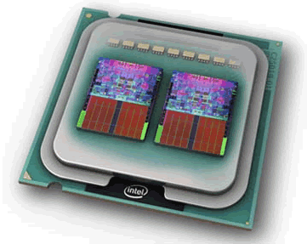
Multicores are the future!
Their caches are visibly central…
> 80% of chips
shipped will be
multi-core
(photo courtesy of Intel Corporation.)
Notes:
A caching hierarchy can be designed either as inclusive, exclusive, and non-inclusive. Referring to our 2-level protocol, “inclusive” means the content of the L1 cache is a subset of the L2 cache. “Exclusive” means that any block that is present in an L1 cache, it cannot be present in the L2 cache in the same cluster. And “non-inclusive” lies between inclusive and exclusive.
In fact, we can take inclusive and exclusive as special cases of non-inclusive protocols. So it can be said that if we can effectively verify non-inclusive protocols, we can actually verify the protocol with any caching policy.

Slide 3
Hierarchical Cache Coherence Protocols will play a major role in multi-core processors
Chip-level protocols
Intra-cluster protocols
…
mem
mem
dir
dir
Inter-cluster protocols
State Space grows multiplicatively across the hierarchy!
Verification will become harder
Notes:
Nowadays, multiple core architecture has been chosen as the choice for future processors.
Given that single-core performance has hit various limits, future processors will be based on multi-cores.
With servers using multicores, there naturally exists a memory hierarchy where cache coherence protocols are used.
As an example, this figure shows a three level protocol hierarchy across which coherence is maintained.
Such organizations will be commonplace, requiring systematic ways of specifying and verifying the protocols

Slide 4
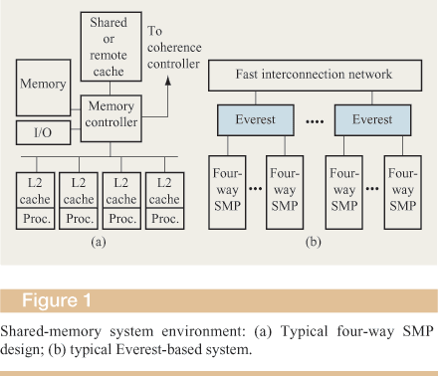
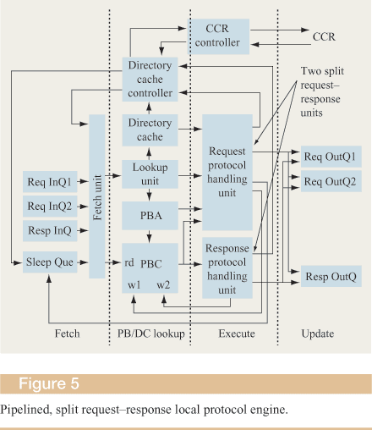
Protocol design happens in “the thick of things” (many interfaces, constraints of performance, power, testability).
From “High-throughput coherence control and hardware messaging in
Everest,” by Nanda et.al., IBM J.R&D 45(2), 2001.
Notes:
Secondly, non-inclusion can make the local dir have an imprecise record of a cache copy. Here we show a simple scenario of how the imprecision could happen. At the beginning, L1 cache-1 and the L2 cache have a shared copy in remote cluster-1. In step 1, L2 swaps the cache line out, and the record in the local dir is also removed. In step 2, L1 cache-2 requests a shared copy. As the local dir doesn’t have any information about this line, it broadcasts this request inside the cluster. In step 4, L1 cache-1 NAcks the request, as it only has a shared copy. The reason is that the broadcasting messages can be interleaved with an invalidation messages coming from outside the cluster. So it is not safe for a shared copy to supply its data when receiving a broadcasting message.
In step 5, the request is forwarded to the global dir, and it is granted in step 6. At this time, because the local dir has lost the information that L1 cache-1 has a shared copy, it can only record that L1 cache-2 has a valid copy for this line. Thus, imprecision happens.
This problem can be solved by conservatively recording all L1 caches as shared under such situations, as the global dir always has conservative information of which cluster has valid copies.

Slide 5
Future Coherence Protocols
Cache coherence protocols that are tuned for the contexts in which they are operating can significantly increase performance and reduce power consumption [Liqun Cheng]
  Producer-consumer sharing pattern-aware protocol [Cheng et.al, HPCA07]
    21% speedup and 15% reduction in network traffic
  Interconnect-aware coherence protocols [Cheng et.al., ISCA06]
    Heterogeneous Interconnect
    Improve performance AND reduce power
    11% speedup and 22% wire power savings
  Bottom-line: Protocols are going to get more complex!
Notes:
A caching hierarchy can be designed either as inclusive, exclusive, and non-inclusive. Referring to our 2-level protocol, “inclusive” means the content of the L1 cache is a subset of the L2 cache. “Exclusive” means that any block that is present in an L1 cache, it cannot be present in the L2 cache in the same cluster. And “non-inclusive” lies between inclusive and exclusive.
In fact, we can take inclusive and exclusive as special cases of non-inclusive protocols. So it can be said that if we can effectively verify non-inclusive protocols, we can actually verify the protocol with any caching policy.

Slide 6
Complexity of Design and Validation
Reasons for design complexity growth
  Performance oriented designs pushing envelope
  Need for Scalability, Error Recoverability
Validation approaches, and need to scale
  Ad-hoc testing yields poor coverage
  Dynamic Verification:
    Effective, but comes late
    Can also have poor coverage
    Debugging bugs is not easy
      Too much happens before bug triggered
  Need to Scale Formal Verification is Unarguable

Slide 7
Leverage Due to Automated FV
Well-built abstract verification models can inexpensively cover vast amounts of the concurrency space (often exhaustive)
Concurrency bugs show up in small domains
  Few address and data bits often sufficient
  Getting scheduling control during dynamic verification is non-trivial
Debugging is often easier, with FV

Slide 8
Designers have poor conceptual tools (e.g., “Informal MSC drawings”).
Need better notations and tools.
L1-1
L1-2
GDir
LDir
(S)
(I)
(S: L1-1)
Drop
Req_S
Broadcast
Fwd_Req
NAck
Gnt_S
(S: L1-2)
Gnt_S

Slide 9
FV Challenges
Even high-level verification models are complex
Need semantically well-specified simple notations
Need complexity mitigation methods
  Especially, given hierarchical nature of protocols
  Product state-space grows fast even for FV models
Must Ensure Correctness of final RTL
  Need modular approaches to achieve this

Slide 10
What changes when moving from a spec to an implementation?
Atomicity
Concurrency
Granularity in modeling
1
1.1
1.3
client
home
client
home
1.2
router
buffer

Slide 11
Design Abstractions in More Modern Flows
An Interleaving Protocol Model (Murphi or TLA+ are the languages of choice here)
  FV here eliminates concurrency bugs
Detailed HDL model
  FV here eliminates implementation bugs; however
    Correspondence with Interleaving Model is lost
      Need more detailed models anyhow
        Interleaving Models are very abstract
    Monolithic Verification of HDL Code Does not Scale
    Design optimizations captured at HDL level
      Interleaving model becomes more obsolete
Need an Integrated Flow:
  Interleaving -> High level HW View -> Final HDL

Slide 12
Outline
Cache coherence verification
Complexity of hierarchical protocols
Combating complexity thru Assume / Guarantee Verification – an Illustration
Salient details, including results
Toward Verified RTL – outline
Future work, discussions, Q/A

Slide 13
Notation for Spec. (and Imp.)
Based on Guarded Commands
  Rule1: g1 ==> a1
  Rule2: g2 ==> a2
  …
  RuleN: gN ==> aN
  Invariant P
Supported by tools such as Murphi (Stanford, Dill’s group)
Presents the behavior declaratively
  Good for specifying “message packet” driven behaviors
  Sequentially dependent actions can be strung using guards
“Rule Sets” can specify behaviors across axes of symmetry
  Processors, memory locations, etc.
Simple and Universally Understood Semantics

Slide 14
Model Transformations: Guard Weakening is Sound, but may give False Alarms
Weakening a guard is sound
  Rule1: g1 \/ Cond1 ==> a1
  Rule2: g2 ==> a2
  Invariant P
Reason: Rule1 fires more often
May get false alarms (P may fail if Rule1 fires spuriously)
For many “weak properties” P, we can “get away” by guard weakening
  This is a standard abstraction, first proposed by Kurshan (E.g. removing a module that is driving this module, letting inputs “dangle”)

Slide 15
Model Transformations: Guard Strengthening is, by itself, Unsound
Strengthening a guard is not sound
  Rule1: g1 /\ Cond1 ==> a1
  Rule2: g2 ==> a2
  Invariant P
Reason: Rule1 fires only when g1 /\ Cond1
So, less behaviors examined in checking P

Slide 16
Guard Strengthening can be made sound, if the conjunct is implied by the guard
This is sound
  Rule1: g1 /\ Cond1 ==> a1
  Rule2: g2 ==> a2
  Invariant P /\ g1 ==> Cond1
Reason: Rule1 fires only when g1 /\ Cond1
BUT, Cond1 is always implied by g1, so no real loss of states over which Rule1 fires…
  Call this “Guard Strengthening Supported by Lemma”
Lemma

Slide 17
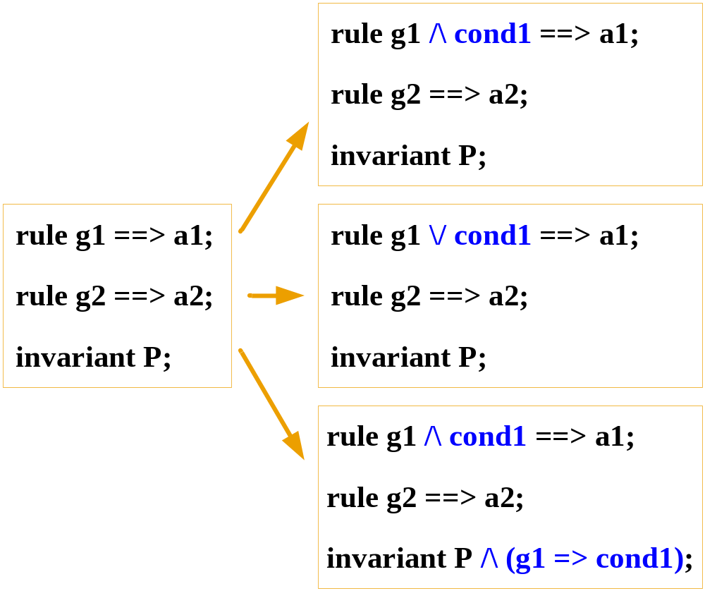
Summary of Transformations
X
✓
✓

Slide 18
Our Approach
Weaken to the Extreme
Then Strengthen Back Just Enough (to pass all properties)

Slide 19
Weaken to the Extreme
  Rule1: g1 \/ True ==> a1
  Rule2: g2 ==> a2
  Invariant P
i.e.
  Rule1: True ==> a1
  Rule2: g2 ==> a2
  Invariant P
“Are you kidding me?”

Slide 20
Strengthen Back Some
  Rule1: True /\ C1 ==> a1
  Rule2: g2 ==> a2
  Invariant P /\ g1 => C1
“Not Enough!”

Slide 21
Strengthen Back More
  Rule1: True /\ C1 ==> a1
  Rule2: g2 ==> a2
  Invariant P /\ g1 => C1
“Not Enough!”
  Rule1: True /\ C1 /\ C2 ==> a1
  Rule2: g2 ==> a2
  Invariant P /\ g1 => C1 /\ g1 => C2
“OK, just right!”

Slide 22
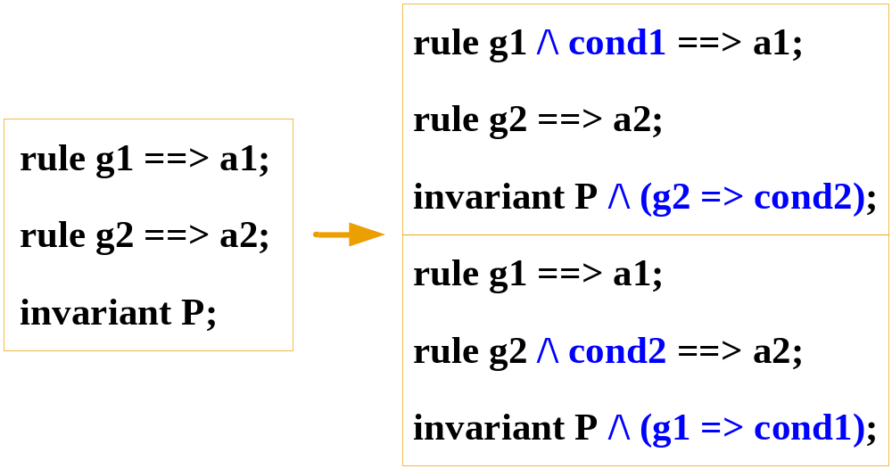
A Variation of Guard Strengthening Supported by Lemma:
Doing it in a meta-circular manner !!
✓
This is the approach in our work

Slide 23
An Example M-CMP Coherence Protocol
Intra-cluster
Remote Cluster 1
Home Cluster
Remote Cluster 2
L1 Cache
L1 Cache
L1 Cache
L1 Cache
L1 Cache
L1 Cache
L2 Cache+Local Dir
L2 Cache+Local Dir
L2 Cache+Local Dir
RAC
RAC
RAC
Global Dir
Main Mem
Inter-cluster
Notes:
In the study of verifying hierarchical coherence protocols, we developed a 2-level protocol, shown here in a multicore system.
As is typical in model checking based coherence verification, one address is modeled.
The home cluster is associated with the main memory for this address (“cluster” here is used as a CMP).
There are also two remote clusters, which are of identical design.
Inside each cluster, there are two processors, each with an L1 cache.
The L2 cache is shared by the two processors, and it contains all the contents of the L1 caches, i.e. inclusive.
“RAC” here stands for remote access controller. It is used to communicate with other clusters and the global dir.
The intra-cluster protocol is used to maintain the coherence within a cluster.
The local directory records which L1 cache has a valid copy, in which specific state.
The inter-cluster protocol is used to maintain the coherence among the clusters.
It only has the high-level information of which cluster has a valid copy, in which specific states.

Slide 24
Our approach:
1. Modeling
Given a protocol to verify, create a
verification model that models a small
number of clusters acting on a single
cache line
Verification Model
Home
Remote
Global directory
Inv P
Notes:
In the study of verifying hierarchical coherence protocols, we developed a 2-level protocol, shown here in a multicore system.
As is typical in model checking based coherence verification, one address is modeled.
The home cluster is associated with the main memory for this address (“cluster” here is used as a CMP).
There are also two remote clusters, which are of identical design.
Inside each cluster, there are two processors, each with an L1 cache.
The L2 cache is shared by the two processors, and it contains all the contents of the L1 caches, i.e. inclusive.
“RAC” here stands for remote access controller. It is used to communicate with other clusters and the global dir.
The intra-cluster protocol is used to maintain the coherence within a cluster.
The local directory records which L1 cache has a valid copy, in which specific state.
The inter-cluster protocol is used to maintain the coherence among the clusters.
It only has the high-level information of which cluster has a valid copy, in which specific states.

Slide 25
2. Exploit Symmetries
Model “home” and the two “remote”s
(one remote, in case of symmetry)
Verification Model
Inv P
Notes:
In the study of verifying hierarchical coherence protocols, we developed a 2-level protocol, shown here in a multicore system.
As is typical in model checking based coherence verification, one address is modeled.
The home cluster is associated with the main memory for this address (“cluster” here is used as a CMP).
There are also two remote clusters, which are of identical design.
Inside each cluster, there are two processors, each with an L1 cache.
The L2 cache is shared by the two processors, and it contains all the contents of the L1 caches, i.e. inclusive.
“RAC” here stands for remote access controller. It is used to communicate with other clusters and the global dir.
The intra-cluster protocol is used to maintain the coherence within a cluster.
The local directory records which L1 cache has a valid copy, in which specific state.
The inter-cluster protocol is used to maintain the coherence among the clusters.
It only has the high-level information of which cluster has a valid copy, in which specific states.

Slide 26
3. Create Abstract Models
(three models in this example)
Inv P1
Inv P2
Inv P
Inv P3
Notes:
In the study of verifying hierarchical coherence protocols, we developed a 2-level protocol, shown here in a multicore system.
As is typical in model checking based coherence verification, one address is modeled.
The home cluster is associated with the main memory for this address (“cluster” here is used as a CMP).
There are also two remote clusters, which are of identical design.
Inside each cluster, there are two processors, each with an L1 cache.
The L2 cache is shared by the two processors, and it contains all the contents of the L1 caches, i.e. inclusive.
“RAC” here stands for remote access controller. It is used to communicate with other clusters and the global dir.
The intra-cluster protocol is used to maintain the coherence within a cluster.
The local directory records which L1 cache has a valid copy, in which specific state.
The inter-cluster protocol is used to maintain the coherence among the clusters.
It only has the high-level information of which cluster has a valid copy, in which specific states.

Slide 27
4. Initial abstraction will be extreme; slowly back-off from this extreme…
Inv P1
Inv P2
P1 fails
Diagnose failure
  Bug
    report to user
  False Alarm
    Diagnose where guard
    is overly weak
    Add Strengthening Guard
    Introduce Lemma to ensure
    Soundness of Strengthening
Inv P3
Notes:
In the study of verifying hierarchical coherence protocols, we developed a 2-level protocol, shown here in a multicore system.
As is typical in model checking based coherence verification, one address is modeled.
The home cluster is associated with the main memory for this address (“cluster” here is used as a CMP).
There are also two remote clusters, which are of identical design.
Inside each cluster, there are two processors, each with an L1 cache.
The L2 cache is shared by the two processors, and it contains all the contents of the L1 caches, i.e. inclusive.
“RAC” here stands for remote access controller. It is used to communicate with other clusters and the global dir.
The intra-cluster protocol is used to maintain the coherence within a cluster.
The local directory records which L1 cache has a valid copy, in which specific state.
The inter-cluster protocol is used to maintain the coherence among the clusters.
It only has the high-level information of which cluster has a valid copy, in which specific states.

Slide 28
Step 1 of Refinement
Inv P1
Inv P2
Inv P1
Inv P2
Inv P3
Inv P3’
Notes:
In the study of verifying hierarchical coherence protocols, we developed a 2-level protocol, shown here in a multicore system.
As is typical in model checking based coherence verification, one address is modeled.
The home cluster is associated with the main memory for this address (“cluster” here is used as a CMP).
There are also two remote clusters, which are of identical design.
Inside each cluster, there are two processors, each with an L1 cache.
The L2 cache is shared by the two processors, and it contains all the contents of the L1 caches, i.e. inclusive.
“RAC” here stands for remote access controller. It is used to communicate with other clusters and the global dir.
The intra-cluster protocol is used to maintain the coherence within a cluster.
The local directory records which L1 cache has a valid copy, in which specific state.
The inter-cluster protocol is used to maintain the coherence among the clusters.
It only has the high-level information of which cluster has a valid copy, in which specific states.

Slide 29
Step 2 of Refinement
Inv P1
Inv P2
Inv P1
Inv P2
Inv P3
Inv P3’
Inv P1
Inv P2’
Inv P3’
Notes:
In the study of verifying hierarchical coherence protocols, we developed a 2-level protocol, shown here in a multicore system.
As is typical in model checking based coherence verification, one address is modeled.
The home cluster is associated with the main memory for this address (“cluster” here is used as a CMP).
There are also two remote clusters, which are of identical design.
Inside each cluster, there are two processors, each with an L1 cache.
The L2 cache is shared by the two processors, and it contains all the contents of the L1 caches, i.e. inclusive.
“RAC” here stands for remote access controller. It is used to communicate with other clusters and the global dir.
The intra-cluster protocol is used to maintain the coherence within a cluster.
The local directory records which L1 cache has a valid copy, in which specific state.
The inter-cluster protocol is used to maintain the coherence among the clusters.
It only has the high-level information of which cluster has a valid copy, in which specific states.

Slide 30
Final Step of Refinement
Inv P1
Inv P2
Inv P1
Inv P2
Inv P3
Inv P3’
Inv P1’
Inv P2’
Inv P1
Inv P2’
Inv P3’
Inv P3’’
Notes:
In the study of verifying hierarchical coherence protocols, we developed a 2-level protocol, shown here in a multicore system.
As is typical in model checking based coherence verification, one address is modeled.
The home cluster is associated with the main memory for this address (“cluster” here is used as a CMP).
There are also two remote clusters, which are of identical design.
Inside each cluster, there are two processors, each with an L1 cache.
The L2 cache is shared by the two processors, and it contains all the contents of the L1 caches, i.e. inclusive.
“RAC” here stands for remote access controller. It is used to communicate with other clusters and the global dir.
The intra-cluster protocol is used to maintain the coherence within a cluster.
The local directory records which L1 cache has a valid copy, in which specific state.
The inter-cluster protocol is used to maintain the coherence among the clusters.
It only has the high-level information of which cluster has a valid copy, in which specific states.

Slide 31
A non-trivial M-CMP Coherence Protocol was verified in this manner…
Intra-cluster
Remote Cluster 1
Home Cluster
Remote Cluster 2
L1 Cache
L1 Cache
L1 Cache
L1 Cache
L1 Cache
L1 Cache
L2 Cache+Local Dir
L2 Cache+Local Dir
L2 Cache+Local Dir
RAC
RAC
RAC
Global Dir
Main Mem
Inter-cluster
Notes:
In the study of verifying hierarchical coherence protocols, we developed a 2-level protocol, shown here in a multicore system.
As is typical in model checking based coherence verification, one address is modeled.
The home cluster is associated with the main memory for this address (“cluster” here is used as a CMP).
There are also two remote clusters, which are of identical design.
Inside each cluster, there are two processors, each with an L1 cache.
The L2 cache is shared by the two processors, and it contains all the contents of the L1 caches, i.e. inclusive.
“RAC” here stands for remote access controller. It is used to communicate with other clusters and the global dir.
The intra-cluster protocol is used to maintain the coherence within a cluster.
The local directory records which L1 cache has a valid copy, in which specific state.
The inter-cluster protocol is used to maintain the coherence among the clusters.
It only has the high-level information of which cluster has a valid copy, in which specific states.

Slide 32
Abstract Protocols Created
Cluster 1
Cluster 2
L1 Cache
L1 Cache
ABS #2
L1 Cache
L1 Cache
ABS #1
L2 Cache+Local Dir
L2 Cache+Local Dir
Cluster 1
Cluster 2
L2 Cache+Local Dir’
L2 Cache+Local Dir’
Global Dir
Main Mem
ABS #3
Notes:
This figure intuitively shows the abstract protocols.
Because the two remote clusters are of the same design, two of the abstract protocols are the same.
So we only show the three distinct protocols here.
In fact, if the three clusters are symmetric, then we only need to create two abstract protocols, one for intra-cluster
and the other for inter-cluster protocol.
The 1st one is the intra-cluster protocol for the home cluster.
The 2nd is the intra- protocol for the remote cluster 1, and the intra- protocol for remote cluster-2 is the same.
The 3rd one is the inter-cluster protocol.
In fact, if the inter-cluster protocol uses a big configuration, e.g. it has 16 or 32 abstracted clusters, then we can combine our approach with Ching Tsun’s parameterized verification, because they are orthogonal.

Slide 33
Protocol Features
Both levels use MESI protocols
Silent drop on non-Modified cache lines
Network channels are non-FIFO
Notes:
In detail, both levels of the protocol use the MESI protocol, which has more features than the simple ESI protocol.
For example, it allows silent drop on non-Modified cache lines.
The intra-cluster uses a protocol similar to the Stanford Flash protocol, and the inter-cluster uses one similar to the DASH protocol.
Flash and DASH are both invalidation-based directory protocols, and they are similar to those being designed and used in practice.
Finally, the network channels are modeled non-FIFO.
That is, messages can arrive out of order.
This can model different hardware implementations for the networking.

Slide 34
High Level Modeling of the Protocol
Tool
  Murphi
  ~ 30 pages of description
Properties to be verified
  No two caches can be both exclusive/modified
  Each coherence read will get the latest copy

Slide 35
A Sample Scenario
Remote Cluster 1
Home Cluster
Remote Cluster 2
Excl
Invld
4. Fwd Req_Ex
5. Grant
1. Req_Ex
6. Grant
3. Fwd Req_Ex
2. Fwd Req_Ex

Slide 36
Map to Abstracted Protocols
Remote Cluster 1
Remote Cluster 2
Excl
Invld
4. Fwd Req_Ex
5. Grant
1. Req_Ex
6. Grant
3. Fwd Req_Ex
2. Fwd Req_Ex

Slide 37
Verification Complexity of the Protocol
Algorithm
  BFS explicit state enumeration (standard approach – tried before our approach was used)
Complexity
  >30 hours running
  40-bit hash compaction of Murphi
  18GB of memory
  Model checking could not complete

Slide 38
An Example of Abstraction
L1 Cache
L1 Cache
Clusters[c].WbMsg.Cmd = WB
Clusters[c].L2.Data := Clusters[c].WbMsg.Data;
Clusters[c].L2.HeadPtr := L2; …
WB
L2 Cache+Local Dir
RAC
Abstract intra-cluster protocol
Notes:
For example, here we show one transition in the original protocol, in which the local dir of a cluster receives a WB request from an L1 cache. On receiving this request, the L2 cache stores the latest copy, and the local dir sets the real owner of the cluster to be the L2 cache, and so on.
After abstraction, the guard of this rule becomes “true”, because “WbMsg” is removed.
And the action becomes “L2.Data := nondet”. Here “nondet” is a nondeterministic data copy.
And the second stmt is removed, because “HeadPtr” is removed.

Slide 39
An Example of Abstraction
L1 Cache
L1 Cache
Clusters[c].WbMsg.Cmd = WB
Clusters[c].L2.Data := Clusters[c].WbMsg.Data;
Clusters[c].L2.HeadPtr := L2; …
WB
L2 Cache+Local Dir
RAC
Abstract intra-cluster protocol
L2 Cache+Local Dir’
RAC
Abstract inter-cluster protocol
Notes:
For example, here we show one transition in the original protocol, in which the local dir of a cluster receives a WB request from an L1 cache. On receiving this request, the L2 cache stores the latest copy, and the local dir sets the real owner of the cluster to be the L2 cache, and so on.
After abstraction, the guard of this rule becomes “true”, because “WbMsg” is removed.
And the action becomes “L2.Data := nondet”. Here “nondet” is a nondeterministic data copy.
And the second stmt is removed, because “HeadPtr” is removed.

Slide 40
An Example of Abstraction
L1 Cache
L1 Cache
Clusters[c].WbMsg.Cmd = WB
Clusters[c].L2.Data := Clusters[c].WbMsg.Data;
Clusters[c].L2.HeadPtr := L2; …
WB
L2 Cache+Local Dir
RAC
Abstract intra-cluster protocol
L2 Cache+Local Dir’
True
Clusters[c].L2.Data := nondet; …
RAC
Abstract inter-cluster protocol
Notes:
For example, here we show one transition in the original protocol, in which the local dir of a cluster receives a WB request from an L1 cache. On receiving this request, the L2 cache stores the latest copy, and the local dir sets the real owner of the cluster to be the L2 cache, and so on.
After abstraction, the guard of this rule becomes “true”, because “WbMsg” is removed.
And the action becomes “L2.Data := nondet”. Here “nondet” is a nondeterministic data copy.
And the second stmt is removed, because “HeadPtr” is removed.

Slide 41
An Example of Constraining
L2 Cache+Local Dir’
True
Clusters[c].L2.Data := nondet; …
RAC
L1 Cache
L1 Cache
WB
L2 Cache+Local Dir
RAC
Notes:
For example, here we consider the writeback example again.
The abstract rule means that the L2 cache line can be updated arbitrarily. This is clearly too permissive.
So we strengthen the condition under which this rule can be fired. Specifically, we add the condition that only when the L2 cache
line is in Exclusive state, can its line be updated.
At the same time, we add a new verification property in the abstract intra-cluster protocols, saying whenever there is a writeback
Request from a L1 cache, the L2 cache line must be exclusive.
In fact, this property only holds for inclusive cache organizations, not for non-inclusive caches. I’ll soon show how to solve
this problem.
Basically, this is the basic idea of assume guarantee reasoning. That is, we introduce a set of assumptions, and at the same time, we
prove them. The proof is based on an induction.

Slide 42
An Example of Constraining
L2 Cache+Local Dir’
True &
Clusters[c].L2.State = Excl
Clusters[c].L2.Data := nondet; …
RAC
L1 Cache
L1 Cache
WB
Clusters[c].WbMsg.Cmd = WB
Clusters[c].L2.State = Excl
L2 Cache+Local Dir
RAC
Lemma
Notes:
For example, here we consider the writeback example again.
The abstract rule means that the L2 cache line can be updated arbitrarily. This is clearly too permissive.
So we strengthen the condition under which this rule can be fired. Specifically, we add the condition that only when the L2 cache
line is in Exclusive state, can its line be updated.
At the same time, we add a new verification property in the abstract intra-cluster protocols, saying whenever there is a writeback
Request from a L1 cache, the L2 cache line must be exclusive.
In fact, this property only holds for inclusive cache organizations, not for non-inclusive caches. I’ll soon show how to solve
this problem.
Basically, this is the basic idea of assume guarantee reasoning. That is, we introduce a set of assumptions, and at the same time, we
prove them. The proof is based on an induction.

Slide 43
Handling Non-inclusive Protocols
L2 state does not imply L1 state
Use History Variables to infer L2 state
  details in our HLDVT’07 paper

Slide 44
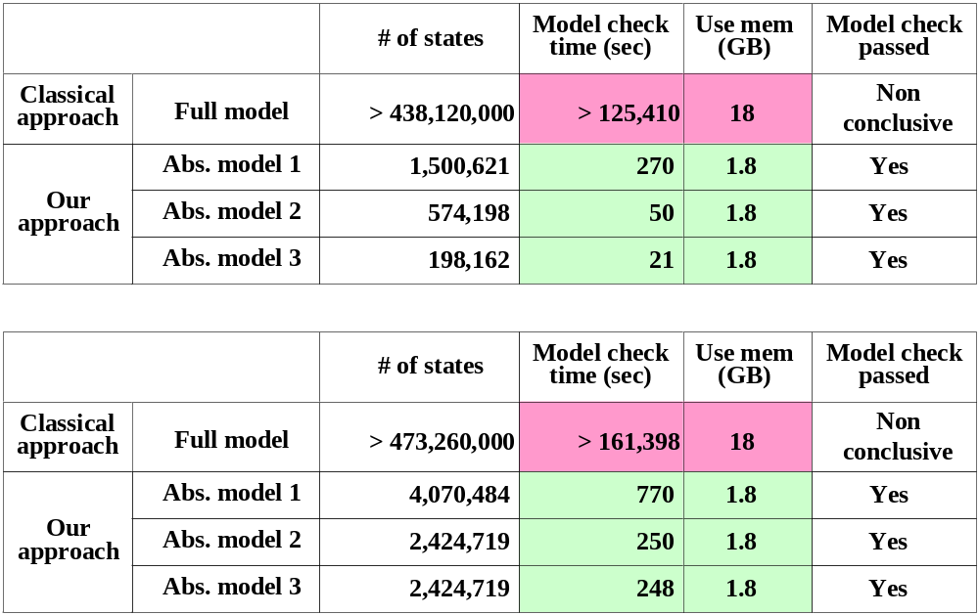
Final Results Using Our Approach:
Results for an Inclusive M-CMP Protocol and a
Non-Inclusive Protocol (respectively) are shown

Slide 45
Automatic Recognition of Spurious / Real Bugs
Problem statement
  Given an error trace of ABS protocol
  Is it a real bug of the original protocol?
Solution
  Search for traces whose projections are stuttering equivalent to the observed traces
  Efficient implementations of this solution are under investigation
  We also hope to synthesize some Lemmas automatically using heuristics…

Slide 46
Basic Idea of Automatic Recognition
Error trace of Abs. protocol
Directed BFS of original protocol
v1=0, v2=0
v1=0, v2=0, v3=0
drop
keep
keep
v1=1, v2=2
v1=3, v2=1, v3=0
v1=1, v2=2, v3=1
v1=0, v2=0, v3=3
……
……
……
v1=6, v2=8

Slide 47
A More Detailed Illustration on a Toy Protocol
Cluster 1
Cluster 2
L1 Cache
L1 Cache
L1 Cache
L1 Cache
L2 Cache+Local Dir
L2 Cache+Local Dir
Global Dir
Main Mem

Slide 48
The state elements
rR
rR
rR
rR
s
p
s
s
s
p
s
s
r
R
r
R
rR
rR
Cluster 1
Cluster 2

Slide 49
The Abstractions
rR
rR
rR
rR
s
p
s
s
s
p
s
s
r
R
r
R
rR
rR
Intra
Inter/2

Slide 50
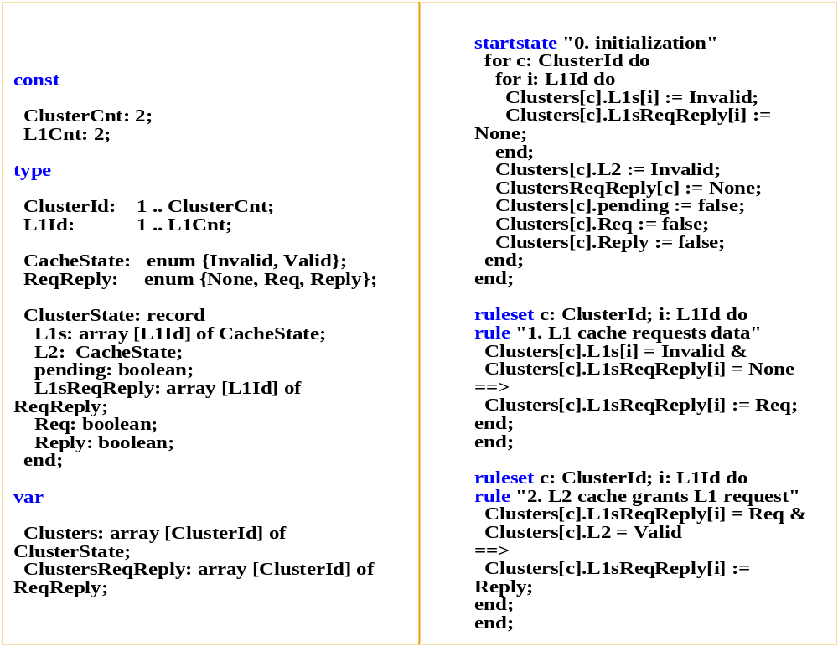

Slide 51
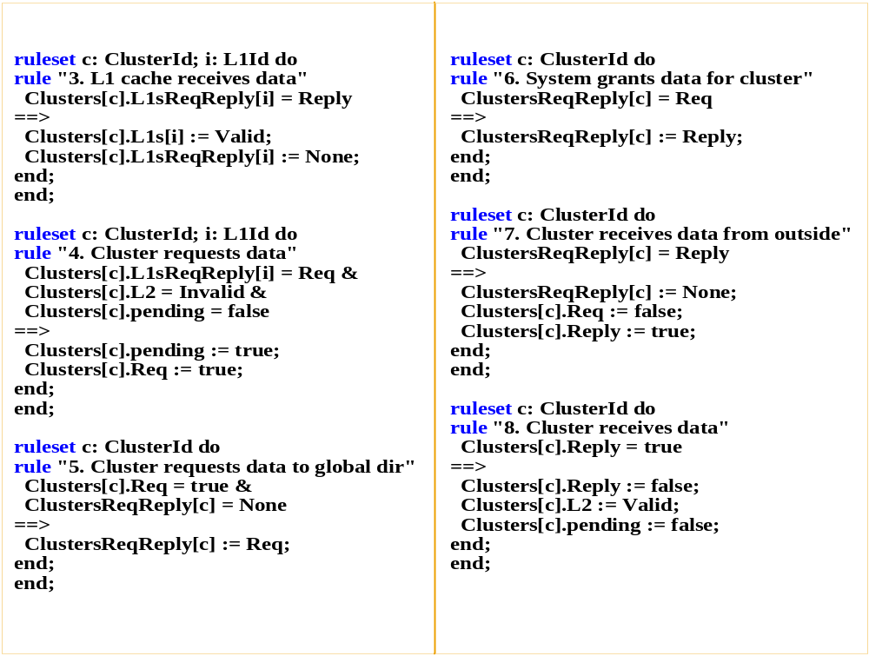

Slide 52
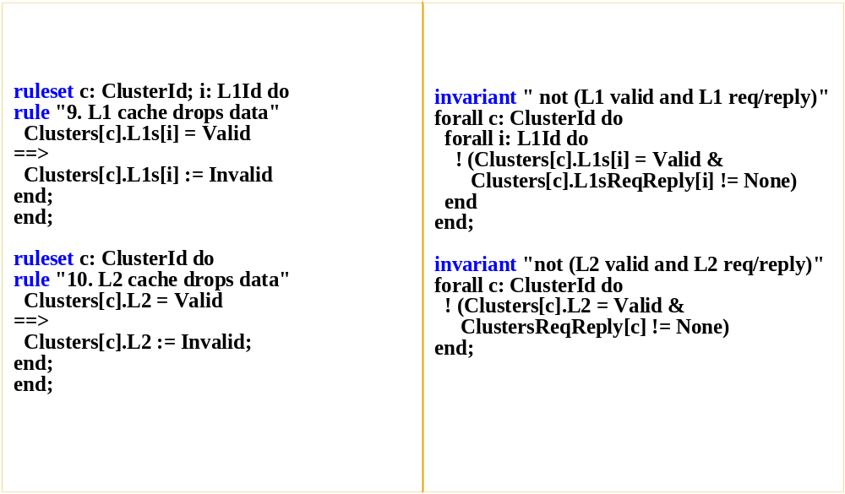

Slide 53
Our Approach
Decomposition
Assume guarantee reasoning
Notes:
To solve this problem, we use a compositional approach.
The basic idea is to use decomposition and refinement.

Slide 54
1. Decomposition
Original protocol
Notes:
In more detail, suppose this is the original protocol.
We first split this protocol into a set of smaller and abstracted protocols, such that they collectively overapproximate the original protocol.
Here, we use the polygons to represent three abstract protocols.

Slide 55
2. Refinement
Notes:
After that, we constrain each abstract protocol back to an appropriate state space.
This constraining is done in a counterexample guided manner, i.e. when we model check an abstract protocol, error traces will be generated corresponding to the overapproximation or genuine bugs.
For genuine bugs, we fix them and regenerate abstract protocols; for spurious bugs, we do refinement.

Slide 56
Our Decomposition
Construct three abstract protocols
Each contains one flat protocol
Notes:
To reduce more on the verification complexity, our current approach uses the same techniques as we just presented.
It creates 4 abstract protocols, and each of them only contains one protocol, either intra-cluster or inter-cluster.

Slide 57
Experimental Results
State space
  symmetry w/o symmetry
  Hierarchical 966 3600
  Intra-cluster 28 46
  Inter-cluster 21 36
Notes:
The experimental results using the current approach are much better than the previous one.
As we can see, every abstract protocol can be completely model checked, using less than 2GB of memory, and within less than 5 minutes individually.

Slide 58
Example: Abstract Inter-Cluster Protocol
Cluster 1
Cluster 2
L2 Cache+Local Dir’
L2 Cache+Local Dir’
Global Dir
Main Mem

Slide 59
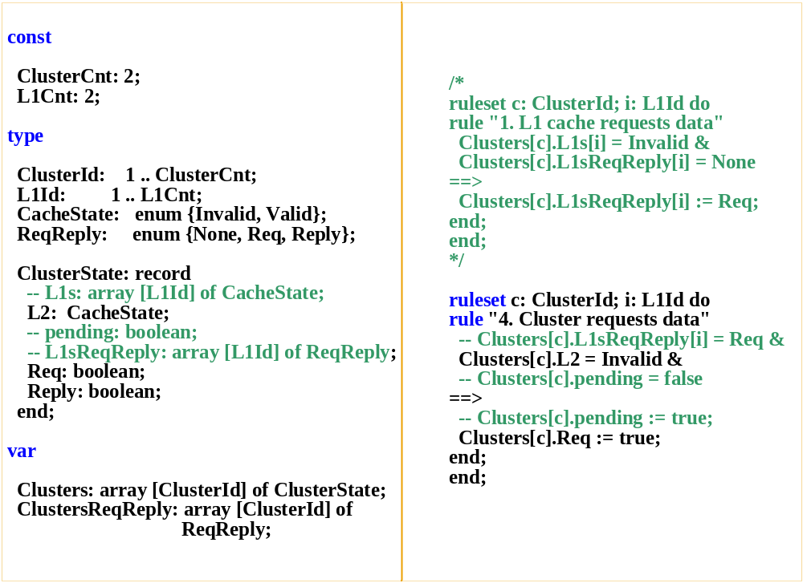

Slide 60
Example: Abstracted Intra-cluster Protocol
Cluster 1
L1 Cache
L1 Cache
L2 Cache+Local Dir

Slide 61
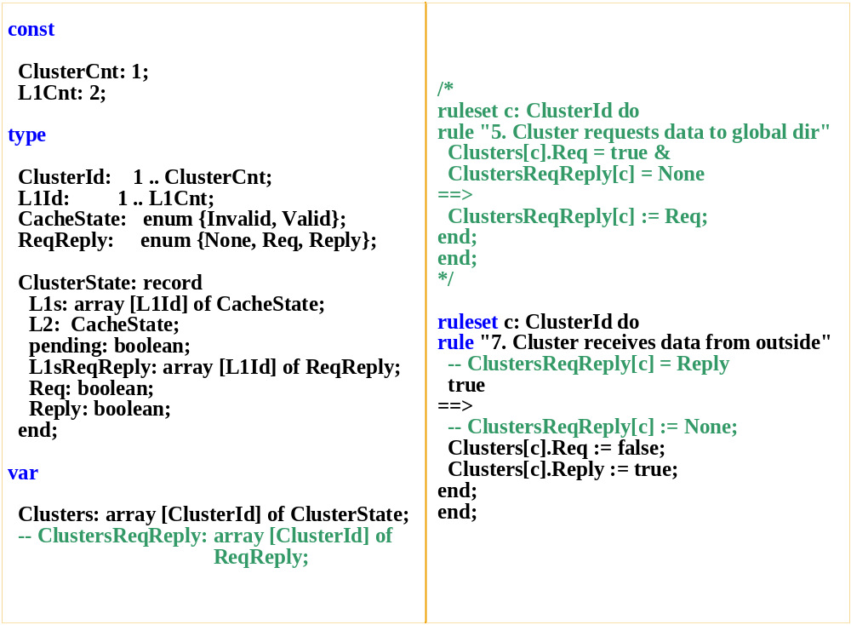

Slide 62
Overapproximation, Now Refinement
Notes:
Because of the overapproximation, when we model check the abstract protocols, counterexamples can be found.
For spurious bugs, we do the refinement.

Slide 63
Refinement
When a false alarm is encountered:
  Analyze and find out problematic rule
  g → a
  Find out original rule in M
  G → A
  Add a new invariant in one abstract protocol
  G P
  Strengthen rule into: g Λ P → a
Notes:
In more detail, when a bogus error is found in an abstract protocol,
We first find out the rule in the abstracted protocol which is too permissive
We then find out the corresponding rule in the original protocol
Then we add a new verification obligation in one abstract protocol. The question of which one to add this, depends on which one has the details to prove it. We will show a simple example soon.
It is worthwhile mention that the new invariant is in the form of the guard of the original rule, G, implies some expr P, and all the variables in P are in the current abstract protocol.
Finally, we strengthen the too permissive rule with P.

Slide 64
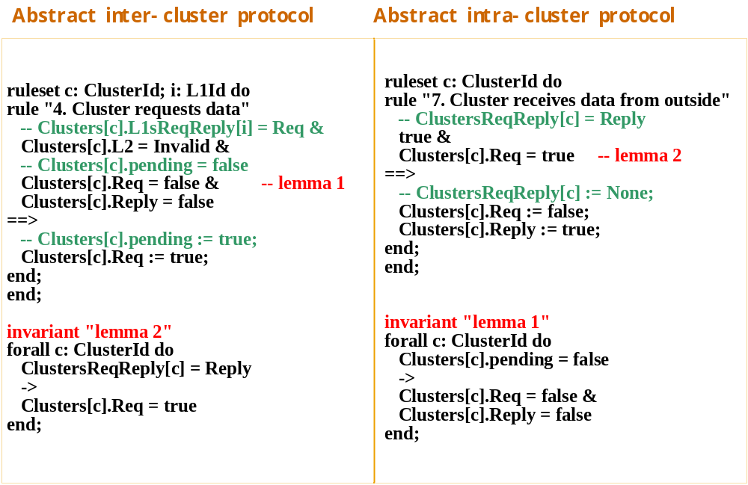

Slide 65
Some Details of RTL Verification
Need a notation to describe RTL implementation behavior formally
Need a formal notion of correspondence
Need an efficient way of checking correspondence
Notes:
Here is the conclusion of our work.
In the study of verifying hierarchical cache coherence protocols, we developed a compositional approach, using abstraction and counter-example guided refinement, and we also extended it slightly for non-inclusive protocols.
We believe that this approach can be applied to verify other hierarchical protocols as well.

Slide 66
Differences in Modeling: Specs vs. Impls
Multiple steps in low-level
One step in high-level
1.3
1
1.1
1.2
home
1.4
remote
home
remote
router
buf
1.5
Notes:
For the second problem, i.e. to check if a RTL impl correctly implements the spec, let’s first look at what is the difference between the high-level and RTL models.
First, one step in the high-level is usually implemented in the low-level by multiple steps.
For example, here we show one step in the high-level is implemented by 5 steps in the low-level.

Slide 67
Differences in Execution between Spec and Implementation
Interleaving in HL
Concurrency in LL
Notes:
Second, in the high-level, every time, at most one step is executed.
While in the low-level, multiple steps can be executed concurrently in the same cycle.
For example, here we show 3 steps in the high-level model, they are mapped into altogether 8 steps in the low-level, executed in 5 clock cycles.
With these differences in modeling and execution, the classical equivalence checkers cannot help much to check the correct implementation.
So we need a new theory and a tool to check this.

Slide 68
Workflow of Our Refinement Check
Murphi
Spec model
Product model in
Hardware Murphi
Muv
Product model
in VHDL
Property check
Hardware Murphi
Impl model
Check implementation meets specification
Notes:
Here is an overview of how our approach works.
Given two models, one spec model in Murphi, and the other impl model in HMurphi, we first combine them into a model in HMurphi.
Because HMurphi is an extension of Murphi, so it can represent the entire Murphi language.
We then translate the HMurphi model into VHDL, using muv.
Muv is a tool developed here by Steven and Geert, and I also worked on it in the summer.
It translates HMurphi to VHDL.
The choice of translating into VHDL, is to take advantage of existing VHDL verification tools in IBM.
In theory, it can translate HMurphi into other languages as well.
Finally, we do property checking on the VHDL model, to check the low-level impl correctly implements the high-level spec.

Slide 69
A Simple Impl. was Verified Using Refinement Checking
Dir
Cache
Mem
Buf
Local
Buf
Home
Buf
Remote
Router
Dir
Cache
Mem
Buf
Local
Buf
Home
Buf
Remote
S. German and G. Janssen, IBM Research Tech Report 2006
Notes:
We have applied our refinement check to a driving coherence protocol example, developed by Steven German and Geert Janssen.
This example models two addresses, and two nodes, and the low-level model has some realistic features of hardware protocols.
As shown here, each node in the low-level contains three protocol processing units, local, home and remote units.
All the processing units can be active at the same time. So a unit may have to wait several clock cycles before it can access a shared resource.
In more detail, the local unit is for the current node to generate new coherence requests.
The remote unit is for the current node to process requests from outside the node.
Messages generated from the nodes all flow through the router unit in the system.
In every cycle, the router can at most transfer one message from the source node, to the destination buffer.

Slide 70
Summary
Method to handle hierarchical protocols at a higher level (guard → action rule) presented
Method can be carried out using a standard model checker (no special tools needed)
Human effort has been modest for us
  Still need to automate
    Distinguishing False Alarms from Genuine Errors
    Synthesizing Lemmas
  Deepens one’s understanding of the protocol
Dramatic savings in verification time and # states
Module-level verification of RTL implementations against higher level spec has been developed
  Need to extend this to cover hierarchical protocols
Notes:
For the future work, right now, we are mechanizing the abstraction process.
That is, given a hierarchical protocol, and the set of state variables to be projected away, we try to automatically generate the abstract protocol.
After abstraction, we also need to recognize if an error obtained in the abstract protocols is a real bug in the original protocol.
And if it is a spurious error, then we need to find the appropriate property to strengthen it.
How to automate all these, is the future direction we will work on.
For the automatic recognition of spurious/real bugs, previously we had thought of using BFS guided search, to try to find a stuttering equivalent trace in the original protocol. It turns out this approach still has the state explosion problem. We have some thoughts on how to adapt the approach to solve the problem, but we haven’t implemented it yet.

Slide 71
Some References
Xiaofang Chen, Yu Yang, Ganesh Gopalakrishnan, and Ching Tsun Chou, “Reducing Verification Complexity of a Multicore Coherence Protocol Using Assume/Guarantee,” FMCAD 2006
Xiaofang Chen, Yu Yang, Michael Delisi, Ganesh Gopalakrishnan, and Ching Tsun Chou, “Hierarchical Cache Coherence Protocol Verification One Level at a Time Through Assume Guarantee,” HLDVT 2007
Xiaofang Chen, Steven M. German, and Ganesh Gopalakrishnan, “Transaction Based Modeling and Verification of Hardware protocols, FMCAD 2007
Ching Tsun Chou, Steven M. German, and Ganesh Gopalakrishnan, “Tutorial on Specification and Verification of Shared Memry Protocols and Consistency Models,” FMCAD 2004 (Slides available from our URL)
Notes:
For the future work, right now, we are mechanizing the abstraction process.
That is, given a hierarchical protocol, and the set of state variables to be projected away, we try to automatically generate the abstract protocol.
After abstraction, we also need to recognize if an error obtained in the abstract protocols is a real bug in the original protocol.
And if it is a spurious error, then we need to find the appropriate property to strengthen it.
How to automate all these, is the future direction we will work on.
For the automatic recognition of spurious/real bugs, previously we had thought of using BFS guided search, to try to find a stuttering equivalent trace in the original protocol. It turns out this approach still has the state explosion problem. We have some thoughts on how to adapt the approach to solve the problem, but we haven’t implemented it yet.

Slide 72
More References
http://www.bluespec.com
Arvind, R. Nikhil, D. Rosenband, and N. Dave, “High-level Synthesis: An Essential Ingredient for Designing Complex ASICs,” ICCAD 2004
Sharad Malik, “A Case for the Runtime Validation,” Keynote Address, IBM Verification Conference, Haifa, 13 November 2005 http://www.princeton.edu/~sharad
Jason F. Cantin, Mikko H. Lipasti, and James E. Smith, “Dynamic Verification of Cache Coherence Protocols.”
Daniel J. Sorin, Mark D. Hill, David A. Wood, “Dynamic Verification of End-to-End Microprocessor Invariants
Dennis Abts, David J. Lilja, and Steve Scott, “Toward Complexity-Effective Verification: A Case Study of the Cray SV2 Cache Coherence Protocol,” Workshop on Complexity-Effective Design (ISCA-2000 workshop)
Notes:
For the future work, right now, we are mechanizing the abstraction process.
That is, given a hierarchical protocol, and the set of state variables to be projected away, we try to automatically generate the abstract protocol.
After abstraction, we also need to recognize if an error obtained in the abstract protocols is a real bug in the original protocol.
And if it is a spurious error, then we need to find the appropriate property to strengthen it.
How to automate all these, is the future direction we will work on.
For the automatic recognition of spurious/real bugs, previously we had thought of using BFS guided search, to try to find a stuttering equivalent trace in the original protocol. It turns out this approach still has the state explosion problem. We have some thoughts on how to adapt the approach to solve the problem, but we haven’t implemented it yet.

