Slide 1

CS 6110, Software Correctness Analysis, Spring 2023 Lecture 9 : Declarative notations, First Order Logic
Ganesh Gopalakrishnan
School of Computing
University of Utah
Salt Lake City, UT 84112

Slide 2
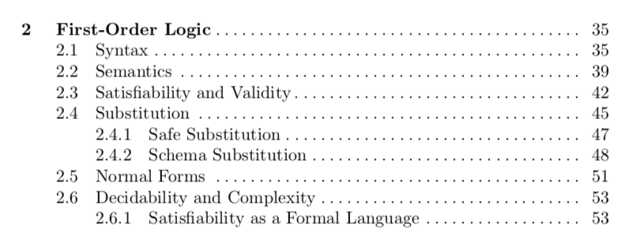
Excerpts from Bradley and Manna’s book
Let’s go through the basics of First Order Logic’s (FOL) syntax and semantics

Slide 3
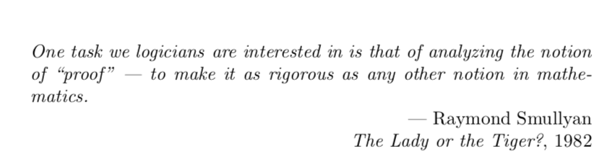
Excerpts from Bradley and Manna’s book

Slide 4
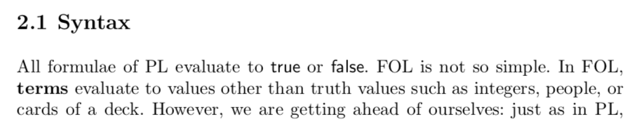
Excerpts from Bradley and Manna’s book

Slide 5
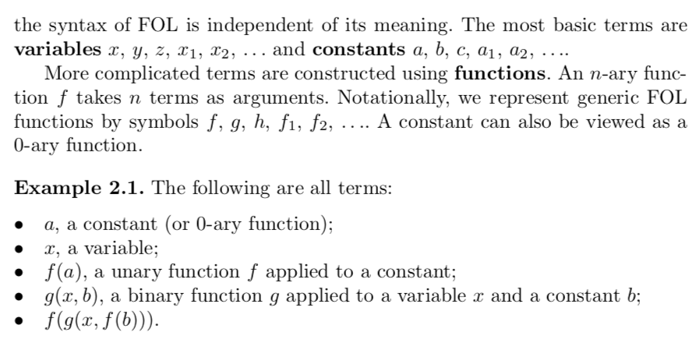
Excerpts from Bradley and Manna’s book

Slide 6
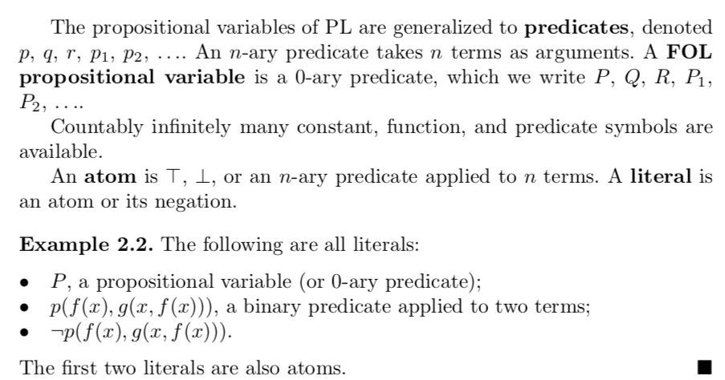
Excerpts from Bradley and Manna’s book

Slide 7
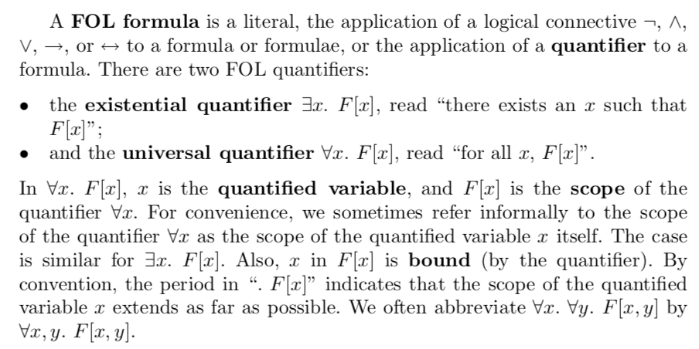
Excerpts from Bradley and Manna’s book

Slide 8
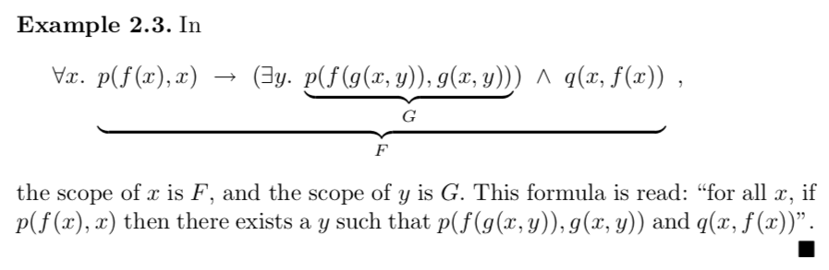
Excerpts from Bradley and Manna’s book

Slide 9
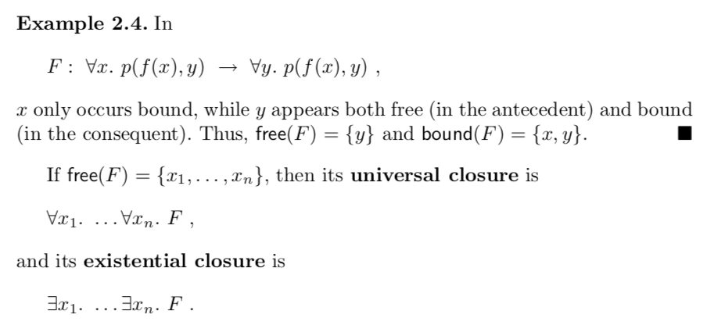
Excerpts from Bradley and Manna’s book
A formula is valid IFF its universal closure is valid
A formula is satisfiable IFF its existential closure is satisfiable

Slide 10
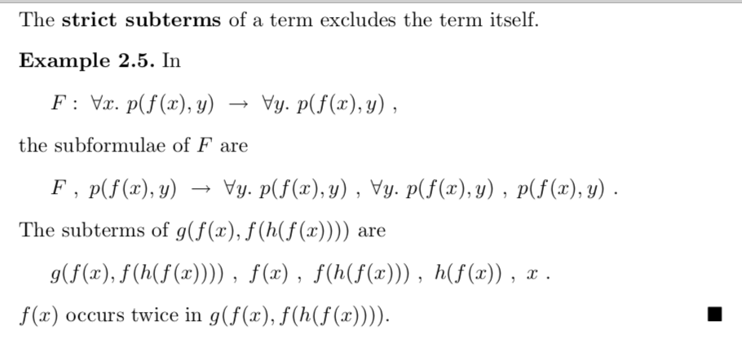
Excerpts from Bradley and Manna’s book

Slide 11
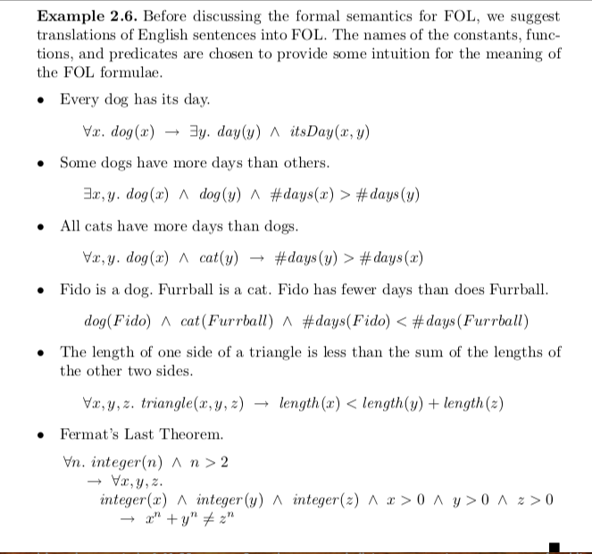
Excerpts from Bradley and Manna’s book

Slide 12
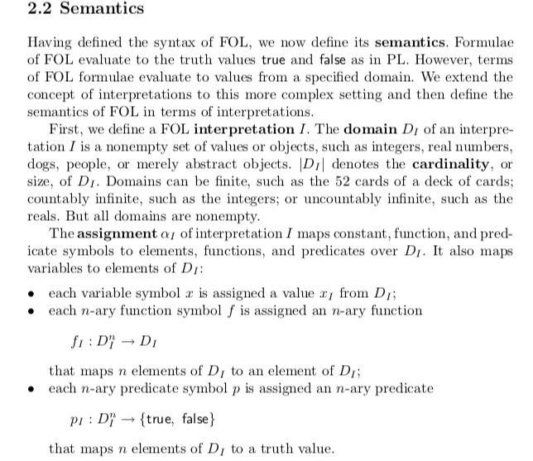
Excerpts from Bradley and Manna’s book
A “model” as generated by Z3
Or
An “instance” as generated
by Alloy
Are examples of ”Interpretations”
Domains of interpretation
Assignments

Slide 13
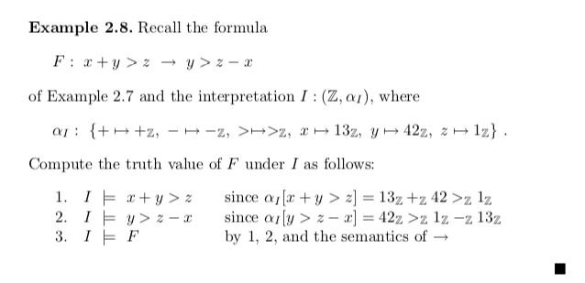
Excerpts from Bradley and Manna’s book

Slide 14
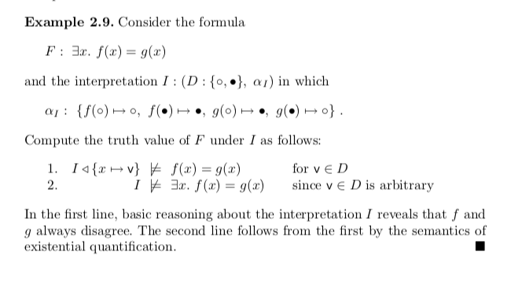
Excerpts from Bradley and Manna’s book

Slide 15
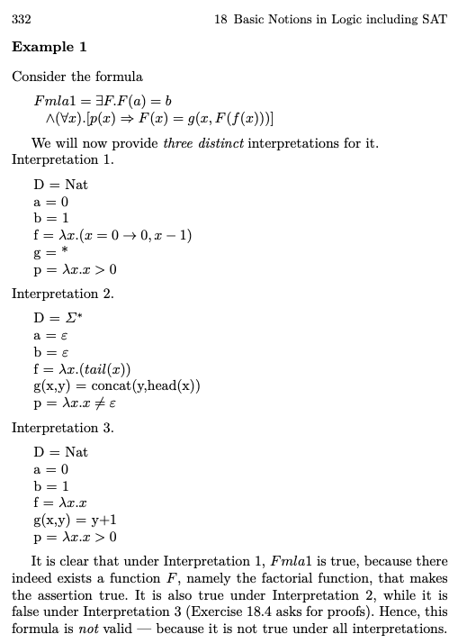
Examples from Manna’s original book about interpretation and validity

Slide 16
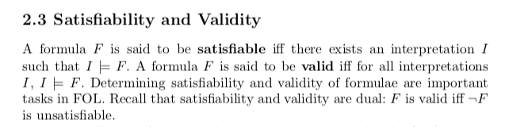
Excerpts from Bradley and Manna’s book
CVC used to be called SVC
Anyway , “V” = validity
But they always checked by negating and checking for unsat
Thus it really is a SAT (or SMT) tool … used to check validity via the above definition

Slide 17
Excerpts from Bradley and Manna’s book

Slide 18
Excerpts from Bradley and Manna’s book

Slide 19
Alloy checks asserts for validity by negating them and checking whether they are sat or not If Sat then … ? If Unsat then … ? Remember that any Boolean formula is * Valid * A contradiction (its negation is valid) * Neither – it and its negation are satisfiable

Slide 20
Alloy checks asserts for validity by negating them and checking whether they are sat or not If Sat then the original assertion is invalid If Unsat then the original assertion is valid Just to be thorough, we will (later) do this: * Write an assertion Assn * Write negAssn = !Assn * We will check both * If Assn’s “check” says “no counterexample, “Assn may be valid”, then ensure that !Assn is satisfiable (there is a counterexample for it) BUT if both Assn and !Assn generate counterexamples, then they are merely satisfiable but not valid AND also not contradictions !!

Slide 21
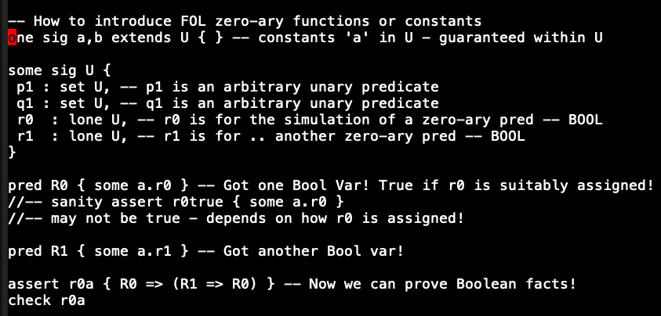
Encoding FOL zero-ary predicates (Bools)

Slide 22
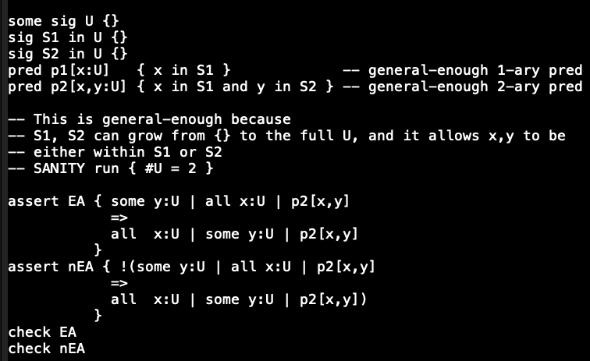
Encoding higher arity predicates

Slide 23
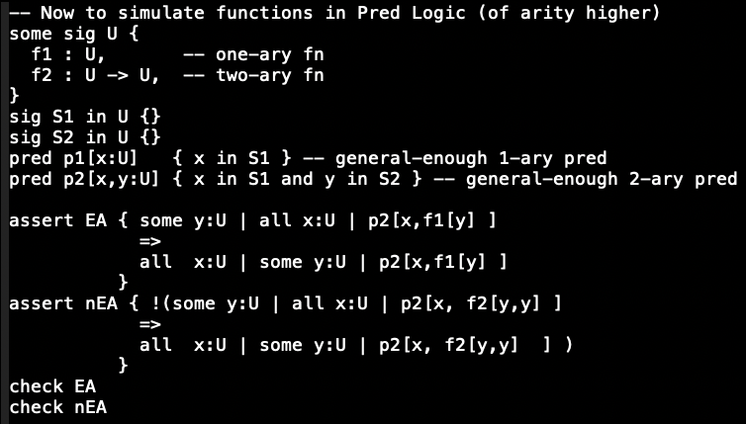
Functions encoded now

Slide 24
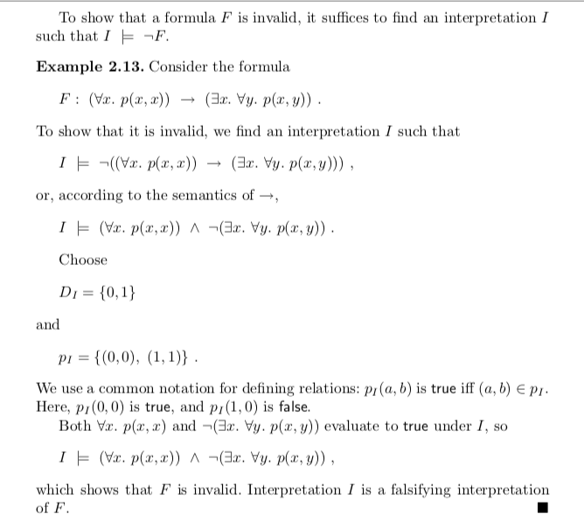
Excerpts from Bradley and Manna’s book

Slide 25
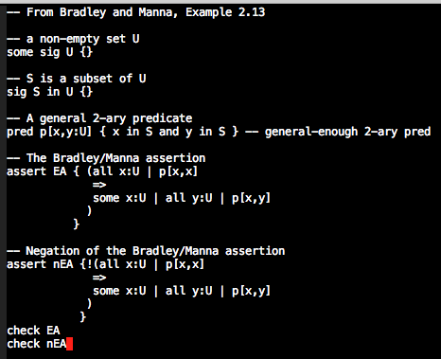
Excerpts from Bradley and Manna’s book

Slide 26
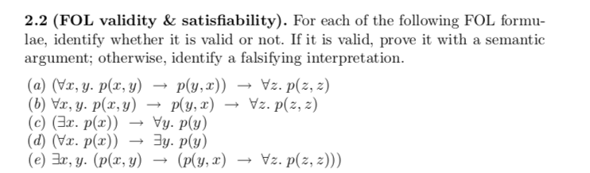
Excerpts from Bradley and Manna’s book

Slide 27
Seeding your FOL experience via a problem
See the solution to Sudoku in https://ericpony.github.io/z3py-tutorial/guide-examples.htm
Modify it to solve Kenken
I’ll give you the cage encoding in Python
See this folder – template Python file kenken-template.py
You should write the constraints and produce a Kenken solution

Slide 28
Finishing up our study of FOL
Review of notions about interpretations
See discussions about Interpretations in the Bradley/Manna book
Soundness and Completeness
Decidability

Slide 29
How do we systematically prove in FOL?
One needs proof systems and proof rules
FOL has a sound proof system (many, actually)
One such proof system is Natural deduction (others are Hibert-style, …)
Sound means if a theorem is proven using proof-rules, it is true
in the sematic model, or in the space of interpretations
More on it soon
Sound proof systems can be rather simple: have no proof rules!
No proofs means no unsoundness!
What more do we need for proof systems?

Slide 30
How do we systematically prove in FOL?
One needs proof systems and proof rules
FOL has a sound proof system (many, actually)
One such proof system is Natural deduction (others are Hibert-style, …)
Sound means if a theorem is proven using proof-rules, it is true
in the sematic model, or in the space of interpretations
More on it soon
Sound proof systems can be rather simple: have no proof rules!
No proofs means no unsoundness!
FOL has a complete proof system
Complete means ”if it is true, then it is provable”
Thus, valid sentences in FOL are recursively enumerable
What is that? (next slide)

Slide 31
How do we systematically prove in FOL?
FOL has a complete proof system
Complete means ”if it is true, then it is provable”
Thus there is a proof
a sequence of proof-steps that chain together, some implying later ones, ending in the theorem of interest
Thus, valid sentences in FOL are recursively enumerable
That means, if true, we can find a proof
How?
Keep enumerating all proofs of all lengths, using a sound and complete proof system
If indeed true, there is a proof that will be discovered in a finite amount of time!
What if the sentence (FOL formula without free variables) is not valid?

Slide 32
How do we systematically prove in FOL?
What if the sentence (formula w/o free variables) is not valid?
Then the previously mentioned enumeration process will never terminate!
In other words, there is a procedure to check for FOL validity
Is there an algorithm to check for FOL validity?

Slide 33
No! Reduction from PCP
An undecidable problem involving arrangement of tiles
Undecidable problem
There is no TM to solve a PCP instance
We build a FOL sentence from a PCP instance such that the FOL sentence is valid IFF the PCP system has a solution!
https://colab.research.google.com/github/ganeshutah/Jove/blob/master/For_CS3100_Fall2020/19_Algo_Proc_PCP/CH15.ipynb

Slide 34
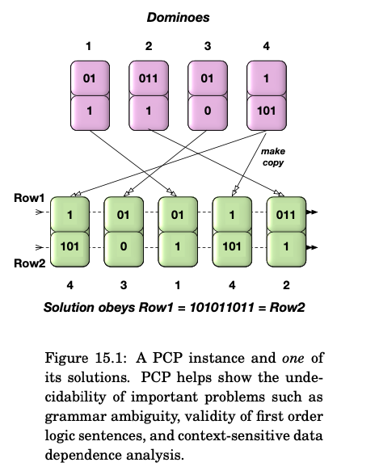
PCP

Slide 35
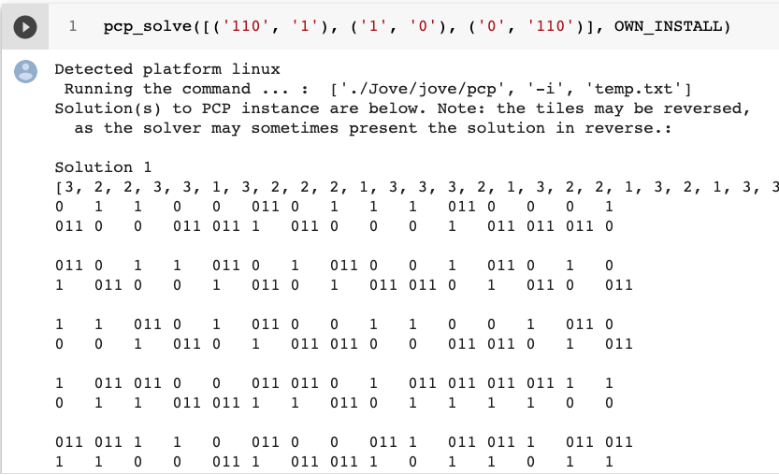
PCP

Slide 36
PCP : Run from here
https://github.com/ganeshutah/Jove/blob/master/For_CS3100_Fall2020/19_Algo_Proc_PCP/CH15.ipynb

Slide 37
Undecidability of Validity
Full proof on Monday
PLEASE SEE https://www.overleaf.com/read/sqgffsctwtsy for a FULL proof that you can check off!
Read Book-1’s proof (taken from Manna who credits Floyd’s elegant proof)
It is a mapping reduction frop PCP to FOL-validity!
(all this in my version of CS 3100 – I tend to cover PCP always!)

Slide 38
FOL Validity is undecidable
Proof: Reduction from PCP
Given a PCP instance, build a specific FOL formula
Argue that the
FOL formula obtained via the translation (mapping reduction) from a given PCP instance { (alpha_1, beta_1), (alpha_2, beta_2), … }
is valid
IFF the PCP instance is solvable

Slide 39
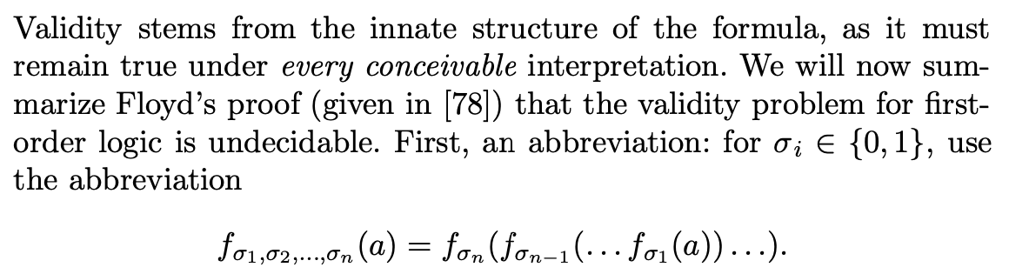
FOL Validity (from Book-1, Manna, Floyd)

Slide 40
Keep these definitions handy! Answer by Zoom Text!
Keep the definitions of alpha_i and beta_i handy
They are bit strings that describe the contents of the dominoes
E.g. given the dominoes [ (110,1), (1,0), (0, 110) ]
Draw the dominoes below
Alpha_1 is 110 and Beta_1 is 1: What are
Alpha_2 ?
Beta_2 ?
Alpha_3 ?
Beta_3 ?
What is f_{alpha_1} ( a ) ?
What is f_{beta_3} ( b ) ?

Slide 41
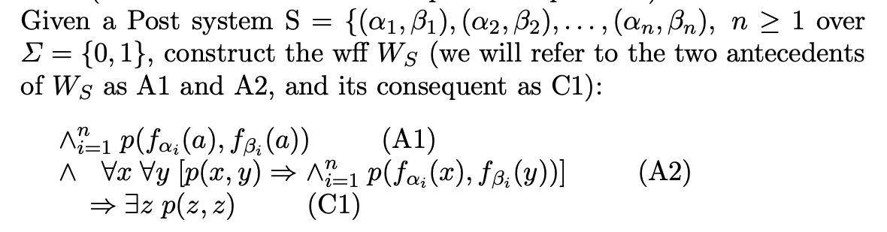
FOL Validity (from Book-1, Manna, Floyd)

Slide 42
Keep these aside! We will need ‘em later
A1
A2
C1

Slide 43
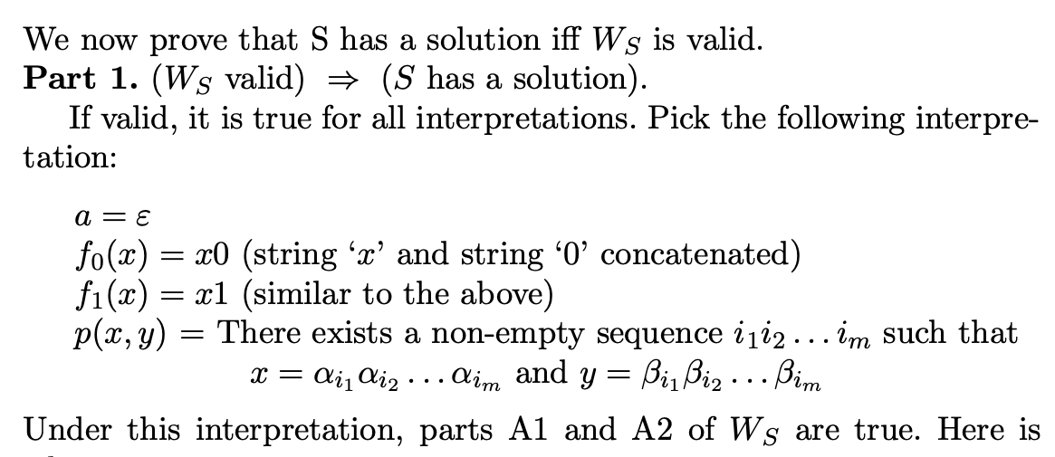
FOL Validity (from Book-1, Manna, Floyd)

Slide 44
Details
We are assuming that W_S, the FOL formula obtained by translating the PCP instance S is valid
Thus S is true under all interpretations
Thus we can choose any interpretation we like (to finish our proof)
Recall (from a previous lecture) that given a formula, we can choose the domain of interpretation D to be Nat or Sigma* and choose the function and predicate symbols’ meanings to be anything at all over that domain (those slides are provided next, to jog your memory)

Slide 45
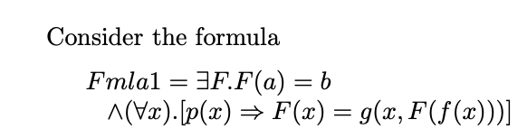
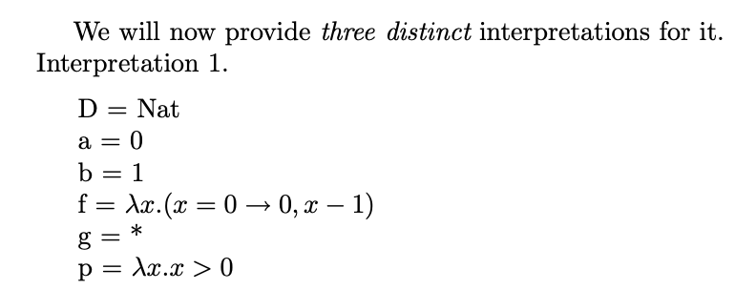
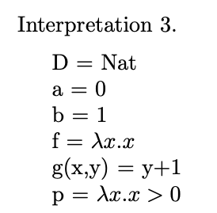
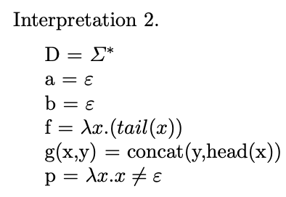
True under this interpretation? Your answer?
For this formula, it was true
Under two interpretations
And false under the third
Which one?

Slide 46
But we are now working on W_S being valid
That means, under ANY interpretation, it is the case that
A1 /\ A2 => C1 is true

Slide 47
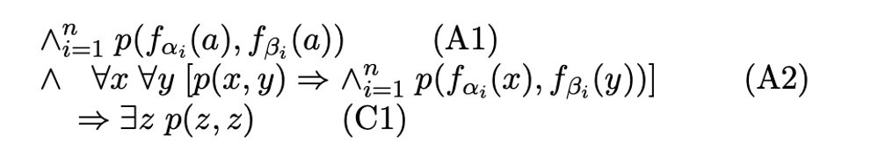
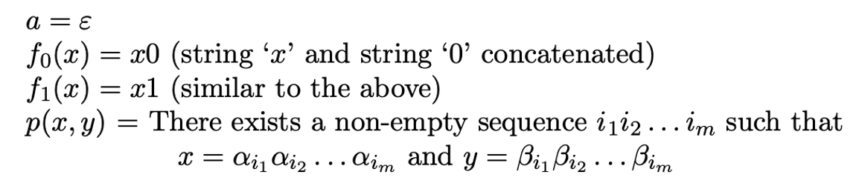
Proof setup for W_S is valid ➔ S is solvable
Thus, we are going to interpret A1 /\ A2 => C1 below, where…
Under THIS interpretation --- call it PI (for Post Interpretation!!)

Slide 48
Why is A1 true under PI? Let us break this down!
Thus, we are going to interpret A1 /\ A2 => C1 below, where…
Under THIS interpretation!

Slide 49
Why is p ( f_{alpha_1}(a), f_{beta_1}(a) ) true?
Thus, we are going to interpret A1 /\ A2 => C1 below, where…
Under THIS interpretation!

Slide 50
Why is p ( f_{alpha_1}(a), f_{beta_1}(a) ) true? Ans: Because it reduces to p ( alpha_1, beta_1 ) !!!
Thus, we are going to interpret A1 /\ A2 => C1 below, where…
Under THIS interpretation!

Slide 51
Why is p ( f_{alpha_2}(a), f_{beta_2}(a) ) true? Ans: YOU PLEASE TYPE IN !!
Thus, we are going to interpret A1 /\ A2 => C1 below, where…
Under THIS interpretation!

Slide 52
The conjunction of all these primitive applications of p are true! Thus A1 is true!
Thus, we are going to interpret A1 /\ A2 => C1 below, where…
Under THIS interpretation!

Slide 53
Now why is one p(x,y) => p(f_{alpha_i}(x), f_{beta_i}(x) ) true?
Thus, we are going to interpret A1 /\ A2 => C1 below, where…
Under THIS interpretation!

Slide 54
Now why is one p(x,y) => p(f_{alpha_i}(x), f_{beta_i}(x) ) true? ANS: see what “f” and “p” mean !!
Thus, we are going to interpret A1 /\ A2 => C1 below, where…
Under THIS interpretation!

Slide 55
Now why is one p(x,y) => p(f_{alpha_i}(x), f_{beta_i}(x) ) true? ANS: Basically, A2 keeps extending the alpha/beta sequences and they are in the matching order! Thus the whole nested A2 conjunction is true!
Thus, we are going to interpret A1 /\ A2 => C1 below, where…
Under THIS interpretation!

Slide 56
This means that A2 is true! We know that A1, A2 are true and A1, A2 => C1 is true [[ why ?? ]] Thus what about C1 ??
Thus, we are going to interpret A1 /\ A2 => C1 below, where…
Under THIS interpretation!

Slide 57
This means that A2 is true! We know that A1, A2 are true and A1, A2 => C1 is true [[ why? W_S is valid! ]] Thus what about C1 ?? True!
Thus, we are going to interpret A1 /\ A2 => C1 below, where…
Under THIS interpretation!

Slide 58
What does C1 being true mean ?
Thus, we are going to interpret A1 /\ A2 => C1 below, where…
Under THIS interpretation!

Slide 59
What does C1 being true mean ? Means that the PCP system S has a solution, namely z !!
Thus, we are going to interpret A1 /\ A2 => C1 below, where…
Under THIS interpretation!

Slide 60
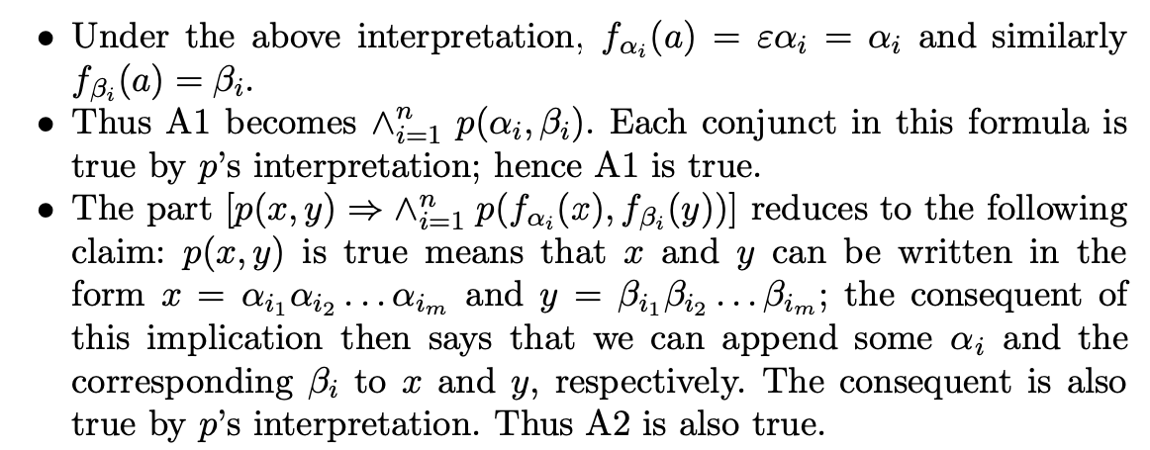
FOL Validity (from Book-1, Manna, Floyd)

Slide 61
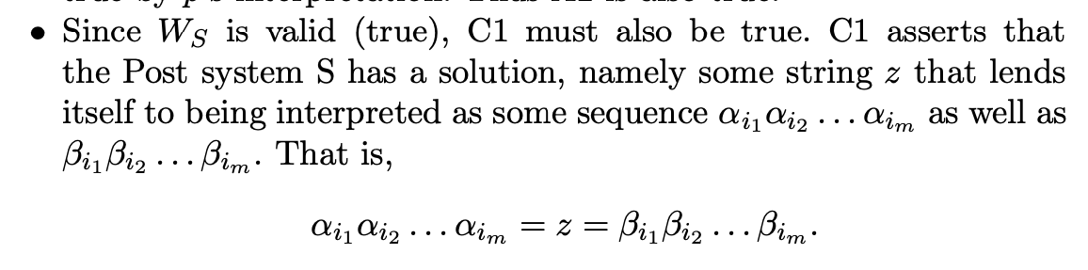
FOL Validity (from Book-1, Manna, Floyd)

Slide 62
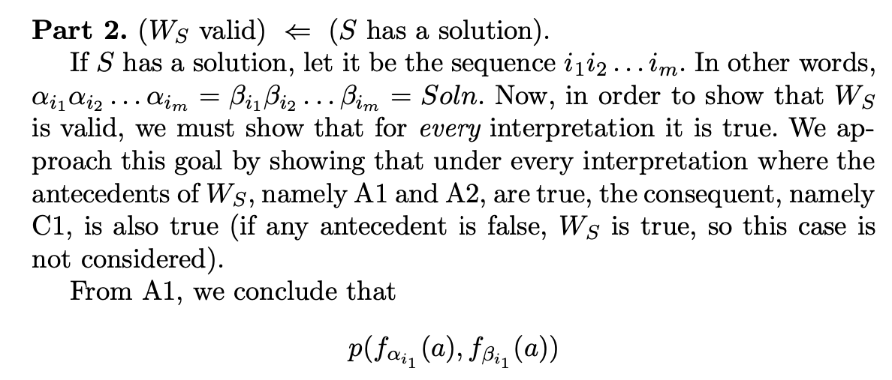
FOL Validity (from Book-1, Manna, Floyd)

Slide 63
Notes
Here we have to show that W_S is valid, given that S has a solution
If S has a solution, there exists a sequence
Alpha_{i1} Alpha_{i2} … Alpha_{iN} that equals a sequence
Beta_{i1} Beta_{i2} … Beta_{iN}
Thus, we proceed as follows

Slide 64
Notes
W_S being valid involves only one really interesting case
making A1 and A2 true
Why?

Slide 65
Notes
W_S being valid involves only one really interesting case
making A1 and A2 true
Why?
Because A1 and A2 being false renders W_S true ☺

Slide 66
Notes
But if A1 and A2 are true, we can use A1 as “axioms” and A2 as a whole bunch of implications
We can apply modus ponens using A1 and A2 instances
Then we can pump up the “f” nests
Pump it up to match the PCP solution given to us !!!

Slide 67
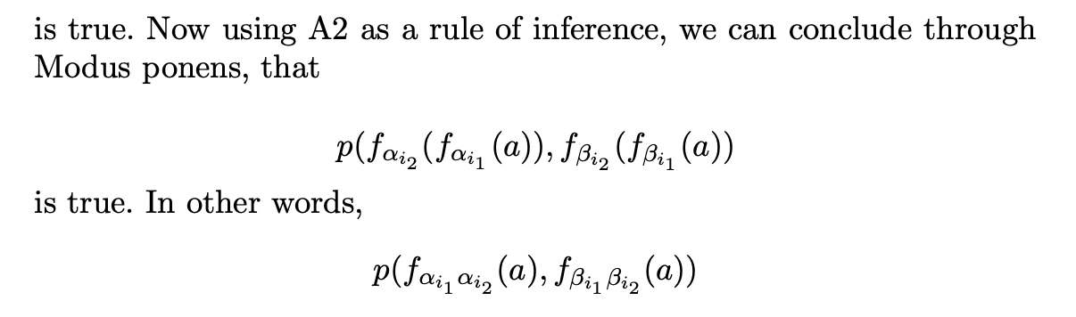
FOL Validity (from Book-1, Manna, Floyd)

Slide 68
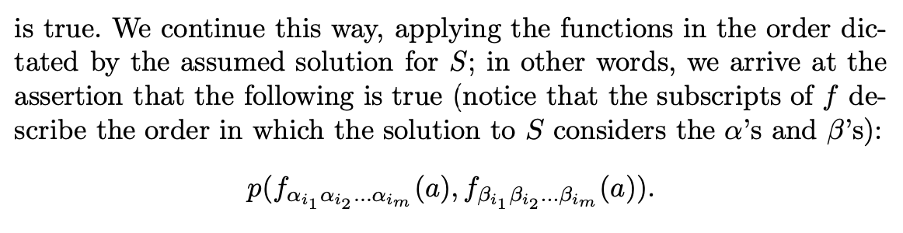
FOL Validity (from Book-1, Manna, Floyd)

Slide 69
Which z shall we pick?

Slide 70
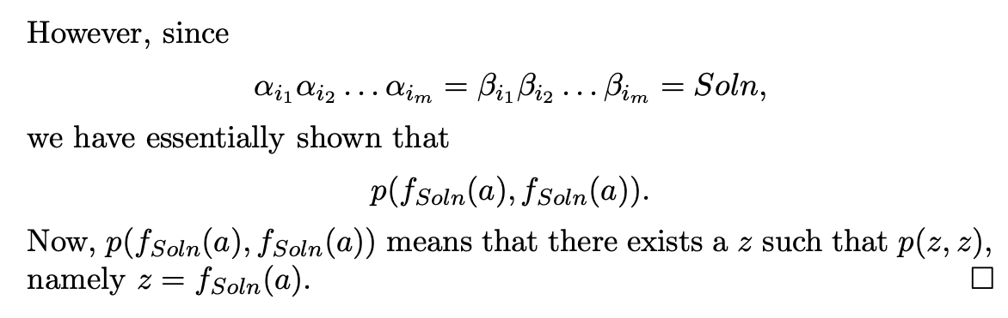
FOL Validity (from Book-1, Manna, Floyd)

Slide 71
Which z shall we pick?
The z picked is the nest of function applications we built up!
open *FOL

Slide 72
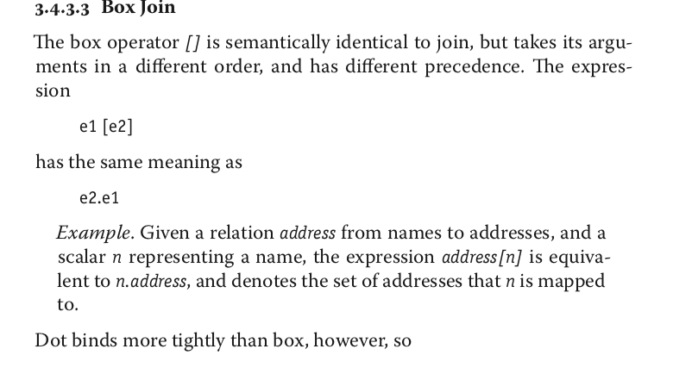
Alloy syntax details

Slide 73
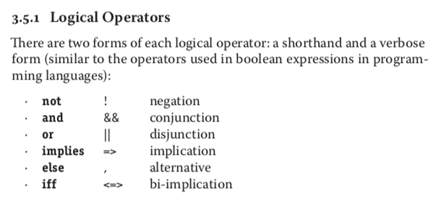
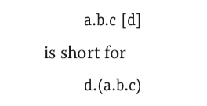
Alloy syntax details

Slide 74
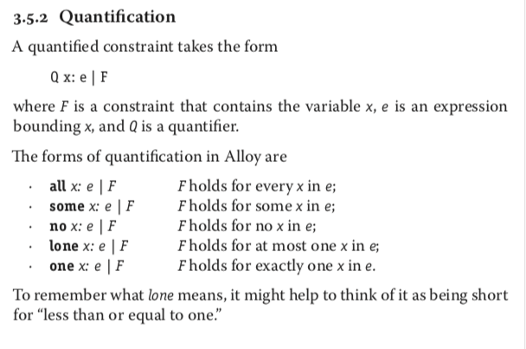
Alloy syntax details

Slide 75
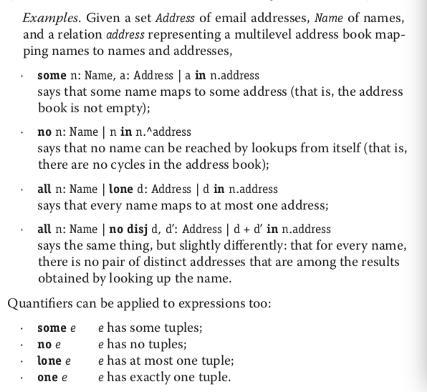
Alloy syntax details

Slide 76
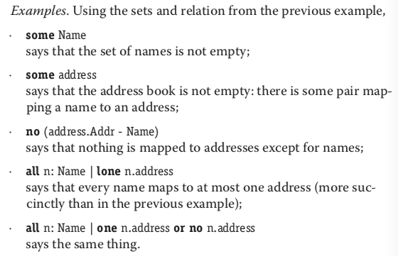
Alloy syntax details

Slide 77
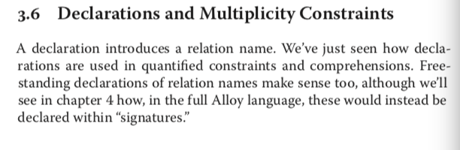
Alloy syntax details

Slide 78
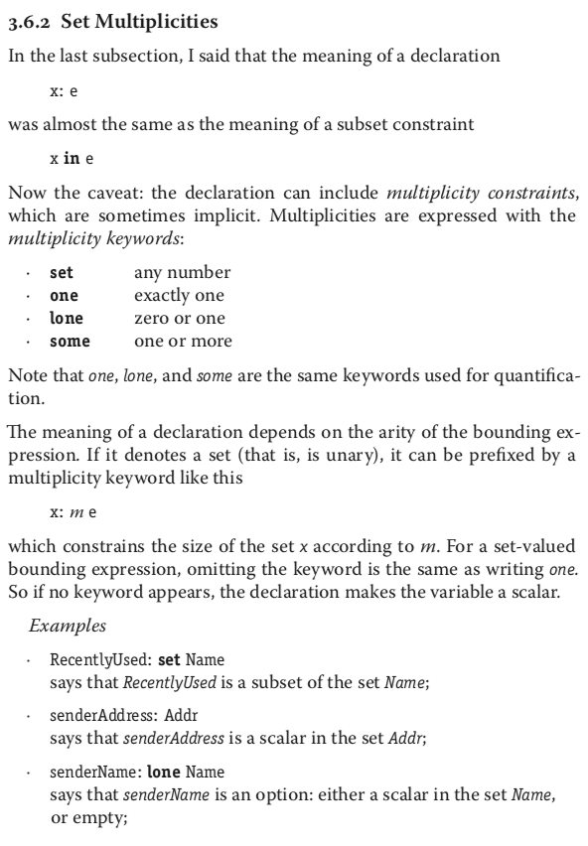
Alloy syntax details

Slide 79
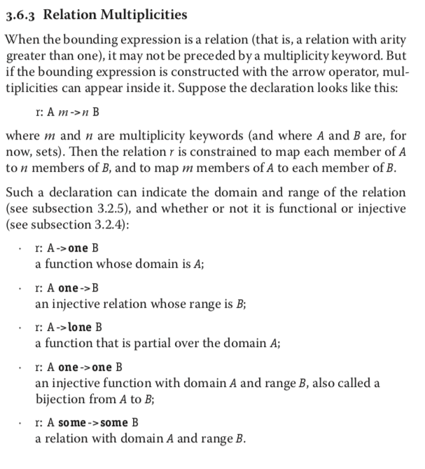
Alloy syntax details

Slide 80
Alloy syntax details

Slide 81
Alloy syntax details

Slide 82
Alloy syntax details

Slide 83
Alloy syntax details

