Slide 1

CS 6110, Software Correctness Analysis, Spring 2023
Ganesh Gopalakrishnan
School of Computing
University of Utah
Salt Lake City, UT 84112

Slide 2
Updates for 2023: Announcements
Finished SPIN
You must all find / fix that liveness bug
Willing to work with you
Why pass up the experience?
Also finish Asg-3 well
There is a ton you’ll learn.. Ask
Project meetings
You get free consulting from me ☺
Your get it as part of your fee
Can go over any material you want to learn in person (AMA or ask me anything)
This is the real value-added of this class!
Soon, only 1-1s for class, simple polls, simple quizzes, no assignments
Happens beginning after Spring Break

Slide 3
Updates for 2023: Topics
Contrast imperative versus declarative
Model-checking-based MWGC
Alloy-based MWGC
Logic is the calculus of computer science!
Moshe Vardi’s annual “Logic Day”
The more you know logic the better you are empowered
In EVERY area of CS that is where knowledge gets condensed
Separation logic
Belief logic
Modal logic
Dynamic logic
Higher-order logic
Linear logic
Constructive logic
X-logic

Slide 4
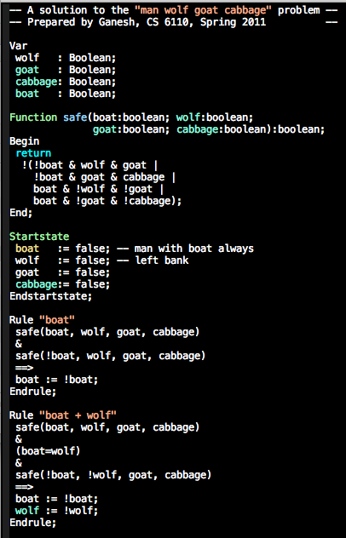
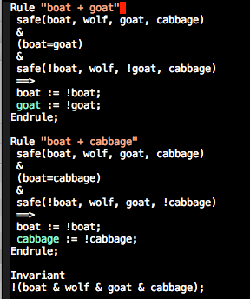
Murphi mwgc.m – let’s run it

Slide 5
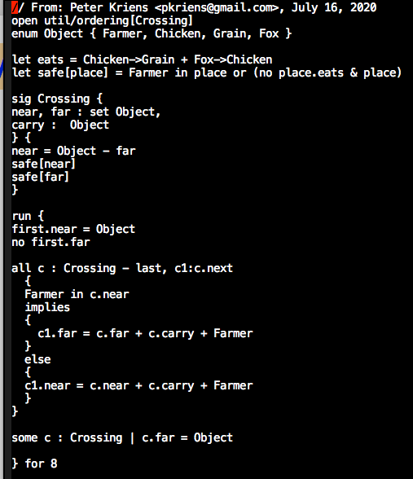
Alloy mwgc – let’s run it

Slide 6
Lecture 14 : First-Order Logic aka predicate logic
Read from Bradley and Manna, Chapter 2
Practice using the files checked into this directory
Having good implementations of SAT-checking for decidable fragments of FOL is why formal methods and rigorous software testing have suddenly become practical!
Alloy introduces a relational logic
FOL expression allowed, maybe even HOL
But all “proofs” are finite-model proofs
Moral: Know relations, functions, FOL, proofs
To do well in software testing, specification, and correctness verification
“Noble bugs” a direct consequence of computability theory
“Stupid bugs” arise due to the Towers of the Babel

Slide 7
An example of FOL (“classical”)
Some patients like every doctor
No patient likes a quack
Prove that no doctor is a quack

Slide 8
An example of FOL (“classical”)
Let “P” be people containing x,y,z, …
Let “p” be a patient-predicate – e.g. p(x)
Let “d” be a doctor-predicate – e.g. d(y)
Let “q” be a quack-predicate – e.g. q(z)
Let “l” be the likes-predicate – e.g. l(x,y) [T/F], !l(x,z) [T/F] etc..
Let’s now see how to model this problem
Forall = “all” and ThereExists = ”exists”
In Alloy it is all / some

Slide 9
An example of FOL (“classical”)
Reminder: P, p, d, q, l are the symbols we have so far
All quantification is over “P” or people
Some patients like every doctor
exists x : p(x) and [all y : d(y) -> l(x,y)]
No patient likes a quack
… give it a shot …
Prove that no doctor is a quack
… state the proof-goal in FOL – give it a shot …

Slide 10
An example of FOL (“classical”)
Reminder: P, p, d, q, l are the symbols we have so far
All quantification is over “P” or people
Some patients like every doctor
exists x : p(x) and [all y : d(y) -> l(x,y)]
No patient likes a quack
all x,y : [ p(x) & q(y) => ! l(x,y) ]
Prove that no doctor is a quack
Goal : prove that all x : d(x) => !q(x)

Slide 11
An example of FOL (“classical”)
Reminder: P, p, d, q, l are the symbols we have so far
All quantification is over “P” or people
Some patients like every doctor
exists x : p(x) and [all y : d(y) -> l(x,y)]
question: Where else can we put “all y” ?
No patient likes a quack
all x,y : [ p(x) & q(y) => ! l(x,y) ]
Prove that no doctor is a quack
Goal : prove that all x : d(x) => !q(x)

Slide 12
An example of FOL (“classical”)
Reminder: P, p, d, q, l are the symbols we have so far
All quantification is over “P” or people
Some patients like every doctor
exists x : p(x) and [all y : d(y) -> l(x,y)]
question: Where else can we put “all y” ?
Which of these “makes sense”
exists x : all y: [ p(x) and [d(y) -> l(x,y) ] ]
All y : exists x : [ p(x) and [d(y) -> l(x,y) ] ]
No patient likes a quack
all x,y : [ p(x) & q(y) => ! l(x,y) ]
Prove that no doctor is a quack
Goal : prove that all x : d(x) => !q(x)

Slide 13
Example of FOL (“classical”): Proof by contra
A1: exists x : p(x) and [all y : d(y) -> l(x,y)]
A2: all x,y : [ p(x) & q(y) => ! l(x,y) ]
G: all x : d(x) => !q(x)
NG: …give it a shot…
A1 skolemize x with p0
A1sk: p(p0) and [all y : d(y) -> l(p0,y)]

Slide 14
Example of FOL (“classical”): Proof by contra
A1: exists x : p(x) and [all y : d(y) -> l(x,y)]
A2: all x,y : [ p(x) & q(y) => ! l(x,y) ]
G: all x : d(x) => !q(x)
NG: exists x : d(x) & q(x)
A1 skolemize x with p0
A1sk: p(p0) and [all y : d(y) -> l(p0,y)]
NGsk: Skolemize NG : d(d0) & q(d0)

Slide 15
Example of FOL (“classical”): Proof by contra
A1: exists x : p(x) and [all y : d(y) -> l(x,y)]
A2: all x,y : [ p(x) & q(y) => ! l(x,y) ]
G: all x : d(x) => !q(x)
NG: exists x : d(x) & q(x)
A1sk: p(p0) and [all y : d(y) -> l(p0,y)]
NGsk: d(d0) & q(d0)
A1sk with d0 specialization: p(p0) & d(d0) => l(p0,d0)
Now what?
Hint : we have not used A2

Slide 16
Example of FOL (“classical”): Proof by contra
A1: exists x : p(x) and [all y : d(y) -> l(x,y)]
A2: all x,y : [ p(x) & q(y) => ! l(x,y) ]
G: all x : d(x) => !q(x)
NG: exists x : d(x) & q(x)
A1sk: p(p0) and [all y : d(y) -> l(p0,y)]
NGsk: d(d0) & q(d0)
A1sk with d0 specialization: p(p0) & d(d0) => l(p0,d0)
Now what?
Hint : we have not used A2
A2sp with p0 and d0: p(p0) & q(d0) => !l(p0,d0)
Do you smell the contradiction?
How to finish?

Slide 17
Example of FOL (“classical”): Proof by contra
A1: exists x : p(x) and [all y : d(y) -> l(x,y)]
A2: all x,y : [ p(x) & q(y) => ! l(x,y) ]
G: all x : d(x) => !q(x)
NG: exists x : d(x) & q(x)
A1sk: p(p0) and [all y : d(y) -> l(p0,y)]
NGsk: d(d0) & q(d0)
A1sk with d0 specialization: (A1sk’): p(p0) & [ d(d0) => l(p0,d0) ]
Now what?
A2sp with p0 and d0: p(p0) & q(d0) => !l(p0,d0)
MP of A1sk’ and NGsk : l(p0,d0)
Contra of !l(p0,d0) and l(p0,d0)

Slide 18
Lecture 14 : First-Order Logic aka predicate logic : Basics
There exist consistent axiomatizations of FOL
There exist complete axiomatizations of FOL
FOL is only semi-decidable
Only procedures exist for deciding validity
No algorithms
No TMs that don’t loop
Semi-algorithms exist because of completeness
If indeed valid (true), there is a proof
And we can discover the proof
via systematic enumeration of all legal inference sequences

Slide 19
Encoding the “doctor/quack theorem” in Alloy
What all FOL concepts are involved?
How to encode each of them in Alloy?

Slide 20
Encoding the “doctor/quack theorem” in Alloy
What all FOL concepts are involved?
Propositional variables
Zero-ary predicates
Predicates of higher arity
One-ary predicates (or subsets of the universe in most cases)
Two-ary predicates (pairs over U)
Zero-ary functions
Or constants in various value domains
One-ary and higher-arity functions
How to encode each of them in Alloy?
We will study how the encoding goes for the doctor/quack theorem
Then we will study how to encode general FOL concepts using Alloy
Again, for bounded-model proofs
Look at Alloy-Constructs-and-Usage.txt for a quick overview

Slide 21

Alloy doctors/quacks encoding

Slide 22
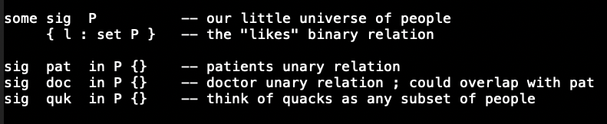
Alloy doctors/quacks encoding

Slide 23
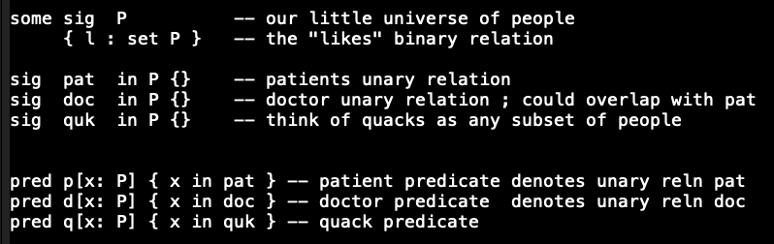
Alloy doctors/quacks encoding

Slide 24
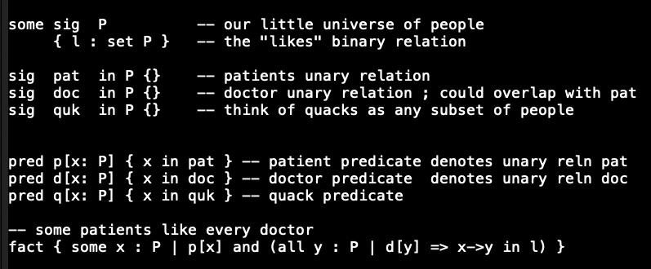
Alloy doctors/quacks encoding

Slide 25
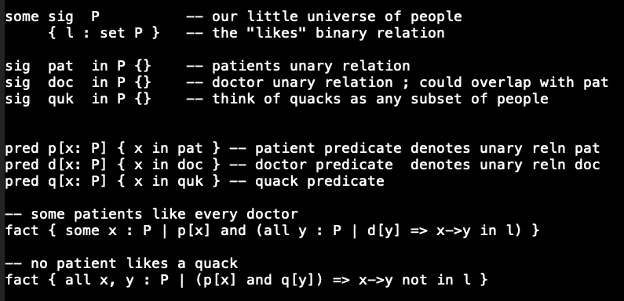
Alloy doctors/quacks encoding

Slide 26
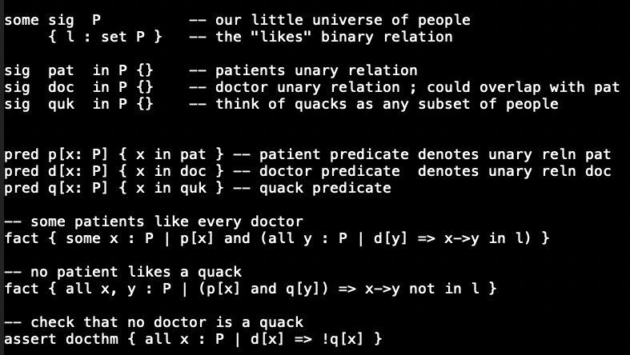
Alloy doctors/quacks encoding

Slide 27
Alloy checks asserts for validity by negating them and checking whether they are sat or not If Sat then … ? If Unsat then … ? Remember that any Boolean formula is * Valid * A contradiction (its negation is valid) * Neither – it and its negation are satisfiable

Slide 28
Alloy checks asserts for validity by negating them and checking whether they are sat or not If Sat then the original assertion is invalid If Unsat then the original assertion is valid Just to be thorough, we will (later) do this: * Write an assertion Assn * Write negAssn = !Assn * We will check both * If Assn’s “check” says “no counterexample, “Assn may be valid”, then ensure that !Assn is satisfiable (there is a counterexample for it) BUT if both Assn and !Assn generate counterexamples, then they are merely satisfiable but not valid AND also not contradictions !!

Slide 29
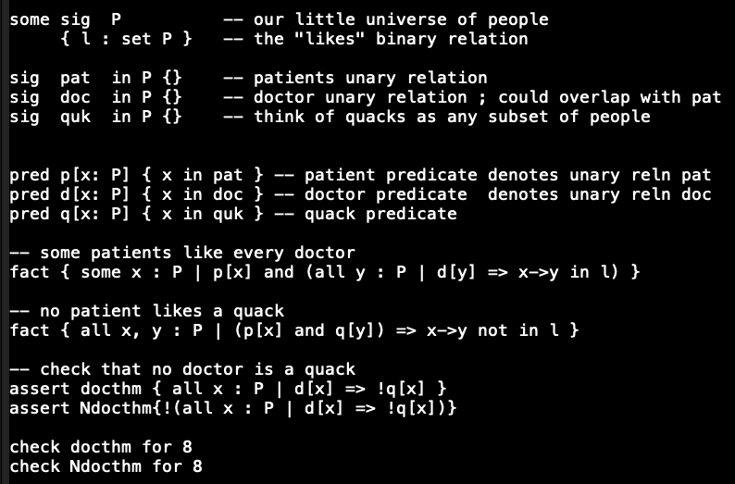
Alloy doctors/quacks encoding

Slide 30
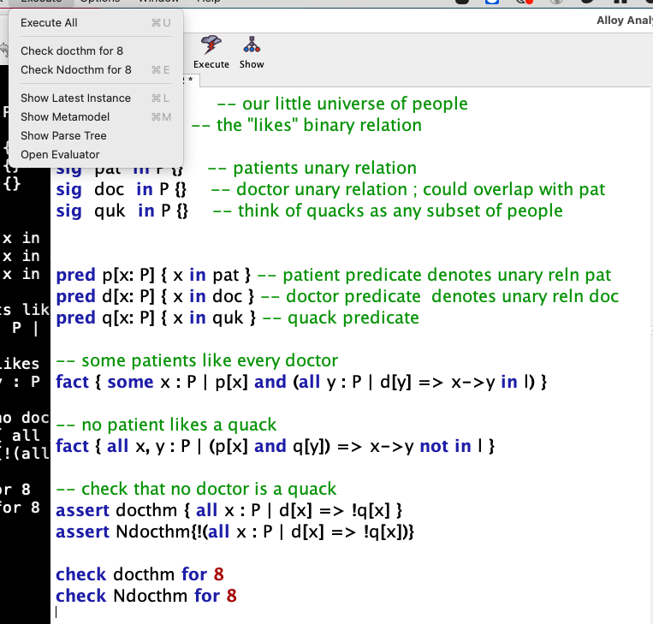
Alloy doctors/quacks encoding
Observe that
Via tbe pulldown
You can run any of the asserts
You’ve planted !!

Slide 31
Excerpts from Bradley and Manna No slides I’ll scroll thru Chapter 2 to familiarize you We will go thru how Alloy models these ideas, and let you read Chapter 2 We will then try and cover Hoare Logic before the Spring break – but no need to hurry if that does not happen!

Slide 32
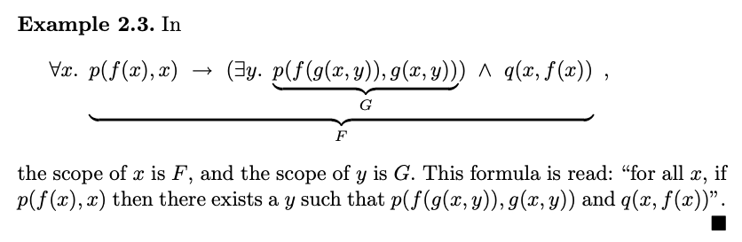
Excerpts from Bradley and Manna: this is the kind of FOL formula we need to understand!

Slide 33
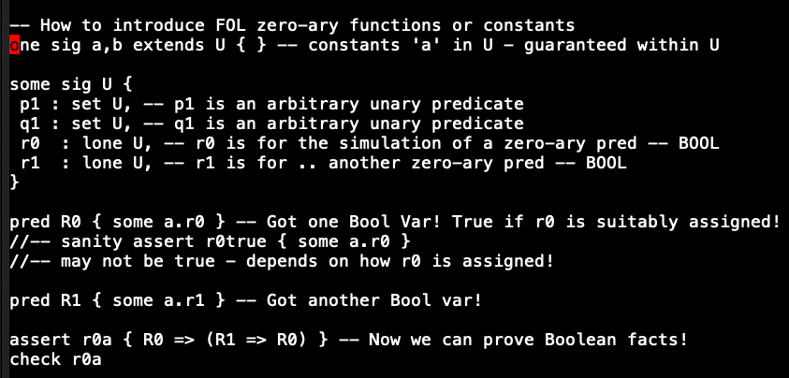
Encoding FOL zero-ary predicates (Bools)

Slide 34
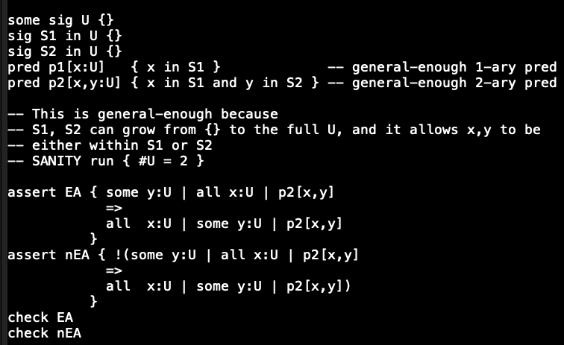
Encoding higher arity predicates

Slide 35
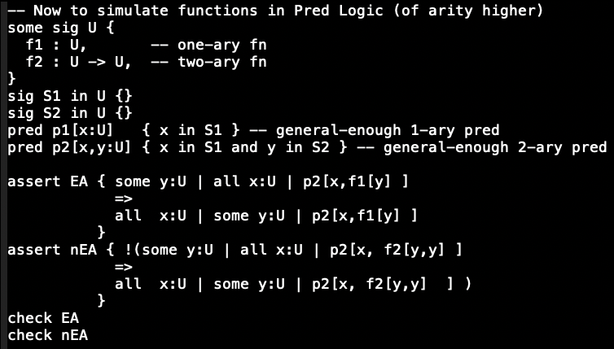
Functions encoded now

Slide 36
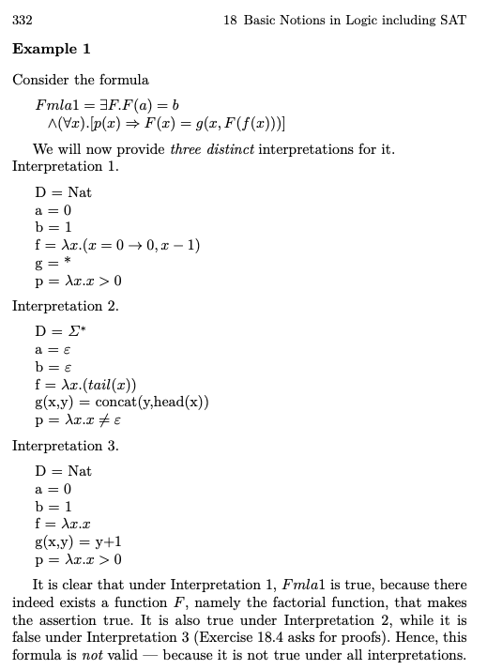
Examples from Manna’s original book about interpretation and validity

