Slide 1

CS 6110, Software Correctness Analysis, Spring 2023 Lecture 8
Ganesh Gopalakrishnan
School of Computing
University of Utah
Salt Lake City, UT 84112

Slide 2
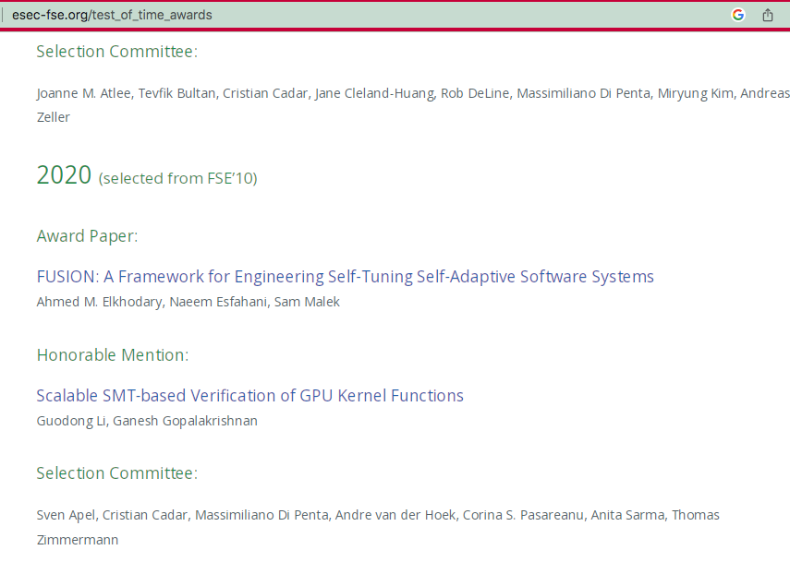
A taste of FOL and how to encode things
Logic is insipid till you learn how to encode things using it
Then it really becomes thrilling
You get a high… much like you get a high when you write a nice functional program!
Or good <beverage of your choice> …
We will learn to encode concurrent schedules
Follow our FSE 2010 paper (Li and Gopalakrishnan)

Slide 3
A taste of FOL and how to encode things
Basic idea is to
Lift each (scalar) variable into an array (lift an array var to an array of arrays)
Essentially add one last index
e.g. “v” that is shared by a collection of threads becomes v[ .. ]
The v[] array contents are “ownership moments”
Thread_i owns this variable at scheduling-step j
Write v_i^j or v_i^tj
Introduce constraints that fill the rest of the story
The “scheduling fly” flies from SSA-point to SSA-point
There is only one fly ☺
If on the “read” SSA-point, grab the value and put it in a register
How many SSA-points for
V := V + 1 ?

Slide 4
A taste of FOL and how to encode things
How many SSA-points for
V := V + 1 ?
Two
V_2 = V_1 + 1
Implicitly, the V_2 SSA point is numbered higher
The scheduling-fly cannot sit at V_2 before it has sat (and pooped) on V_1
But if the fly sits at V_1 at “time t”, should it sit at V_2 at ”time t+1” ?
Answer if there is one thread
Now answer if there are two threads

Slide 5
A taste of FOL and how to encode things
If the fly sits at V_1 at “time t”, should it sit at V_2 at ”t+1” ?
No need for #threads > 1
It could go sit on an SSA ID of the other thread and come back!
THUS, V_2 := V_1 + 1
Can be changed to
V[v_2^t1] := V[v_1^t1] + 1
V[ 3 ] := V[ 1 ] + 1 ⬅ possible if the scheduling-fly read the RHS, flew to
the other thread, did something there, and came back!

Slide 6
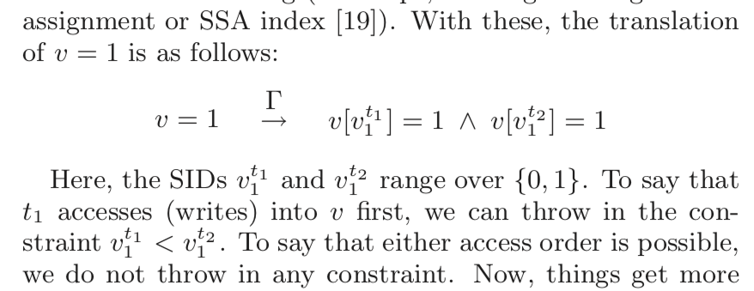
Putting it all together...

Slide 7
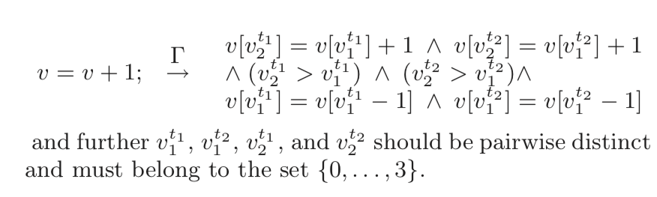
Putting it all together...

Slide 8
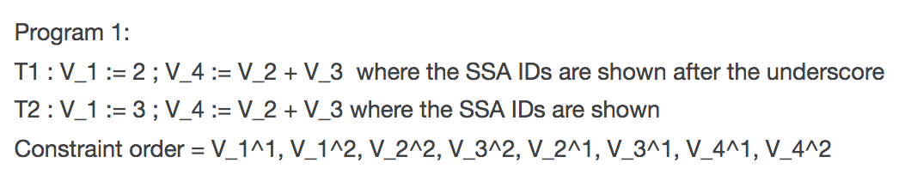
Problem-1

Slide 9
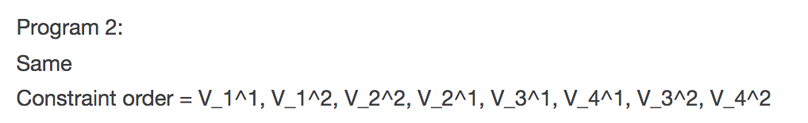
Problem-2

Slide 10
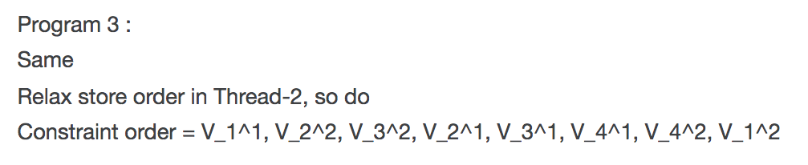
Problem-3

Slide 11
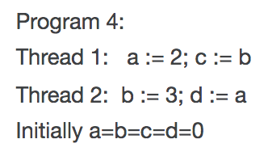
Problem-4: Do as per TSO; generate constraints; show there are 6 schedules! Also which schedules will yield distinct final values?

Slide 12
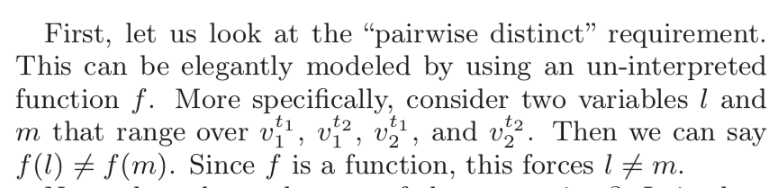
Putting it all together...

Slide 13
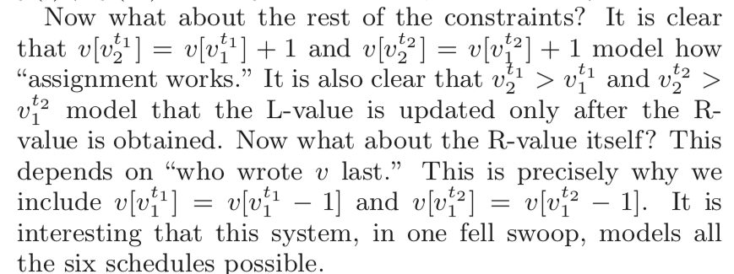
Putting it all together...

Slide 14
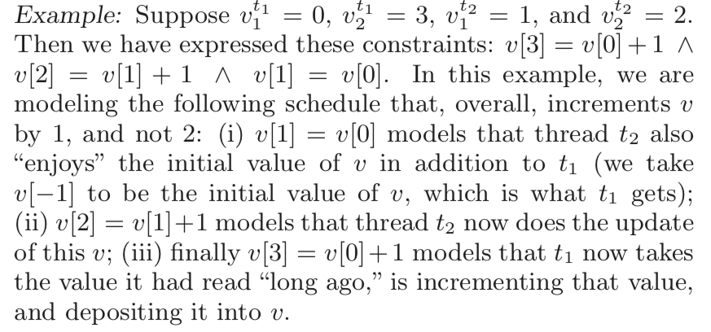
Putting it all together...

Slide 15
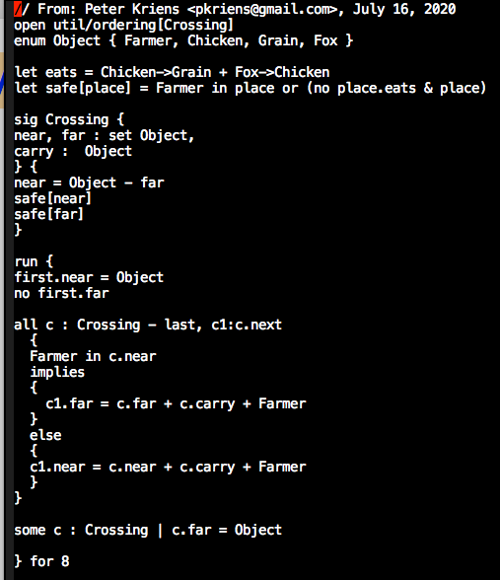
Alloy mwgc – let’s run it

Slide 16
Lecture 14 : First-Order Logic aka predicate logic : Basics
There exist consistent axiomatizations of FOL
There exist complete axiomatizations of FOL
FOL is only semi-decidable
Only procedures exist for deciding validity
No algorithms
No TMs that don’t loop
Semi-algorithms exist because of completeness
If indeed valid (true), there is a proof
And we can discover the proof
via systematic enumeration of all legal inference sequences

Slide 17
Alloy checks asserts for validity by negating them and checking whether they are sat or not If Sat then … ? If Unsat then … ? Remember that any Boolean formula is * Valid * A contradiction (its negation is valid) * Neither – it and its negation are satisfiable

Slide 18
Alloy checks asserts for validity by negating them and checking whether they are sat or not If Sat then the original assertion is invalid If Unsat then the original assertion is valid Just to be thorough, we will (later) do this: * Write an assertion Assn * Write negAssn = !Assn * We will check both * If Assn’s “check” says “no counterexample, “Assn may be valid”, then ensure that !Assn is satisfiable (there is a counterexample for it) BUT if both Assn and !Assn generate counterexamples, then they are merely satisfiable but not valid AND also not contradictions !!

Slide 19
Excerpts from Bradley and Manna No slides I’ll scroll thru Chapter 2 to familiarize you We will go thru how Alloy models these ideas, and let you read Chapter 2 We will then try and cover Hoare Logic before the Spring break – but no need to hurry if that does not happen!

Slide 20
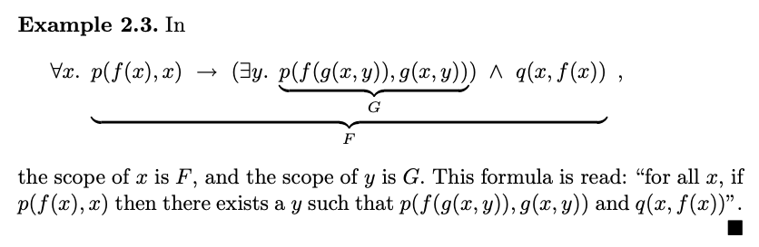
Excerpts from Bradley and Manna: this is the kind of FOL formula we need to understand!

Slide 21
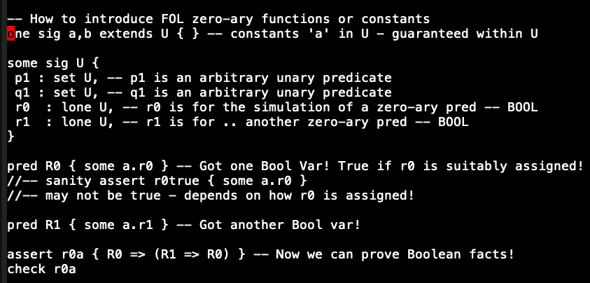
Encoding FOL zero-ary predicates (Bools)

Slide 22
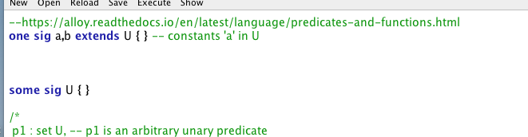
Encoding FOL zero-ary predicates (Bools)

Slide 23
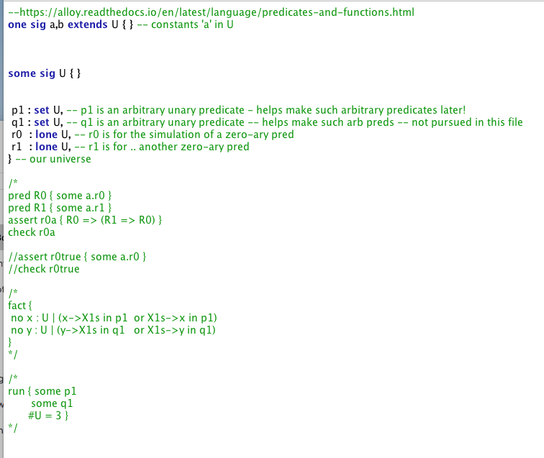
Encoding FOL zero-ary predicates (Bools)

Slide 24
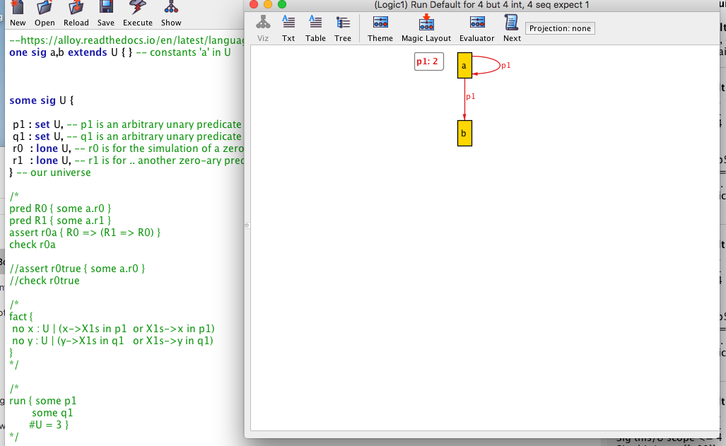
Encoding FOL zero-ary predicates (Bools)

Slide 25
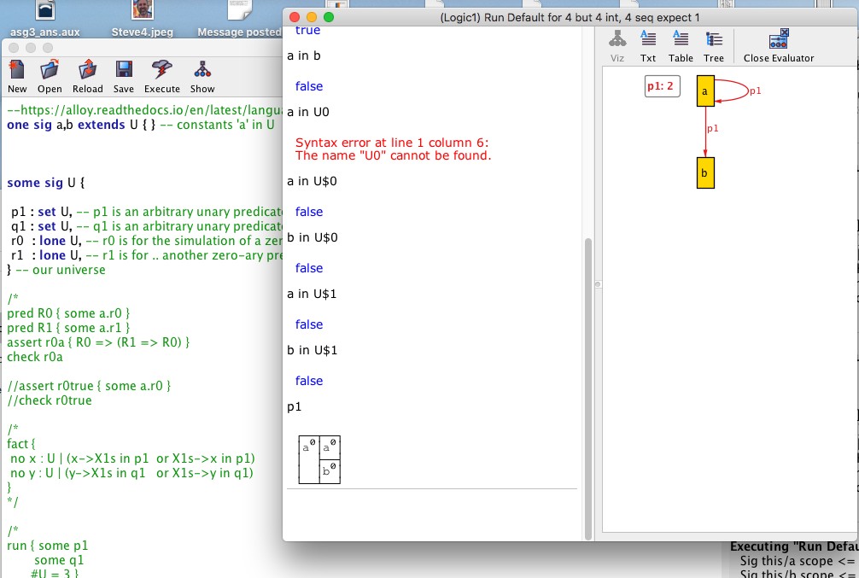
Encoding FOL zero-ary predicates (Bools)

Slide 26
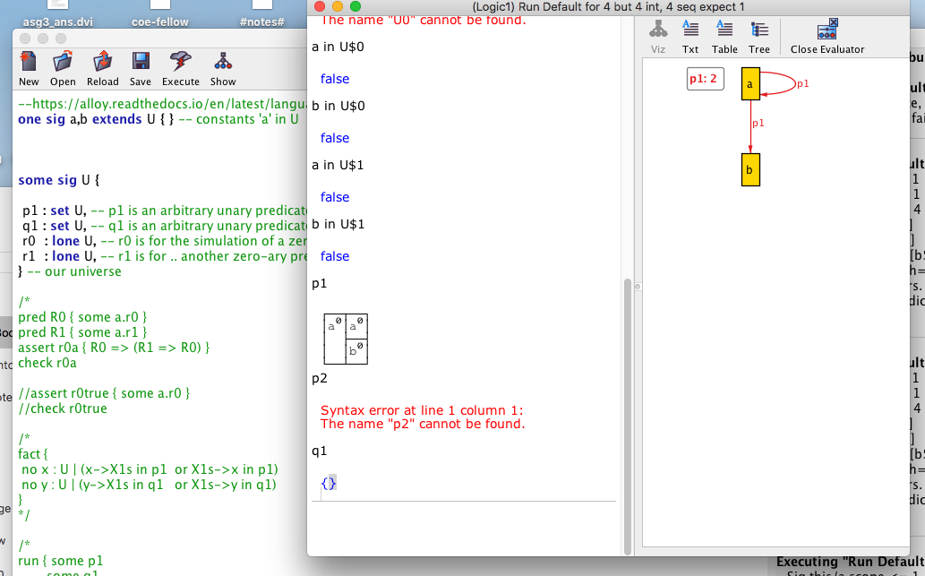
Encoding FOL zero-ary predicates (Bools)

Slide 27
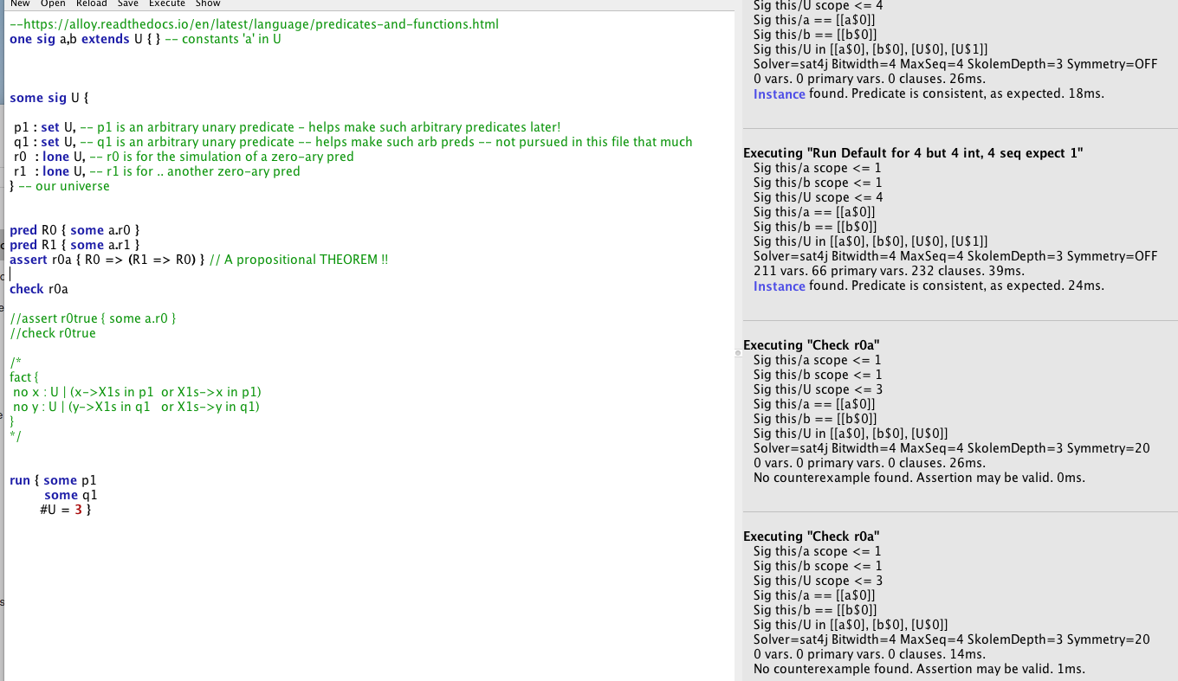
Encoding FOL zero-ary predicates (Bools)

Slide 28
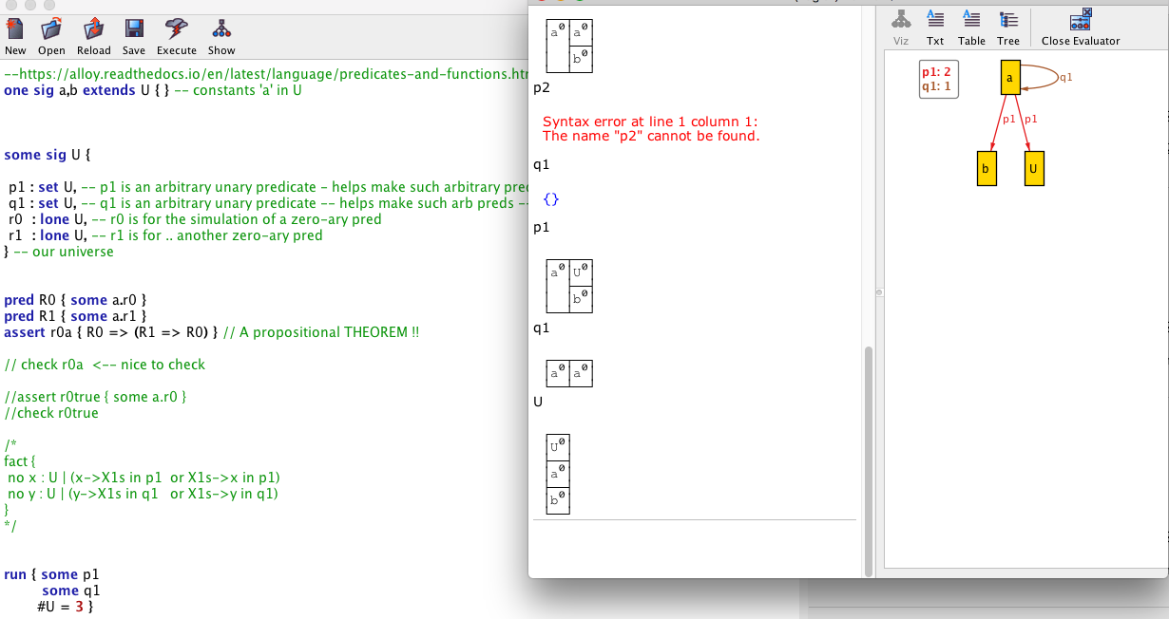
Encoding FOL zero-ary predicates (Bools)

Slide 29
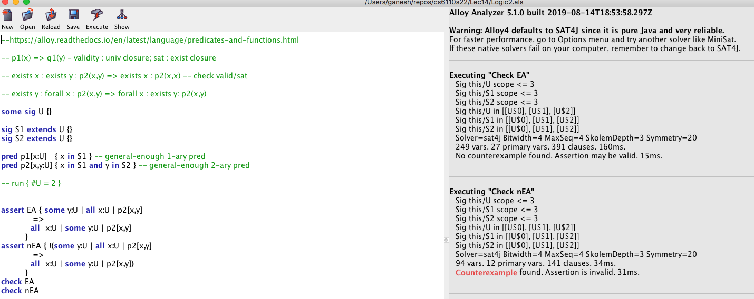
Encoding FOL zero-ary predicates (Bools)

Slide 30
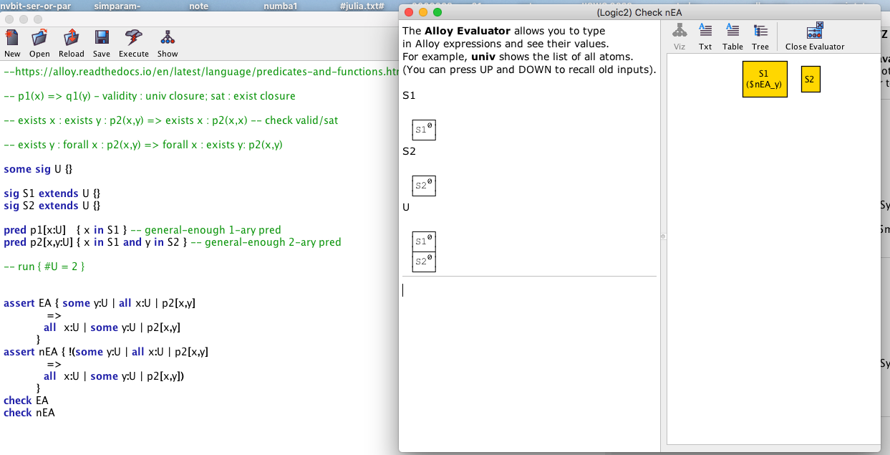
Encoding FOL zero-ary predicates (Bools)

Slide 31
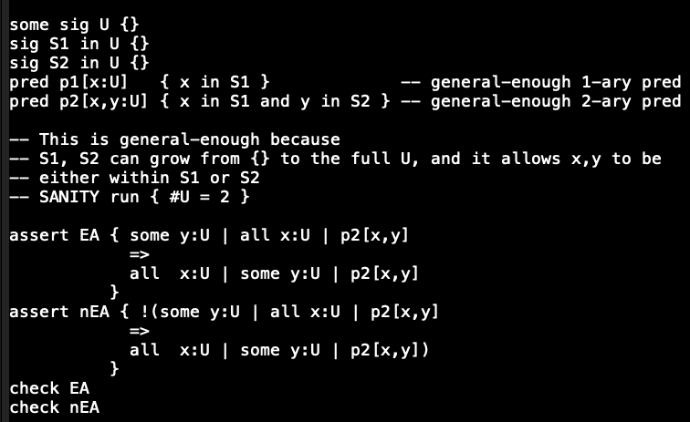
Encoding higher arity predicates

Slide 32
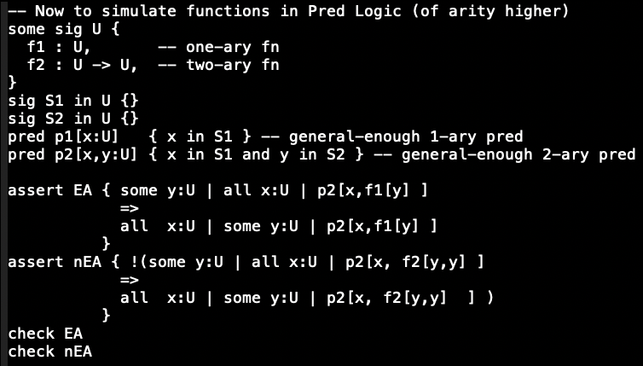
Functions encoded now

Slide 33
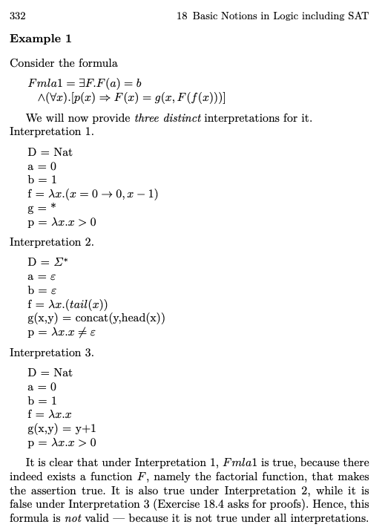
Examples from Manna’s original book about interpretation and validity

