Slide 1
Low overhead data race detection in large structured parallel applications
PhD Proposal Defense
Simone Atzeni
simone@cs.utah.edu
May 5, 2016

Slide 2
Thesis Statement Make race checking of large HPC application practical
Combining the best of static and dynamic analysis techniques for data race detection and tailoring the implementation to the actual concurrency structure of structured parallel languages such as OpenMP, we can make data race checking of HPC applications practical.

Slide 3
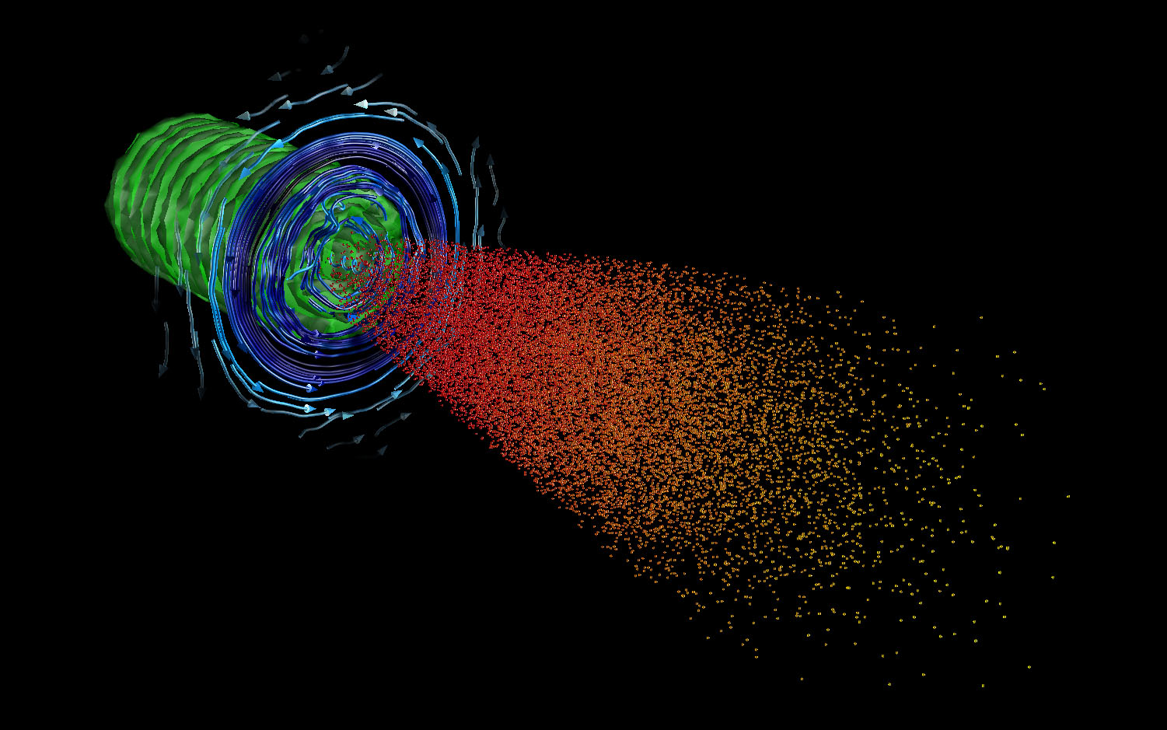
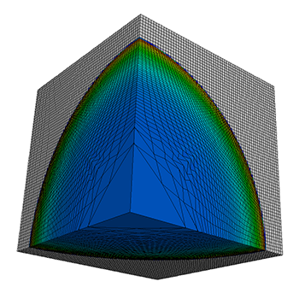
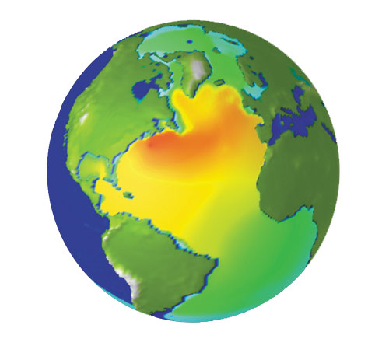
Motivation Understand scientific phenomena and model them
Fast-ignition-scale laser simulation
Climate modeling
Hydrodynamics modeling

Slide 4
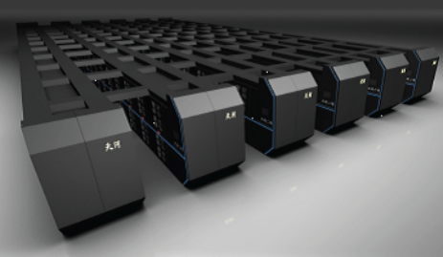
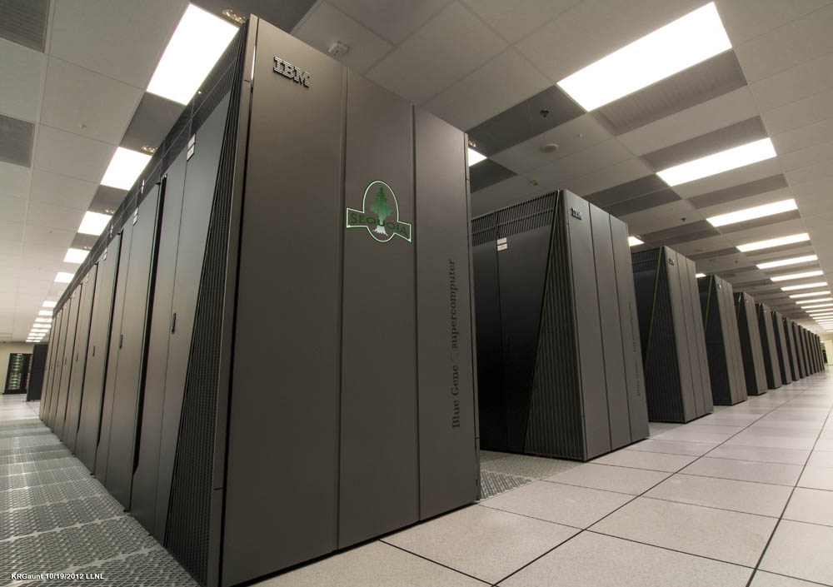
Motivation Increased adoption of on-node parallelism in HPC
Tianhe-2
33 PFLOPS
Peta-Scale Machines
Sequoia
17 PFLOPS

Slide 5
Motivation Architectural trends make HPC debugging a greater challenge
Amounts of concurrency grow exponentially
Explosion of on-node parallelism options
More cores, SIMD units, accelerators (GPUs), etc.
Bring applications to a crossroad for hybrid parallelism
i.e. MPI + OpenMP
More sources of non-determinism: OpenMP data races
Need more capable and scalable tools
General strategy – bring best capabilities and compose them

Slide 6
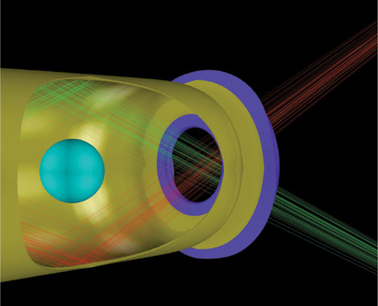
Motivation OpenMP is widely used in HPC applications
HYDRA – large multiphysics MPI/OpenMP application
Non-deterministic crashes on a threaded version of Hypre library
Above certain optimization levels and certain scales (8K MPI processes)
Suspected data race
Cost scientists months …

Slide 7
Motivation Gap in High-End computing environment
Data race bugs in multi-threaded environment:
One of the most notorious sources of unsafe non-determinism
Identifying them in large OpenMP applications is highly challenging

Slide 8
State of the art Overview of Data Race Detection Techniques
Static analyses
Dynamic analyses

Slide 9
State of the art Static Data Race Detection Techniques
Static Analysis
Reason about all inputs/interleavings
Very imprecise, many “false positives” and “false negatives” (miss races)
Very scalable and fast (i.e. no runtime overhead)
Example Tools:
Intel Static Security Analysis
Support C/C++ and Fortran

Slide 10
State of the art Dynamic Data Race Detection Techniques
Dynamic Analysis
Very precise, no false positives
Reports races only in branches of the programs that are actually executed
Very high runtime and memory overhead (5-20x for best tools)
Example Techniques:
Lockset Algorithm
Happens-Before Relation
Hybrid data race detection
combination of lockset and happens-before relation

Slide 11
State of the art Dynamic Data Race Detection Tools
Not many (OpenMP) data race detectors out there!
Commercial tools:
Intel Inspector XE: Pthread and OpenMP C/C++ and Fortran
Sun Studio Data-Race Detection Tool: Pthread and OpenMP C/C++
Open-source tools:
Helgrind (based on Valgrind): Pthread C/C++ and Fortran
Thread Sanitizer: Pthread C/C++ and Go
High runtime and memory overhead!
100x slower on HPC application!

Slide 12
Overall Research Plan Low overhead data race detection for OpenMP
Data race detection technique for large OpenMP applications
Combine static and dynamic analysis
Reduce amount of code to analyze at runtime
Exploit concurrency structure of OpenMP
More structured than Pthreads progams
i.e. join of team of threads at the same point
Avoid pure happens-before relation
Vector clocks are expensive
Data race checking of HPC applications
accurate
precise
practical

Slide 13
Overall Research Plan Step-by-step contributions for OpenMP data race checking
Sequential Blacklisting
Identify sequential code
Data Dependency Analysis
Identify race free code
Archer v1
Combine static techniques and existing dynamic analysis
Clock-less runtime algorithm
Exploit structured OpenMP parallelism
Archer v2
Embed static techniques with new runtime algorithm

Slide 14
Static Analysis Blacklisting Sequential Code
Pthreads fork-join parallelism
Master thread keeps doing its own work while it spawns new threads
Hard to distinguish sequential from parallel instructions
Master thread may access shared variables between other threads
Some threads may join later

Slide 15
Static Analysis Blacklisting Sequential Code
OpenMP’s structured fork-join parallelism
Guarantee finding sequential instructions
Every instruction outside a OpenMP construct is executed by the master thread
Master thread take part of the parallel team

Slide 16
Static Analysis Data Dependency Analysis
Loop-carried data dependency analysis:
Parallel for-loops with no dependencies are race free
Blacklisting these regions from runtime analysis
#pragma omp parallel for
for(int i = 0; i < N; i++) {
a[i] = a[i] + 1;
}
No data dependency, code can be excluded from runtime analysis
#pragma omp parallel for
for(int i = 1; i < N; i++) {
a[i] = a[i - 1];
}
Data dependency on array access, potentially race therefore checked at runtime

Slide 17
Archer v1 Combining Static and Dynamic Analysis
LLVM/Clang based tool
LLVM Passes
Sequential blacklisting
Polly + custom pass to identify OpenMP for-loops
Custom TSan instrumentation process
Exploit static analysis result to exclude race free code from runtime analysis

Slide 18
Archer v1 Combining Static and Dynamic Analysis
TSan data race runtime analysis
Instrumented OpenMP runtime
Annotations mechanism to communicate TSan runtime about happens-before relations between threads
Unknown synchronization mechanism (i.e. barriers, criticals, etc.)

Slide 19
Example Archer Static Analysis at Work

Slide 20
Example Archer Runtime with Annotated OpenMP Runtime
6 #pragma omp parallel for
7 {
8 for(int i = 0; i < 100; i++)
9 v[i] = v[i] * v[i];
}
11
12 #pragma omp parallel
13 {
14 if (a < 100) {
15 #pragma omp critical
16 a++;
17 }
18 }
Excluded from them runtime check because
it is race free.
WARNING: ThreadSanitizer: data race
Read of size 4 at 0x7fffffffdcdc by thread T2:
#0 .omp_outlined. race.c:14 (race+0x0000004a6dce)
#1 __kmp_invoke_microtask <null> (libomp_tsan.so)
Previous write of size 4 at 0x7fffffffdcdc by main thread:
#0 .omp_outlined. race.c:16 (race+0x0000004a6e2c)
#1 __kmp_invoke_microtask <null> (libomp_tsan.so)

Slide 21
Archer v1 Accomplished Research
First open source OpenMP data race detector tool
25% speedup while maintaining same or better precision and accuracy than other tools (OmpSCR and AMG benchmarks)
Used by HPC community
Presentation at IPDPS’16

Slide 22
Clock-less runtime algorithm Exploit structured OpenMP parallelism
OpenMP concurrency model
Race within parallel region (e.g. 3 and 4)
Race across parallel regions (e.g. 8 and 5)
No race between threads that belong to consequent parallel regions (e.g. 3 and 9)
Labeling approach
Limit data race checking only to concurrent threads

Slide 23
Clock-less runtime algorithm OpenMP Formal Concurrency Model
Definition of OpenMP concurrency structure
State machine and a set of transition rules
Rules model the behavior of the OpenMP constructs (e.g. parallel begin and end, barriers, critical sections, loads/stores, etc.)
“RaceCheck” rule can fire anytime during the state machine execution

Slide 24
Clock-less runtime algorithm Implementation as Approximation of the State Machine
Corner cases in OpenMP data race checking
Lock-free data structure to model the concurrency structure of a parallel region
Store a representative set of memory accesses (e.g. sampling, etc.)
Perform race checking at barrier checkpoints
Implementation based on OpenMP Tools API (OMPT)

Slide 25
Timeline Past and future publications
Feasibility of combining static and dynamic analysis for OpenMP data race detection [LLVM-HPC WS/SC’14]
Archer v1 – static analysis and TSan runtime [IPDPS’16]
Clock-less runtime algorithm [POPL’17, PPoPP’17]
Archer v2 – static analysis and clock-less runtime algorithm [PLDI’17, IPDPS’17]

Slide 26
Questions?

