Slide 1
Low overhead data race detection in large structured parallel applications
PhD Proposal Defense
Simone Atzeni
simone@cs.utah.edu
May 5, 2016

Slide 2
Motivation Architectural trends make HPC debugging a greater challenge
Amounts of concurrency grow exponentially
Make at-scale bugs commonplace
Explosion of on-node parallelism options
More cores, wider SMT and SIMD units, accelerators (GPUs) …
Bring applications to a crossroad for hybrid parallelism: MPI + X
More sources of non-determinism: OpenMP data races
Need more capable and scalable tools
General strategy – bring best capabilities and compose them

Slide 3
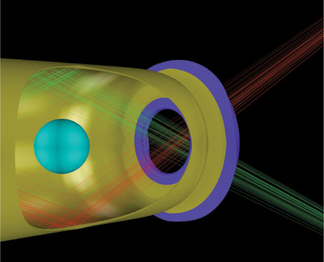
Motivation OpenMP is widely used in HPC applications
HYDRA – large multiphysics MPI/OpenMP application
Non-deterministic crashes on a threaded version of Hypre library
Above certain optimization levels and certain scales (8K MPI processes)
Suspected data race
Cost scientists months …

Slide 4
Motivation Gap in High-End computing environment
Data race bugs in multi-threaded environment:
One of the most notorious sources of unsafe non-determinism
Identifying them in large OpenMP applications is highly challenging

Slide 5
Static Analysis Blacklisting Sequential Code
Data race bugs in multi-threaded environment:
One of the most notorious sources of unsafe non-determinism
Identifying them in large OpenMP applications is highly challenging

