Slide 1
Low overhead data race detection in large structured parallel applications
PhD Proposal Defense
Simone Atzeni
simone@cs.utah.edu
May 5, 2016

Slide 2
Motivation Architectural trends make HPC debugging a greater challenge
Amounts of concurrency grow exponentially
Make at-scale bugs commonplace
Explosion of on-node parallelism options
More cores, wider SMT and SIMD units, accelerators (GPUs) …
Bring applications to a crossroad for hybrid parallelism: MPI + X
More sources of non-determinism: OpenMP data races
Need more capable and scalable tools
General strategy – bring best capabilities and compose them

Slide 3
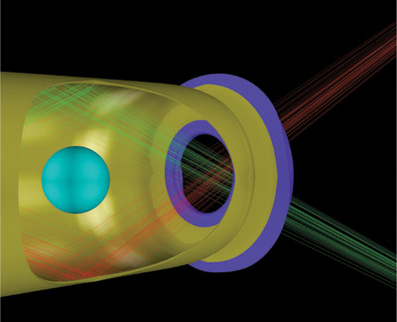
Motivation OpenMP is widely used in HPC applications
HYDRA – large multiphysics MPI/OpenMP application
Non-deterministic crashes on a threaded version of Hypre library
Above certain optimization levels and certain scales (8K MPI processes)
Suspected data race
Cost scientists months …

Slide 4
Motivation Gap in High-End computing environment
Data race bugs in multi-threaded environment:
One of the most notorious sources of unsafe non-determinism
Identifying them in large OpenMP applications is highly challenging

Slide 5
Static Analysis Blacklisting Sequential Code
Pthreads fork-join parallelism
Master thread keeps doing its own work while it spawns new threads
Hard to distinguish sequential from parallel instructions
Master thread may access shared variables between other threads
Some threads may join later

Slide 6
Static Analysis Blacklisting Sequential Code
OpenMP’s structured fork-join parallelism
Guarantee finding sequential instructions
Every instruction outside a OpenMP construct is executed by the master thread
Master thread take part of the parallel team

Slide 7
Static Analysis Data Dependency Analysis
Loop-carried data dependency analysis:
Parallel for-loops with no dependencies are race free
Blacklisting these regions from runtime analysis
#pragma omp parallel for
for(int i = 0; i < N; i++) {
a[i] = a[i] + 1;
}
No data dependency, code can be excluded from runtime analysis
#pragma omp parallel for
for(int i = 1; i < N; i++) {
a[i] = a[i - 1];
}
Data dependency on array access, potentially race therefore checked at runtime

Slide 8
Archer v1 Combining Static and Dynamic Analysis
LLVM/Clang based tool
TSan data race runtime analysis
Instrumented OpenMP runtime
Annotations mechanism to communicate TSan runtime about happens-before relations between threads
Unknown synchronization mechanism (i.e. barriers, criticals, etc.)

