Slide 1
BCA Mini Project (Review I)
STUDENT SKILL EXCHANGE
Submitted to the Presidency University, Bengaluru in partial fulfillment for the award of the degree of Bachelor of Computer Applications(BCA)
Project Number : 28
Name | Roll Number
Ganesh V Vishal Sandeep Kumar Mahatho Md Fazail Shahid | 20241BCA0107 20241BCA0159 20241BCA0143 20241BCA0109

Slide 2
Content
Problem Statement
SAMPLE LITERATURE REVIEW
Tools and Technologies to be used
Timeline of the Project

Slide 3
Problem Statement
Students have different technical and non-technical skills.
Many students want to learn new skills but cannot find the right person to teach them.
Existing learning platforms often require payment.
There is no simple platform specifically designed for students to exchange skills.
Students face difficulty finding learning partners based on their skills and interests.
The proposed system allows students to teach the skills they know and learn the skills they need.
It provides a platform for skill matching, communication, and peer-to-peer learning.

Slide 4
SAMPLE LITERATURE REVIEW
Theme 1: Architectural Foundations of Skill Swap Platforms
Establishes that replacing traditional cash transactions with non-monetary peer ecosystems drastically reduces accessibility barriers. Demonstrates that building on full-stack frameworks (MERN) matches requirements for scalable profile indexes and secure real-time partner discovery workflows.
Authors: Aniket Eknath Pawar, Kasturi Nikumbh, Reshma Vishwas Gade, Sakshi Vijay Patade, Priyanka Arun Rokade (2026)
Source: ResearchGate Academic Repository
URL: https://www.researchgate.net/publication/407081355_SKILL-SWAP_PLATFORM_Peer_to_peer_skill_exchange_system
Theme 2: Collaborative Multi-Role Peer-to-Peer Learning Systems
Validates that dynamic dual-role networks (where users toggle seamlessly between mentor and learner states) encourage collaborative habits and retain knowledge better than standard one-way lectures. Proves the necessity of integrating lightweight async WebSockets for instantly bridging knowledge gaps.
Authors: Educational Technology Frameworks & Pedagogical Research Cohorts (2026)
Source: 21st Century School Instructional Analysis Design
URL: https://www.21kschool.com/in/blog/examples-of-peer-learning-activities/

Slide 5
Theme 3: Request Pipelines in Skill-Based Barter Ecosystems
Investigates systematic request-response handshakes to avoid scheduling deadlocks. Proves that structured database state logic (Pending -> Active -> Resolved states) creates a transparent transaction log for matching technical assets (e.g., coding) with creative assets (e.g., UI design).
Authors: Software Engineering Network Protocol Authors (2026)
Source: Journal of Emerging Technologies and Innovative Research (JETIR)
URL: https://www.jetir.org/download1.php?file=JETIRHQ06120.pdf
Theme 4: Structured Management Frameworks (The LearnXChange Architecture)
Examines a comprehensive community exchange matrix detailing profile mapping, integrated scheduler logs, and user performance reviews. Asserts that transparent rating features directly improve safety, mitigate bad behavior, and guarantee quality control across unmoderated distributed learning portals. Validates the deployment of centralized cloud databases like MongoDB Atlas for data organization.
Authors: P. Deokar, et al. (2026)
Source: Zenodo Open-Science Repository / Journal of Advancement in Software Engineering and Testing
URL: https://zenodo.org/records/18767798 | http://hbrppublication.com/OJS/index.php/JASET/article/view/9324

Slide 6
Theme 5: Academic Validation and Pedagogical Impacts of Peer Instruction
Provides historical confirmation that students assimilate complex concepts with higher clarity when taught by immediate campus peers using shared contextual phrasing. Proves that active peer instruction triggers higher interactive participation rates, improves grade point metrics, and establishes self-confidence.
Authors: Meta-Analysis of Project-Based Learning (PjBL) Environments (2026)
Source: ResearchGate Academic Databases (Classroom Instruction Systematic Review)
URL: https://www.researchgate.net/publication/379632645_Systematic_Literature_Review_SLR_Implementation_of_The_Project-Based_Learning_PJBL_Approach_to_Improve_Students'_Speaking_Skills

Slide 7
Module Design
Brief Overview of the Project’s Modular Architecture
The Student Skill Exchange project is divided into multiple independent modules.
Each module performs a specific function of the system.
The modules work together to provide a complete skill-sharing platform.
The architecture makes the system easier to develop, test, maintain, and upgrade.
Purpose of Dividing the Project into Modules
To divide the project into smaller and manageable parts.
To make development easier and faster.
To simplify testing and debugging.
To improve system maintenance.
To allow new features to be added easily.
To provide better security and organization.

Slide 8
Modular Breakdown
Module 1: User Registration & Authentication
Allows students to create an account.
Provides login and logout functionality.
Manages user authentication and security.
Stores basic student information.
Module 2: Student Profile Management
Allows students to create and update their profiles.
Students can add their interests, experience, and availability.
Displays information that helps other students find suitable partners.

Slide 9
Module 3: Skill Management
Students can add the skills they can teach.
Students can specify the skills they want to learn.
Skills can be categorized as technical or non-technical.
Students can update or remove their skills.
Module 4: Skill Matching
Searches for students based on required skills.
Matches students who can teach and learn from each other.
Considers skill requirements and student preferences.
Helps users find suitable skill-exchange partners.

Slide 10
Module 5: Exchange Request
Allows students to send skill-exchange requests.
Students can accept or reject requests.
Maintains the status of each exchange request.
Helps organize the skill-exchange process.
Module 6: Communication & Chat
Allows matched students to communicate.
Students can discuss learning requirements and schedules.
Supports real-time messaging between users.

Slide 11
Module 7: Session Scheduling
Allows students to schedule learning sessions.
Users can select suitable dates and times.
Helps students manage their learning activities.
Module 8: Rating & Feedback
Students can rate their learning partners.
Users can provide feedback after completing an exchange.
Helps maintain the quality and reliability of the platform.

Slide 12
Module 9: Admin Module
Admin can manage student accounts.
Admin can monitor skills and exchange activities.
Admin can handle inappropriate users or content.
Provides overall control of the system.

Slide 13
Tools And Technologies To Be Used
Development Tools: Visual Studio Code
Programming Languages: HTML, CSS, JavaScript
Frameworks/Libraries: React.js, Node.js, Express.js
Database: MongoDB
Version Control: Git, GitHub
Additional Tools: Postman, Figma, JWT Authentication, REST APIs
Cloud Services: MongoDB Atlas, Cloudinary (optional)

Slide 14
Software Requirement Analysis
Purpose:
A peer-to-peer platform where students teach skills they know and learn skills they want, without monetary payment.
Functional Requirements | Non-Functional Requirements
User Registration & Authentication – Secure signup and login. | Security – Protect user data using JWT and password hashing.
Profile & Skill Management – Add interests, skills and availability. | Performance – Provide fast search, matching and messaging.
Skill Matching – Find suitable learning partners. | Scalability – Support increasing users and data.
Exchange & Communication – Send requests and chat with partners. | Usability – Simple and user-friendly interface.
Scheduling & Rating – Schedule sessions and provide feedback. | Reliability – Maintain accurate and consistent records.

Slide 15
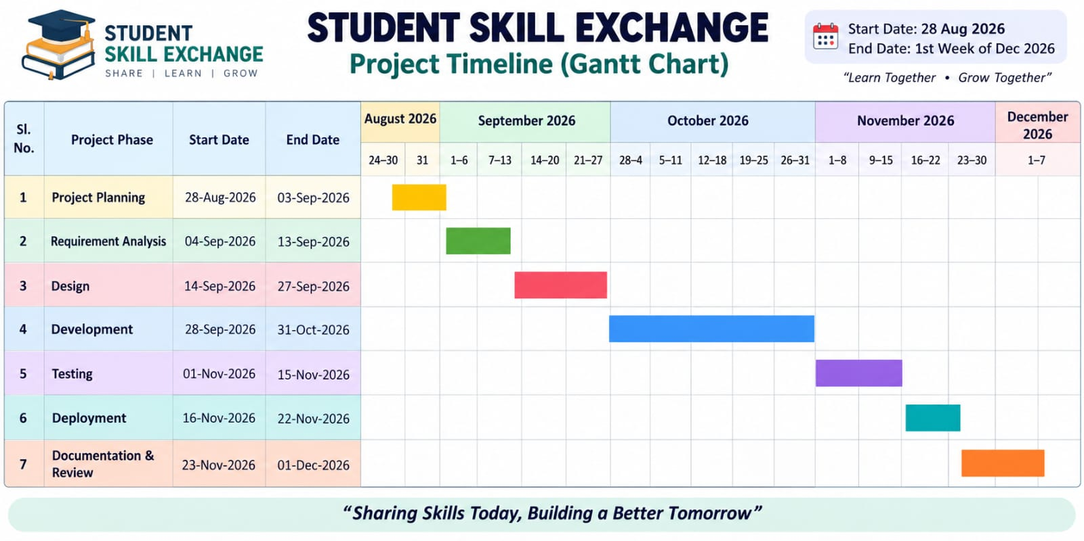

Slide 16


