Slide 1
vHSM Configuration and Setting TC36X

Slide 2
Agenda
Overview
Data and Service Flow of Crypto Jobs
Inter-Processor Communication (IPC)
Integration
HSM Memory Regions
HSM UCB Settings
Synchronizing HSM and Application Cores

Slide 3
Agenda
Overview
Data and Service Flow of Crypto Jobs
Inter-Processor Communication (IPC)
Integration
HSM Memory Regions
HSM UCB Settings
Synchronizing HSM and Application Cores

Slide 4
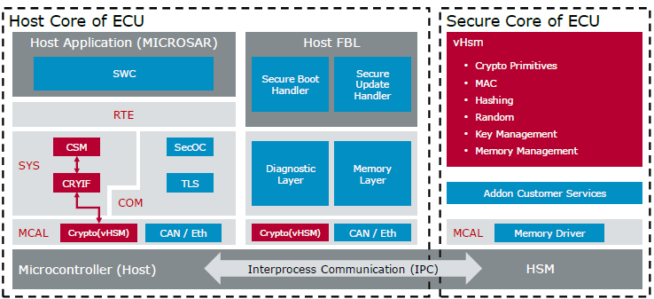
vHsm Overview
Software Architecture:
vHsm is based on approach that hardware provides a dedicated secure zone for security applications including a
Core
Secure Memory
Crypto Hardware Accelerators
This secure zone provides
Provides security services
Stores the key in a memory section accessible only by HSM core (typically HSM exclusive data flash)
Manages keys
Executes cryptographical algorithm using software and/ or hardware implementations
From the above image, at least three projects can be distinguished:
Application, Bootloader and vHsm
Modules marked in red are essentially required for HSM crypto mechanism
Modules marked in blue are indicating typical environment

Slide 5
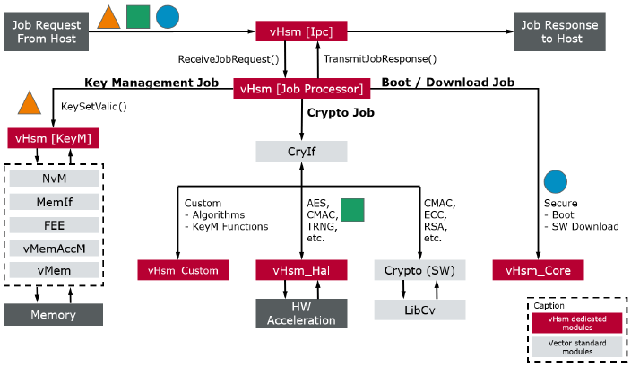
vHsm Overview.. contd
Functional Principle:
vHsm includes multiple crypto drivers that provide different functionality (e.g. access to available hardware accelerators, key storange)
The HSM core communicates via a software defined Inter processor communication (placed in shared RAM) with the application core(s).

Slide 6
Agenda
Overview
Data and Service Flow of Crypto Jobs
Inter-Processor Communication (IPC)
Integration
HSM Memory Regions
HSM UCB Settings
Synchronizing HSM and Application Cores

Slide 7
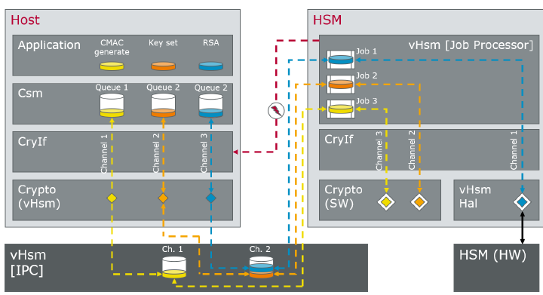
Data and Service Flow
Host core must run following AUTOSAR standard crypto modules:
CSM provides an interface to higher layer modules and distributes service request to adequate queues
CryIf forwards the crypto service request to respective crypto drivers.
Crypto (vHsm) is the driver for the communication with the HSM core. It provides the IPC communication. In addition, it specifies the available crypto primitives and the available keys stored in the HSM

Slide 8
Agenda
Overview
Data and Service Flow of Crypto Jobs
Inter-Processor Communication (IPC)
Integration
HSM Memory Regions
HSM UCB Settings
Synchronizing HSM and Application Cores

Slide 9
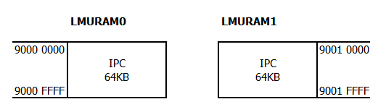
HSM Inter-Processor Communication (IPC)
HSM uses a software Inter-Processor Communication (IPC) interface for information exchange between application software and vHSM
The information, which are written into the IPC are only pointers for Job processing. The actual data will be fetched from the address the pointer refers to.
Each Host core that is using security services of HSM core requires an IPC instance.
This interface is placed in shared RAM (LMURAM) of microcontroller to which HSM as well as application cores have access.
Limitations due to AURIX Architecture
All memory access from HSM to application core is cached and there is no cache coherence implemented in the hardware.
While reading host memory from the HSM is possible by invalidating cache lines, but writing through cache would require invalidation which writes back the whole cache line and may corrupt the data (For more details refer Microcontroller User Manual, Section 2.5 and 9.5.1)
Therefore, for writing there is a single access memory window (F005 0000 ~ F005 FFFF) which bypasses the cache.

Slide 10
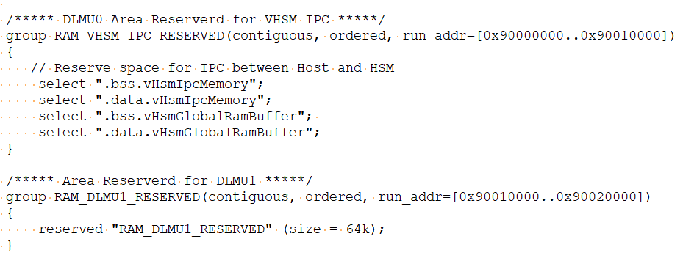
HSM Inter-Processor Communication (IPC) …contd
Application side requirements:
There are two linker sections which are important to HSM communication and must be taken special care of
vHsmIpcMemory locates the IPC in the ram to communicate
vHsmGlobalRamBuffer for exchanging data where the HSM has no read or write permission.
These sections must be accessed by the HSM. Therefore, they must be mapped to a 64KB (due to limit of LMURAM) range so that HSM can configure the access memory window to write to these sections at the same time.
Example of Linker Changes required:
Important to know:
Any read pointer provided to vHsm via a job will not be modified and data is ready directly from Cache
Any write pointer, will be rewritten by the vHsm so that the upper 16 bits of the address are 0xF005. This means that any write access is done through the Single Access Window

Slide 11
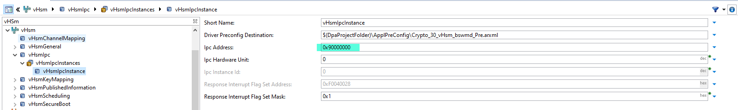
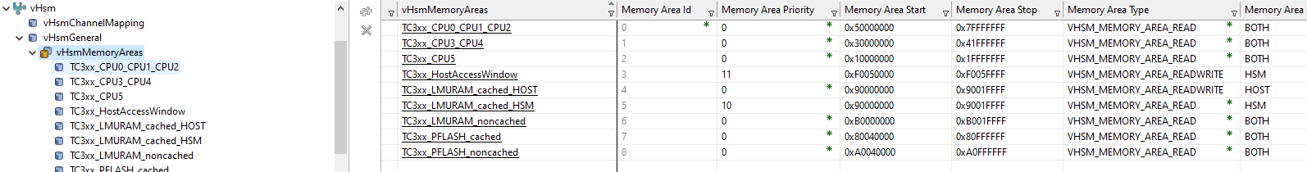
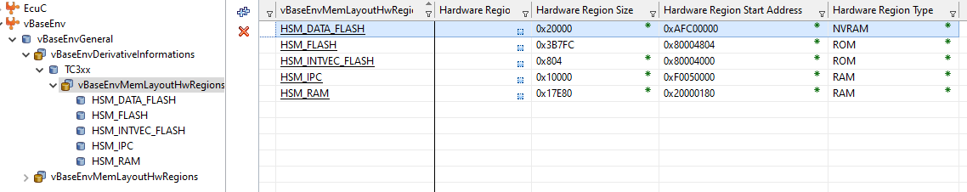
HSM Inter-Processor Communication (IPC) …contd
HSM side requirements:
vHsm firmware needs to know where the application places the vHsmIpcMemory section.
vHsm firmware must know which memory areas it can access. Ensure, areas are set to R/W which meet one of the following conditions
Area is 0xF0050000 ~ 0xF005FFFF (Single access memory window)
Area start with the IPC-Address and is not bigger than 64Kb (in our case, it is 0x9000000)

Slide 12
Agenda
Overview
Data and Service Flow of Crypto Jobs
Inter-Processor Communication (IPC)
Integration
HSM Memory Regions
HSM UCB Settings
Synchronizing HSM and Application Cores

Slide 13
Integration
HSM Project:
Supported MCAL Base package Integration
Configuration/ Selection of crypto key types, keys and key elements
Propagating configured keys to CryIf and Csm Keys
Configure Memory Regions and IPC Instance
Configuration of Interrupt / Polling mode
Generation of configure project which shall also generate (pre-config arxml file which shall be input to Host project)
Compilation of HSM project
Switch to HOST (Application) Davinci project:
Add “Csm”, “CryIf” and “Crypto” modules
Add a path to “pre-config arxml” generated in HSM project by adding it has “Additional module definition”.
Crypto module should not be modified in HOST project as all necessary settings shall be imported using “pre-config arxml” like IPC setting, Primitives, Driver Objects.4. Propagate the required keys from Crypto driver to “Csm” and “CryIf” modules.
Propagate keys from Crypto module to CryIf and Csm
Create CryIf channel and provide 1-1 mapping to Driver Object.
Create Csm Queue which shall be mapped 1-1 to CryIf channel
Create Csm Primitive with required algorithms
Create Csm Job and map the job to respective Primitive, Key, Queue. Select if Job has to processed Synchronously or Asynchronously

Slide 14
Agenda
Overview
Data and Service Flow of Crypto Jobs
Inter-Processor Communication (IPC)
Integration
HSM Memory Regions
HSM UCB Settings
Synchronizing HSM and Application Cores

Slide 15
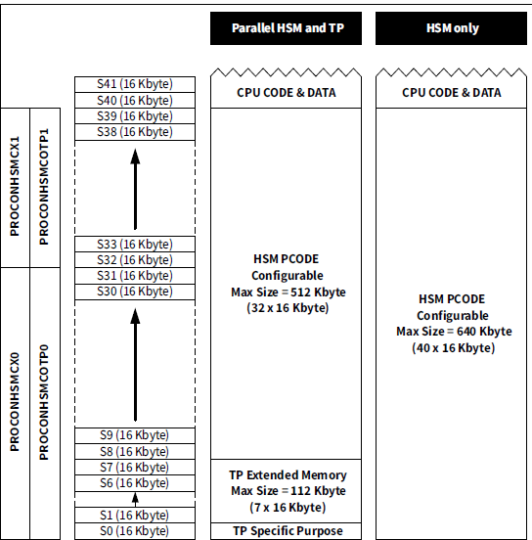
HSM PFLASH Memory
HSM Application should be flashed in PFLASH0 (8000 0000 ~ 801F FFFF)
Out of 2MB PFLASH0 size, Max of 640 KB (8000 0000 ~ 8009 FFFF) can be allotted to HSM Application
640 KB addresses is divided into 40 sector (S0 ~ S39) of each 16KB (16KB * 40)
HSM Sectors can be made HSM exclusive so that no other Core can access this area
HSM Sectors can also be made OTP to avoid re-flashing (Security Feature)

Slide 16
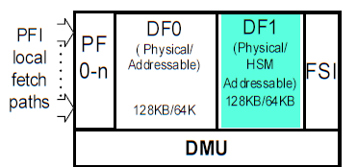
HSM DFLASH Memory
HSM uses 128KB of DFLASH1 (AFC0 0000 ~ AFC1 FFFF) memory for NvM Storage.
DFLASH1 memory can be made exclusive to HSM to protect this memory to be accessed by other Cores.
On Virgin HSM data flash it may be needed to initialize it before the memory stack is used. If data flash is not initialized, it may lead to an endless loop during readall at startup.
To fix this, two solution is available (either of below can be applied)
Flash DFLASH1 using the hex file (writing 0xFF) provided by Vector along with Demo HSM project (Recommended by Vector)
Note: Writing to data flash using debugger must be allowed by the HSM. So, either disable the HSM or do not set DF exclusive bits when enabling HSM.
Uncheck “Virgin Flash Illegal State” option in Fee\FeeIfxSpecificConfig. This parameter enables FEE to reach illegal state upon detection of virgin flash

Slide 17
Agenda
Overview
Data and Service Flow of Crypto Jobs
Inter-Processor Communication (IPC)
Integration
HSM Memory Regions
HSM UCB Settings
Synchronizing HSM and Application Cores

Slide 18
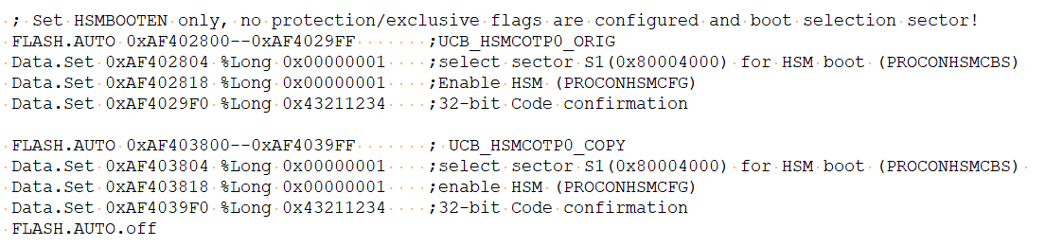
HSM UCB Settings:
PROCONHSMCX(0~1) : Register to set the sectors HSM Exclusive
PROCONHSMC0TP(0~1) : Register to set the sectors One Time Programmable
PROCONHSMCFG: Register to configure following settings:
HSMBOOTEN (Bit 0) : HSM Boot Enable. Setting this bit, HSM Boot will be enabled. Enabling this will make HSM firmware to look for application at the selected sector (see PRCONHSMCBS register)
SSWWAIT (Bit 1): Setting this bit will wait for HSM to release the jump to CPU0 to User code.
HSMDX (Bit 2): This bit indicates whether DFLASH1 logical sectors of EEPROM are configures as “HSM exclusive”
HSMENRES (Bit 9~10): This bit indicates whether HSM can trigger Reset. Setting both bit enables Reset.
PRCONHSMCBS: Boot Sector Selector
BOOTSEL0 (Bit 0~5): This field controls which of the HSM code sectors (S0~S39) is searched for boot code.
If this bit is Set without having valid HSM application at selected code sectors and HSM Boot enable, ECU will be locked forever
Note: Both UCB (ORG and COPY) has to be configured. Above UCB used as following address range,
ORG: AF40 2800 ~ AF40 2BFF
COPY: AF40 3800 ~ AF40 3BFF

Slide 19
Agenda
Overview
Data and Service Flow of Crypto Jobs
Inter-Processor Communication (IPC)
Integration
HSM Memory Regions
HSM UCB Settings
Synchronizing HSM and Application Cores

Slide 20
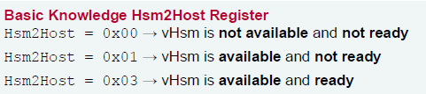
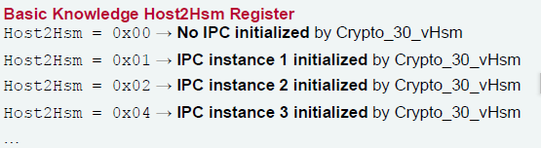
Synchronizing HSM and Application Core:
vHsm automatically starts the applications cores if the SSW on application side waits for it. To enable this behavior, the corresponding bit in PROCONHSMCFG must be set.
For configuration where the application cores start automatically, it is required to wait for the vHsm to be fully operational on application side before the vHsm crypto driver is initialized. This can be obtained by calling Crypto_30_vHsm_WaitForHsmRam() function
This function internally wait until following status is read,
HSM2HST (0xF0040034) register read as 0x03
HST2HSM (0xF0040038) register read as “No. of Instances”.
For e.g. if one IPC instance is created, value is “1”.
Note:
HST2HSM register needs to be initialed to zero once at the very beginning during the host startup. This is because on some hardware revision the register might not be zero at startup.
This may stop HSM module consider wrong number of IPC initialization which in turn stop IPC initialization in vHSM application.

