Slide 1
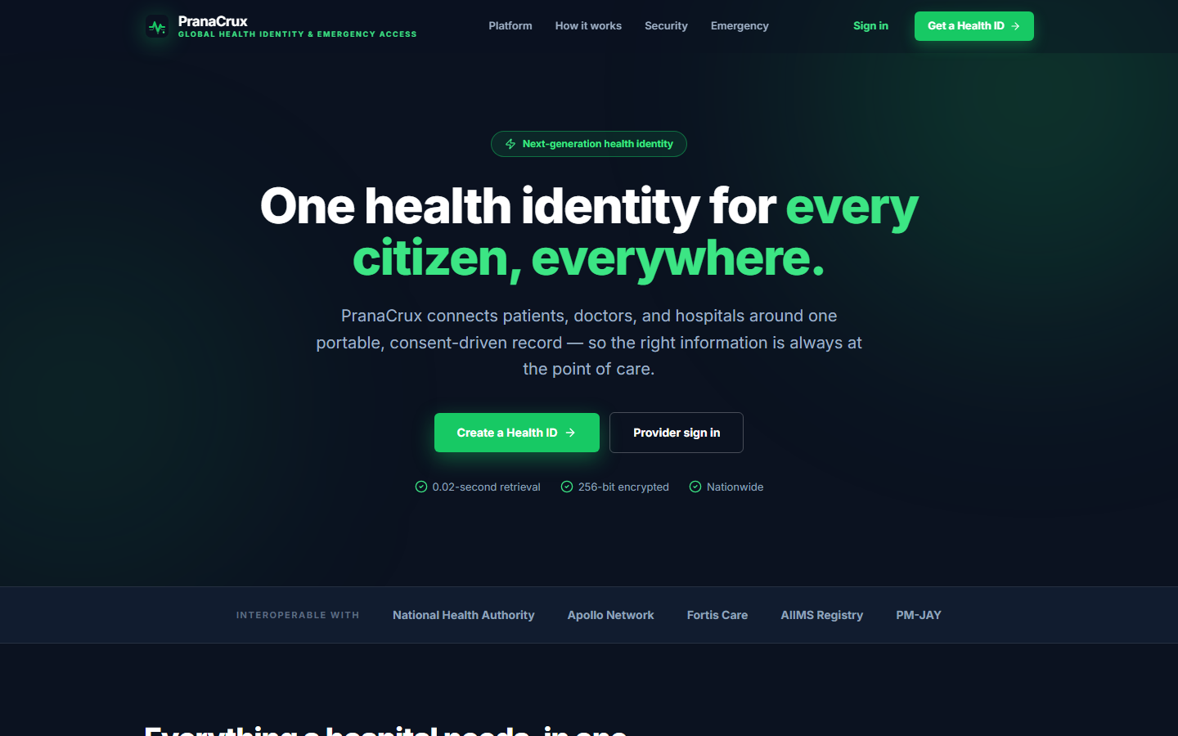
HACKATHON · FINAL PRESENTATION
PranaCrux
Digital Health Identity & Emergency Access Platform
“Critical health information, available when it matters most.”
One Health ID
Controlled Access
Emergency Ready
Audit Traceable
Live product preview
One digital identity.
Relevant information, shown only to authorized roles, every access traceable.
PranaCrux Digital Health Identity & Emergency Access Platform
01 / 10

Slide 2
THE CHALLENGE
PRANACRUX
The Problem
In a medical emergency, the biggest problem can be the information gap.
Accident
>
Unconscious Patient
>
Doctor
>
Missing Medical History
Fragmented Records
Emergency Information Gap
1
2
Health data is scattered across hospitals, labs, and paper files.
An unconscious patient cannot communicate critical medical history.
Delayed Access
Lack of Accountability
3
4
Doctors may not know medications, labs, vitals, or conditions in time.
Sensitive data needs controlled and fully traceable access.
PranaCrux Digital Health Identity & Emergency Access Platform
02 / 10

Slide 3
THE SOLUTION
PRANACRUX
Meet PranaCrux
One identity. Relevant information. Controlled access.
Appointments
FROM FRAGMENTED → UNIFIED
Emergency Access
Fragmented Information
PranaCrux
Unified Digital Health Identity
>
>
Medications
ONE
DIGITAL
HEALTH ID
Patient Profile
EMERGENCY FLOW
Vitals
Emergency
Verify
Essential Info
Audit
>
>
>
Medical Records
Designed for the moment a patient cannot speak for themselves.
Lab Reports
PranaCrux Digital Health Identity & Emergency Access Platform
03 / 10

Slide 4
THE USERS
PRANACRUX
Patients & Doctors — One Controlled Flow
Profile
Authorized Records
Global Health ID
Patient Search
Appointments
Lab Reports
CONTROLLED
HEALTH
INFORMATION
FLOW
PATIENT
DOCTOR
Emergency Card
Medical Records
Access History
Vitals
Lab Reports
Patient → Authorized Access → Doctor
Medications
Medications
Schedule
Vitals
Appointments
PranaCrux Digital Health Identity & Emergency Access Platform
04 / 10

Slide 5
GOVERNANCE
PRANACRUX
Doctors & Hospital Admins
Appointments
Access Monitoring
Access History
Hospital Records
Update Medical Data
DOCTOR
Operational Oversight
HOSPITAL
ADMIN
Manage Schedule
Hospital Management
View Records
Scoped Access
Patient Lookup
Doctor Management
PLATFORM HIERARCHY
PranaCrux
Platform
>
Hospital
>
Doctors
>
Patients
Hospital access is scoped to its own context — never platform-wide.
PranaCrux Digital Health Identity & Emergency Access Platform
05 / 10

Slide 6
ARCHITECTURE
PRANACRUX
Technology Behind PranaCrux
FRONTEND
INFRASTRUCTURE
React 19 · TypeScript · Vite
Vercel
Render
Frontend hosting
Backend hosting
Cloud MySQL
Brevo
>
REST / JSON
Managed database
Email verification
BACKEND
Java 17 · Spring Boot 3 · REST APIs
CORE CONCEPTS
● Role-based access control
>
JPA
● Authentication & consent-gated records
DATA LAYER
● Audit logging for every sensitive access
MySQL · JPA / Hibernate
● QR-based emergency access card
● Relational data model (patients ↔ doctors ↔ hospitals)
PranaCrux Digital Health Identity & Emergency Access Platform
06 / 10

Slide 7
WHY IT'S DIFFERENT
PRANACRUX
Innovation & Scalability
Emergency-First Access
Controlled Access
01
Critical health information is reachable when the patient cannot communicate.
02
Access is role-based and context-aware — never an open record dump.
One Health Identity
Accountable Access
03
A single digital ID connects records, labs, vitals, meds, and appointments.
04
Every sensitive access leaves an audit trail — who, what, when, how.
SCALABILITY PATH
Patient
>
Doctor
>
Hospital
>
Healthcare Network
Wider healthcare integration
is designed-in future scalability — not current functionality.
PranaCrux Digital Health Identity & Emergency Access Platform
07 / 10

Slide 8
ROADMAP
PRANACRUX
What's Next for PranaCrux?
NOW
NEXT
SCALE
What today's prototype demonstrates
Planned near-term enhancements
Long-term expansion
● Unified digital health identity
● Hospital & healthcare-system integration
● Analytics & decision support
● Role-based controlled access
● Standardized interoperability (HL7 / FHIR)
● Wider emergency responder network
● Emergency access mechanism
● Advanced identity verification (biometrics, KYC)
● Interoperable healthcare ecosystem
● Full audit trail
● Dedicated mobile application
● Population health insights
LIVE AND RUNNING
FUTURE INTEGRATION
FUTURE VISION
Built phase-by-phase so each enhancement extends the core — no redesign required.
PranaCrux Digital Health Identity & Emergency Access Platform
08 / 10

Slide 9
THE DIFFERENTIATOR
PRANACRUX
When Seconds Matter, Information Matters
1
Unconscious patient arrives at the hospital
Fast access does not
mean uncontrolled access.
2
Patient cannot explain medical history
3
PranaCrux emergency access is initiated
THE PRANACRUX PRINCIPLE
4
Identity is verified securely
Emergency
>
Verify
>
Essential Info
>
Audit
5
Essential health information is revealed
PranaCrux delivers the right information to authorized professionals — it does not make clinical decisions.
6
Doctor makes an informed decision
Every access is logged & auditable
Emergency → Verify → Essential info → Audit
Accessible when it matters. Accountable always.
7
PranaCrux Digital Health Identity & Emergency Access Platform
09 / 10

Slide 10

Thank You
Explore PranaCrux
Scan to open the live application
PranaCrux · Digital Health Identity & Emergency Access Platform
Live Demo: https://prana-crux.vercel.app/

