Slide 1


G.H. RAISONI COLLEGE OF ENGINEERING
AND MANAGEMENT, WAGHOLI, PUNE
Department of CSE ( AI & AIML)
< Online trading classes >
Guide:
< prof. Shubhankar Dolke>
Name of projectees
< Kashish Shaikh D2>
<Yashaswi Bannapure D4>
<Ganga Chillale D5>

Slide 2
Contents
Introduction
Justifications for Selecting the Title
Problem Statement
Literature Survey
Block Diagram
Expected Result
Work plan
References

Slide 3
Introduction
Online Trading Classes
The purpose of this project is to develop an interactive web application that offers comprehensive trading classes focused on the integration of machine learning techniques.
It aims to provide users with the tools and resources needed to understand, develop, and implement ML models for trading purposes.

Slide 4
Justification For Selecting The Title
Growing Interest in Financial Markets
2. Accessibility and Convenience
3. Need for Education in Financial Literacy
4. Response to Current Trends:

Slide 5
Problem Statement
In today's financial markets, individuals are increasingly interested in participating in trading and investing, many lack the necessary knowledge, skills, and resources to do so effectively and safely.
The lack of accessible, comprehensive, and practical trading education is a critical issue that needs to be addressed
To of an online trading classes websiteaddress these challenges, we propose the development

Slide 6
Literature Survey
Sr. No. | Paper Title and Year | Details of Publication | Findings
1
2
3
4
5
6

Slide 7
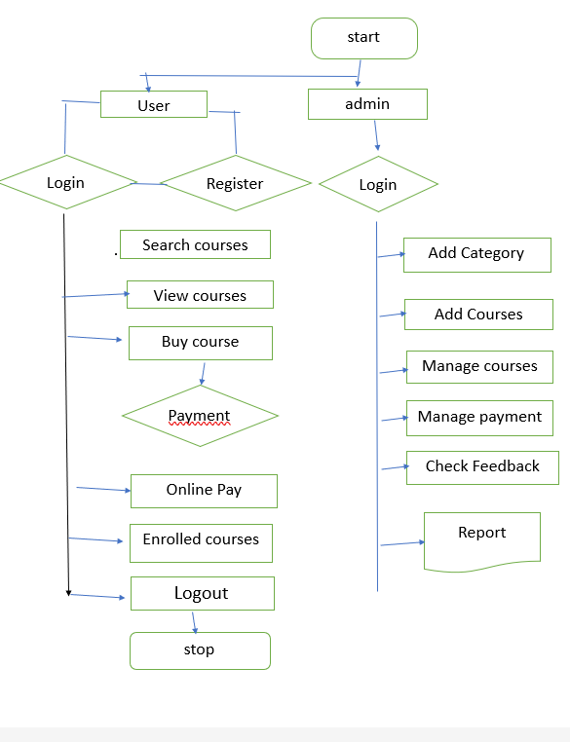
Block Diagram

Slide 8
Expected Result
User-Friendly Interface: Easy navigation with clear course categories and descriptions
Mobile Compatibility: A responsive design that works well on smartphones and tablets.
Customer Support: Reliable and accessible support for any issues or inquiries
Secure Transactions: Safe and secure payment processing options.

Slide 9
Work – Plan
Months Activities | August’23 | Sept’23 | Oct’23 | Nov’23
Literature Reviews | √
Requirement Analysis | √
Designing | √
Experimental Analysis | √ | √ | √
Module wise Implementation |  | √ | √
Testing and Debugging |  |  | √ | √
Preparation of Project Report |  |  |  | √

Slide 10
References
Smith, J. (2023). Principles of Online Trading and Investment Strategies. New York: Financial Times Publishing.
This book provided insights into the foundational principles of trading and investment strategies, which informed the structure of the courses offered in the web application.
2. Investopedia. (2023). "Introduction to Trading." Retrieved from https://www.investopedia.com/terms/t/trading.asp
An online resource that provided basic definitions and concepts of trading, used to ensure the content in the courses is accurate and up-to-date.2
3. Kumar, P. (2023). Web Development with HTML, CSS, and JavaScript. Bangalore: CodeGuru Publications.
This book was essential for designing the technical architecture of the web application, particularly in integrating the front-end and back-end systems.

Slide 11
Thank you !

