Slide 1


01
NEXORA
PROJECT
Smart Attendance App
Presented By: Ganga S Anil
LBSITW | B.Tech IT | SEM III

Slide 2
02
Time-Consuming Process
Manual attendance consumes valuable classroom time
Problem Statement
Proxy Attendance
Students can mark attendance for absent classmates.
Poor Record
Management
Maintaining attendance records manually is difficult and error-prone.
Need For A Smart Solution
Lack of Automation
Attendance tracking and report generation require additional effort.
To develop an intelligent attendance management system that automates attendance tracking using facial recognition and cloud-based data management.
Visual Suggestion: Add a small image of a classroom, attendance sheet, or teacher taking attendance.
Scalability Issues
Managing attendance in large classrooms becomes challenging.

Slide 3

Key Features
03
Secure User Authentication
Proposed Solution
Student Enrollment System
Face Registration Module
AI-Based Face Detection
Automated Attendance Recording
Nexora Smart Attendance AI
Teacher Dashboard
Smarter Presence Management
Nexora Smart Attendance AI is an AI-powered attendance management system designed to automate attendance tracking through facial recognition technology.
Attendance Reports & Analytics

Slide 4
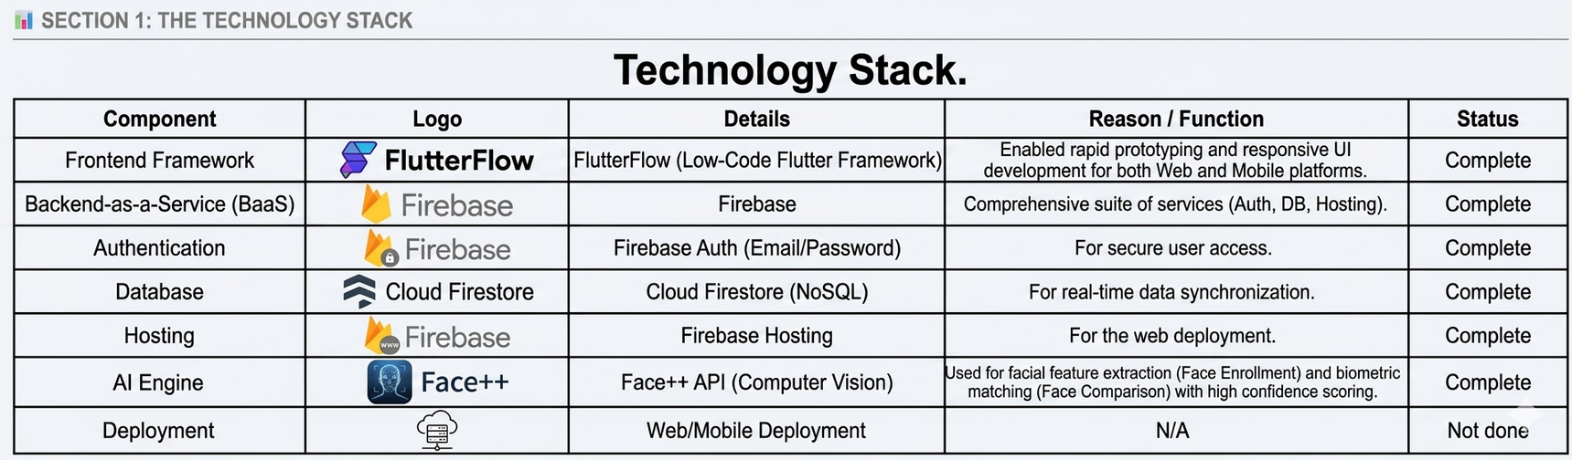
Technology Stack
04

Slide 5
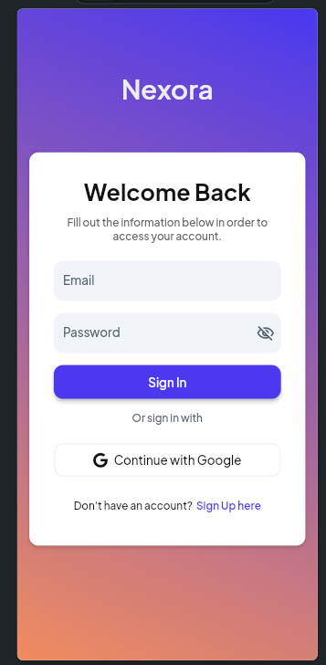
05
Login
Prompt used:
A high-fidelity mobile app UI mockup of a modern login screen, vertical orientation. The background features a smooth, vibrant linear gradient transitioning from deep purple at the top to a warm coral/orange at the bottom. In the center, there is a clean white card container with rounded corners and a soft drop shadow. Inside the card, the title reads 'Welcome Back' in bold black font, with a smaller subtitle below it: 'Fill out the information below in order to access your account.' The form includes two minimalist, light-gray input fields labeled 'Email' and 'Password' (with an eye icon on the right). Below the inputs is a prominent, bright royal blue 'Sign In' button with white text. Underneath the button, it says 'Or sign in with' followed by a white button containing the Google logo and the text 'Continue with Google'. At the very bottom of the white card, the text reads 'Don't have an account? Sign Up here' with 'Sign Up here' highlighted in blue. Clean, professional, minimalist app design, UI/UX asset style.

Slide 6
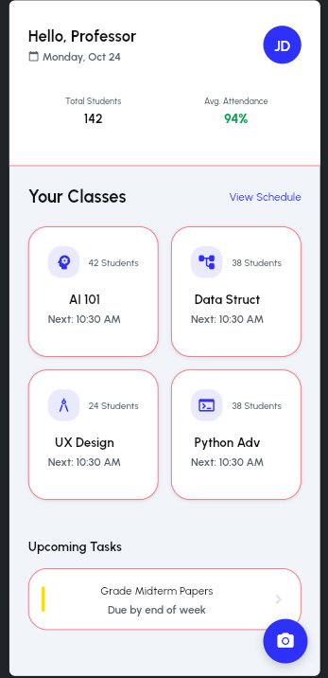
06
Teachers Dashboard
Prompt used:
A professional Teacher's Command Center dashboard. Top section: A welcoming header 'Hello, Professor' with a profile picture and a date widget. Middle section: A grid of 'Class Cards'. Each card should have a subject name (e.g., AI 101), the number of enrolled students, and a small 'Start Attendance' button. Bottom section: A floating action button (FAB) in the bottom right corner with a camera icon. Color palette: White background, Electric Blue accents, and soft gray cards. Style: Modern SaaS Dashboard, clean grid system.

Slide 7
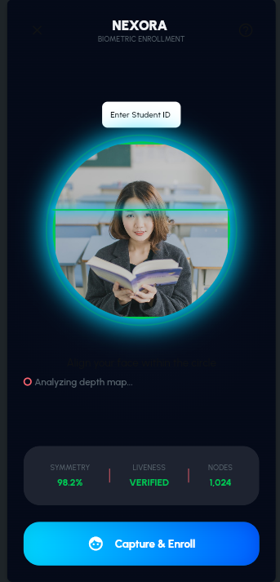
07
Face Enrollment
Prompt used:
A high-tech face registration interface. Dark mode theme with a deep navy background. Center of the screen: a large, glowing circular camera viewfinder with a pulsing electric blue border to guide face placement. Below the viewfinder, a status text 'Align your face within the circle' in white. At the bottom, a futuristic, glassmorphism-style button that says 'Capture & Enroll' with a subtle glow effect. Style: Futuristic, AI-driven, Cyber-minimalism.

Slide 8
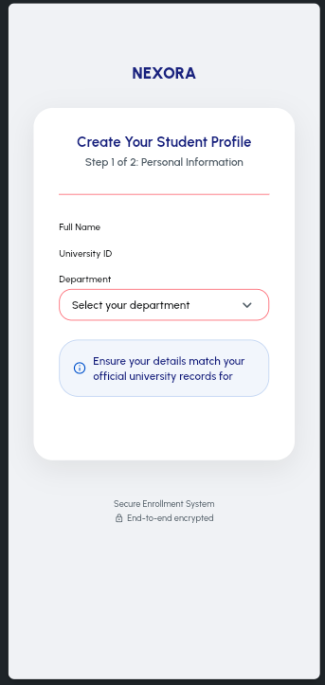
08
Student Registration
Prompt used:
A professional student enrollment screen. Use a clean, centered card layout with a soft white background and a subtle outer glow. Header: 'Create Your Student Profile' in bold dark navy. Include input fields for 'Full Name', 'University ID', and 'Department' with floating labels. At the bottom, a large, rounded Electric Blue button that says 'Proceed to Face Registration' with a right-arrow icon. The background should be a very light gray #F0F2F5 to make the white card pop. Style: Modern Enterprise UI, clean lines.

Slide 9
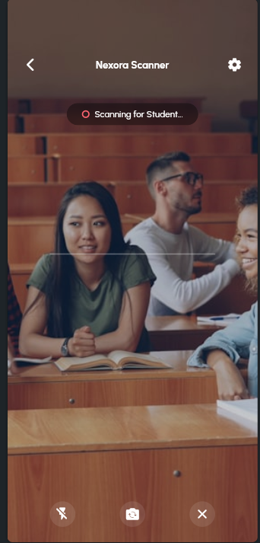
Attendance Scanning
09
Prompt used:
A minimalist full-screen camera scanner interface. The screen is almost entirely a camera view. In the center: a thin, white square scanning frame with four corner brackets. Above the frame, a floating semi-transparent pill-shaped label that says 'Scanning for Student...'. At the bottom, a large, rounded Electric Blue button that says 'Capture Face'. The UI should be overlayed on the camera feed with high transparency. Style: Modern Utility App, focused and clean.

Slide 10
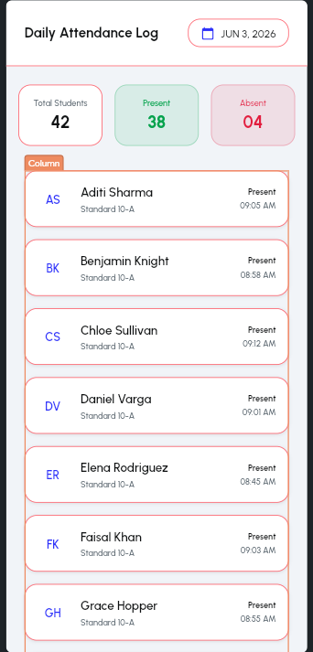
10
Attendance Report
Prompt used:
A professional attendance report page. Header: 'Daily Attendance Log' with a date picker at the top right. Main content: A clean list of students. Each row should be a white card with a soft shadow. Left side: Student's small circular profile photo and name. Right side: A bright green pill-shaped badge that says 'Present' and a timestamp (e.g., 09:05 AM). Use a light gray background to separate the cards. Style: Clean Administrative UI, high readability.

Slide 11
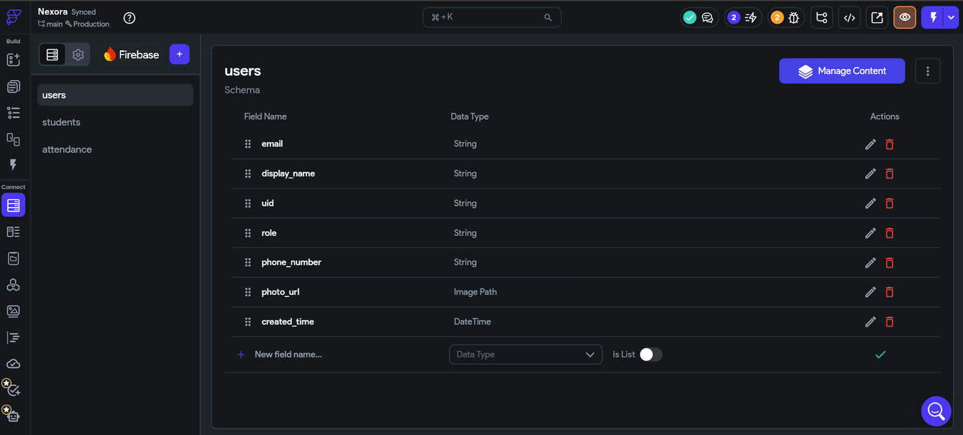
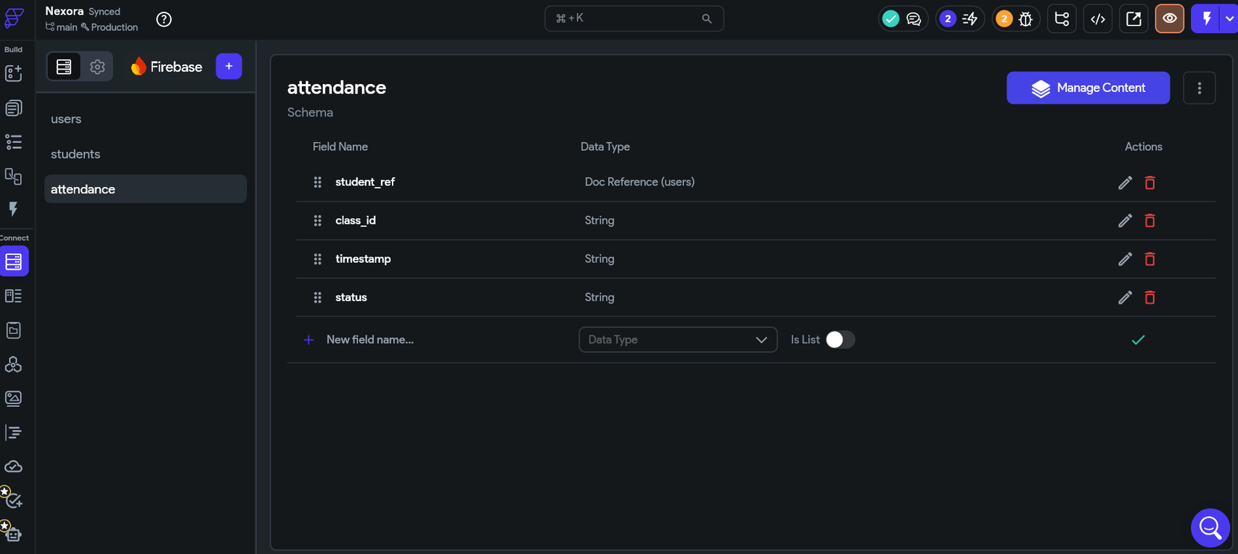
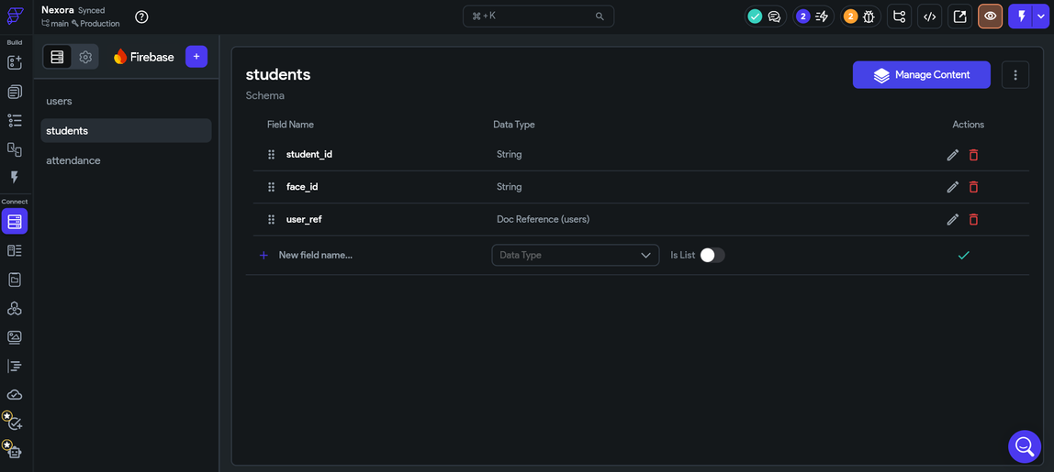
Database
11

Slide 12
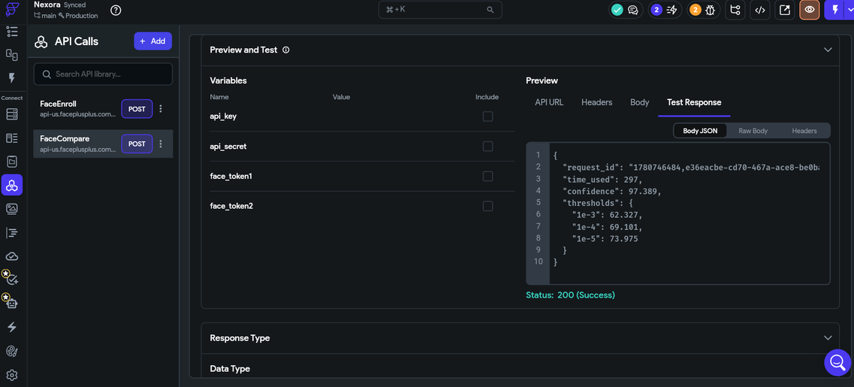
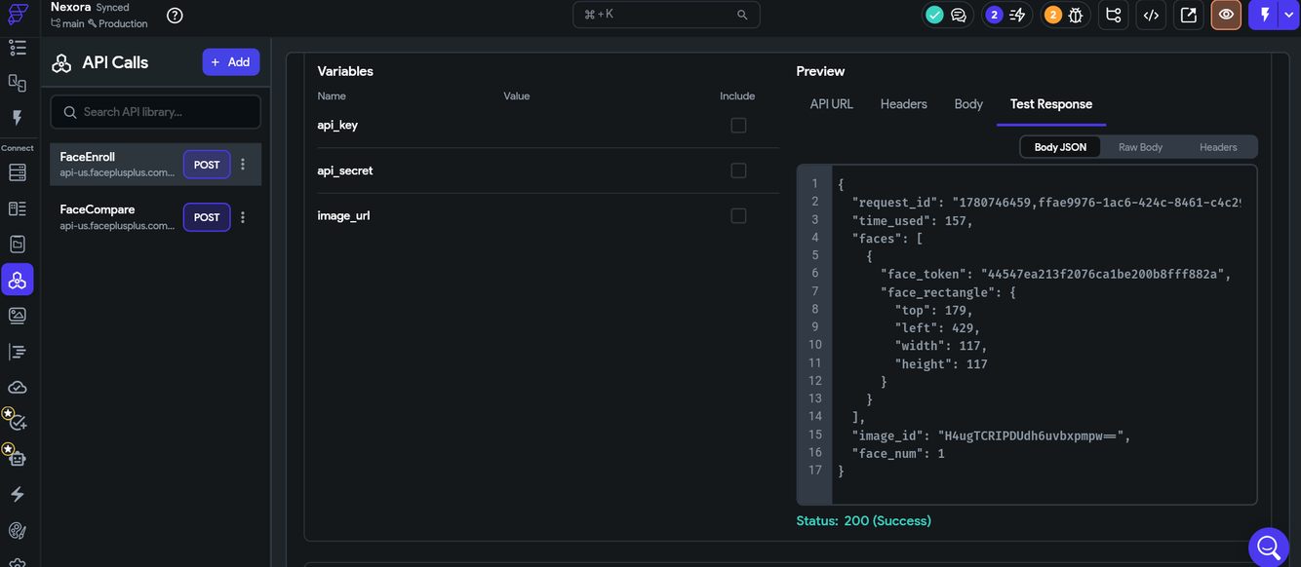
API Calls
12

Slide 13
13
Thank You
gangaanil2007xyz@gmail.com

