Slide 1
ANALYSIS OF H1B VISA APPLICANTS

Slide 2
Big Data
What it is and why it matters
Extremely large datasets that are hard to deal with using Relational Databases
Storage/Cost
Search/Performance
Analytics and Visualization
Need for parallel processing on hundreds of machines

Slide 3
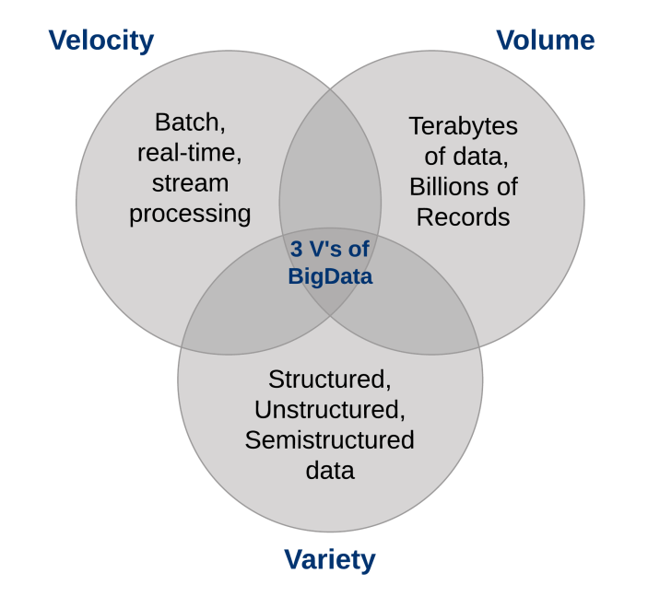

Slide 4
What is Hadoop?
Hadoop is an open-source software framework for storing data and running applications on clusters of commodity hardware. It provides massive storage for any kind of data, enormous processing power and the ability to handle virtually limitless concurrent tasks or jobs.

Slide 5


Slide 6
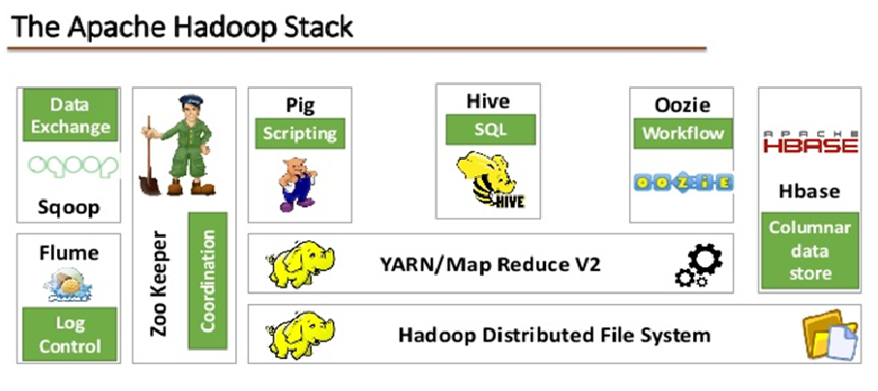
Hadoop EcoSystem

Slide 7
HDFS
Filesystems that manage the storage across a network of machines are called distributed filesystems.
Hadoop comes with a distributed filesystem called HDFS, which stands for Hadoop Distributed Filesystem.
HDFS, the Hadoop Distributed File System, is a distributed file system designed to hold very large amounts of data (terabytes or even petabytes), and provide high-throughput access to this information.

Slide 8
What is MapReduce?
MapReduce is a programming model
Programs written in this functional style are automatically parallelized and executed on a large cluster of commodity machines
MapReduce is an associated implementation for processing and generating large data sets.

Slide 9
What is Hive?
Hive is a data warehouse infrastructure tool to process structured data in Hadoop.
It resides on top of Hadoop to summarize Big Data, and makes querying and analyzing easy.
Initially Hive was developed by Facebook, later the Apache Software Foundation took it up and developed it further as an open source under the name Apache Hive.

Slide 10
Features of Hive
It stores schema in a database and processed data into HDFS.
It provides SQL type language for querying called HiveQL or HQL.
Hive is not RDBMS.
It is familiar, fast, scalable, and extensible.

Slide 11
What is Apache Pig?
Pig is a platform for analyzing large data sets that consists of a high-level language for expressing data analysis programs
Pig generates and compiles a Map/Reduce program(s) on the fly.

Slide 12
Features of Pig Apache
Rich set of operators: It provides many operators to perform operations like join, sort, filer, etc.
Ease of programming
Optimization opportunities

Slide 13
Project Synopsis
1 a) Is the number of petitions with Data Engineer job title increasing over time?
b) Find top 5 job titles who are having highest growth in applications.
2 a) Which part of the US has the most Data Engineer jobs for each year?
b) Find top 5 locations in the US who have got certified visa for each year.
3)Which industry has the most number of Data Scientist positions?
4)Which top 5 employers file the most petitions each year?
5) Find the most popular top 10 job positions for H1B visa applications for each
year?

Slide 14
6) Find the percentage and the count of each case status on total applications for each year. Create a graph depicting the pattern of All the cases over the period of time.
7) Create a bar graph to depict the number of applications for each year
8) Find the average Prevailing Wage for each Job for each Year (take part time and full time separate)
9) Which are top ten employers who have the highest success rate in petitions?
10) Which are the top 10 job positions which have the highest success rate in petitions?

Slide 15
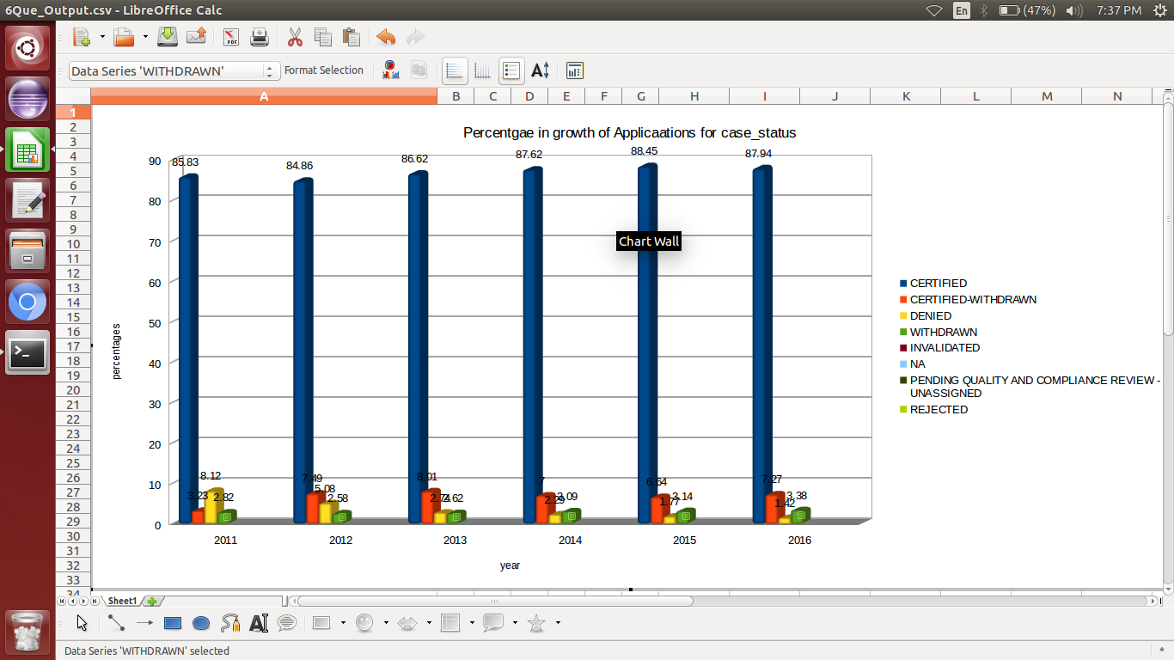

Slide 16
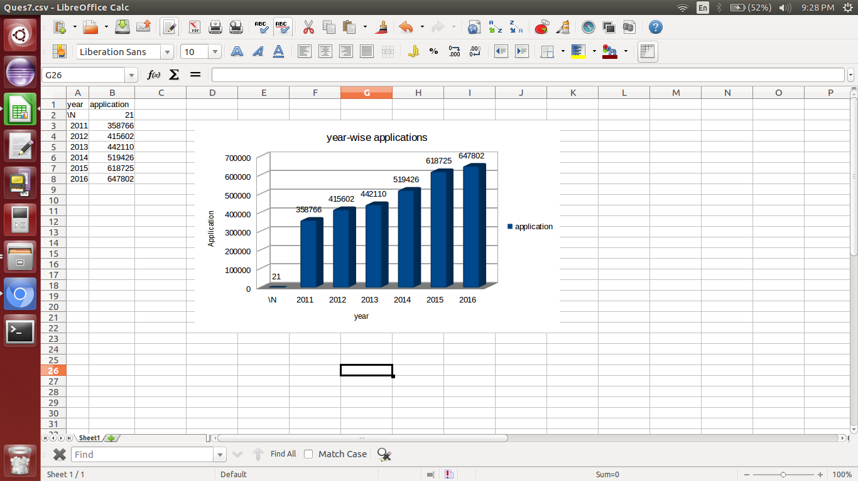

Slide 17
Thank You

