Slide 1
GNR 602
Canny’s Edge Detection
Team:
Rongali Sai Bhargav 190100102
NV Sai Gangadhar 190100080
Ansh Charak 19D170001

Slide 2
Canny’s Edge Detection
Canny’s edge detection is well known for its ability to generate single-pixel thick continuous edges.
Inputs taken- Image,smoothing parameter, high threshold and low threshold values

Slide 3
5 Major steps
Canny’s edge detection can be implemented in five major steps
Applying the gaussian
Finding intensity gradients of the image
Non-maxima suppression
Double thresholding
Edge tracking by hysteresis

Slide 4
Step-1: Generation of Masks
In Canny’s edge detection masks used are first derivative of gaussian in x, y direction
Reasonable computation of mask size.
We chose mask size based on analyzing the gaussian and applying a threshold T.”shalf” is computed by finding the point on the curve where the gaussian value drops below T, i.e., solving exp(-x^2/(2sigma^2)) = T
This gives sHalf = round(sqrt(-logT *2*sigma^2)). The mask size is then 2sHalf+1 to incorporate both positive and negative sides of the mask

Slide 5

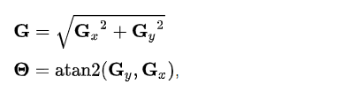
Applying Masks to images
Gaussian filter of size (2k+1)X(2k+1) is
The masks are applied to the images using convolution. Horizontal edges are seen in fx and vertical edges are seen in fy. (Sobel operator is preferred for calculation of gradient).
Edge gradient and direction are computed as

Slide 6
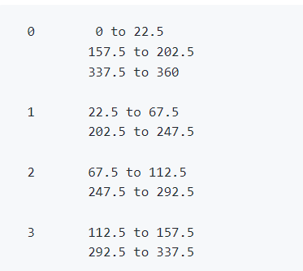
Non Maxima Suppression
Non maxima suppression step makes all edges one pixel thick. The first step is to quantize gradient direction into just four directions. In the implementation we assigned the following values.
Pick two neighbors of each edge point along the gradient direction.
This is because gradient direction is perpendicular to the edge

Slide 7
Hysteresis Thresholding
Apply two thresholds to follow edges.
Made the border pixels zero, so that finding neighbors doesn’t go out of bounds.
Next image is scanned from left to right , top to bottom. The first pixel in non-maxima suppressed magnitude which is above a certain threshold is declared an edge.
Two stopping conditions: If neighbor is below TI, we won’t recurse on it also if a neighbor has already been visited.

Slide 8
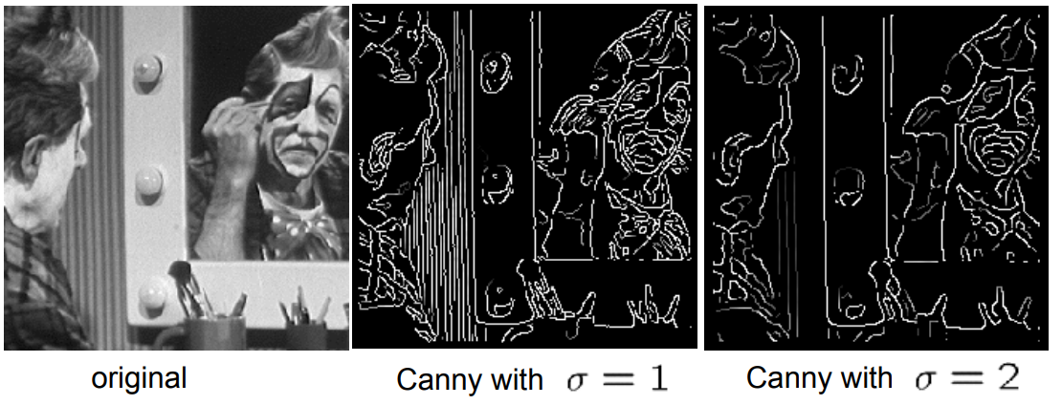
Effects of sigma
Large sigma detects large scale edges
Small sigma detects fine features

Slide 9
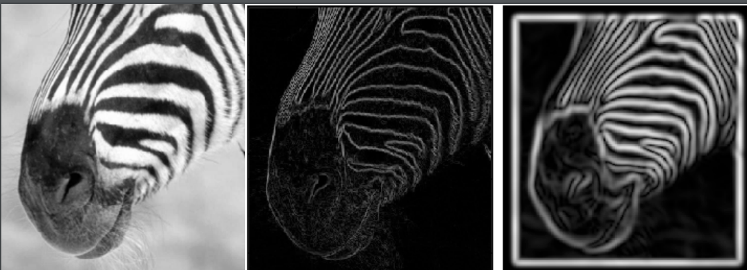
Effects of scaling
Smoothing eliminates noise edges and removes the fine detail

Slide 10
Have a look at the code

