Slide 1


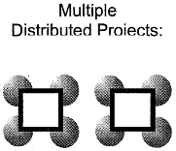



 | Single Project | Multiple Projects (Program)
Single Location
Multiple Locations
Caption:

