Slide 1

Online Quiz Application
GANGADHARA RAVI TEJA
41611049
CSE WITH SPECIALIZATION IN ARTIFICIAL INTELLIGENCE AND MACHINE LEARNING
Guided by :
Dr. MINU SUSAN JACOB M.E., Ph.D

Slide 2
Presentation Outline
Abstract
Introduction
Objective
Existing Availabilities
Disadvantage of existing Product
System Architecture / Ideation Map
Design Requirements
Product Working Principle
Application - Snapshots
Reference

Slide 3
“Online Quiz Application” is a collection of number of different types of quizzes like Data Structures, Python programming, Java etc. A user can access/play all of the quiz and can attempt any of the one. There will be limited number of questions and for each correct answer user will get the result. User can see answers as well as can ask a query related to it.
By this application the user will come to know about his/her level and can learn additional knowledge.
Also by this application a user can expand his/her knowledge among the world. Online Quiz System , as described above, can lead to error free, secure, reliable and fast management system.

Slide 4
Introduction
The "Online Quiz System" has been developed to override the problems prevailing in the practicing manual system. This software is supported to eliminate and in some cases reduce the hardships faced by this existing system. Moreover this system is designed for the particular need of the company to carry out operations in a smooth and effective manner.
The application is reduced as much as possible to avoid errors while entering the data. It also provides error message while entering invalid data. No formal knowledge is needed for the user to use this system. Thus by this all it proves it is user-fnendly.

Slide 5
Introduction
There are many quiz applications available currently on internet. But there are few which provide better understanding between users and the application like, providing proper answers, user query Solving, uploading user questions as well as answer to it, etc. To develop a user friendly quiz application.which will contain .
Numbers of quiz, Answers to every question, Query solving regarding any question, Uploading of user question and answer, and to improve the knowledge level of users. To develop an application which will contain solution to the above problems.

Slide 6
Objectives
The main objective of “Quiz Application” is to facilitate a user friendly environment for all users and reduces the manual effort. In past days quiz is conducted manually but in further resolution of the technology we are able to generate the score and pose the queries automatically.
The functional requirements include creating users that are going to participate in the quiz, automatic score and report generation and administrative tasks like add, delete, update for admin privilege users.
In this application, all the permissions lies with the administrator i.e., specifying the details of the quiz with checking result will show to interviewee or not, addition of question and answers.

Slide 7
Objectives
Implement stringent privacy and security measures to safeguard user data, particularly when working with potentially sensitive images.
Develop an intuitive and user-friendly interface that makes the tool accessible to both novice and experienced users.
Ultimately, the goal of the project is to deliver a feature-rich and reliable online quiz application tool that empowers users in the creative industry to efficiently and effectively work with differrent quizes.

Slide 8
Existing Availabilities
There are so many Projects are available on Quiz Application . There are as follow –
QuizUp Combining trivia and a social network, Quiz Up invites you to choose from more than 1,200 topics, take part in challenges and illustrated quizzes and post about your interests. You can play against friends or go up against millions of the platform‟s users.
HeadsUp! Suitable for all the family, this game sees players guess words/names/titles, which may include celebrities, characters, movies, books and songs, which are described or acted out by their friends.

Slide 9
Existing Availabilities
PopcornTrivia
Test out your knowledge of the silver screen with this addictive movie trivia app. Questions, based on classic films, blockbusters and fan favorites, span picture rounds and multiple choices. Each question is followed with an interesting fact. Play solo or against others.

Slide 10
Disadvantages of the existing Product
Data Privacy Concerns: Online quiz platforms collect a significant amount of data on students, which can raise concerns about privacy and data security.
Dependency on Internet Connection: Some Projects may require a constant internet connection, which can be inconvenient for users in areas with unreliable internet access.
Technical Issues: Online quizzes may encounter technical problems, such as server crashes, slow loading times, or compatibility issues with different devices and browsers.These technical glitches can disrupt the quiz-taking experience and cause frustration for both students and educators.

Slide 11
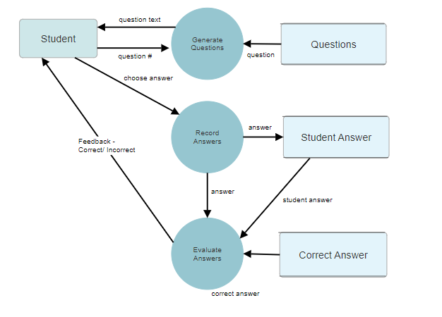
System Architecture / Ideation Map

Slide 12
Design Requirements
Software Requirements
Web Development Environment : Code Editor/Integrated Development Environment (IDE) such as Visual Studio Code, Sublime Text, or JetBrains WebStorm for Running HTML, CSS, and JavaScript code
Web Browser : Modern web browser (e.g., Chrome, Firefox, Safari) for testing and running the web application.
Web Hosting : A web hosting or cloud hosting service for deploying the web application. Options include AWS, Heroku, Netlify, or similar platforms.

Slide 13
Design Requirements
Hardware Requirements
Development Machine : A computer with sufficient processing power, memory, and storage for web development tasks
Operating System: Windows 8, Windows 10, MAC OS, Linux.
Internet Connection : A reliable internet connection for development, testing, and deployment.

Slide 14
Product working principle
Pre-requisites:
Node version 8.10.0
npm version 5.6
A text editor (VS Code recommended).
Mongo DB
STEPS TO SETUP REACT PROJECT
Step 1 — Download the necessary prerequisites, including Node.js, React, MongoDB, and a text editor.v

Slide 15
Product working principle
Step 2— Creating a New Project with Create React App In this step, we will create a new application using the npm package manager to run a remote script. The script will copy the necessary files into a new directory and install all dependencies.
Step 3 — Using React Scripts React Scripts is a set of scripts from the create-react-app starter pack. Create react- app helps us kick off projects without configuring, so we do not have to setup your project by our self. React-scripts start sets up the development environment and starts a server, as well as hot module reloading

Slide 16
Product working principle
Step 4 —Starting the Server and Client We start our project with another npm script. Like npm test, this script does not need the run command. When we run the script we will start a local server, execute the project code, start a watcher that listens for code changes, and open the project in a web browser.
npm install
npx nodemon index.js
npm start

Slide 17
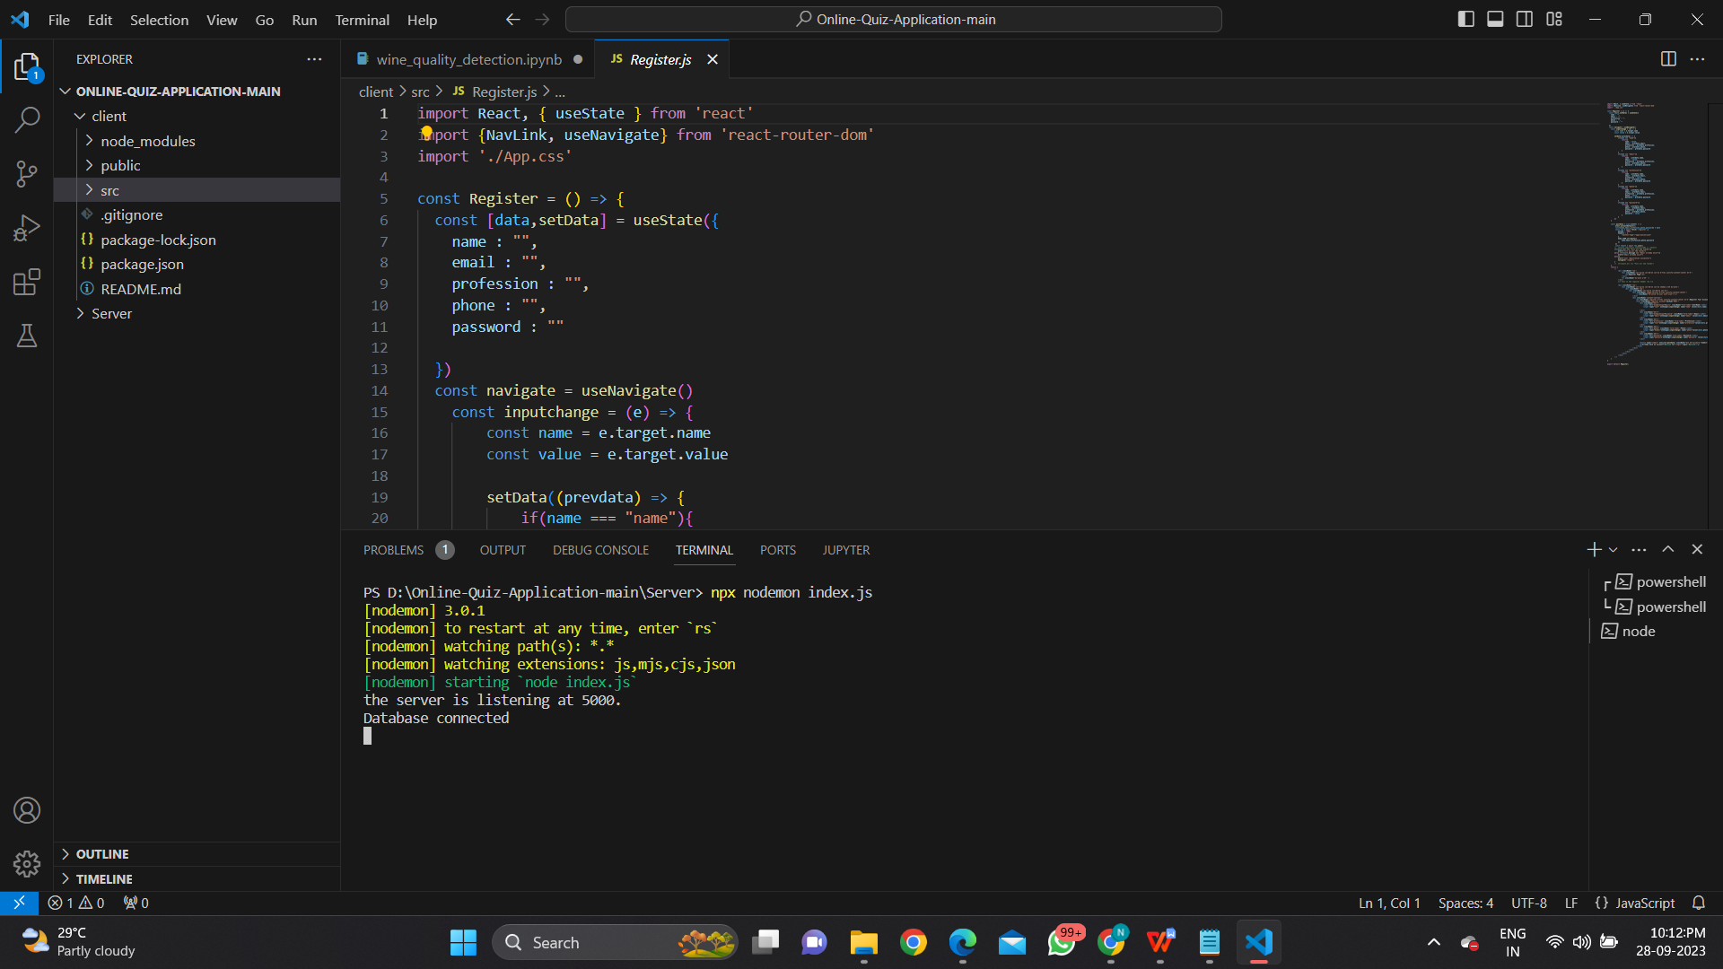
Product working principle
Output for Server:

Slide 18
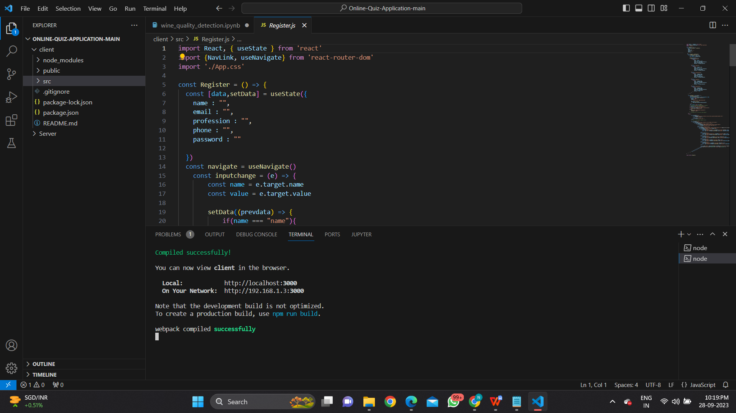
Product working principle
Output for Client:

Slide 19
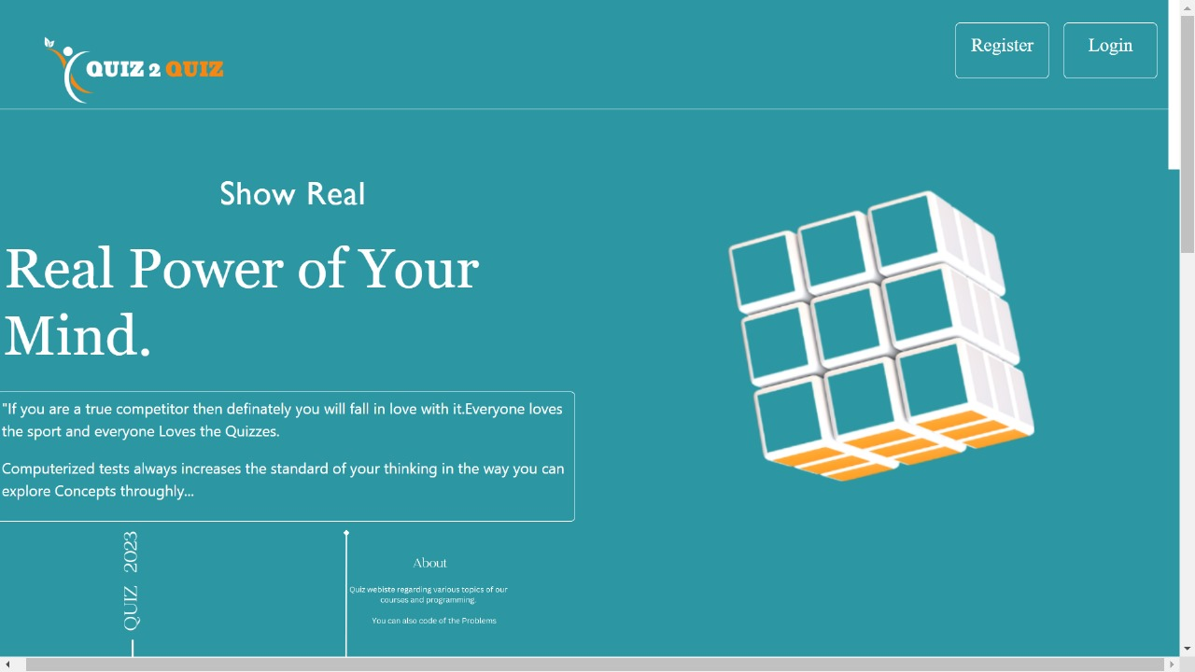
Application - Snapshots

Slide 20
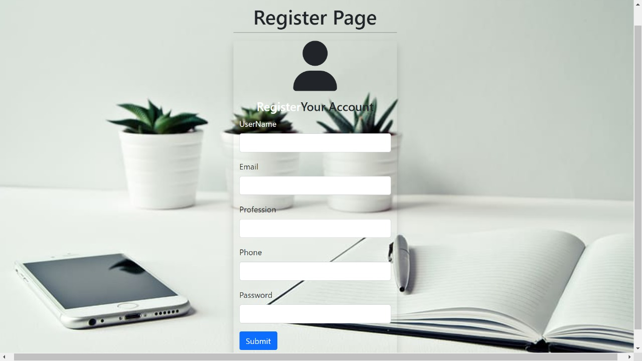
Application - Snapshots

Slide 21
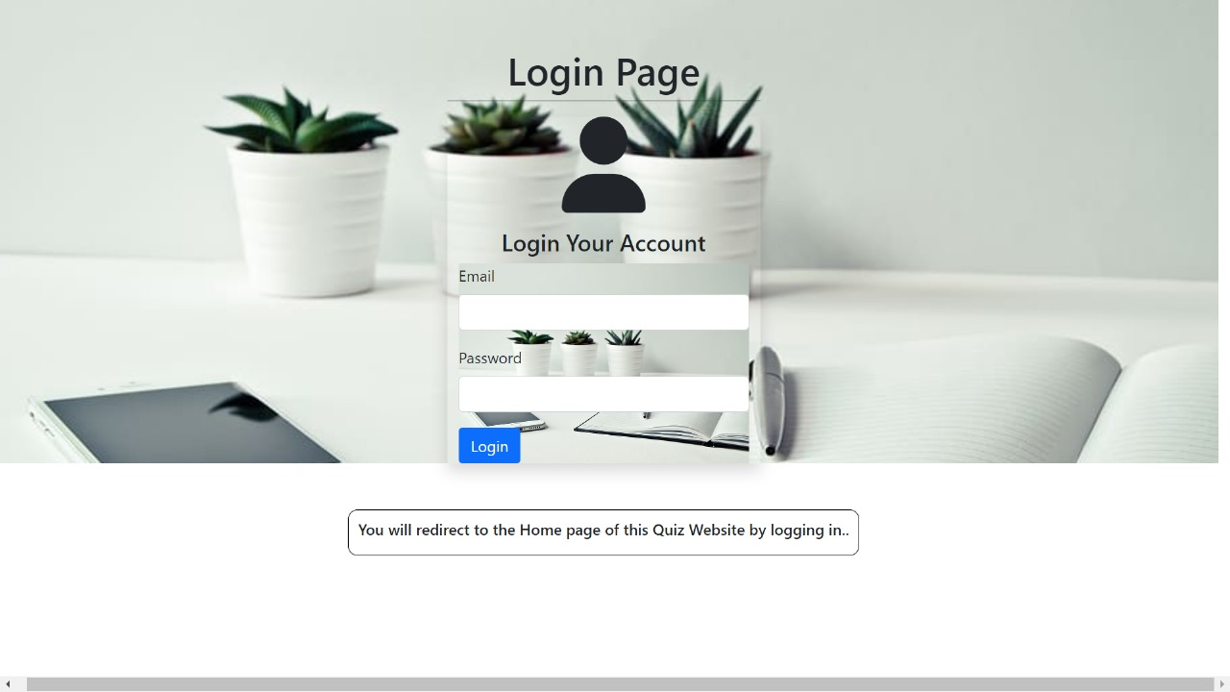
Application - Snapshots

Slide 22
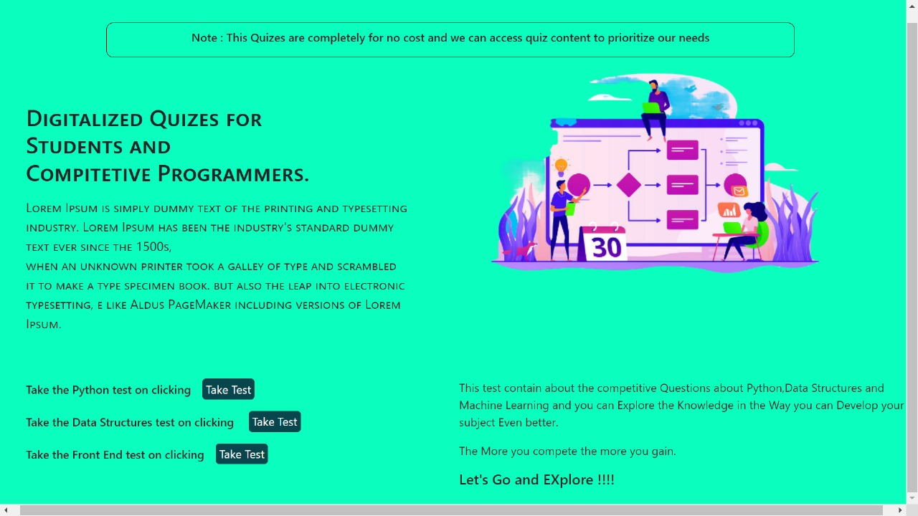
Application - Snapshots

Slide 23
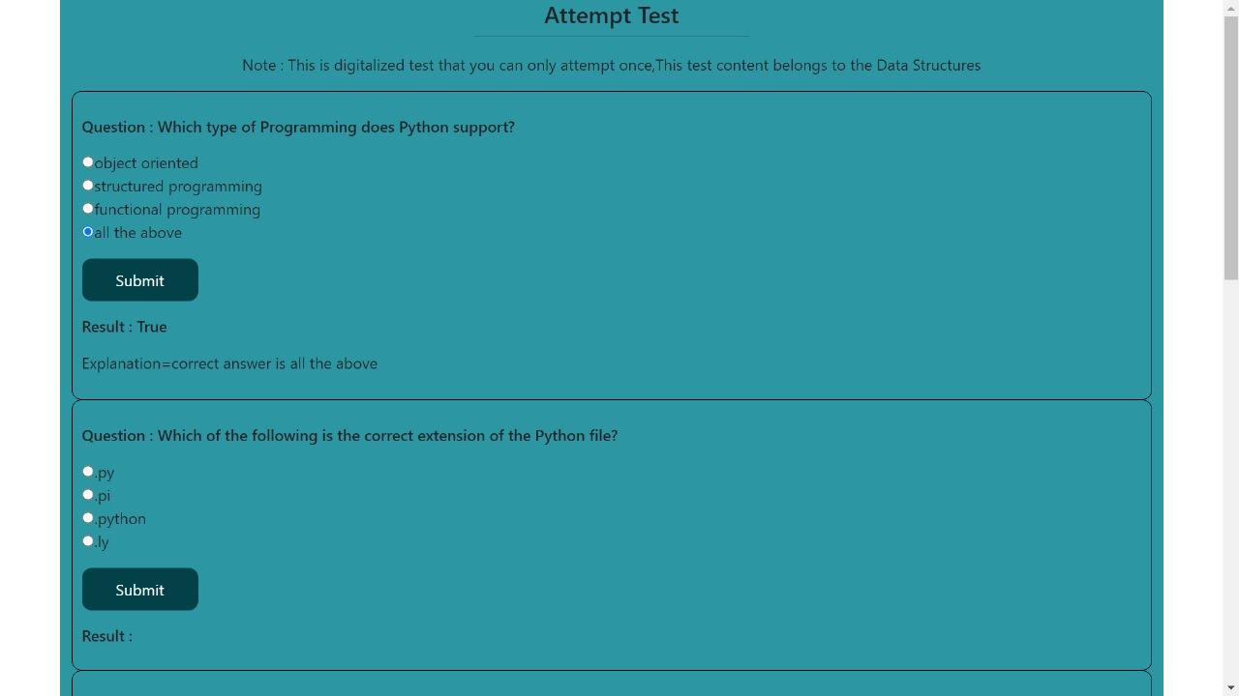
Application - Snapshots

Slide 24
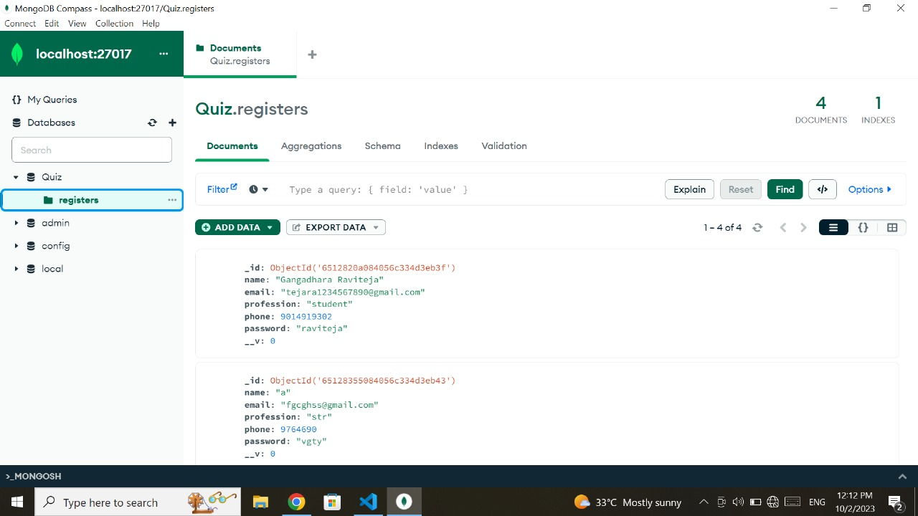
Application - Snapshots

Slide 25
Reference
https://www.w3schools.com/howto/howto_css_login_form.asp
https://www.geeksforgeeks.org/how-to-create-a-simple-javascript-quiz/
https://codingtorque.com/quiz-app-using-javascript/
https://www.javatpoint.com/jsp-architecture
https://www.tutorialspoint.com/servlets-tutorial
https://www.edureka.com/jsp/
https://www.researchgate.net/publication/
https://www.geeksforgeeks.com/jsp-architecture/
https://guru99.com/servlets/

Slide 26

THANK YOU

