Slide 1

STUDENT ATTENDANCE MANAGEMENT SYSTEM BASED FACIAL RECOGNITION
BIRRE GANGADHAR - 18T91A0510
M L N V KRISHNA TEJA - 18T91A0529
GOPAVARAPU SUSHMITHA - 18T91A0517
SETTI NEELESH KUMAR - 18T91A0544
PRESENTED BY:
UNDER GUIDENCE:
Dr . SHEIK MEERA SHARIF
Professor & HOD
Department of CSE

Slide 2
CONTENTS
Abstract
Literature Survey
Existing System
Limitations
Proposed System
Advantages
Requirement Analysis
Functional and Non-Functional Requirements
Design
UML and Data Flow Diagrams
Methodology

Slide 3
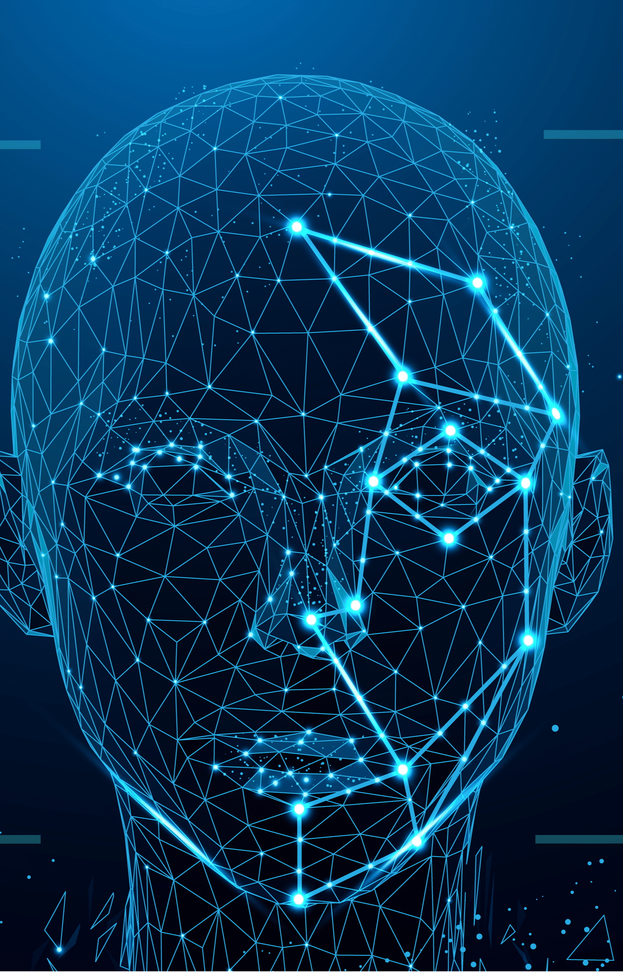
STUDENT ATTENDENCE MANAGEMENT SYSTEM
Based –Facial Recognition

Slide 4
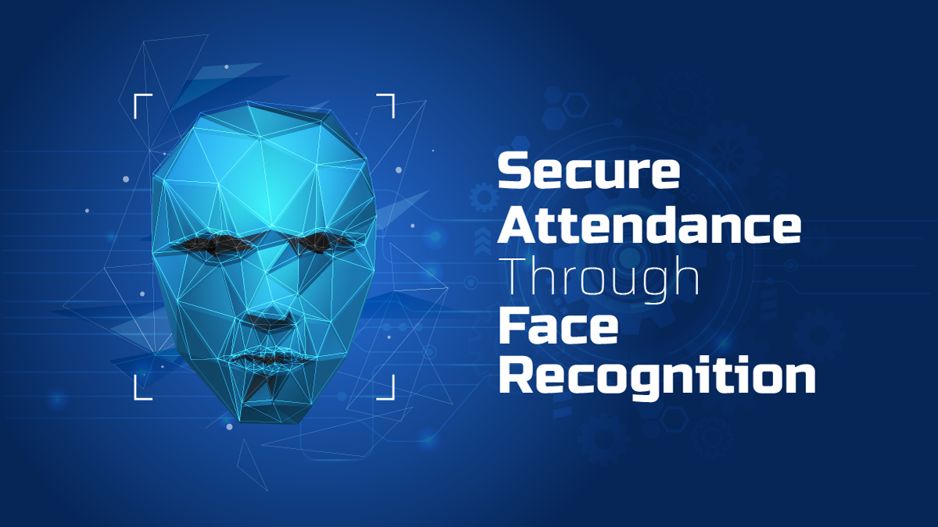
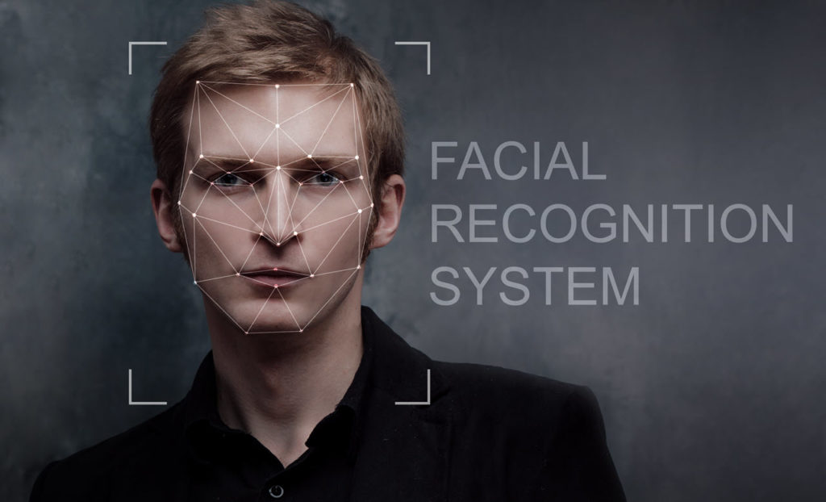
ABSTRACT:
Face recognition technology has made many improvements in a changing world. Smart attendance using real-time face recognition is a real-world solution that comes with a method to handle the daily activities of student attendance systems. Attendance management can be a great burden for the teacher if it is done manually. To solve the problem, the smart attendance management has been used. Our attendance system takes the attendance automatically using the face recognition. In our method we using, continuous observation technique which improves the performance for the estimation of the attendance based on face recognition.

Slide 5
Literature Survey Automated Attendance System Using Face Recognition
Automated Attendance System using Face Recognition proposes that the system is based on face detection and recognition algorithms, which is used to automatically detects the student face when he/she enters the class and the system is capable to marks the attendance by recognizing him.
Haar-cascade Algorithm has been used for face detection which detect human face using cascade classifier for feature selection and SVM for classification.
When it is compared to traditional attendance marking this system saves the time and also helps to monitor the students.

Slide 6
In this proposed system the student is requested to stand Face Recognition Based Attendance Publication in front of the camera to detect and recognize the iris, for the system to mark attendance for the student.
Some algorithms like Gray Scale Conversion, Six Segment Rectangular Filter, Skin Pixel Detection is being used to detect the iris.
It helps in preventing the proxy issues and it maintains the attendance of the student in an effective manner, but in one of the time-consuming process for a student or a staff to wait until the completion of the previous members.

Slide 7
FACE DETECTION USING HAAR CASCADE METHOD
Face detection is a type of application classified under “computer vision” technology. It is the process in which algorithms are developed and trained to properly locate faces or objects (in object detection, a related system), in images.
These can be in real time from a video camera or from photographs. An example where this technology is used are in airport security systems. In order to recognize a face, the camera software must first detect it and identify the features before making an identification.
These are in JPEG format only. Before we continue, we must differentiate between face recognition and face detection. They are not the same, but one depends on the other. In this case face recognition needs face detection for making an identification to “recognize” a face.
It will only cover face detection. Face detection uses classifiers, which are algorithms that detects what is either a face (1) or not a face (0) in an image. Classifiers have been trained to detect faces using thousands to millions of images in order to get more accuracy.

Slide 8
HAAR CASCADES
Haar Cascade classifier is based on the Haar Wavelet technique to analyse pixels in the image into squares by function. This uses “integral image” concepts to compute the “features” detected.
Haar Cascades use the Ada-boost learning algorithm which selects a small number of important features from a large set to give an efficient result of classifiers then use cascading techniques to detect face in a image. Here are some Haar-Features.

Slide 9
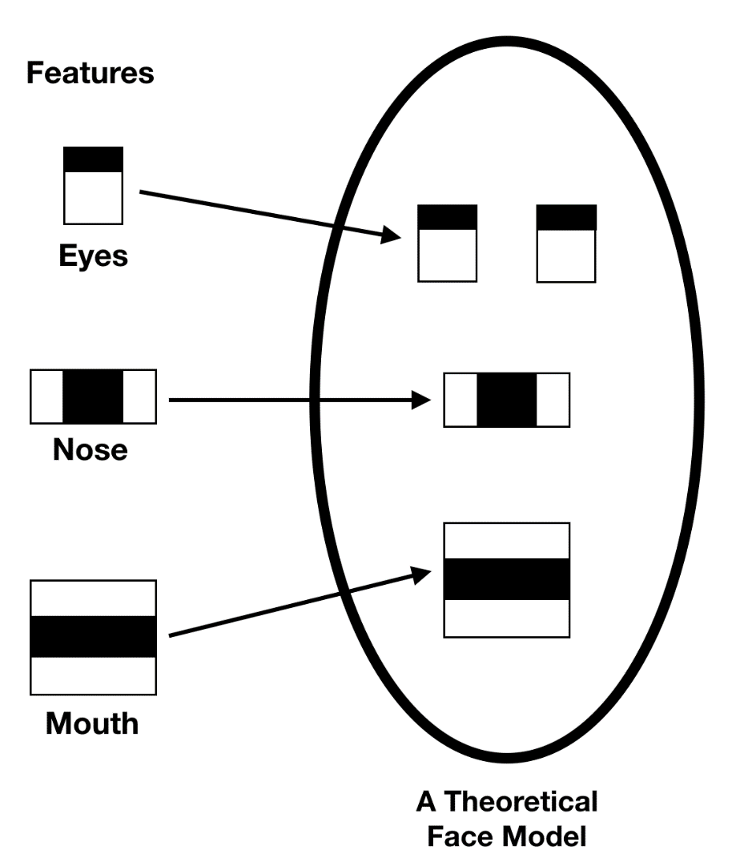
Feature Extraction:

Slide 10

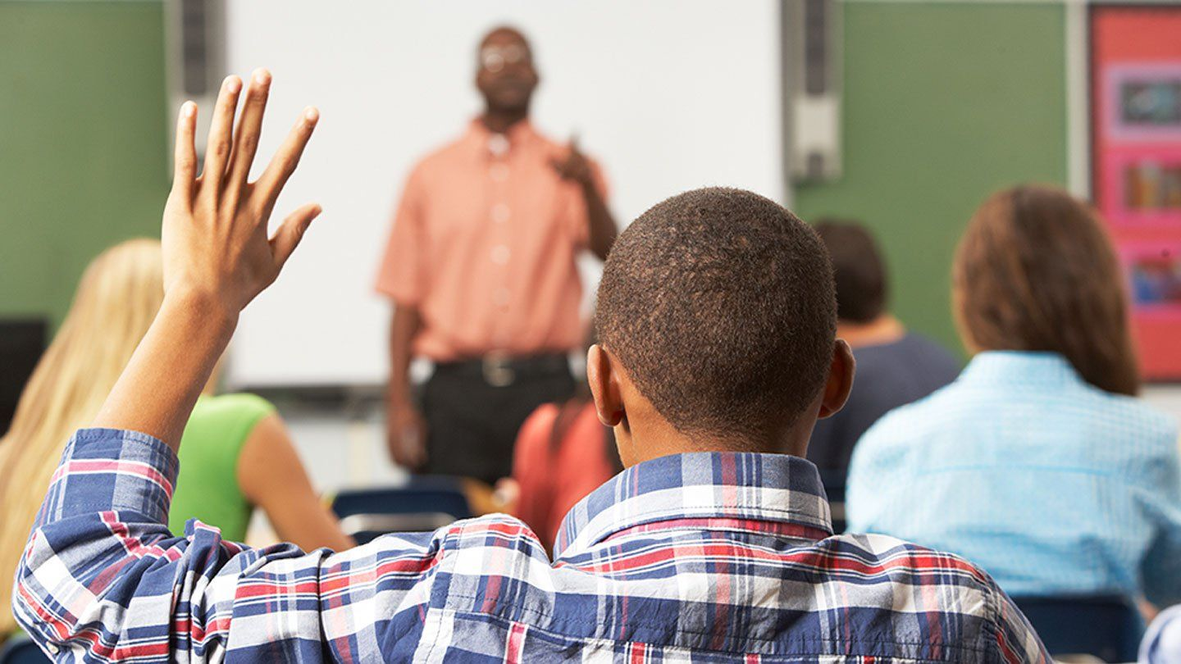
EXISTING SYSTEM
The Existing System is a Manual Entry for the students. here the attendance will be carried out in the hand written registers. the retrieval of the information is not easy as the records are maintained in the hand written registers.
This application requires correct feed on input into the respective field.

Slide 11
Limitations:
Manual time entry is very time-consuming
Are ineffective and outdated
Too much paperwork
There is a risk of human error

Slide 12
Proposed System:
To overcome the drawbacks of the existing system, the proposed system has been evolved.
This project aims to reduce the paper work and saving time to generate accurate results from the student’s attendance.
The system provides with the best user interface. The efficient reports can be generated by using this proposed system.

Slide 13
Advantages:
It is trouble-free to use.
It is a relatively fast approach to enter attendance.
Is highly reliable, approximate result from user.
Efficient reports

Slide 14
Requirement Analysis
Software Requirements:
Operating System : Windows10
Coding Language : Python 3.7
GUI : Django 3.0
IDE : Visual Studio Code Editor
DataBase : MySQL 5.7
Hardware Requirements:
System processor : Intel i5 or later with 2.4 GHz.
Hard Disk : 256GB
Ram : 4GB
Monitor : 15 VGA Colour.

Slide 15
Functional and Non-Functional Requirements
Functional Requirements:
Dataset Creation
Evaluation Metric
Experimental Settings
Performance Analysis of HAAR CASCADE
Non-Functional Requirements:
Feasibility Study
During system analysis the feasibility study of the proposed system is to be carried out.Three key considerations involved in the feasibility analysis are:
>> Economical Feasibility
>> Technical Feasibility
>> Social Feasibility
Accuracy
Capability

Slide 16
Design:

Slide 24
CONCLUSION:
From our experiment, we noticed the face recognition was sensitive to face background, light, and head orientations. This technique described the accurate and efficient method of automatic attendance in the classroom which could replace the traditional method. An automatic attendance has many advantages, most of the existing systems are time consuming and require semi manual interference from lecturers, our system seeks to solve these issues by using face recognition in the process to save the time and labor. And No need for installing complex hardware for taking the attendance in classroom, all we need is a camera and laptop. We used algorithms that can detect and recognize faces in the image.

Slide 25
THANK YOU

