Slide 1

Rice Type Classification
using Random Forest Machine Learning Algorithm
Name of the Student: Mr. Chakali Gangadhar
Register Number: 39110202
Project Supervisor: Dr. M. Selvi, M.E., Ph.D.,

Slide 2
Presentation Outline
Course Certificate
Introduction
Objectives
System Architecture / Ideation Map
Module Implementation
Application Snapshots
Results and Discussions
Conclusion & Future work
References

Slide 3

Course Certificate

Slide 4
Introduction
Rice plays a vital role in our country. From the perspective of the end consumer, the first feature is the physical appearance that comes to mind from the criteria that stand out in the rice varieties that are sold packaged on market shelves.
Therefore, when we look at the recent studies on cereal products using machine learning techniques, it is seen that the products are examined in terms of many physical properties such as color, texture, quality, and size.

Slide 5
Introduction(cont.)
Rice Type Classification is one of the many problems that can be solved by Machine learning Algorithms
The primary goal of the project is to train an ML model with a given Algorithm, that can predict the type of rice, based on the input features given to it.
The main challenge of this project is to understand the dataset, deal with missing values, use the right performance metrics for the algorithm and train the model with good accuracy for classification.
Using python and python integrated modules helps to face the challenges of a dataset and make an efficient model for predicting things.

Slide 6
Objectives
Train a Machine Learning model that can predict the type of rice, based on the input features, with reasonable accuracy.
This project helps classify the rice types with machines more efficiently and reduces the time consumed for separating different rice varieties.
By understanding the dataset's features, extracting morphological features of rice, cleaning the dataset, finding necessary features that help for prediction, training model using different hyperparameters of the model, testing using performance metrics can bring the model to maximum accuracy.

Slide 7
System Architecture Map
Import packages and
Dataset
Training Model Algorithm with part of dataset
Understanding Dataset
Testing model accuracy using test dataset
Dealing with Missing values
Evaluation of model using performance metrics
Visualising dataset for better understanding
Building data structure for model training input
Visualising performance metrics

Slide 8
Project Implementation
Selection of dataset with large data and proper labelled values
Software Requirements:
Installing Anaconda Individual edition 64-bit(PY 3.8)
Use Jupyter notebook in Anaconda Navigator for running project Python notebook.
Python Notebook also works in Google Colab, Kaggle Notebook editor.

Slide 9
Project Implementation(cont.)
Hardware Requirements:
License: Free use and redistribution under the terms of the EULA for Anaconda Individual Edition.
Operating system: Windows 8 or newer, 64-bit macOS 10.13+, or Linux, including Ubuntu, RedHat, CentOS 7+, and others.
System architecture: Windows- 64-bit x86, 32-bit x86; MacOS- 64-bit x86; Linux- 64-bit x86, 64-bit aarch64 (AWS Graviton2 / arm64), 64-bit Power8/Power9, s390x (Linux on IBM Z & LinuxONE).
Minimum 5 GB disk space to download and install.

Slide 10
Project Implementation(cont.)
Modules in Jupyter Notebook
Visualization Libraries
matplotlib.pyplot
seaborn
graphviz
sklearn.tree
export_graphviz
Data processing libraries
numpy
pandas
sklearn.model_selection
test_train_split
sklearn.preprocessing
LabelEncoder

Slide 11
Project Implementation(cont.)
ML model Algorithm
sklearn.ensemble
RandomForestClassifier
Performance metrics
sklearn.metrics
confusion_matrix
roc_auc_score
RocCurveDisplay
auc
roc_curve
precision_recall_fscore_support
plot_confusion_matrix
log_loss
accuracy_score
f1_score

Slide 12
Project Implementation(cont.)
Building model:
The model is built using RandomForestClassifier by choosing hyper parameters for good performance
Hyperparameters :
n_estimators : The number of decision trees in the forest ,(int,default=100).
bootstrap : Whether bootstrap samples are used when building trees. If False, the whole dataset is used to build each tree. (bool, default=True)
random_state : Controls both the randomness of the bootstrapping of the samples used when building trees and the sampling of the features to consider when looking for the best split at each node (int, default=None)

Slide 13
Project Implementation (cont.)
Hyperparameters (cont.):
max_depth : The maximum depth of the tree. If None, then nodes are expanded until all leaves are pure or until all leaves contain less than min_samples_split samples. (int, default=None)
min_samples_leaf : The minimum number of samples required to be at a leaf node. A split point at any depth will only be considered if it leaves at least ``min_samples_leaf`` training samples in each of the left and right branches. This may have the effect of smoothing the model, especially in regression. - If int, then consider `min_samples_leaf` as the minimum number. - If float, then `min_samples_leaf` is a fraction and `ceil(min_samples_leaf * n_samples)` are the minimum number of samples for each node. (int or float, default=1)

Slide 14
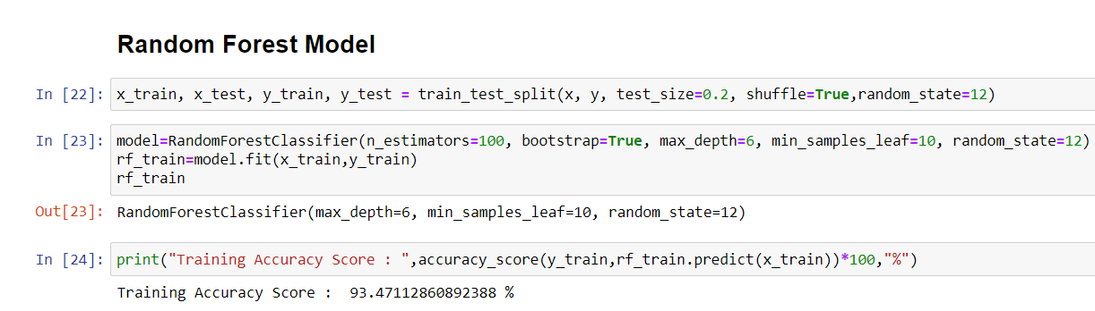
Application Snapshots

Slide 15
Methodology
A Qualitative method has been used in the study. Various primary and secondary sources have been used. Literary sources like articles, journals have been used to substantiate the argument in the study. Leo Breiman methodology is used in my study.
Building a model needs a methodology to achieve good accuracy for the problem. We are following the bagging method [1], which is a combination of learning methods to increase the result. Random forest algorithm is based on bagging method which is based on decision tree algorithm.
Random forest is a supervised learning algorithm made up of decision trees where we can set the number of decision trees built by the algorithm for predicting the result [7]. To use a random forest algorithm we need a sci-kit learn(sklearn) module installed or imported in jupyter, google colab, Kaggle notebooks.

Slide 16
Methodology (cont.)
Random forest algorithm can be tuned with hyperparameters which increases the accuracy of the model. The hyperparameters need to be tested and then included according to the dataset.
For this classification problem, we are including five hyperparameters, which are n_estimators, max_depth, min_sample_leaf, boot_strap, random_state. for testing these hyperparameters we can build the function that can give hyperparametric values of the model for better performance.
Generally, ML Algorithms are trained with 80% of the total dataset and the remaining 20% of data is used to test the model's performance. Here we are selecting the same 80%-20% formula followed by professionals.

Slide 17
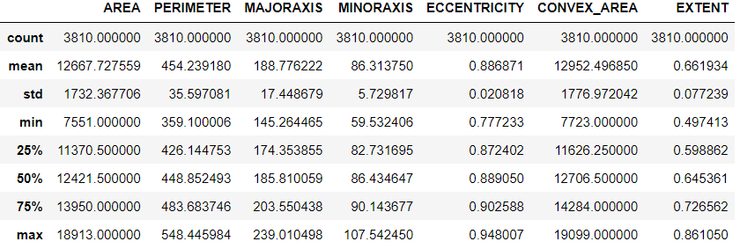
Results and Discussion
By understanding the dataset we acquired the values of the dataset via tables and graphs.
Description of dataset

Slide 18
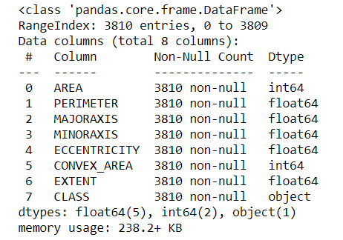
Results and Discussion
Datatypes in dataset and missing values count

Slide 19
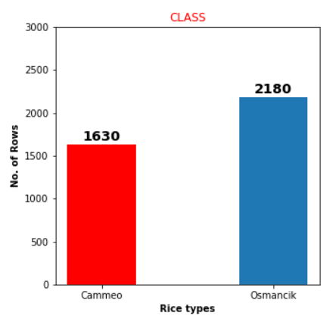
Results and Discussion
Prediction class Values (Cammeo=1630,Osmancik=2180)

Slide 20
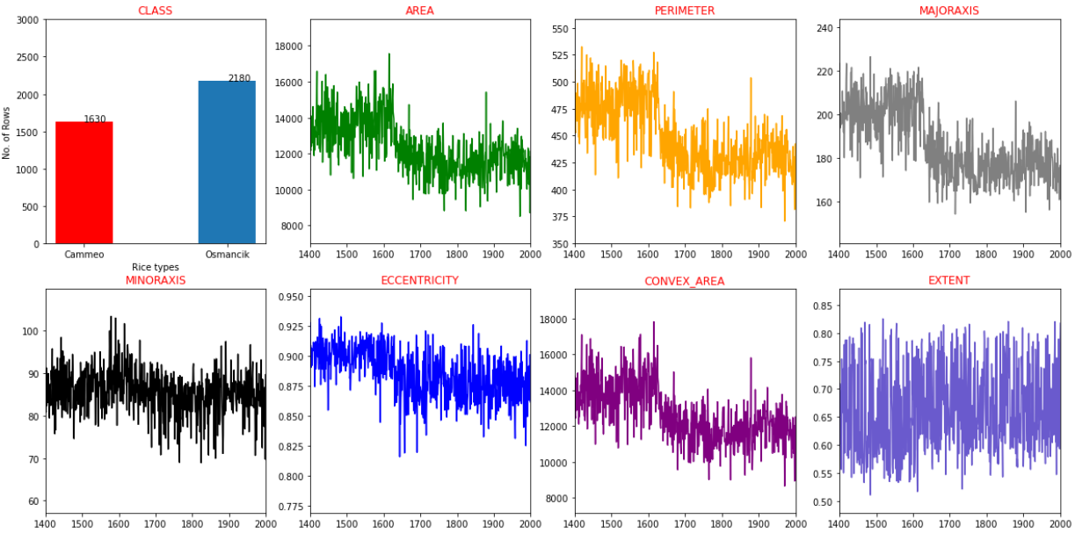
Results and Discussion
Features characteristics

Slide 21
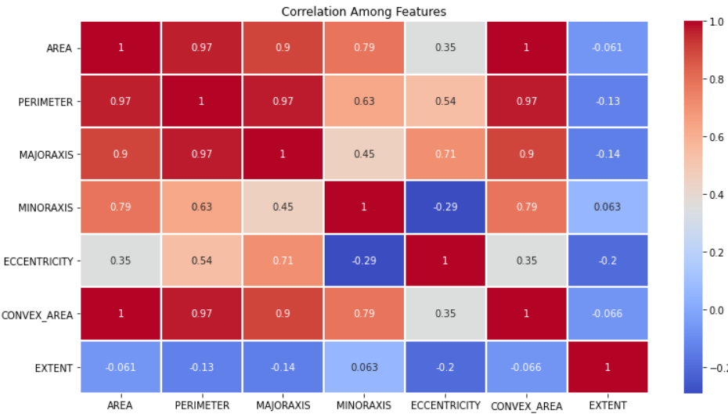
Results and Discussion
Correlation among features

Slide 22
Results and Discussion
Model features building
As we mention in my methodology, we build the model with five hyperparameter in which there are unchanged parameters in the model while we are testing they are :
n_estimators =100, which means there will be 100 decision trees are build while training with data.
bootstrap=True, which means the model will use only 80% of the dataset to build decision trees rather than training with the whole dataset.

Slide 23
Results and Discussion(cont.)
random_state=12, randomness is created based on a seed which is fed to randomness algorithm by the processor based on different factors. Value of random state is a whole number in which it creates randomness based on the seed 12 assigned by us, rather than the seed fed from the processor.

Slide 24
Results and Discussion(cont.)
Model complexity is one of the factors that affect performance. The complexity of the model decides the overfitting, underfitting, appropriate fitting decisions made by the model.
Overfitting occurs when your model learns the training data too well and incorporates details and noise specific to your dataset.
A model is overfitting when it performs great on your training/validation set, but poorly on the test set (or new real-world data).
Underfitting occurs when your model over-generalizes and fails to incorporate relevant variations in your data that would give your model more predictive power.

Slide 25
Results and Discussion(cont.)
A model is underfitting when it performs poorly on both training and test sets.
Best Fit /Appropriate fit occurs when your model actualizes and learns the patterns of data to incorporate relevant variations in your data that would give your model more predictive power.
A model is Best /Appropriate fitting when the model performs great in both training and testing datasets.

Slide 26
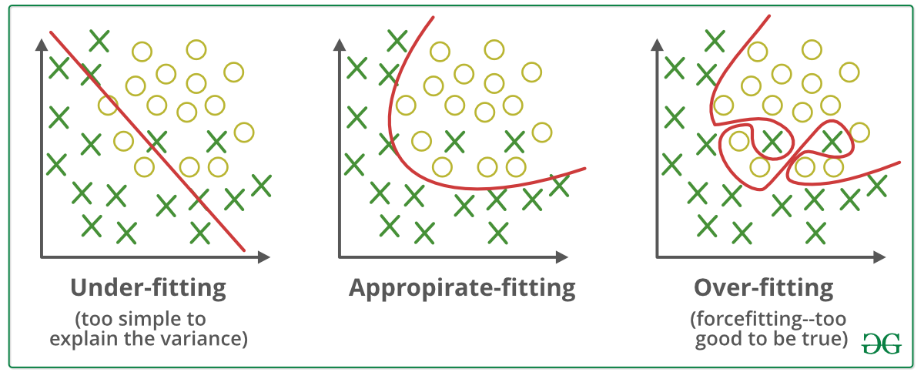
Results and Discussion(cont.)
We need model to appropriate fit where it can go wrong in some values in prediction but gets the right majority of the part of it.

Slide 27
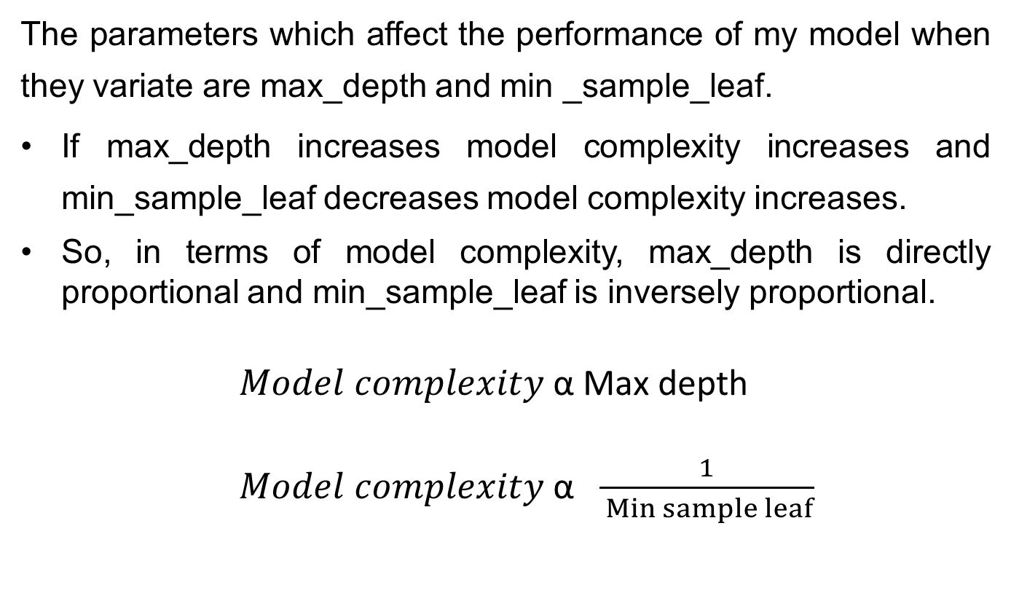
Results and Discussion(cont.)
The parameters which affect the performance of my model when they variate are max_depth and min _sample_leaf.
If max_depth increases model complexity increases and min_sample_leaf decreases model complexity increases.
So, in terms of model complexity, max_depth is directly proportional and min_sample_leaf is inversely proportional.
$Model complexity$ α Max depth
$Model complexity$ α $\frac{1}{ Min sample leaf}$

Slide 28
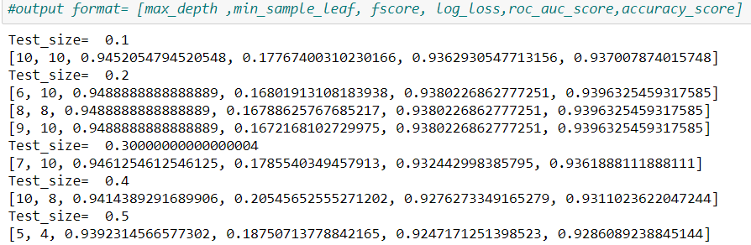
Results and Discussion(cont.)
Best model function:
For testing the hyperparameters max depth and min sample leaf, we build a function called bestmodel which tests the model by changing parameters inversely and fed to model, and performance is tested. The results obtained from the function is:

Slide 29
Results and Discussion(cont.)
At the test size=0.2(20%) we get the best accuracy and f1_score values which are major performance metrics for classification
But here we have three combination values of max depth and min sample leaf in which we are selecting (max_depth=6, min_sample_leaf=10) because the complexity of the model needs to be decreased for appropriate fit for the model.
The reason we choose these parametric values is, the performance of the model is very well with a larger dataset even though there is a little log loss than others.
The main metric we are considering the for performance of the model is f1_score which balances the both precision and recall of the prediction and eventually brings best accuracy.

Slide 30
Results and Discussion(cont.)
Performance Metrics
Possible Performance metrics for classification problem are
Confusion Matrix
F1score (balances the precision and recall)
Log loss
Accuracy score
ROC curve
ROC-AUC score(Area Under Curve in ROC Graph)

Slide 31
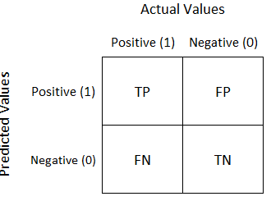
Results and Discussion(cont.)
Confusion Matrix
A confusion matrix is a technique for summarizing the performance of a classification algorithm.
It is a Matrix with 4 different combinations of predicted and actual values.[5][11]

Slide 32
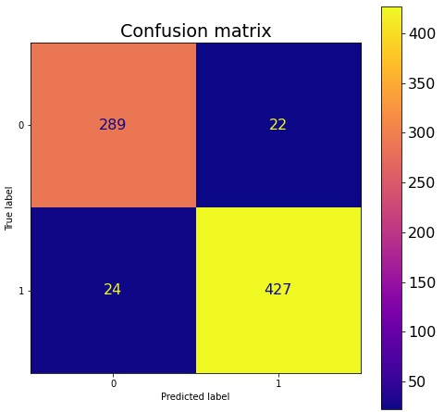
Results and Discussion(cont.)
Confusion matrix result of model

Slide 33



Results and Discussion(cont.)
Precision, Recall, and F-1 Score
Precision is the fraction of the correctly classified instances from the total classified instances.
Recall is the fraction of the correctly classified instances from the total classified instances.
Precision and recall are given as follows
The F1 score can be interpreted as a weighted average of the precision and recall.
F1 score reaches its best value at 1 and worst score at 0.

Slide 34
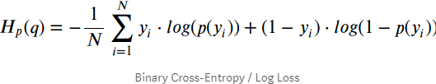
Results and Discussion(cont.)
Log loss
Logarithmic loss (or log loss) measures the performance of a classification model where the prediction is a probability value between 0 and 1.
Log loss increases as the predicted probability diverge from the actual label. Lower the log-loss value, better are the predictions of the model.

Slide 35
Results and Discussion(cont.)
Accuracy Score
In multilabel classification, this function computes subset accuracy: the set of labels predicted for a sample must exactly match the corresponding set of labels in y_true.
It ranges from 0 to 1, where 0 is Worst and 1 is Best.
Its is often multiplied with 100 to get accuracy percentage.
ROC AUC score
It is used to find Area Under Curve(AUC) in ROC graph.
It ranges from 0 to 1, where 0 is Worst and 1 is Best

Slide 36
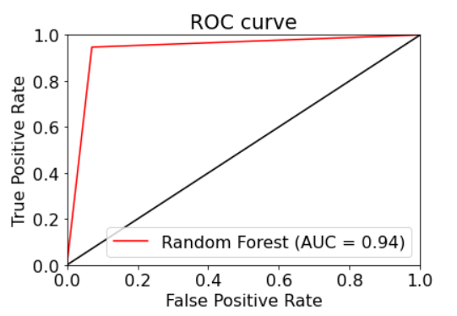
Results and Discussion(cont.)
ROC curve for True Positives VS False Positives

Slide 37
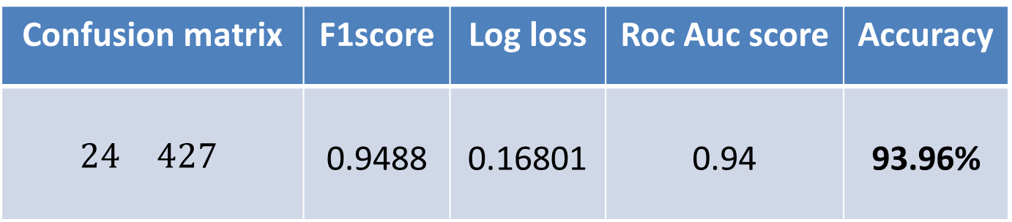
Results and Discussion(cont.)
Final Result
Model parameters
Performance Metrics
Random state | Test size | Max depth | Min sample leaf
12 | 0.2 | 6 | 10
Confusion matrix | F1score | Log loss | Roc Auc score | Accuracy
$$\begin{matrix} & \\ 24 & 427\end{matrix}$$ | 0.9488 | 0.16801 | 0.94 | 93.96%
289 | 22
24 | 427

Slide 38
Conclusion
Rice type classification using Random forest model is built with 93.96% accuracy with the dataset size of 3810 records of two rice features(cammeo and osmancik) combined and 1630 of Cammeo, 2180 of Osmancik individual provided, that can classify these two rice types based on their features.
An Machine Learning model that machines can use to predict the rice types based on their features has been built with good accuracy.

Slide 39
Conclusion(cont.)
The ML model can be used in industrial machines that extract features by image processing and give input to my model, which can easily classify the rice types. by developing this solution reduces time and saves manpower. But here there is a limitation: the model needs to be trained continuously over the batches of new rice because of ongoing global warming, climate changes, and usage of chemicals that can change the rice's physical structure, which led to misclassification of rice when it is not trained.

Slide 40
References
[1] 1.11. ensemble methods. scikit. (n.d.). Retrieved November 2, 2021, from https://scikit-learn.org/stable/modules/ensemble.html#bagging-meta-estimator.
[2] 5. visualizations. scikit. (n.d.). Retrieved November 2, 2021, from https://scikit-learn.org/stable/visualizations.html.
[3] The absolute basics for beginners. NumPy. (n.d.). Retrieved November 2, 2021, from https://numpy.org/doc/stable/user/absolute_beginners.html.
[4] Matplotlib.pyplot. matplotlib.pyplot - Matplotlib 3.4.3 documentation. (n.d.). Retrieved November 2, 2021, from https://matplotlib.org/stable/api/_as_gen/matplotlib.pyplot.html.
[5] Narkhede, S. (2021, June 15). Understanding confusion matrix. Medium. Retrieved November 2, 2021, from https://towardsdatascience.com/understanding-confusion-matrix-a9ad42dcfd62.

Slide 41
References(cont.)
[6] Pandas.dataframe. pandas.DataFrame - pandas 1.3.4 documentation. (n.d.). Retrieved November 2, 2021, from https://pandas.pydata.org/pandas-docs/stable/reference/api/pandas.DataFrame.html.
[7] Sklearn.ensemble.randomforestclassifier. scikit. (n.d.). Retrieved November 2, 2021, from https://scikit-learn.org/stable/modules/generated/sklearn.ensemble.RandomForestClassifier.html.
[8] Sklearn.metrics.roc_auc_score. scikit. (n.d.). Retrieved November 2, 2021, from https://scikit-learn.org/stable/modules/generated/sklearn.metrics.roc_auc_score.html

Slide 42
References(cont.)
[9] Sklearn.metrics.roc_curve. scikit. (n.d.). Retrieved November 2, 2021, from https://scikit-learn.org/stable/modules/generated/sklearn.metrics.roc_curve.html.
[10] Vidiyala, R. (2020, July 26). Performance metrics for classification machine learning problems. Medium. Retrieved November 2, 2021, from https://towardsdatascience.com/performance-metrics-for-classification-machine-learning-problems-97e7e774a007.
[11] Sklearn.metrics.confusion_matrix. scikit. (n.d.). Retrieved November 5, 2021, from https://scikit-learn.org/stable/modules/generated/sklearn.metrics.confusion_matrix.html.
[12] T, D. (2019, July 25). Confusion matrix visualization. Medium. Retrieved November 5, 2021, from https://medium.com/@dtuk81/confusion-matrix-visualization-fc31e3f30fea.

Slide 43
References(cont.)
[13] Sklearn.metrics.log_loss. scikit. (n.d.). Retrieved November 5, 2021, from https://scikit-learn.org/stable/modules/generated/sklearn.metrics.log_loss.html.
[14] Sklearn.metrics.accuracy_score. scikit. (n.d.). Retrieved November 6, 2021, from https://scikit-learn.org/stable/modules/generated/sklearn.metrics.accuracy_score.html.
[15] Pandas.dataframe.corr. pandas.DataFrame.corr - pandas 1.3.4 documentation. (n.d.). Retrieved November 6, 2021, from https://pandas.pydata.org/docs/reference/api/pandas.DataFrame.corr.html.
[16] Hayes, A. (2021, November 3). What is correlation in finance? Investopedia. Retrieved November 6, 2021, from https://www.investopedia.com/terms/c/correlation.asp#:~:text=Correlation%20is%20a%20statistical%20term,they%20have%20a%20negative%20correlation.
[17] Sklearn.preprocessing.LabelEncoder. scikit. (n.d.). Retrieved November 6, 2021, from https://scikit-learn.org/stable/modules/generated/sklearn.preprocessing.LabelEncoder.html.

