Slide 1

Student Placement Prediction Using
Naive Bayes Algorithm
Name of the Student: Mr. Chakali Gangadhar
Register Number: 39110202
Project Supervisor: Dr. A. Pravin, M.E., Ph.D.,

Slide 2
Presentation Outline
Course Certificate
Introduction
Objectives
System Architecture / Ideation Map
Module Implementation
Application Snapshots
Results and Discussions
Conclusion & Future work
References

Slide 3

Course Certificate

Slide 4
Introduction
Majority of students in higher education join a course for securing a good job. Therefore, taking a wise career decision regarding the placement after completing a particular course is crucial in a student’s life. It is a well-known fact all around the world that admission of students in an educational institution depends on the placements. Placement is one of the factors considered for determining the quality of the institution. Hence every institution strives hard to provide better placements to their students.

Slide 5
Introduction(cont.)
Campus placement performs an essential position in each academic group in supporting college students to achieve their goals. Managing placement and education information in any large corporation is tough because the scholar quantity is high; in such a situation differentiation and classification on different categories will become tedious. All college students dream to get employment to provide by their hands earlier than they depart their college.

Slide 6
Introduction(cont.)
In this project, Naive Bayes algorithms is used to predict the student placement using factors, such as gender, ssc_p, ssc_b, hsc_p, hsc_b, hsc_s, degree_p, degree_t, workex, etest_p, specialisation, mba_p, status etc. A placement probability predictor allows college students to possess a thought regarding wherever they stand and what to be performed to obtain a decent placement. The result acquired from this can assist the students to better understand their weak regions to work upon. Working in those regions will permit college students to obtain a better number of placements in a college institution.

Slide 7
Objectives
To perform a Data Analysis using data science techniques on the selected dataset and train Naive Bayes Machine learning model to predict the placement of student.
This project helps understand Data Analytics statistical methods used to understand and train Machine learning model.
By understanding the dataset's features, extracting useful features of student placement dataset, preforming data pre-processing, finding necessary features that helps for the prediction, training model using different parameters of the model, testing model using performance metrics can bring the model to maximum accuracy.

Slide 8
System Architecture Map
Selection of dataset
Import packages and dataset
Data pre-processing
Exploratory
Data analysis
Training the model
Parameter tuning
Model Initialization
Testing the model
Evaluating the model
Final model

Slide 9
Project Implementation
Selection of dataset with large data and proper labelled values
Software Requirements:
Installing Anaconda Individual edition 64-bit(R-4.1.3)
Use Jupyter notebook in Anaconda Navigator for running project R notebook.
R Notebook also works in Rstudio, Kaggle Notebook editor.

Slide 10
Project Implementation(cont.)
Hardware Requirements:
License: Free use and redistribution under the terms of the EULA for Anaconda Individual Edition.
Operating system: Windows 8 or newer, 64-bit macOS 10.13+, or Linux, including Ubuntu, RedHat, CentOS 7+, and others.
System architecture: Windows- 64-bit x86, 32-bit x86; MacOS- 64-bit x86; Linux- 64-bit x86, 64-bit aarch64 (AWS Graviton2 / arm64), 64-bit Power8/Power9, s390x (Linux on IBM Z & LinuxONE).
Minimum 5 GB disk space to download and install.

Slide 11
Project Implementation(cont.)
Requried Libraries in Jupyter Notebook(R)
library(naivebayes)
library(e1071)
library(caTools)
library(ggplot2)
library(caret)
library(dplyr)
library(gdata)
library(ROSE)
library(stringr)
library(rBayesianOptimization)
library(psych)
library(smotefamily)
library(randomForest)
library(class)
library(superml)
library(corrplot)
library(klaR)

Slide 12
Project Implementation(cont.)
Data Pre-processing:
Cleaning dataset,
Handing categorical data
Checking NULL values
Re-sampling,
Random sampling,
Normalization,
Label Encoding
Attribute Selection
Exploratory Data Analysis:
Dataset description
Correlation map
Data distribution
Vs graphs

Slide 13
Project Implementation(cont.)
Building model:
The model is built using naive_bayes by tuning hyper parameters for good performance
Hyperparameters :
usekernel : parameter allows us to use a kernel density estimate for continuous variables versus a guassian density estimate,
adjust : allows us to adjust the bandwidth of the kernel density (larger numbers mean more flexible density estimate),
fL : allows us to incorporate the Laplace smoother.

Slide 14
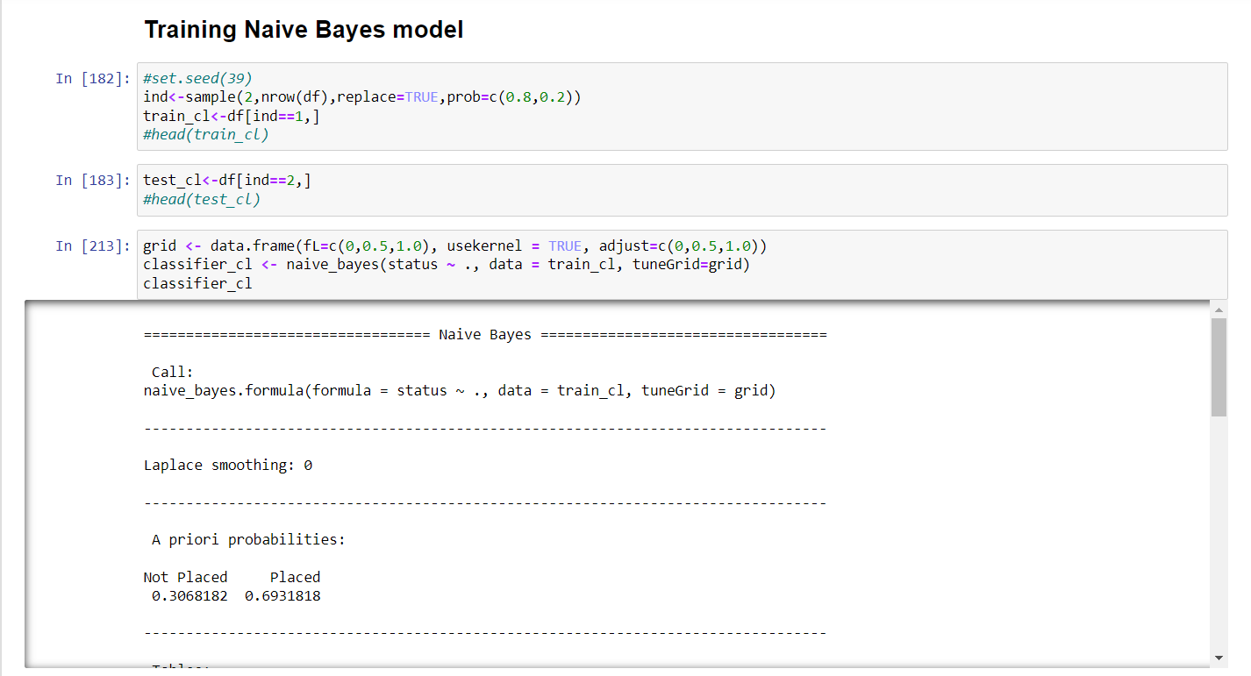
Application Snapshots

Slide 15
Methodology
A Qualitative method has been used in the study. Various primary and secondary sources have been used. Literary sources like articles, journals have been used to substantiate the argument in the study. Bayes Theorom methodology is used in my study.
Building a model needs a methodology to achieve good accuracy for the problem. We are following the Bayes theorem method [1], which is based on calculation of posterior probability.
Naive Bayes is a supervised learning algorithm based on Bayes’ theorem with the assumption of independence between every pair of features. Naive Bayes classifiers work well in many real-world situations such as document classification and spam filtering. This algorithm requires a small amount of training data to estimate the necessary parameters. Naive Bayes[2] classifiers are extremely fast compared to more sophisticated methods.

Slide 16
Methodology(cont.)
Random Sampling [3]:
After training datapoints to the model due to random splitting of data, model is not performing consistently in test environment this is due to imbalance data of two class variables and less number of data points. To make model performance model better we need to train model with data obtained from random sampling such that model performs better in all situations. We can perform random sampling by randomly splitting data and training and testing it to get better results if we get results we save that datapoints and use to train model and tune hyperparameters of model.

Slide 17
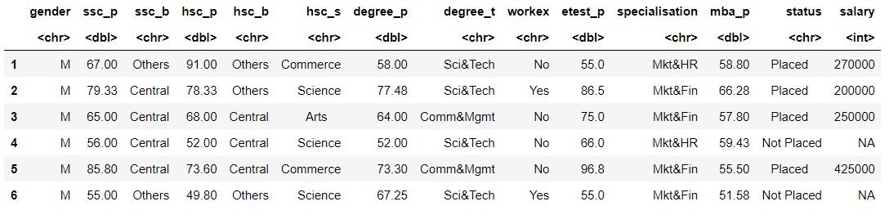
Results and Discussion
Sample of dataset

Slide 18
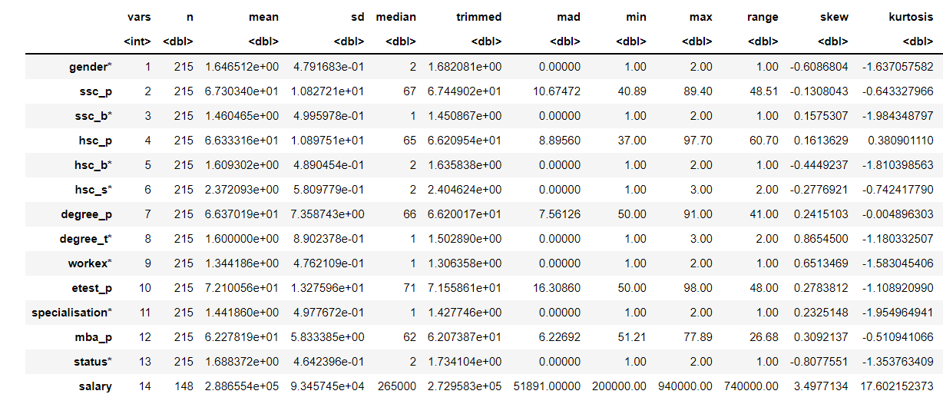
Results and Discussion(cont.)
By understanding the dataset we acquired the values of the dataset via tables and graphs.
Description of dataset

Slide 19
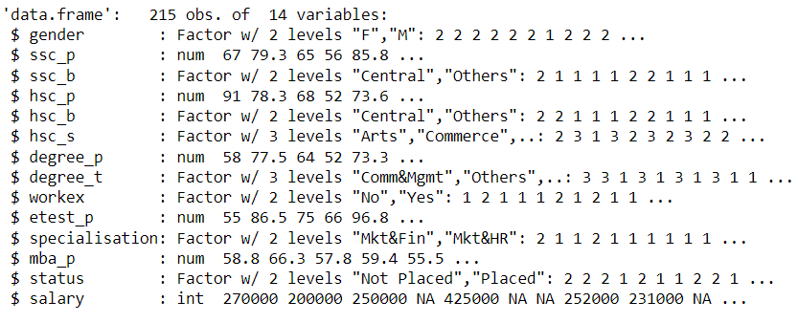
Results and Discussion(cont.)
Datatypes in dataset

Slide 20
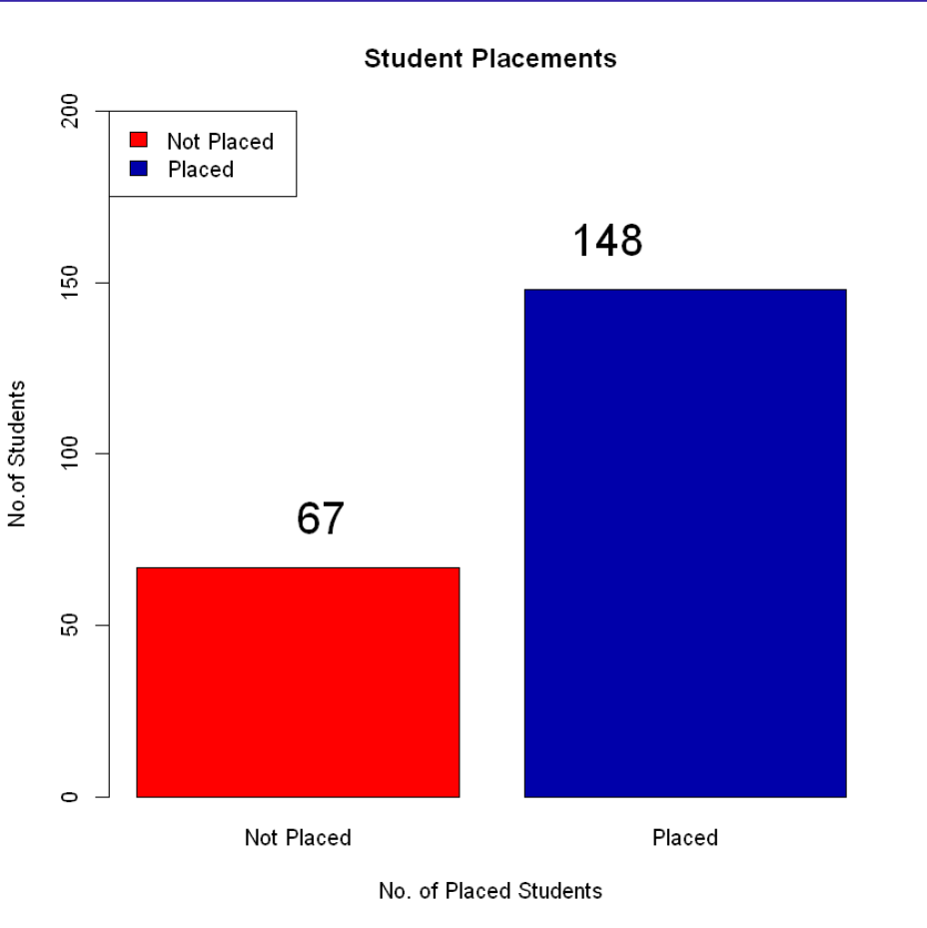
Results and Discussion(cont.)
Prediction class Values (Placed=148, Not Placed=67)

Slide 21
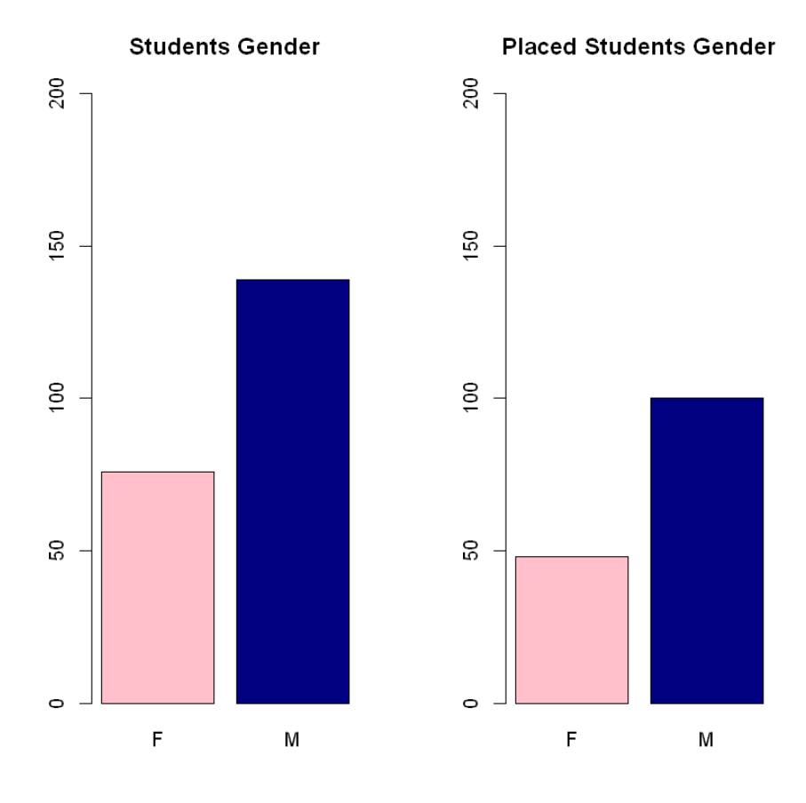
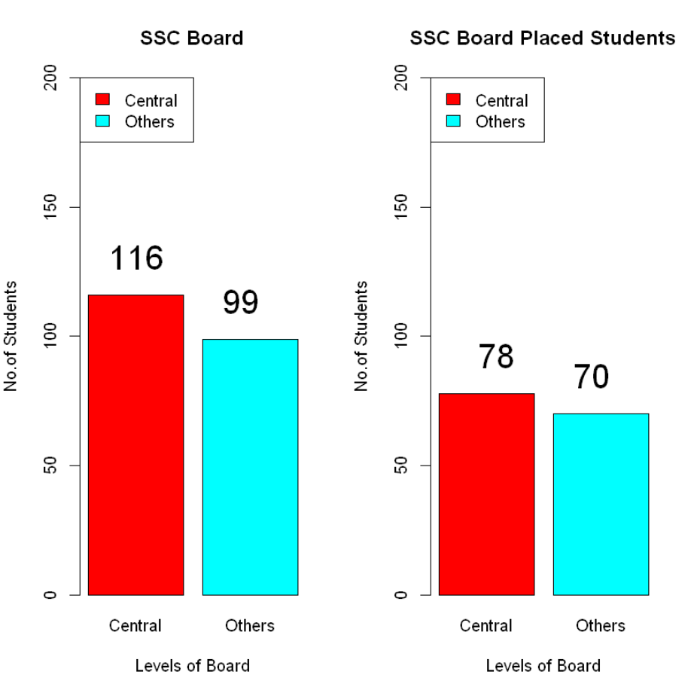
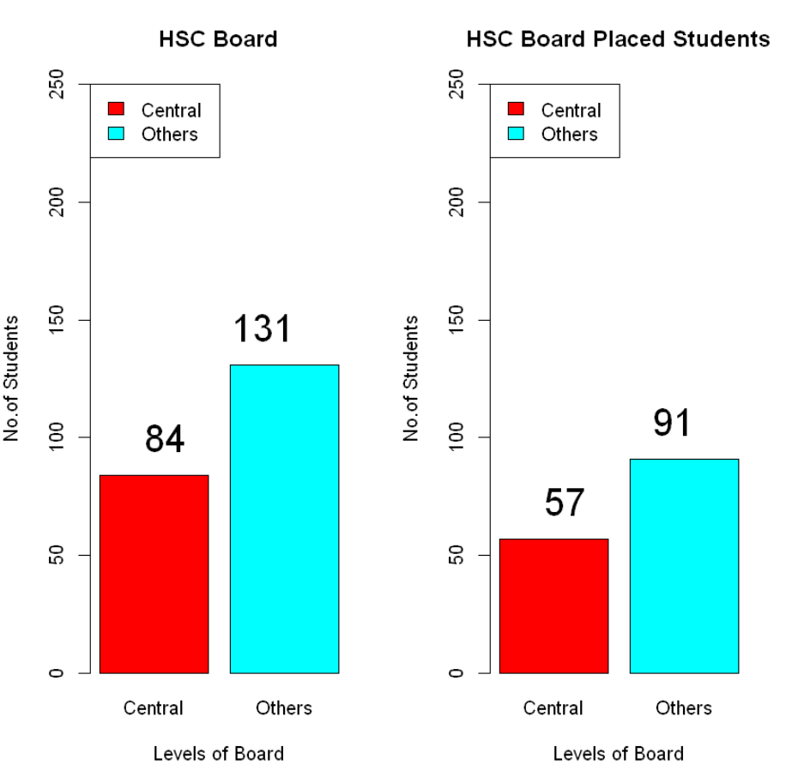
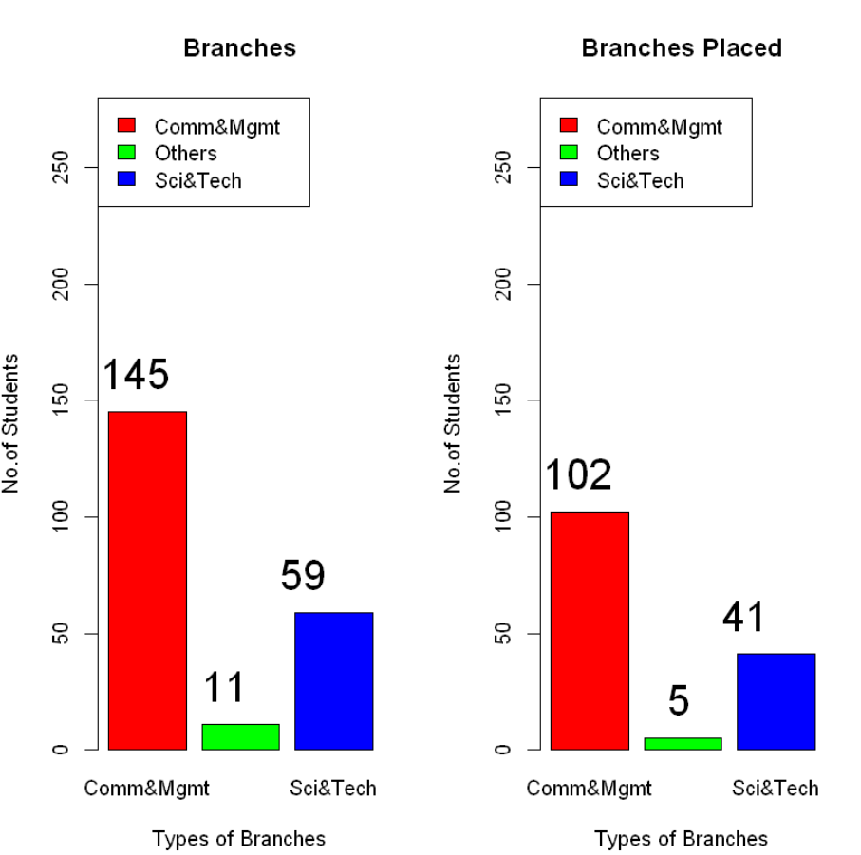
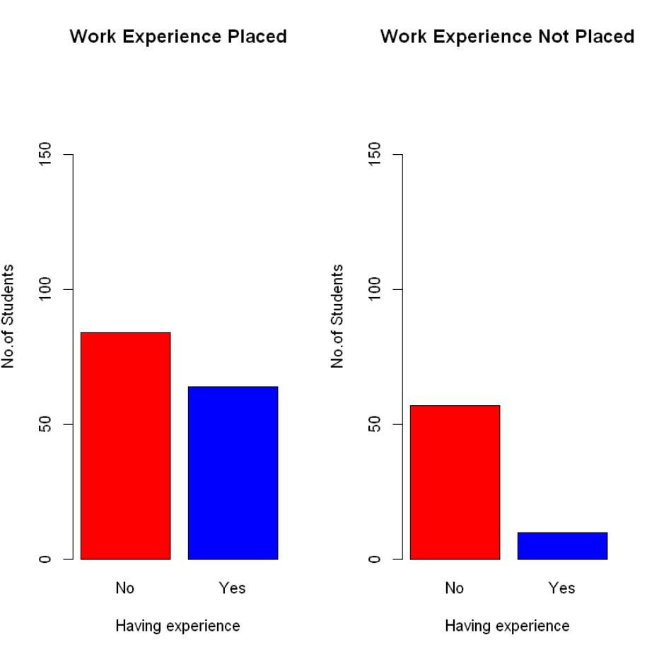
Results and Discussion(cont.)
Feature Characteristics

Slide 22
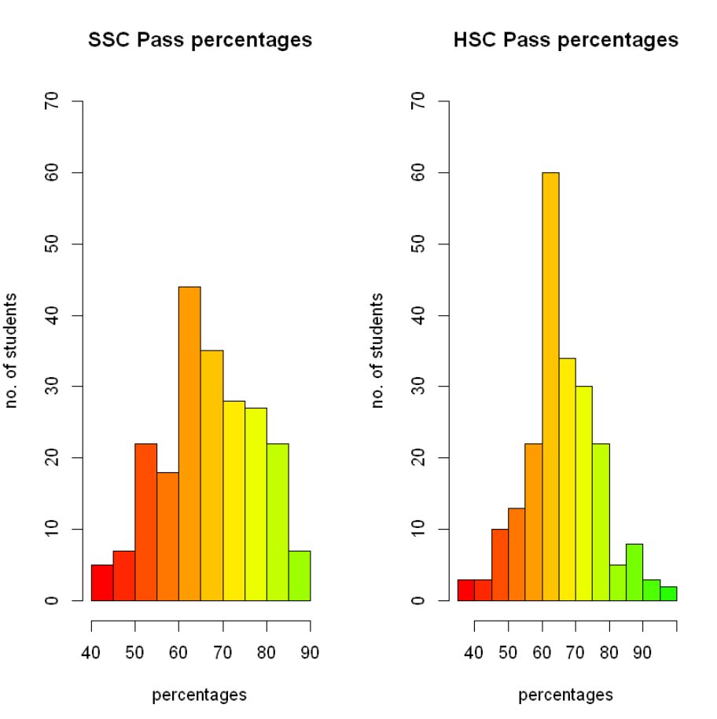
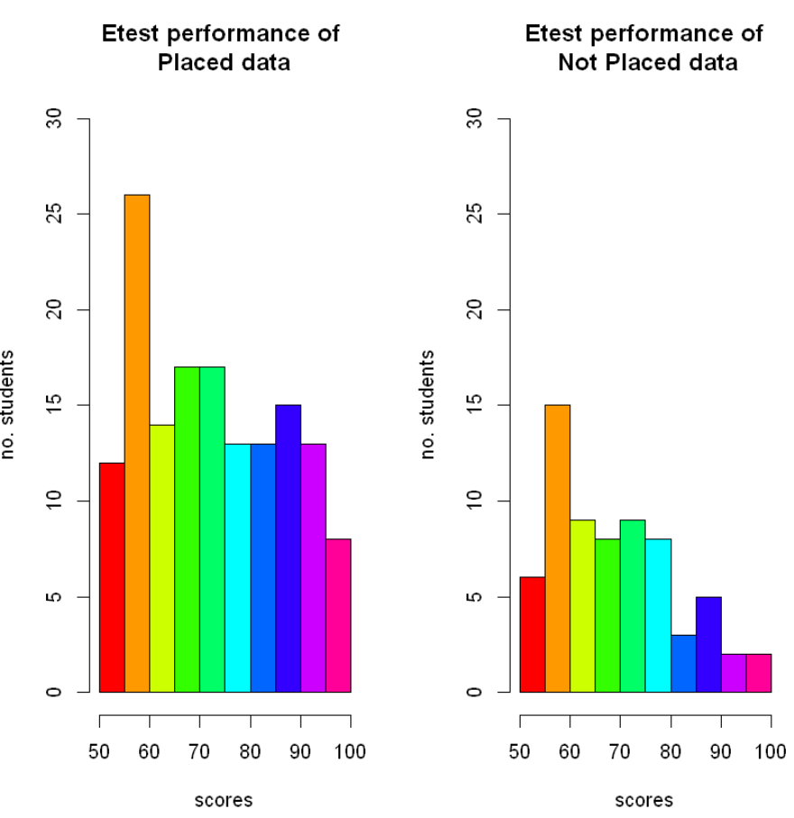
Results and Discussion(cont.)
Feature Characteristics

Slide 23
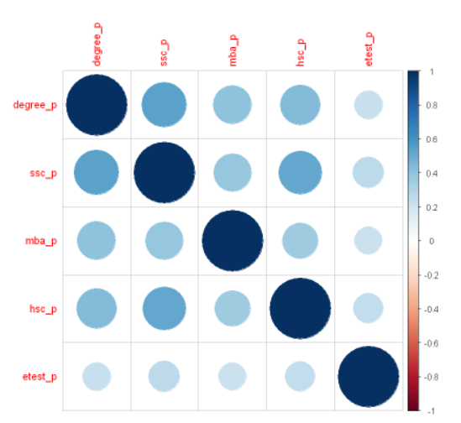
Results and Discussion(cont.)
Correlation among features

Slide 24
Results and Discussion(cont.)
Comparing Naïve bayes performance with other models
Algorithm | Min_Accuracy | Max_Accuracy | Min_F1score | Max_F1score | KFold_Accuracy | KFold_F1score
<chr> | <dbl> | <dbl> | <dbl> | <dbl> | <dbl> | <dbl>
Naive Bayes | 77.27273 | 90.32258 | 82.75862 | 86.36364 | 83.22844 | 87.71825
Logistic Regression | 75.00000 | 91.52542 | 81.35593 | 88.63636 | 84.70862 | 88.69462
K-Nearest Neighbours | 75.00000 | 90.90909 | 83.58209 | 86.36364 | 80.50117 | 87.14736
Random Forest | 84.09091 | 93.75000 | 88.88889 | 90.90909 | 87.43590 | 91.30113
Support Vector Machine | 86.36364 | 96.66667 | 90.00000 | 95.45455 | 90.27972 | 92.98305

Slide 25
Results and Discussion(cont.)
Model complexity is one of the factors that affect performance. The complexity of the model decides the overfitting, underfitting, appropriate fitting decisions made by the model.
Overfitting occurs when your model learns the training data too well and incorporates details and noise specific to your dataset.
A model is overfitting when it performs great on your training/validation set, but poorly on the test set (or new real-world data).
Underfitting occurs when your model over-generalizes and fails to incorporate relevant variations in your data that would give your model more predictive power.

Slide 26
Results and Discussion(cont.)
A model is underfitting when it performs poorly on both training and test sets.
Best Fit /Appropriate fit occurs when your model actualizes and learns the patterns of data to incorporate relevant variations in your data that would give your model more predictive power.
A model is Best /Appropriate fitting when the model performs great in both training and testing datasets.

Slide 27
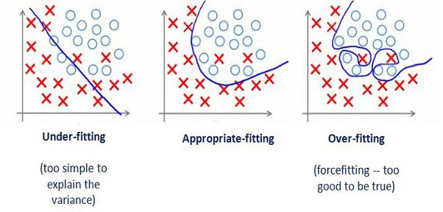
Results and Discussion(cont.)
We need model to appropriate fit where it can go wrong in some values in prediction but gets the right majority of the part of it.

Slide 28
Results and Discussion(cont.)
Model features building
we build the model with three hyperparameter and 80-20% ratio of data split :
fL=c(0,0.5,1.0),
usekernel = TRUE
adjust=c(0,0.5,1.0)

Slide 29
Results and Discussion(cont.)
Performance Metrics
Possible Performance metrics for classification problem are
Confusion Matrix
Accuracy score
F1score (balances the precision and recall)
ROC curve
ROC-AUC score(Area Under Curve in ROC Graph)

Slide 30
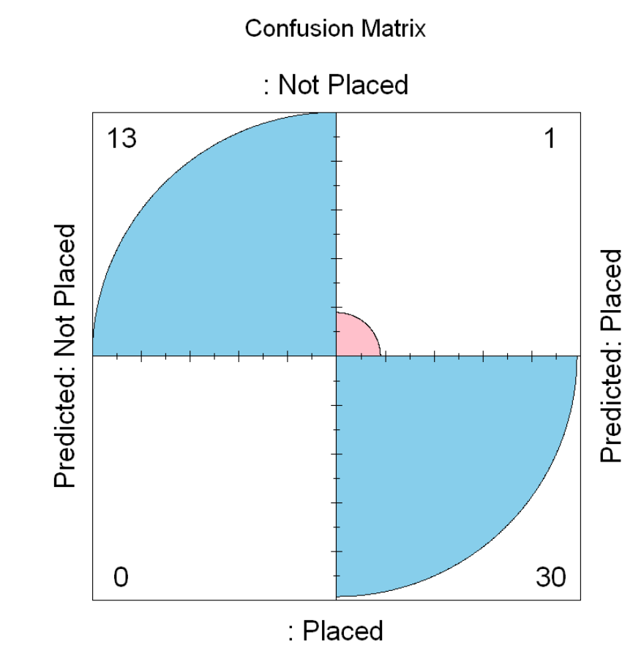
Results and Discussion(cont.)
Confusion matrix result of model

Slide 31
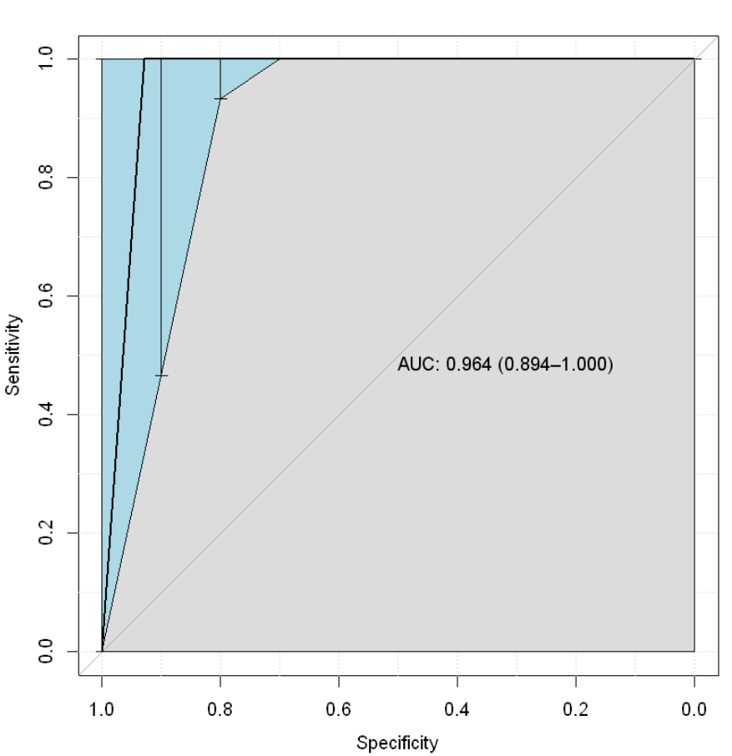
Results and Discussion(cont.)
ROC curve for Sensitivity VS Specificity

Slide 32
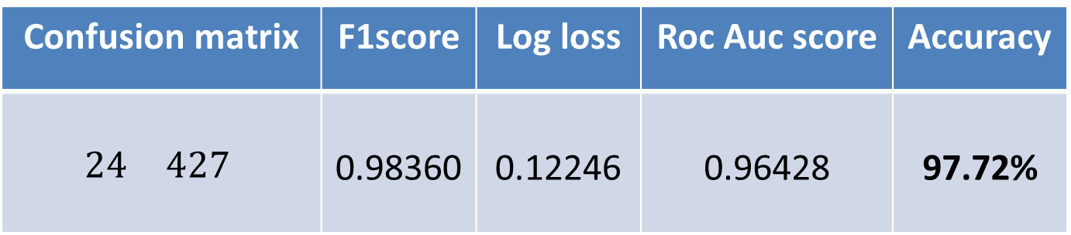
Results and Discussion(cont.)
Final Result
Model parameters
Performance Metrics
Validation metric | Train size | Test size
LogLoss | 0.8 | 0.2
Confusion matrix | F1score | Log loss | Roc Auc score | Accuracy
$$\begin{matrix} & \\ 24 & 427\end{matrix}$$ | 0.98360 | 0.12246 | 0.96428 | 97.72%
13 | 1
0 | 13

Slide 33
Conclusion
This project presents a recommendation system that uses Data Science algorithm for predicting, the student placement. The Naive Bayes Data Science algorithm is used for predicting the placement of students in a company. The students in pre-final and final years of their course can also use this system to know their individual placement status that they are most likely to achieve. This application endows the targeted group of students to boost their placement probability. Thus, this project concludes, Naive Bayes Algorithm performs better and faster when compared to other statistical techniques. This project can be further extended using some more data science algorithm and deep learning algorithms to improve the performance of prediction system.

Slide 34
References
[1] Wikimedia Foundation. (2022, March 22). Bayes' theorem. Wikipedia. Retrieved April 11, 2022, from https://en.wikipedia.org/wiki/Bayes%27_theorem
[2] Random sampling. Corporate Finance Institute. (2021, July 29). Retrieved April 11, 2022, from https://corporatefinanceinstitute.com/resources/knowledge/other/random-sampling/
[3] Comprehensive R Archive Network (CRAN). (n.d.). Package naivebayes. CRAN. Retrieved April 11, 2022, from https://cran.r-project.org/web/packages/naivebayes/
[4] Vidiyala, R. (2020, July 26). Performance metrics for classification machine learning problems. Medium. Retrieved November 2, 2021, from https://towardsdatascience.com/performance-metrics-for-classification-machine-learning-problems-97e7e774a007

Slide 35
References
[5] Narkhede, S. (2021, June 15). Understanding confusion matrix. Medium. Retrieved November 2, 2021, from https://towardsdatascience.com/understanding-confusion-matrix-a9ad42dcfd62
[6] LabelEncoder: Label encoder. RDocumentation. (n.d.). Retrieved April 14, 2022, from https://www.rdocumentation.org/packages/superml/versions/0.5.3/topics/LabelEncoder
[7] Correlation matrix : A quick start guide to analyze, format and visualize a correlation matrix using R software. STHDA. (n.d.). Retrieved April 15, 2022, from http://www.sthda.com/english/wiki/correlation-matrix-a-quick-start-guide-to-analyze-format-and-visualize-a-correlation-matrix-using-r-software
[8] Taiyun Wei, V. S. (2021, November 18). An introduction to corrplot package. Retrieved April 15, 2022, from https://cran.r-project.org/web/packages/corrplot/vignettes/corrplot-intro.html

Slide 36
References
[9] Khintibidze, L. (2021, May 16). Visualize confusion matrix using caret package in R. Delft Stack. Retrieved April 15, 2022, from https://www.delftstack.com/howto/r/visualize-confusion-matrix-in-r/
[10] Views, R. (2019, March 1). Some R packages for ROC curves. · R Views. Retrieved April 15, 2022, from https://rviews.rstudio.com/2019/03/01/some-r-packages-for-roc-curves/
[11] Logloss: Log loss / cross-entropy loss. RDocumentation. (n.d.). Retrieved April 15, 2022, from https://www.rdocumentation.org/packages/MLmetrics/versions/1.1.1/topics/LogLoss

