Slide 1
Multithreding

Slide 2
Multithreading in Java
A process of executing multiple threads simultaneously.
A thread is a lightweight sub-process, the smallest unit of processing. Multiprocessing and multithreading, both are used to achieve multitasking.
However, we use multithreading than multiprocessing because threads use a shared memory area. They don't allocate separate memory area so saves memory, and context-switching between the threads takes less time than process.

Slide 3
Advantages of Java Multithreading
1) It doesn't block the user because threads are independent and you can perform multiple operations at the same time.
2) You can perform many operations together, so it saves time.
3) Threads are independent, so it doesn't affect other threads if an exception occurs in a single thread.

Slide 4
Multitasking
Multitasking is a process of executing multiple tasks simultaneously.
We use multitasking to utilize the CPU. Multitasking can be achieved in two ways:
Process-based Multitasking (Multiprocessing)
Thread-based Multitasking (Multithreading)

Slide 5
Process-based Multitasking (Multiprocessing)
Each process has an address in memory. In other words, each process allocates a separate memory area.
A process is heavyweight.
Cost of communication between the process is high.
Switching from one process to another requires some time for saving and loading registers, memory maps, updating lists, etc.

Slide 6
2) Thread-based Multitasking (Multithreading)
Threads share the same address space.
A thread is lightweight.
Cost of communication between the thread is low.
Note: At least one process is required for each thread.

Slide 7
What is Thread in java
A thread is a lightweight subprocess, the smallest unit of processing. It is a separate path of execution.
Threads are independent. If there occurs exception in one thread, it doesn't affect other threads. It uses a shared memory area.
a thread is executed inside the process.

Slide 8
Single-threaded systems use an approach called an event loop with polling. In this model, a single thread of control runs in an infinite loop, polling a single event queue to decide what to do next. Once this polling mechanism returns with, say, a signal that a network file is ready to be read, then the event loop dispatches control to the appropriate event handler. Until this event handler returns, nothing else can happen in the program.
This wastes CPU time. It can also result in one part of a program dominating the system and preventing any other events from being processed. In general, in a single-threaded environment, when a thread blocks (that is, suspends execution) because it is waiting for some resource, the entire program stops running.

Slide 9
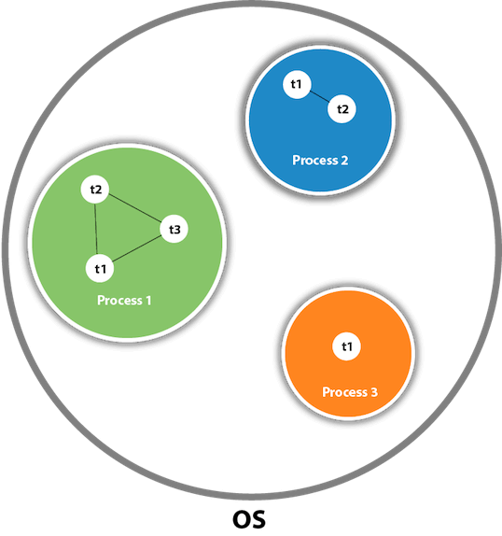
There is context-switching between the threads.
There can be multiple processes inside the OS, and one process can have multiple threads.
Note: At a time one thread is executed only.

Slide 10
Key Points in Multithreading
Multithreading concepts
Life Cycle of a Thread
Two ways to create a Thread
How to perform multiple tasks by multiple threads
Thread Scheduler, Sleeping a thread
Can we start a thread twice?
What happens if we call the run() method instead of start() method?
Joining a thread, Naming a thread
Priority of a thread, Daemon Thread
Garbage collection
Synchronization with synchronized method
Synchronized block
Static synchronization
Deadlock, Inter-thread communication

Slide 11
Life cycle of a Thread (Thread States)
In Java, a thread always exists in any one of the following states. These states are:
New -
Active state- (Running and Runnable)
Blocked / Waiting /Timed Waiting
Terminated

Slide 12
Threads exist in several states. Here is a general description. A thread can be running.
It can be ready to run as soon as it gets CPU time. A running thread can be suspended, which
temporarily halts its activity. A suspended thread can then be resumed, allowing it to pick up
where it left off. A thread can be blocked when waiting for a resource. At any time, a thread
can be terminated, which halts its execution immediately. Once terminated, a thread
cannot be resumed.

Slide 13
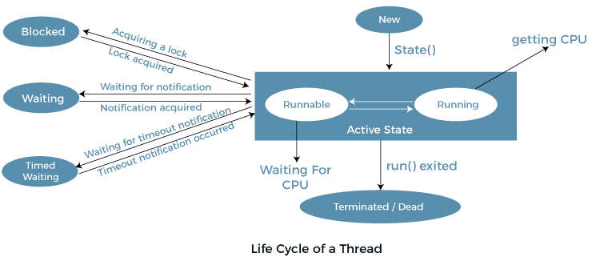

Slide 14
The Main Thread
// Controlling the main Thread.
class CurrentThreadDemo
{ public static void main(String args[])
{ Thread t = Thread.currentThread();
System.out.println("Current thread: " + t);
// change the name of the thread
t.setName("My Thread");
System.out.println("After name change: " + t);
try { for(int n = 5; n > 0; n--)
{ System.out.println(n);
Thread.sleep(1000);
}
} catch (InterruptedException e) { System.out.println("Main thread interrupted"); }
}
}

Slide 15
Thread Priorities
Java assigns to each thread a priority that determines how that thread should be treated with respect to the others.
Thread priorities are integers that specify the relative priority of one thread to another.
As an absolute value, a priority is meaningless; a higher-priority thread doesn’t run any faster than a lower-priority thread if it is the only thread running.
Instead, a thread’s priority is used to decide when to switch from one running thread to the next. This is called a context switch. The rules that determine when a context switch takes place are simple:
A thread can voluntarily relinquish control. This is done by explicitly yielding, sleeping, or blocking on pending I/O. In this scenario, all other threads are examined, and the highest-priority thread that is ready to run is given the CPU.
• A thread can be preempted by a higher-priority thread. In this case, a lower-priority thread that does not yield the processor is simply preempted—no matter what it is doing—by a higher-priority thread. Basically, as soon as a higher-priority thread wants to run, it does. This is called preemptive multitasking.
In cases where two threads with the same priority are competing for CPU cycles, the situation is a bit complicated. For operating systems such as Windows, threads of equal priority are time-sliced automatically in round-robin fashion. For other types of operating systems, threads of equal priority must voluntarily yield control to their peers. If they don’t, the other threads will not run.

Slide 16
Synchronization
Because multithreading introduces an asynchronous behavior to your programs, there must be a way for you to enforce synchronicity when you need it. For example, if you want two threads to communicate and share a complicated data structure, such as a linked list, you need some way to ensure that they don’t conflict with each other. That is, you must prevent one thread from writing data while another thread is in the middle of reading it.
For this purpose, Java implements an elegant twist on an age-old model of interprocess synchronization: the monitor. The monitor is a control mechanism first defined by C.A.R. Hoare. You can think of a monitor as a very small box that can hold only one thread. Once a thread enters a monitor, all other threads must wait until that thread exits the monitor. In this way, a monitor can be used to protect a shared asset from being manipulated by more than one thread at a time.
In Java, there is no class “Monitor”; instead, each object has its own implicit monitor that is automatically entered when one of the object’s synchronized methods is called. Once a thread is inside a synchronized method, no other thread can call any other synchronized method on the same object. This enables you to write very clear and concise multithreaded code, because synchronization support is built into the language.

Slide 17
Synchronization
Synchronization in Java is the capability to control the access of multiple threads to any shared resource.
Java Synchronization is better option where we want to allow only one thread to access the shared resource

Slide 18
Why use Synchronization?
The synchronization is mainly used to
To prevent thread interference.
To prevent consistency problem.

Slide 19
Messaging
After you divide your program into separate threads, you need to define how they will communicate with each other.
When programming with some other languages, you must depend on the operating system to establish communication between threads. This, of course, adds overhead.
By contrast, Java provides a clean, low-cost way for two or more threads to talk to each other, via calls to predefined methods that all objects have.
Java’s messaging system allows a thread to enter a synchronized method on an object, and then wait there until some other thread explicitly notifies it to come out.

Slide 20
Thread Class and the Runnable Interface
Java’s multithreading system is built upon the Thread class, its methods, and its companion interface, Runnable. Thread encapsulates a thread of execution.
To create a new thread, your program will either extend Thread or implement the Runnable interface.

Slide 21
Thread class Methods
Thread class defines several methods that help manage threads. Several of those
used in this chapter are shown here:
Method | Meaning
getName() | Obtain a thread’s name.
getPriority() | Obtain a thread’s priority.
isAlive() | Determine if a thread is still running.
join() | Wait for a thread to terminate.
run() | Entry point for the thread.
sleep(n) | Suspend a thread for a period of time.
start() | Start a thread by calling its run method
Link for Thread Class methods

Slide 22
The Main Thread
When a Java program starts up, one thread begins running immediately. This is usually called the main thread of your program, because it is the one that is executed when your program begins. The main thread is important for two reasons:
It is the thread from which other “child” threads will be spawned.
Often, it must be the last thread to finish execution because it performs various shutdown actions.

Slide 23
The Main Thread
The main thread is created automatically when your program is started,
It can be controlled through a Thread object.
We can obtain a reference to the thread by calling the method currentThread( ), which is a public static member of Thread.
Its general form is shown here:
static Thread currentThread( )
This method returns a reference to the thread in which it is called.
Once you have a reference to the main thread, you can control it just like any other thread.

Slide 24
// Controlling the main Thread.
_{class CurrentThreadDemo}
{ public static void main(String args[])
{ Thread t = Thread.currentThread();
System.out.println("Current thread: " + t);
// change the name of the thread
_{t.setName("My Thread");}
System.out.println("After name change: " + t);
try { for(int n = 5; n > 0; n--)
{ System.out.println(n); Thread.sleep(1000);
}
} catch (InterruptedException e)
{ System.out.println("Main thread interrupted"); }
}
}

Slide 25
sleep( ) method causes the thread from which it is called to suspend execution for the specified period of milliseconds. Its general form is shown here:
static void sleep(long milliseconds) throws InterruptedException
The number of milliseconds to suspend is specified in milliseconds. This method may throw an InterruptedException.
The sleep( ) method has a second form, shown next, which allows you to specify the period in terms of milliseconds and nanoseconds:
static void sleep(long milliseconds, int nanoseconds) throws InterruptedException
This second form is useful only in environments that allow timing periods as short as nanoseconds.

Slide 26
Thread class few methods
final void setName(String threadName)
final String getName( )
Here, threadName specifies the name of the thread.

Slide 27
Creating a Thread
you create a thread by instantiating an object of type Thread. Java defines two ways in which this can be accomplished:
• You can implement the Runnable interface.
• You can extend the Thread class, itself.

Slide 28
Syntax for Implementing Runnable interface
The easiest way to create a thread is to create a class that implements the Runnable interface.
Runnable abstracts a unit of executable code. You can construct a thread on any object that implements Runnable.
To implement Runnable, a class need only implement a single method called run( ), which is declared like this:
public void run( )
Inside run( ), you will define the code that constitutes the new thread. It is important to understand that run( ) can call other methods, use other classes, and declare variables, just like the main thread can. The only difference is that run( ) establishes the entry point for another, concurrent thread of execution within your program. This thread will end when run( ) returns.
After you create a class that implements Runnable, you will instantiate an object of type
Thread from within that class. Thread defines several constructors.

Slide 29
Syntax for Runnable Interface
Syntax:
Thread(Runnable threadOb, String threadName)
In this constructor, threadOb is an instance of a class that implements the Runnable interface. This defines where execution of the thread will begin.
The name of the new thread is specified by threadName.
After the new thread is created, it will not start running until you call its start( ) method, which is declared within Thread. In essence, start( ) executes a call to run( ).
The start( ) method is shown here:
void start( )

Slide 30
Example using Runnable
Example of Runnable
class RunnableExample implements Runnable{
Thread t;
RunnableExample(){
t= new Thread(this);
t.start();
}
public void run(){
System.out.println("Thread is running for Runnable Implementation");
}
public static void main(String args[]){
RunnableExample thread1=new RunnableExample();
}
}

Slide 31
// Create a second thread.
class NewThread implements Runnable
{ Thread t;
NewThread()
{ t = new Thread(this, "Demo Thread");
System.out.println("Child thread: " + t);
t.start(); // Start the thread
}
// This is the entry point for the second thread.
public void run() {
try { for(int i = 5; i > 0; i--)
{ System.out.println("Child Thread: " + i);
Thread.sleep(500);
}
} catch (InterruptedException e) {
System.out.println("Child interrupted.");
}
System.out.println("Exiting child thread.");
}
}

Slide 32
class ThreadDemo
{ public static void main(String args[ ] )
{ new NewThread(); // create a new thread
try { for(int i = 5; i > 0; i--)
{ System.out.println("Main Thread: " + i);
Thread.sleep(1000);
}
} catch (InterruptedException e) {
System.out.println("Main thread interrupted.");
}
System.out.println("Main thread exiting.");
}
}

Slide 33
// Create a thread by extending Thread
class NewThread extends Thread
{ NewThread()
{ super("Demo Thread");
System.out.println("Child thread: " + this);
start(); // Start the thread
}
public void run() {
try { for(int i = 5; i > 0; i--)
{ System.out.println("Child Thread: " + i);
Thread.sleep(500);
}
} catch (InterruptedException e) {
System.out.println("Child interrupted."); }
System.out.println("Exiting child thread.");
}
}

Slide 34
Extending thread class
class ExtendThread {
public static void main(String args[]) {
new NewThread(); // create a new thread
try {
for(int i = 5; i > 0; i--) {
System.out.println("Main Thread: " + i);
Thread.sleep(1000);
}
} catch (InterruptedException e) {
System.out.println("Main thread interrupted.");
}
System.out.println("Main thread exiting.");
}
}

Slide 35
Sr. No. | Key | Thread | Runnable
1 | Basic | Thread is a class. It is used to create a thread | Runnable is a functional interface which is used to create a thread
2 | Methods | It has multiple methods including start() and run() | It has only abstract method run()
3 |  | Each thread creates a unique object and gets associated with it | Multiple threads share the same objects.
4 | Memory | More memory required | Less memory required
5 | Limitation | Multiple Inheritance is not allowed in java hence after a class extends Thread class, it can not extend any other class | If a class is implementing the runnable interface then your class can extend another class.

Slide 36
Using isAlive( ) and join( )
Two ways exist to determine whether a thread has finished. First, you can call isAlive( ) on the thread. This method is defined by Thread, and its general form is shown here:
final boolean isAlive( )
The isAlive( ) method returns true if the thread upon which it is called is still running. It returns false otherwise.
While isAlive( ) is occasionally useful, the method that you will more commonly use to wait for a thread to finish is called join( ), shown here:
final void join( ) throws InterruptedException
This method waits until the thread on which it is called terminates. Its name comes from the concept of the calling thread waiting until the specified thread joins it.

Slide 37
Messaging

Slide 38
Synchronization
When two or more threads need access to a shared resource, they need some way to ensure that the resource will be used by only one thread at a time.
The process by which this is achieved is called synchronization.

Slide 39
Synchronization
Key to synchronization is the concept of the monitor. A monitor is an object that is used as a mutually exclusive lock. Only one thread can own a monitor at a given time.
When a thread acquires a lock, it is said to have entered the monitor.
All other threads attempting to enter the locked monitor will be suspended until the first thread exits the monitor.
These other threads are said to be waiting for the monitor. A thread that owns a monitor can reenter the same monitor if it so desires.

Slide 40
Synchronization
You can synchronize your code in either of two ways. Both involve the use of the synchronized keyword.
Using Synchronized Methods
Synchronized block( statement)

Slide 41
Synchronization
Synchronization is easy in Java, because all objects have their own implicit monitor associated with them.
To enter an object’s monitor, just call a method that has been modified with the synchronized keyword.
While a thread is inside a synchronized method, all other threads that
try to call it (or any other synchronized method) on the same instance have to wait.
To exit the monitor and relinquish control of the object to the next waiting thread, the owner of the monitor simply returns from the synchronized method.

Slide 42
The synchronized Statement
While creating synchronized methods within classes that you create is an easy and effective means of achieving synchronization, it will not work in all cases.
This is the general form of the synchronized statement:
synchronized(objRef) {
// statements to be synchronized
}

Slide 43
If the class does not use synchronized methods. Then we cannot have synchronized methods.
Further, this class was not created by you, but by a third party, and you do not have access to the source code.
Thus, you can’t add synchronized to the appropriate methods within the
class. How can access to an object of this class be synchronized? Fortunately, the solution to this problem is quite easy: You simply put calls to the methods defined by this class inside a
synchronized block.

Slide 44
This is the general form of the synchronized statement:
synchronized(objRef) {
// statements to be synchronized
}

Slide 45
Interthread Communication
Wait
Notify
Notifyall

Slide 46
Suspending, Resuming, and Stopping Threads

Slide 47
