Slide 1
OBJECT ORIENTED PROGRAMMING WITH JAVA
COURSE CODE : BCS306A
Dr. Ganga Holi,
Professor and Head, Dept of CSE-ICB
Notes:
Notes for title slide

Slide 2
COURSE INFORMATION
Object Oriented Programming with JAVA Semester
Course Code BCS306A CIE Marks 50 SEE Marks 50
Total Hours of Pedagogy 28 Hours of Theory + 20 Hours of Practical
Total Marks : 100
Credits 03 Exam Hours 03
Examination type (SEE) Theory
Object Oriented Programming with Java

Slide 3

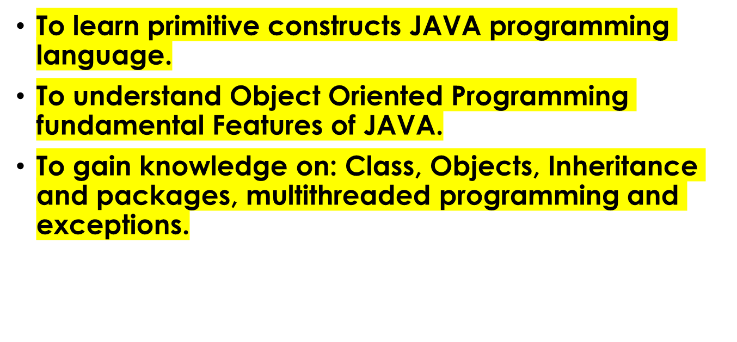
COURSE OBJECTIVES:
Object Oriented Programming with Java

Slide 4
MODULE-1
An Overview of Java: Object-Oriented Programming (Two Paradigms, Abstraction, The Three OOP Principles), Using Blocks of Code, Lexical Issues (Whitespace, Identifiers, Literals, Comments, Separators, The Java Keywords).
Data Types, Variables, and Arrays: The Primitive Types (Integers, Floating-Point Types, Characters, Booleans), Variables, Type Conversion and Casting, Automatic Type Promotion in Expressions, Arrays, Introducing Type Inference with Local Variables.
Object Oriented Programming with Java

Slide 5
MODULE-1
Operators: Arithmetic Operators, Relational Operators, Boolean Logical Operators, The Assignment Operator, The ? Operator, Operator Precedence, Using Parentheses.
Control Statements: Java’s Selection Statements (if, The Traditional switch), Iteration Statements (while, do-while, for, The For-Each Version of the for Loop, Local Variable Type Inference in a for Loop, Nested Loops), Jump Statements (Using break, Using continue, return).
Chapters 2, 3, 4, 5
Object Oriented Programming with Java

Slide 6
MODULE-2
Introducing Classes: Class Fundamentals, Declaring Objects, Assigning Object Reference Variables,
Introducing Methods, Constructors, The this Keyword, Garbage Collection.
Methods and Classes: Overloading Methods, Objects as Parameters, Argument Passing, Returning Objects, Recursion, Access Control, Understanding static, Introducing final, Introducing Nested and Inner Classes.
Chapter 6, 7
Object Oriented Programming with Java

Slide 7
MODULE-3
Inheritance: Inheritance Basics, Using super, Creating a Multilevel Hierarchy, When Constructors Are Executed, Method Overriding, Dynamic Method Dispatch, Using Abstract Classes, Using final with Inheritance, Local Variable Type Inference and Inheritance, The Object Class.
Interfaces: Interfaces, Default Interface Methods, Use static Methods in an Interface, Private Interface
Methods.
Chapter 8, 9
Object Oriented Programming with Java

Slide 8
MODULE- 4
Packages: Packages, Packages and Member Access, Importing Packages.
Exceptions: Exception-Handling Fundamentals, Exception Types, Uncaught Exceptions, Using try and catch, Multiple catch Clauses, Nested try Statements, throw, throws, finally, Java’s Built-in Exceptions,
Creating Your Own Exception Subclasses, Chained Exceptions.
Chapter 9, 10
Object Oriented Programming with Java

Slide 9
MODULE-5
Multithreaded Programming: The Java Thread Model, The Main Thread, Creating a Thread, Creating Multiple Threads, Using isAlive() and join(), Thread Priorities, Synchronization, Interthread Communication, Suspending, Resuming, and Stopping Threads, Obtaining a Thread’s State.
Enumerations, Type Wrappers and Autoboxing: Enumerations (Enumeration Fundamentals, The values() and valueOf() Methods), Type Wrappers (Character, Boolean, The Numeric Type Wrappers), Autoboxing (Autoboxing and Methods, Autoboxing/Unboxing Occurs in Expressions, Autoboxing/Unboxing Boolean and Character Values).
Chapter 11, 12
Object Oriented Programming with Java

Slide 10
CHAPTER 2 OVERVIEW OF JAVA
Java Features
Simple
Object Oriented
Robust
Multithreaded
Architecture Neutral
Interpreted and High Performance
Distributed
Dynamic
Object Oriented Programming with Java

Slide 11
SOME SALIENT CHARACTERISTICS OF JAVA
Java is platform independent: the same program can run on any correctly implemented Java system
Java is object-oriented:
  Structured in terms of classes, which group data with operations on that data
  Can construct new classes by extending existing ones
Java designed as
  A core language plus
  A rich collection of commonly available packages
Java can be embedded in Web pages
Object Oriented Programming with Java

Slide 12
JAVA PROCESSING AND EXECUTION
Begin with Java source code in text files: Model.java
A Java source code compiler produces Java byte code
  Outputs one file per class: Model.class
  May be standalone or part of an IDE
A Java Virtual Machine loads and executes class files
  May compile them to native code (e.g., x86) internally
Object Oriented Programming with Java

Slide 13
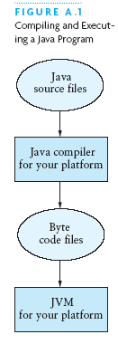
COMPILING AND EXECUTING A JAVA PROGRAM
Object Oriented Programming with Java

Slide 14
CLASSES AND OBJECTS
The class is the unit of programming
A Java program is a collection of classes
  Each class definition (usually) in its own .java file
  The file name must match the class name
A class describes objects (instances)
  Describes their common characteristics: is a blueprint
  Thus all the instances have these same characteristics
These characteristics are:
  Data fields for each object
  Methods (operations) that do work on the objects
Object Oriented Programming with Java

Slide 15
GROUPING CLASSES: THE JAVA API
API = Application Programming Interface
Java = small core + extensive collection of packages
A package consists of some related Java classes:
  Swing: a GUI (graphical user interface) package
  AWT: Application Window Toolkit (more GUI)
  util: utility data structures (important to CS 187!)
The import statement tells the compiler to make available classes and methods of another package
A main method indicates where to begin executing a class (if it is designed to be run as a program)
Object Oriented Programming with Java

Slide 16
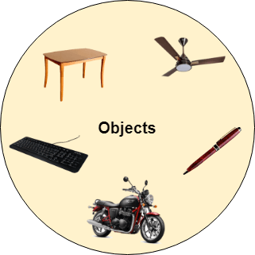
OOPS CONCEPTS
Object Oriented Programming with Java

Slide 17
CLASS & OBJECT
Object
Any entity that has state and behavior is known as an object. For example, a chair, pen, table, keyboard, bike, etc. It can be physical or logical.
Class
Collection of objects is called class. It is a logical entity.
A class can also be defined as a blueprint from which you can create an individual object. Class doesn't consume any space.
Object Oriented Programming with Java

Slide 18
OOPS CONCEPTS
Object-Oriented Programming is a methodology or paradigm to design a program using classes and objects.
It provides many concepts, such as inheritance, data binding, polymorphism, etc.
Abstraction
Inheritance
Polymorphism
Object Oriented Programming with Java

Slide 19
Inheritance
When one object acquires all the properties and behaviors of a parent object, it is known as inheritance. It provides code reusability. It is used to achieve runtime polymorphism
Object Oriented Programming with Java

Slide 20
REFERENCES AND PRIMITIVE DATA TYPES
Java distinguishes two kinds of entities
  Primitive types
  Objects
Primitive-type data is stored in primitive-type variables
Reference variables store the address of an object
Object Oriented Programming with Java

Slide 21
PRIMITIVE DATA TYPES
Represent numbers, characters, boolean values
Integers: byte, short, int, and long
Real numbers: float and double
Characters: char
Object Oriented Programming with Java

Slide 22
PRIMITIVE DATA TYPES
Data type | Range of values
byte | -128 .. 127 (8 bits)
short | -32,768 .. 32,767 (16 bits)
int | -2,147,483,648 .. 2,147,483,647 (32 bits)
long | -9,223,372,036,854,775,808 .. ... (64 bits)
float | +/-10⁻³⁸ to +/-10⁺³⁸ and 0, about 6 digits precision
double | +/-10⁻³⁰⁸ to +/-10⁺³⁰⁸ and 0, about 15 digits precision
char | Unicode characters (generally 16 bits per char)
boolean | True or false
Object Oriented Programming with Java

Slide 23
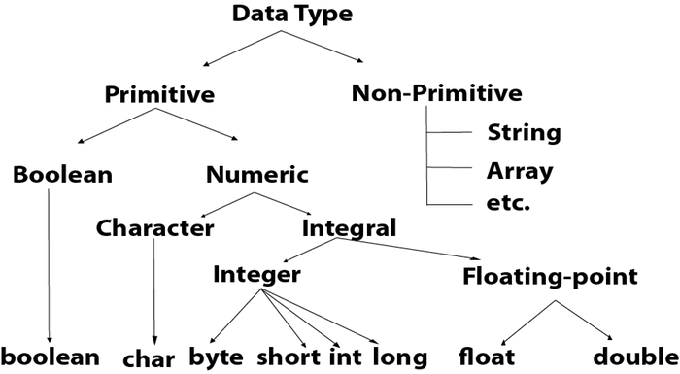
PRIMITIVE DATA TYPES
Object Oriented Programming with Java

Slide 24
COMMENTS
// single line comment
/* */ multiline comment
Object Oriented Programming with Java

Slide 25

Object Oriented Programming with Java

Slide 26
Object Oriented Programming with Java

Slide 27
OPERATORS
subscript [ ], call ( ), member access .
pre/post-increment ++ --, boolean complement !, bitwise complement ~, unary + -, type cast (type), object creation new
* / %
binary + - (+ also concatenates strings)
signed shift << >>, unsigned shift >>>
comparison < <= > >=, class test instanceof
equality comparison == !=
bitwise and &
bitwise or |
Object Oriented Programming with Java

Slide 28
OPERATORS
logical (sequential) and &&
logical (sequential) or ||
conditional cond ? true-expr : false-expr
assignment =, compound assignment += -= *= /= <<= >>= >>>= &= |=
Object Oriented Programming with Java

Slide 29
TYPE COMPATIBILITY AND CONVERSION
Widening conversion:
  In operations on mixed-type operands, the numeric type of the smaller range is converted to the numeric type of the larger range
  In an assignment, a numeric type of smaller range can be assigned to a numeric type of larger range
byte to short to int to long
int kind to float to double
Object Oriented Programming with Java

Slide 30
DECLARING AND SETTING VARIABLES
int square;
square = n * n;
double cube = n * (double)square;
  Can generally declare local variables where they are initialized
  All variables get a safe initial value anyway (zero/null)
Object Oriented Programming with Java

Slide 31

REFERENCING AND CREATING OBJECTS
You can declare reference variables
  They reference objects of specified types
Two reference variables can reference the same object
The new operator creates an instance of a class
A constructor executes when a new object is created
Example: String greeting = ″hello″;
Object Oriented Programming with Java

Slide 32
JAVA CONTROL STATEMENTS
A group of statements executed in order is written
  { stmt1; stmt2; ...; stmtN; }
The statements execute in the order 1, 2, ..., N
Control statements alter this sequential flow of execution
Object Oriented Programming with Java

Slide 33
METHODS
A Java method defines a group of statements as performing a particular operation
static indicates a static or class method
A method that is not static is an instance method
All method arguments are call-by-value
  Primitive type: value is passed to the method
  Method may modify local copy but will not affect caller’s value
  Object reference: address of object is passed
  Change to reference variable does not affect caller
  But operations can affect the object, visible to caller
Object Oriented Programming with Java

Slide 34
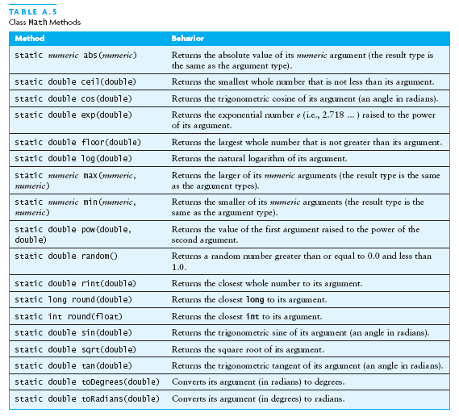
THE CLASS MATH
Object Oriented Programming with Java

Slide 35
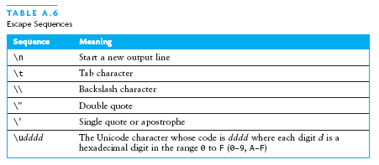
ESCAPE SEQUENCES
An escape sequence is a sequence of two characters beginning with the character \
A way to represents special characters/symbols
Object Oriented Programming with Java

Slide 36
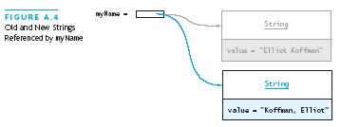
THE STRING CLASS
The String class defines a data type that is used to store a sequence of characters
You cannot modify a String object
  If you attempt to do so, Java will create a new object that contains the modified character sequence
Object Oriented Programming with Java

Slide 37
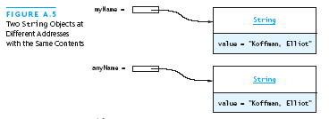

COMPARING OBJECTS
You can’t use the relational or equality operators to compare the values stored in strings (or other objects)
    (You will compare the pointers, not the objects!)
Object Oriented Programming with Java

Slide 38
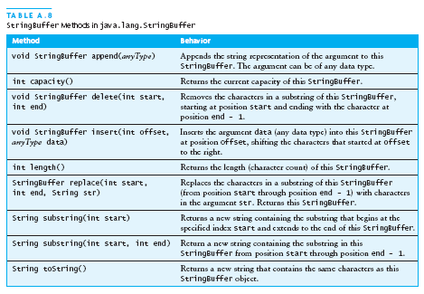
THE STRINGBUFFER CLASS
Stores character sequences
Unlike a String object, you can change the contents of a StringBuffer object
Object Oriented Programming with Java

Slide 39
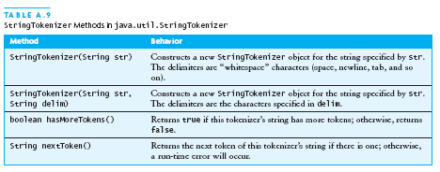
STRINGTOKENIZER CLASS
We often need to process individual pieces, or tokens, of a String
Object Oriented Programming with Java

Slide 40
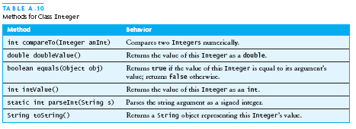
WRAPPER CLASSES FOR PRIMITIVE TYPES
Sometimes we need to process primitive-type data as objects
Java provides a set of classes called wrapper classes whose objects contain primitive-type values: Float, Double, Integer, Boolean, Character, etc.
Object Oriented Programming with Java

Slide 41
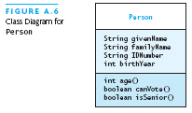
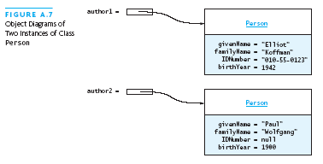
DEFINING YOUR OWN CLASSES
Unified Modeling Language (UML) is a standard diagram notation for describing a class
Field signatures: type and name
Method signatures: name, argument types, result type
Field values
Class name
Class name
Object Oriented Programming with Java

Slide 42
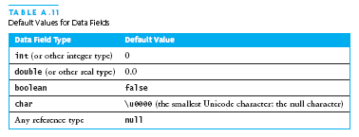
DEFINING YOUR OWN CLASSES (CONTINUED)
The modifier private limits access to just this class
Only class members with public visibility can be accessed outside of the class* (* but see protected)
Constructors initialize the data fields of an instance
Object Oriented Programming with Java

Slide 43
THE PERSON CLASS
// we have omitted javadoc to save space
public class Person {
private String givenName;
private String familyName;
private String IDNumber;
private int birthYear;
private static final int VOTE_AGE = 18;
private static final int SENIOR_AGE = 65;
...
Object Oriented Programming with Java

Slide 44
THE PERSON CLASS (2)
// constructors: fill in new objects
public Person(String first, String family,
String ID, int birth) {
this.givenName = first;
this.familyName = family;
this.IDNumber = ID;
this.birthYear = birth;
}
public Person (String ID) {
this.IDNumber = ID;
}
Object Oriented Programming with Java

Slide 45
THE PERSON CLASS (3)
// modifier and accessor for givenName
public void setGivenName (String given) {
this.givenName = given;
}
public String getGivenName () {
return this.givenName;
}
Object Oriented Programming with Java

Slide 46
THE PERSON CLASS (4)
// more interesting methods ...
public int age (int inYear) {
return inYear – birthYear;
}
public boolean canVote (int inYear) {
int theAge = age(inYear);
return theAge >= VOTE_AGE;
}
Object Oriented Programming with Java

Slide 47
THE PERSON CLASS (5)
// “printing” a Person
public String toString () {
return “Given name: “ + givenName + “\n”
+ “Family name: “ + familyName + “\n”
+ “ID number: “ + IDNumber + “\n”
+ “Year of birth: “ + birthYear + “\n”;
}
Object Oriented Programming with Java

Slide 48
THE PERSON CLASS (6)
// same Person?
public boolean equals (Person per) {
return (per == null) ? false :
this.IDNumber.equals(per.IDNumber);
}
Object Oriented Programming with Java

Slide 49
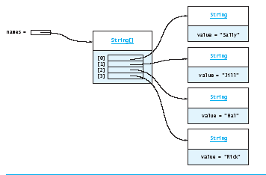
ARRAYS
In Java, an array is also an object
The elements are indexes and are referenced using the form arrayvar[subscript]
Object Oriented Programming with Java

Slide 50
ARRAY EXAMPLE
float grades[] = new float[numStudents];
... grades[student] = something; ...
float total = 0.0;
for (int i = 0; i < grades.length; ++i) {
total += grades[i];
}
System.out.printf(“Average = %6.2f%n”,
total / numStudents);
Object Oriented Programming with Java

Slide 51
ARRAY EXAMPLE VARIATIONS
// possibly more efficient
for (int i = grades.length; --i >= 0; ) {
total += grades[i];
}
// uses Java 5.0 “for each” looping
for (float grade : grades) {
total += grade;
}
Object Oriented Programming with Java

Slide 52
INPUT/OUTPUT USING CLASS JOPTIONPANE
Java 1.2 and higher provide class JOptionPane, which facilitates display
  Dialog windows for input
  Message windows for output
Object Oriented Programming with Java

Slide 53
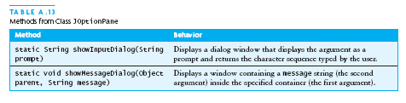

INPUT/OUTPUT USING CLASS JOPTIONPANE (CONTINUED)
Object Oriented Programming with Java

Slide 54
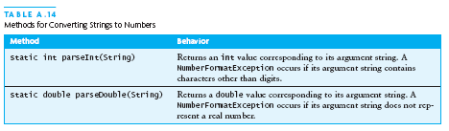
CONVERTING NUMERIC STRINGS TO NUMBERS
A dialog window always returns a reference to a String
Therefore, a conversion is required, using static methods of class String:
Object Oriented Programming with Java

Slide 55
INPUT/OUTPUT USING STREAMS
An InputStream is a sequence of characters representing program input data
An OutputStream is a sequence of characters representing program output
The console keyboard stream is System.in
The console window is associated with System.out
Object Oriented Programming with Java

Slide 56
OPENING AND USING FILES: READING INPUT
import java.io.*;
public static void main (String[] args) {
// open an input stream (**exceptions!)
BufferedReader rdr =
new BufferedReader(
new FileReader(args[0]));
// read a line of input
String line = rdr.readLine();
// see if at end of file
if (line == null) { ... }
Object Oriented Programming with Java

Slide 57
OPENING AND USING FILES: READING INPUT (2)
// using input with StringTokenizer
StringTokenizer sTok =
new StringTokenizer (line);
while (sTok.hasMoreElements()) {
String token = sTok.nextToken();
...;
}
// when done, always close a stream/reader
rdr.close();
Object Oriented Programming with Java

Slide 58
ALTERNATE WAYS TO SPLIT A STRING
Use the split method of String:
  String[] = s.split(“\\s”);
  // see class Pattern in java.util.regex
Use a StreamTokenizer (in java.io)
Object Oriented Programming with Java

Slide 59
OPENING AND USING FILES: WRITING OUTPUT
// open a print stream (**exceptions!)
PrintStream ps = new PrintStream(args[0]);
// ways to write output
ps.print(“Hello”); // a string
ps.print(i+3); // an integer
ps.println(“ and goodbye.”); // with NL
ps.printf(“%2d %12d%n”, i, 1<<i); // like C
ps.format(“%2d %12d%n”, i, 1<<i); // same
// closing output streams is very important!
ps.close();
Object Oriented Programming with Java

Slide 60
SUMMARY OF THE REVIEW
A Java program is a collection of classes
The JVM approach enables a Java program written on one machine to execute on any other machine that has a JVM
Java defines a set of primitive data types that are used to represent numbers, characters, and boolean data
The control structures of Java are similar to those found in other languages
The Java String and StringBuffer classes are used to reference objects that store character strings
Object Oriented Programming with Java

Slide 61
CHAPTER REVIEW (CONTINUED)
Be sure to use methods such as equals and compareTo to compare the contents of String objects
You can declare your own Java classes and create objects of these classes using the new operator
A class has data fields and instance methods
Array variables can reference array objects
Class JOptionPane can be used to display dialog windows for data entry and message windows for output
The stream classes in package java.io read strings from the console and display strings to the console, and also support file I/O
Object Oriented Programming with Java

