Slide 1
Object Oriented Programming with Java Course Code : BCS306A
Dr. Ganga Holi,
Professor and Head, Dept of CSE-ICB
Notes:
Notes for title slide

Slide 2
Course Information
Object Oriented Programming with JAVA Semester
Course Code BCS306A CIE Marks 50 SEE Marks 50
Total Hours of Pedagogy 28 Hours of Theory + 20 Hours of Practical
Total Marks : 100
Credits 03 Exam Hours 03
Examination type (SEE) Theory

Slide 3
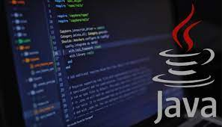
Course objectives:
To learn primitive constructs JAVA programming language.
To understand Object Oriented Programming fundamental Features of JAVA.
To gain knowledge on: Class, Objects, Inheritance and packages, multithreaded programming and exceptions.

Slide 4
Module-1
An Overview of Java: Object-Oriented Programming (Two Paradigms, Abstraction, The Three OOP Principles), Using Blocks of Code, Lexical Issues (Whitespace, Identifiers, Literals, Comments, Separators, The Java Keywords).
Data Types, Variables, and Arrays: The Primitive Types (Integers, Floating-Point Types, Characters, Booleans), Variables, Type Conversion and Casting, Automatic Type Promotion in Expressions, Arrays, Introducing Type Inference with Local Variables.

Slide 5
Module-1
Operators: Arithmetic Operators, Relational Operators, Boolean Logical Operators, The Assignment Operator, The ? Operator, Operator Precedence, Using Parentheses.
Control Statements: Java’s Selection Statements (if, The Traditional switch), Iteration Statements (while, do-while, for, The For-Each Version of the for Loop, Local Variable Type Inference in a for Loop, Nested Loops), Jump Statements (Using break, Using continue, return).
Chapters 2, 3, 4, 5

Slide 6
Module-2
Introducing Classes: Class Fundamentals, Declaring Objects, Assigning Object Reference Variables,
Introducing Methods, Constructors, The this Keyword, Garbage Collection.
Methods and Classes: Overloading Methods, Objects as Parameters, Argument Passing, Returning Objects, Recursion, Access Control, Understanding static, Introducing final, Introducing Nested and Inner Classes.
Chapter 6, 7

Slide 7
Module-3
Inheritance: Inheritance Basics, Using super, Creating a Multilevel Hierarchy, When Constructors Are Executed, Method Overriding, Dynamic Method Dispatch, Using Abstract Classes, Using final with Inheritance, Local Variable Type Inference and Inheritance, The Object Class.
Interfaces: Interfaces, Default Interface Methods, Use static Methods in an Interface, Private Interface
Methods.
Chapter 8, 9

Slide 8
Module- 4
Packages: Packages, Packages and Member Access, Importing Packages.
Exceptions: Exception-Handling Fundamentals, Exception Types, Uncaught Exceptions, Using try and catch, Multiple catch Clauses, Nested try Statements, throw, throws, finally, Java’s Built-in Exceptions,
Creating Your Own Exception Subclasses, Chained Exceptions.
Chapter 9, 10

Slide 9
Module-5
Multithreaded Programming: The Java Thread Model, The Main Thread, Creating a Thread, Creating Multiple Threads, Using isAlive() and join(), Thread Priorities, Synchronization, Interthread Communication, Suspending, Resuming, and Stopping Threads, Obtaining a Thread’s State.
Enumerations, Type Wrappers and Autoboxing: Enumerations (Enumeration Fundamentals, The values() and valueOf() Methods), Type Wrappers (Character, Boolean, The Numeric Type Wrappers), Autoboxing (Autoboxing and Methods, Autoboxing/Unboxing Occurs in Expressions, Autoboxing/Unboxing Boolean and Character Values).
Chapter 11, 12

Slide 10
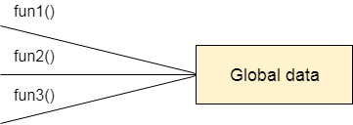
Process-Oriented Programming
Data Representation in Process/Procedure-Oriented Programming

Slide 11
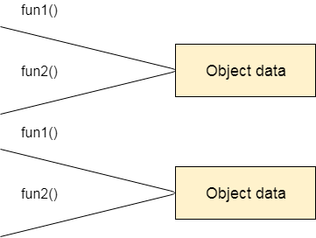
Object-Oriented Programming
Data Representation in Object-Oriented Programming

Slide 12
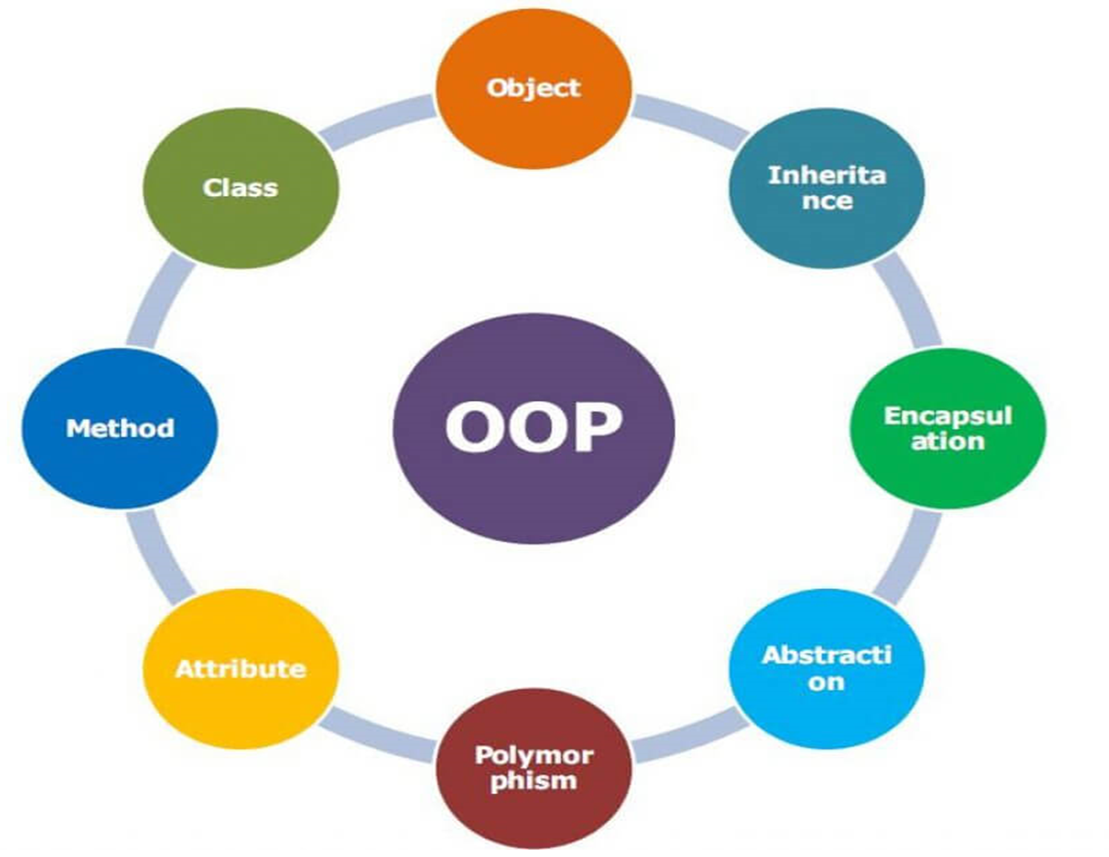
Object Oriented PROGRamming Concepts

Slide 13
Object Oriented PROGRamming Concepts
Object
Class
Methods
Attributes( Data Members)
Abstraction
Encapsulation
Inheritance
Polymorphism

Slide 14
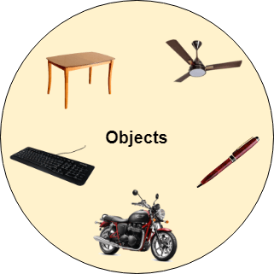
OOP Concepts

Slide 15
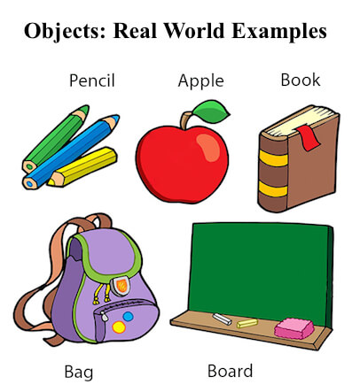
Class & Objects

Slide 16
Object
An Object is a real-time entity having some state and behavior.
In Java, an Object is an instance of the class having instance variables (state) and methods (behavior).
The object of a class can be created by using the new keyword in the Java Programming language.

Slide 17
Objects
Various Definitions of an Object:
An object is a real-world entity.
An object is a runtime entity.
An object is an entity that has a state and behavior.
An object is an instance of a class.

Slide 18
Class
A class is a template or blueprint from which objects are created.
An object is the instance (result) of a class.
Student Class
Name | USN | Phone Number
1KS23IC001 | ADITHI S BHARADWAJ | 99228822
1KS23IC002 | ADITYA KUMAR B | 94948494
1KS23IC003 | AKHILA P V | 85648393
1KS23IC004 | AKSHAY KUMAR G C | 47476383
Object

Slide 19
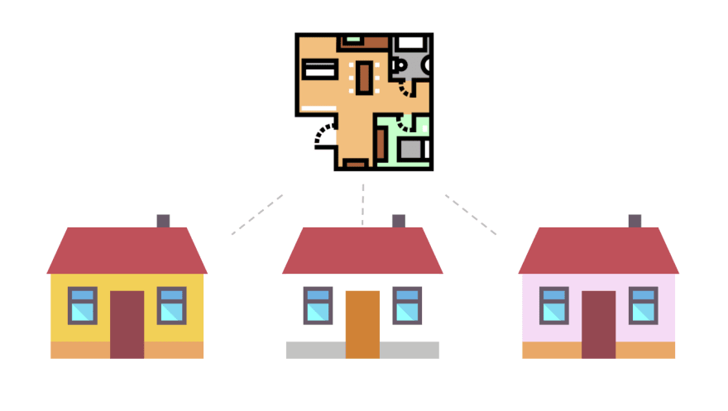
Class & Objects
No of Rooms, Colour, Interiors, Furnitures

Slide 20
Methods and Data
Data members ( Attributes) - Name, USN, Phone
Member Functions( Methods/ Functions), getUSN, getName, setName, setPhoneNumber()
Name | USN | Phone Number
1KS23IC001 | ADITHI S BHARADWAJ | 99228822
1KS23IC002 | ADITYA KUMAR B | 94948494
1KS23IC003 | AKHILA P V | 85648393
1KS23IC004 | AKSHAY KUMAR G C | 47476383

Slide 21

Abstraction
Abstraction means hiding lower-level details and exposing only the essential and relevant details to the users.
Hiding internal details and showing functionality is known as abstraction.

Slide 22

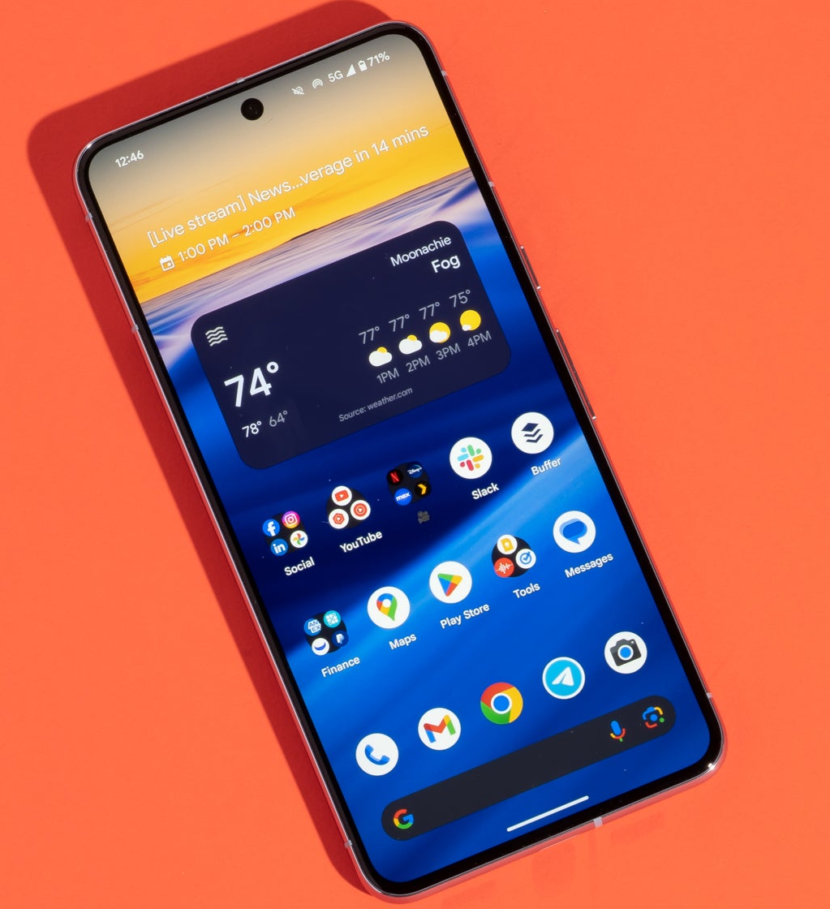
Abstraction

Slide 23
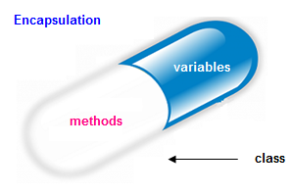
Encapsulation
Encapsulation is the process of wrapping data and methods in a single unit.
In OOP, data and methods operating on that data are combined together to form a single unit, which is referred to as a Class.
Encapsulation is the mechanism that binds together code and the data it manipulates and keeps both safe from outside interference and misuse.

Slide 24
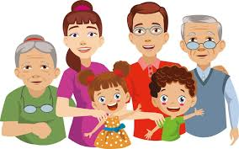
Inheritance

Slide 25
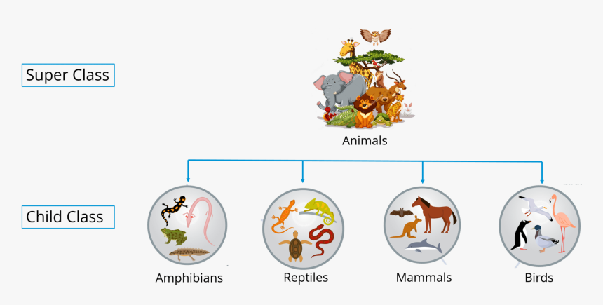
Inheritance

Slide 26
Polymorphism
The fact that something such as an animal or chemical can exist in different forms.
Ex. Carbon has two polymorphs, which are graphite and diamond.
Polymorphism is the process of representing one form in multiple forms.

Slide 27
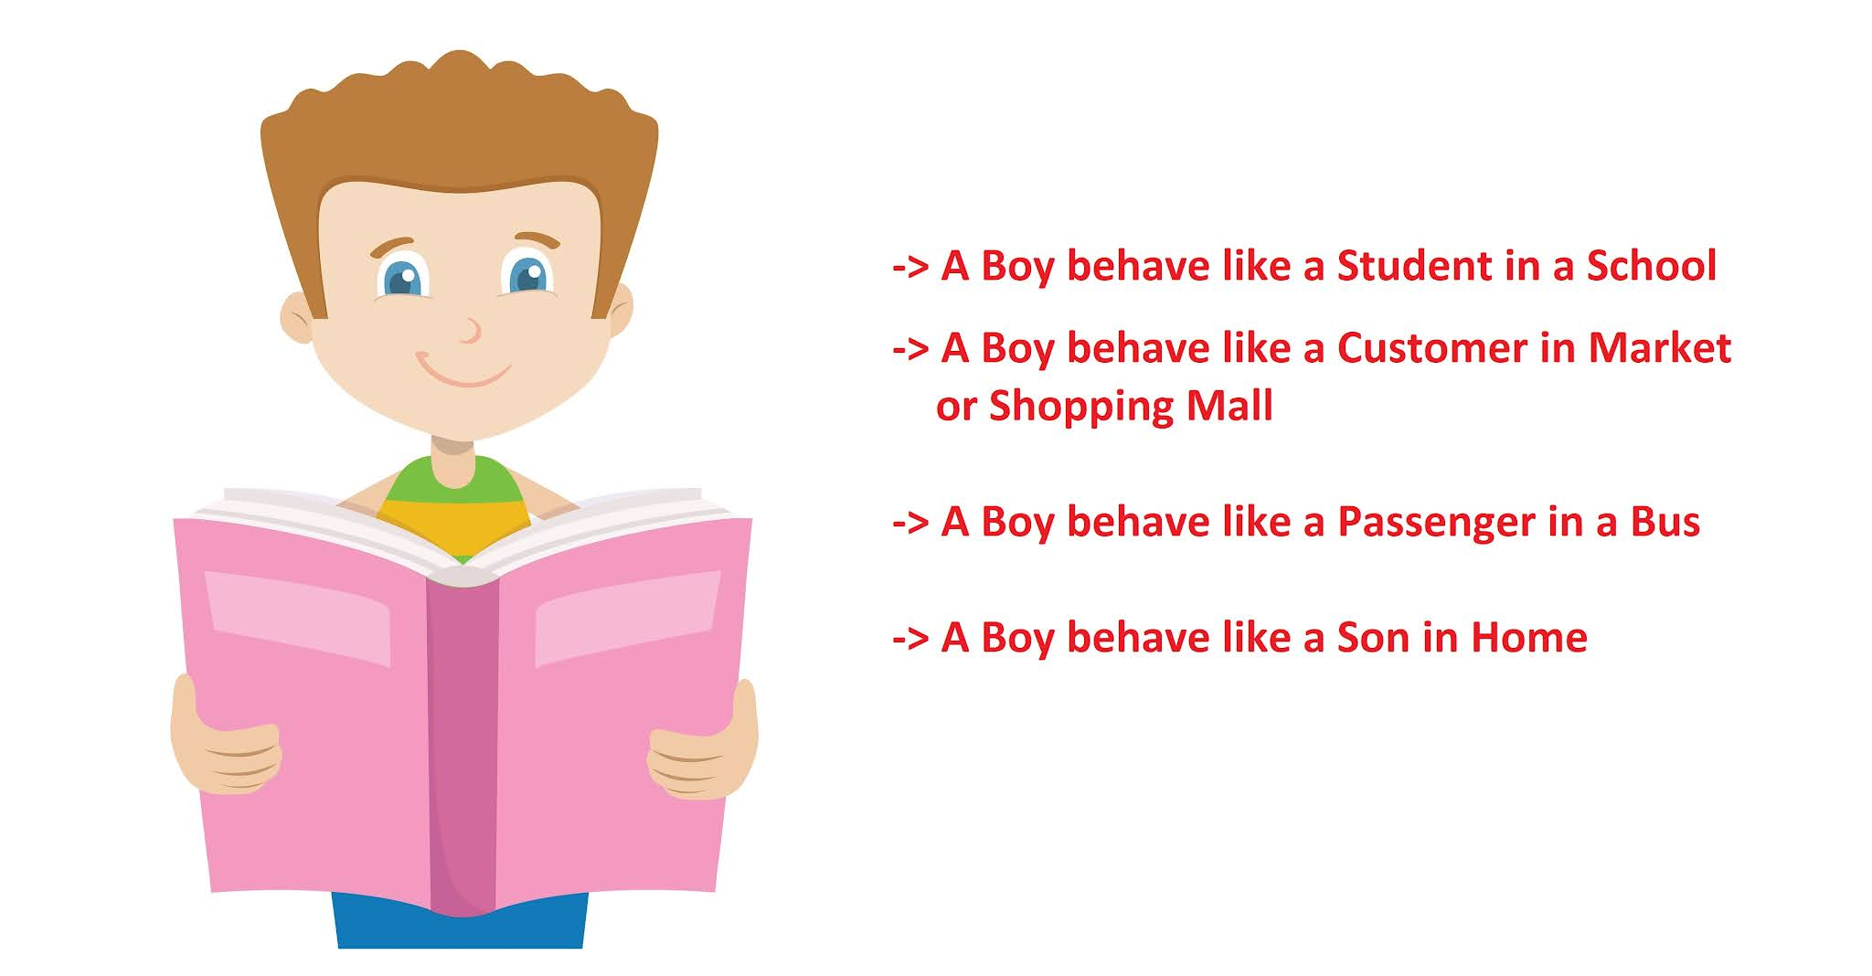
Polymorphism

Slide 28
Polymorphism:
Definitions of Polymorphism:
Polymorphism allows us to perform a single action in different ways.
Polymorphism allows you to define one interface and have multiple implementations.
We can create functions or reference variables that behave differently in different programmatic contexts.
Polymorphism means many forms.

Slide 29
https://www.javaguides.net/2019/08/oops-concepts-in-java-with-realtime-examples.html

Slide 30
History of Java
Java was originally designed for interactive television, but it was too advanced technology for the digital cable television industry at the time.
Java team members (also known as Green Team), initiated this project to develop a language for digital devices such as set-top boxes, televisions, etc. However, it was best suited for internet programming.
The principles for creating Java programming were "Simple, Robust, Portable, Platform-independent, Secured, High Performance, Multithreaded, Architecture Neutral, Object-Oriented, Interpreted, and Dynamic".

Slide 31
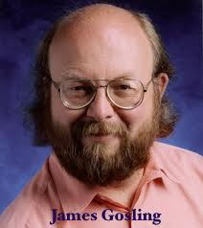
Java was developed by James Gosling, who is known as the father of Java, in 1995. James Gosling and his team members started the project in the early '90s.
Currently, Java is used in internet programming, mobile devices, games, e-business solutions, etc.

Slide 32
Following are given significant points that describe the history of Java.
1) James Gosling, Mike Sheridan, and Patrick Naughton initiated the Java language project in June 1991. The small team of sun engineers called Green Team.
2) Initially it was designed for small, embedded systems in electronic appliances like set-top boxes.
3) Firstly, it was called "Greentalk" by James Gosling, and the file extension was .gt.
4) After that, it was called Oak and was developed as a part of the Green project.

Slide 33
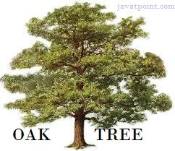
Why Java was named as "Oak"?
5) Why Oak? Oak is a symbol of strength and chosen as a national tree of many countries like the U.S.A., France, Germany, Romania, etc.
6) In 1995, Oak was renamed as "Java" because it was already a trademark by Oak Technologies.

Slide 34
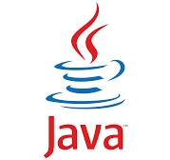
Why Java Programming named "Java"?
7) Why had they chose the name Java for Java language? The team gathered to choose a new name. The suggested words were "dynamic", "revolutionary", "Silk", "jolt", "DNA", etc. They wanted something that reflected the essence of the technology: revolutionary, dynamic, lively, cool, unique, and easy to spell, and fun to say.
According to James Gosling, "Java was one of the top choices along with Silk". Since Java was so unique, most of the team members preferred Java than other names.
8) Java is an island in Indonesia where the first coffee was produced (called Java coffee). It is a kind of espresso bean. Java name was chosen by James Gosling while having a cup of coffee nearby his office.
9) Notice that Java is just a name, not an acronym.

Slide 35
10) Initially developed by James Gosling at Sun Microsystems (which is now a subsidiary of Oracle Corporation) and released in 1995.
11) In 1995, Time magazine called Java one of the Ten Best Products of 1995.
12) JDK 1.0 was released on January 23, 1996. After the first release of Java, there have been many additional features added to the language. Now Java is being used in Windows applications, Web applications, enterprise applications, mobile applications, cards, etc. Each new version adds new features in Java.

Slide 36
Chapter 2 Overview of Java
Java Features
Simple
Object-Oriented
Portable
Platform independent
Secured
Robust
Architecture neutral
Interpreted
High Performance
Multithreaded
Distributed
Dynamic

Slide 37
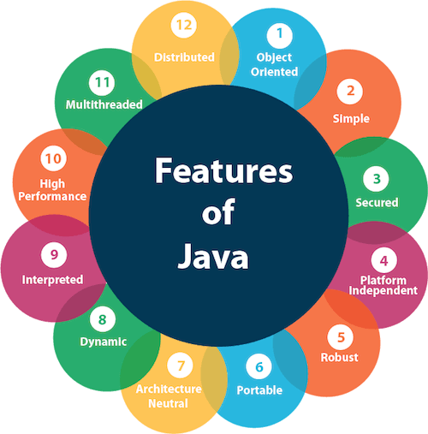

Slide 38
Java Features
Simple
Java is very easy to learn, and its syntax is simple, clean and easy to understand.
Java syntax is based on C & C++ (so easier for programmers to learn it after C, C++).
Java has removed explicit pointers, operator overloading, etc.

Slide 39
Object-Oriented
Java is an object-oriented programming language. Everything in Java is an object. Object-oriented means we organize our software as a combination of different types of objects that incorporate both data and behavior.
Basic concepts of OOPs are:
Object
Class
Inheritance
Polymorphism
Abstraction
Encapsulation

Slide 40
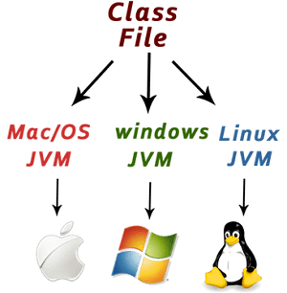
Platform Independent
Java is platform independent because it is different from other languages like C, C++, etc. which are compiled into platform specific machines while Java is a write once, run anywhere language.
A platform is the hardware or software environment in which a program runs.

Slide 41
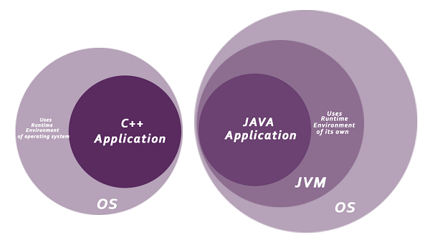
Secured
Java is best known for its security. With Java, we can develop virus-free systems. Java is secured because:
No explicit pointer
Java Programs run inside a virtual machine sandbox

Slide 42
Robust - The English mining of Robust is strong. Java is robust because:
It uses strong memory management.
Java provides automatic garbage collection which runs on the Java Virtual Machine to get rid of objects which are not being used by a Java application anymore.
There are exception handling and the type checking mechanism in Java.
All these points make Java robust.

Slide 43
Architecture-neutral
Java is architecture neutral because there are no implementation dependent features, for example, the size of primitive types is fixed.
In C programming, int data type occupies 2 bytes of memory for 32-bit architecture and 4 bytes of memory for 64-bit architecture. However, it occupies 4 bytes of memory for both 32 and 64-bit architectures in Java.
Portable
Java is portable because it facilitates you to carry the Java bytecode to any platform. It doesn't require any implementation.
High-performance
Java is faster than other traditional interpreted programming languages because Java bytecode is "close" to native code.

Slide 44
Distributed
Java is distributed because it facilitates users to create distributed applications in Java.
Multi-threaded
A thread is like a separate program, executing concurrently. We can write Java programs that deal with many tasks at once by defining multiple threads. The main advantage of multi-threading is that it doesn't occupy memory for each thread. It shares a common memory area. Threads are important for multi-media, Web applications, etc.
Dynamic
Java is a dynamic language. It supports the dynamic loading of classes. It means classes are loaded on demand. It also supports functions from its native languages, i.e., C and C++.

Slide 45
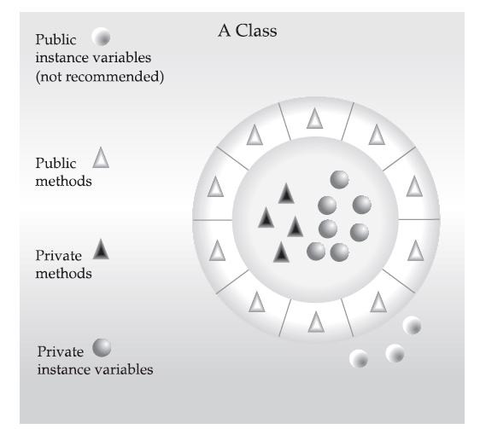
The Three OOP Principles
Abstraction ( Encapsulation)
Inheritance
Polymorphism

Slide 46
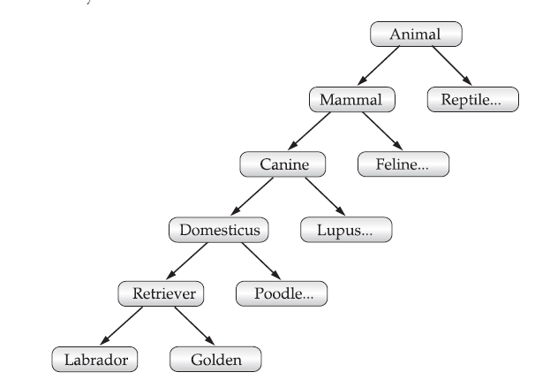

Slide 47
Simple Java Program
/*
This is a simple Java program. Call this file "Example.java".
*/
class Example {
// Your program begins with a call to main().
public static void main(String args[]) {
System.out.println("This is a simple Java program.");
}
}

Slide 48
Simple Java Program
class keyword is used to declare a class in Java.
public keyword is an access modifier that represents visibility. It means it is visible to all.
static is a keyword. If we declare any method as static, it is known as the static method. The core advantage of the static method is that there is no need to create an object to invoke the static method. The main() method is executed by the JVM, so it doesn't require creating an object to invoke the main() method. So, it saves memory.
void is the return type of the method. It means it doesn't return any value.
main represents the starting point of the program.
String[] args or String args[] is used for command line argument. We will discuss it in coming section.

Slide 49
Simple Java Program
System.out.println() is used to print statement. Here, System is a class, out is an object of the PrintStream class, println() is a method of the PrintStream class. We will discuss the internal working of System.out.println() statement in the coming section.
To compile: | javac Example.java
To execute: | java Example

Slide 50
The public keyword is an access modifier, which allows the programmer to control the visibility of class members. When a class member is preceded by public, then that member may be accessed by code outside the class in which it is declared.
The keyword static allows main( ) to be called without having to instantiate a particular instance of the class. This is necessary since main( ) is called by the Java Virtual Machine before any objects are made.
As stated, main( ) is the method called when a Java application begins. Keep in mind that Java is case-sensitive. Thus, Main is different from main. In main( ), there is only one parameter, albeit a complicated one.
String args[ ] declares a parameter named args, which is an array of instances of the class String. (Arrays are collections of similar objects.) Objects of type String store character strings. In this case, args receives any command-line arguments present when the program
is executed.

Slide 51
A Second Short Program
/* Here is another short example. Call this file "Example2.java". */
class Example2 {
public static void main(String args []) {
int num; // this declares a variable called num
num = 100; // this assigns num the value 100
System.out.println("This is num: " + num);
num = num * 2;
System.out.print("The value of num * 2 is ");
System.out.println(num);
}
}
When you run this program, you will see the following output:
This is num: 100
The value of num * 2 is 200

Slide 52
Two Control Statements
IF CONDITION And For loop simple codes
Using Blocks of Code
Java allows two or more statements to be grouped into blocks of code, also called code blocks.
This is done by enclosing the statements between opening and closing curly braces. Once a block of code has been created, it becomes a logical unit that can be used any place that a single statement can. For example, a block can be a target for Java’s if and for statements.
Consider this if statement:
if(x < y) { // begin a block
x = y;
y = 0;
} // end of block

Slide 53
Lexical Issues- Tokens
Java is case-sensitive
Java programs are a collection of
Whitespace- Java is a free-form language
Identifiers- Identifiers are used to name things, such as classes, variables, and methods. An identifier may be any descriptive sequence of uppercase and lowercase letters, numbers, or the underscore and dollar-sign characters
Literals- Constants A constant value in Java is created by using a literal representation of it.
Comments - //, /* */
Operators – All operators
separators, and -
keywords

Slide 54
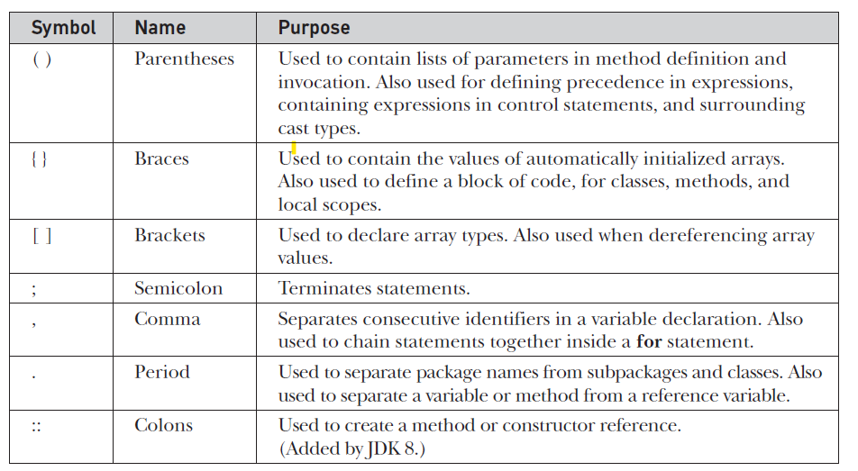
Separators

Slide 55
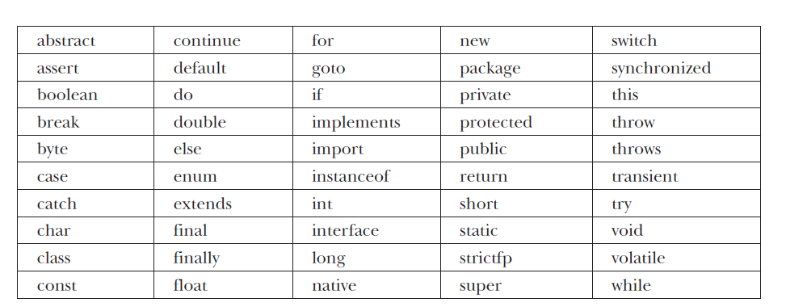
Keywords
There are 50 keywords currently defined in the Java language

Slide 56
Java Processing and Execution
Begin with Java source code in text files: Example.java
A Java source code compiler produces Java byte code
Outputs one file per class: Example.class
May be standalone or part of an IDE
A Java Virtual Machine loads and executes class files
May compile them to native code (e.g., x86) internally

Slide 57
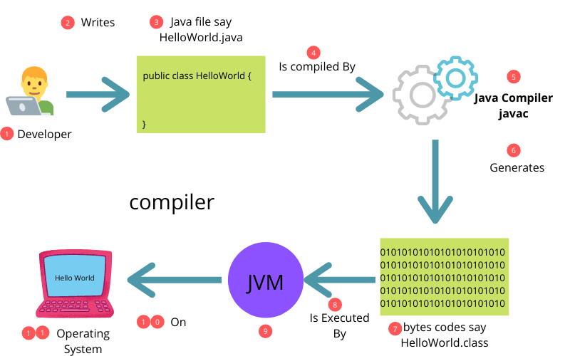
Compiling and Executing a Java Program

Slide 58
Classes and Objects
The class is the unit of programming
A Java program is a collection of classes
Each class definition (usually) in its own .java file
The file name must match the class name
A class describes objects (instances)
Describes their common characteristics: is a blueprint
Thus all the instances have these same characteristics
These characteristics are:
Data fields for each object
Methods (operations) that do work on the objects

Slide 59
Grouping Classes: The Java API
A package consists of some related Java classes:
Swing: a GUI (graphical user interface) package
AWT: Application Window Toolkit (more GUI)
util: utility data structures
The import statement tells the compiler to make available classes and methods of another package
A main method indicates where to begin executing a class (if it is designed to be run as a program)

Slide 60
References and Primitive Data Types
Java distinguishes two kinds of entities
Primitive types
Objects
Primitive-type data is stored in primitive-type variables
Reference variables store the address of an object

Slide 61
Primitive Data Types
Data type | Range of values
byte | -128 .. 127 (8 bits)
short | -32,768 .. 32,767 (16 bits)
int | -2,147,483,648 .. 2,147,483,647 (32 bits)
long | -9,223,372,036,854,775,808 .. ... (64 bits)
float | +/-10⁻³⁸ to +/-10⁺³⁸ and 0, about 6 digits precision
double | +/-10⁻³⁰⁸ to +/-10⁺³⁰⁸ and 0, about 15 digits precision
char | Unicode characters (generally 16 bits per char)
boolean | True or false

Slide 62
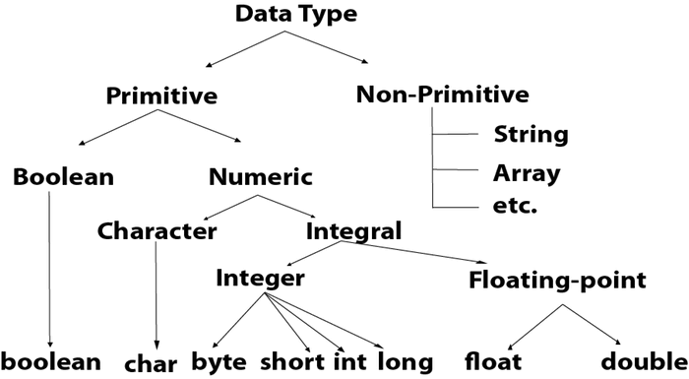
Primitive Data Types

