Slide 1
OOPs with Java Chapter 8 Inheritance
Dr. Ganga Holi
Professor & Head, Dept of CSE(ICB)

Slide 2
Inheritance
Inheritance represents the IS-A relationship which is also known as a parent-child relationship.
When you inherit from an existing class, you can reuse methods and fields of the parent class. Moreover, you can add new methods and fields in your current class also.
Why use inheritance in java
For Method Overriding (so runtime polymorphism can be achieved).
For Code Reusability.

Slide 3
Terms used in Inheritance
Class: A class is a group of objects which have common properties. It is a template or blueprint from which objects are created.
Sub Class/Child Class: Subclass is a class which inherits the other class. It is also called a derived class, extended class, or child class.
Super Class/Parent Class: Superclass is the class from where a subclass inherits the features. It is also called a base class or a parent class.
Reusability: As the name specifies, reusability is a mechanism which facilitates you to reuse the fields and methods of the existing class when you create a new class. You can use the same fields and methods already defined in the previous class.

Slide 4
The syntax of Java Inheritance
class Subclass-name extends Superclass-name
{
//methods and fields
}

Slide 5
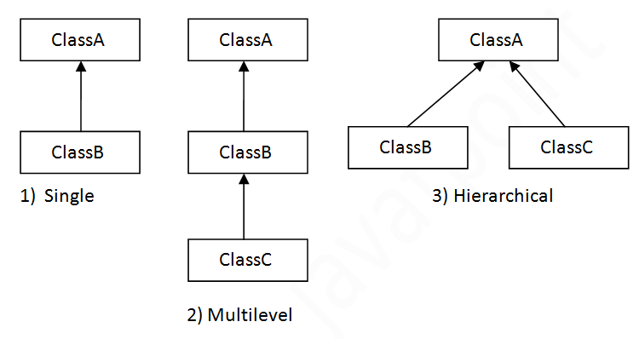
Types of inheritance in java

Slide 6
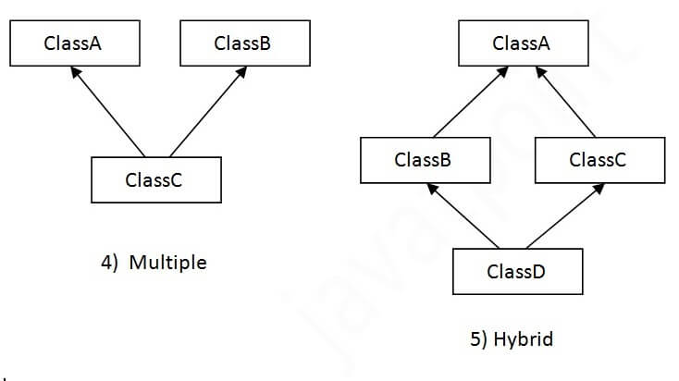
Multiple and Hybrid inheritance is not supported in Java through class. But achieved using Interface. To reduce the complexity and simplify the language, multiple inheritance is not supported in java.

Slide 7
_{class Animal}
_{{ void eat()}
{ System.out.println("eating...");}
}
_{class Dog extends Animal}
{
_{void bark()}
{ System.out.println("barking...");}
}
_{class TestInheritance}
{ public static void main(String args[])
{
Dog d=new Dog(); Animal a = new Animal();
_{a.eat();}
_{d.bark(); d.eat();}
}
}

Slide 8
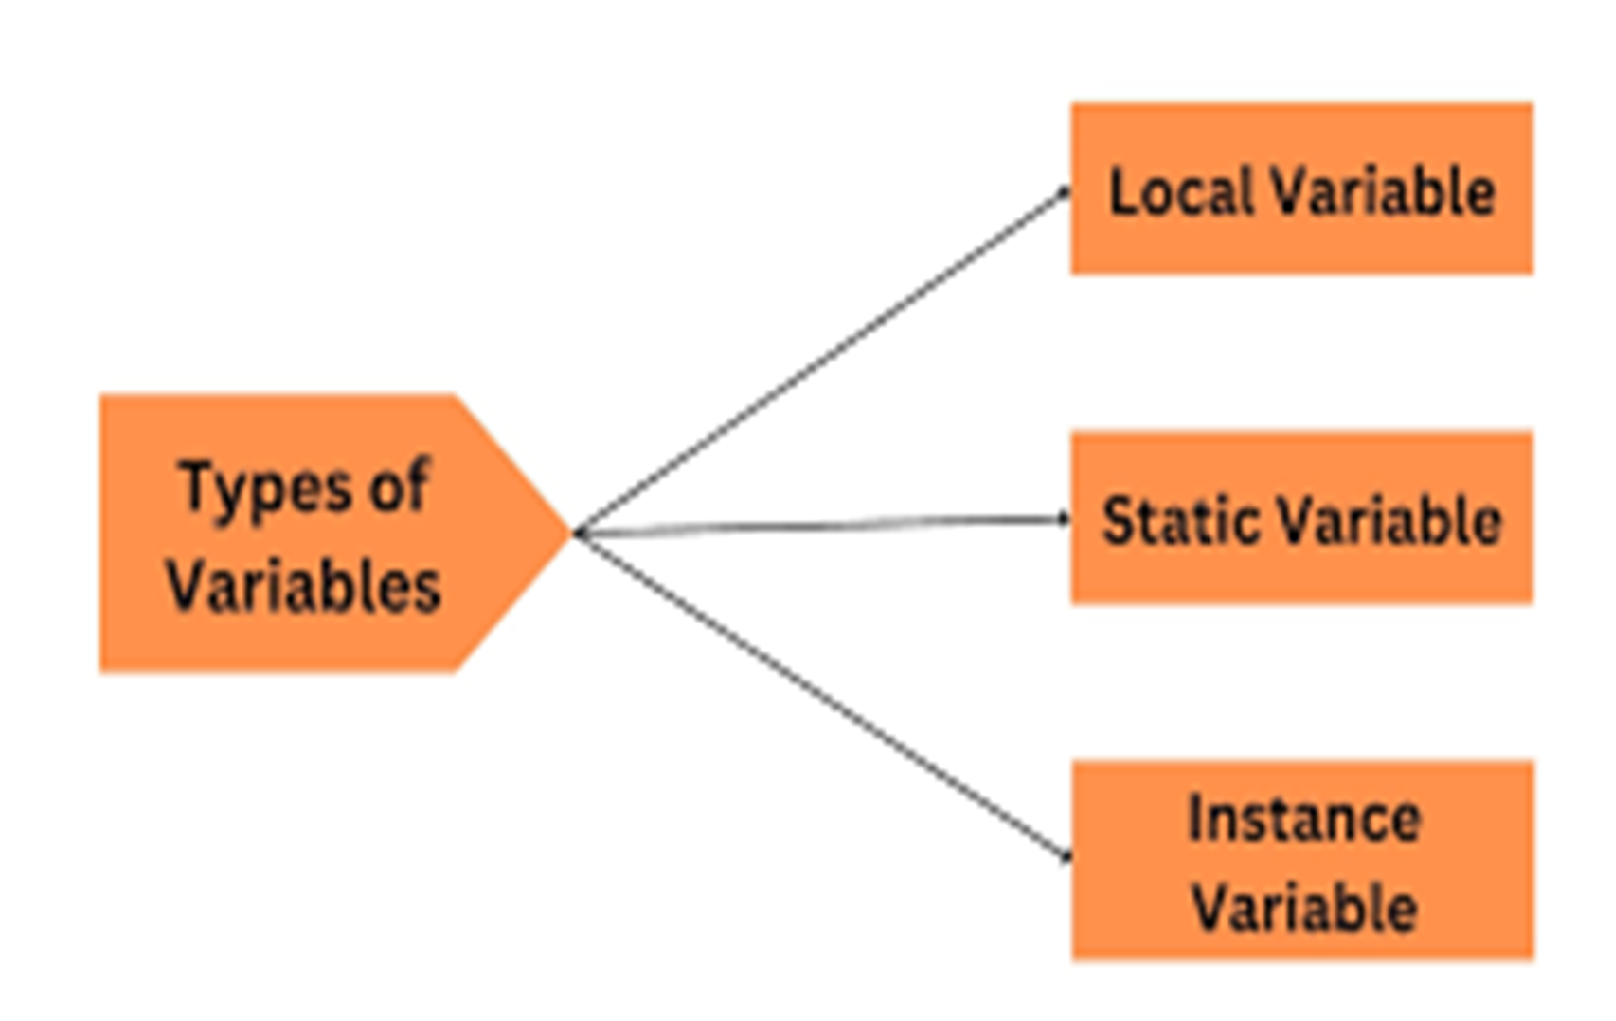

Slide 9
Class Variables
{
int x,y; // instance Variable
static int a=10; //---→ static variable
final int MAX=100; // constant Variable
void sum()
{ int s=0;
for(int i=1;i<=10;i++)
{ s=s+i; }
}
}

Slide 10
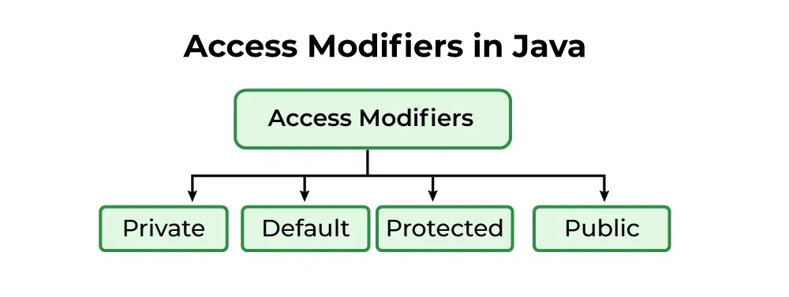
Access Specifier

Slide 11
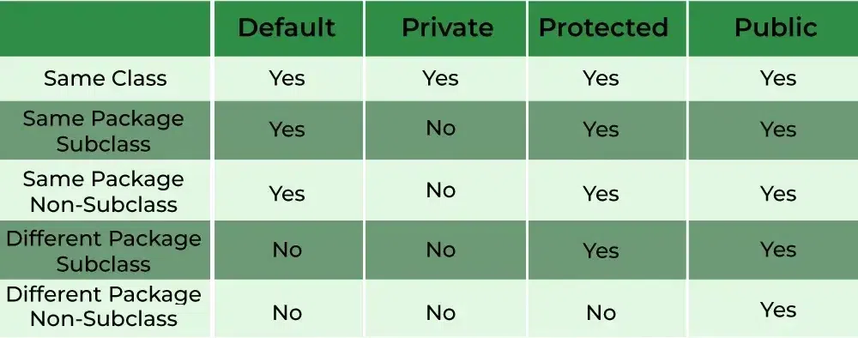
Access Specifier

Slide 12
 | Private | Default – No keyword required | Protected | Public
Same Class | YES | YES | YES | YES
Same package Sub class | NO | YES | YES | YES
Same package non sub class | NO | YES | YES | YES
Different package Sub class | NO | NO | YES | YES
Different package Non subclass | NO | NO | NO | YES

Slide 13
A Superclass Variable Can Reference a Subclass Object
A reference variable of a superclass can be assigned a reference to any subclass derived from that superclass.
It is important to understand that it is the type of the reference variable—not the type of the object that it refers to—that determines what members can be accessed.
That is, when a reference to a subclass object is assigned to a superclass reference variable, you will have access only to those parts of the object defined by the superclass

Slide 14
Using super- Whenever a subclass needs to refer to its immediate superclass, it can do so by use of the keyword super.
super has two general forms.
The first calls the superclass’ constructor.
The second is used to access a member of the superclass that has been hidden by a member of a subclass.

Slide 15
Using super to Call Superclass Constructors
A subclass can call a constructor defined by its superclass by use of the following form of
super:
super(arg-list);
Here, arg-list specifies any arguments needed by the constructor in the superclass.
super( )
must always be the first statement executed inside a subclass’ constructor.

Slide 16
Using super
class BoxWeight extends Box
{
double weight; // weight of box
// initialize width, height, and depth using super()
BoxWeight(double w, double h, double d, double m)
{ super(w, h, d); // call superclass constructor
weight = m;
}
}

Slide 17
Program example
Program example

Slide 18
A Second Use for super
The second form of super acts somewhat like this, except that it always refers to the superclass of the subclass in which it is used. This usage has the following general form:
super.member
Here, member can be either a method or an instance variable.
This second form of super is most applicable to situations in which member names of a subclass hide members by the same name in the superclass.

Slide 19
// Using super to overcome name hiding.
class A {
int i;
}
// Create a subclass by extending class A.

Slide 20
class B extends A {
int i; // this i hides the i in A
B(int a, int b) {
super.i = a; // i in A
i = b; // i in B
}
void show() {
System.out.println("i in superclass: " + super.i);
System.out.println("i in subclass: " + i);
}
}
class UseSuper {
public static void main(String args[]) {
B subOb = new B(1, 2);
subOb.show();
}
}

Slide 21
Dynamic Dispatch Method
..\Java_Programs\Java_Programs\Inheritance\Dynamic Method Dispatch.docx

Slide 22
Characteristics of Super Keywords in Java
Accessing Superclass Members
Avoiding Name Conflicts
Calling Superclass Constructors
Maintaining Inheritance
Chaining Constructors
Initialization super class data members
Helps Prevent Errors

Slide 23
Dynamic Dispatch Method
Method overriding forms the basis for one of Java’s most powerful concepts: dynamic method dispatch.
Dynamic method dispatch is the mechanism by which a call to an overridden method is resolved at run time, rather than compile time. ‘
Dynamic method dispatch is important because this is how Java implements run-time polymorphism.

Slide 24
When an overridden method is called through a superclass reference, Java determines which version of that method to execute based upon the type of the object being referred to at the time the call occurs. Thus, this determination is made at run time.
When different types of objects are referred to, different versions of an overridden method will be called. In other words, it is the type of the object being referred to (not the type of the reference variable) that determines which version of an overridden method will be executed.
Therefore, if a superclass contains a method that is overridden by a subclass, then when different types of objects are referred to through a superclass reference variable, different versions of the method are executed.

Slide 25
Why Overridden Methods?
Overridden methods allow Java to support run-time polymorphism.
Polymorphism is essential to object-oriented programming for one reason: it allows a general class to specify methods that will be common to all of its derivatives, while allowing subclasses to define the specific implementation of some or all of those methods.
Overridden methods are another way that Java implements the “one interface, multiple methods” aspect of polymorphism.
Dynamic, run-time polymorphism is one of the most powerful mechanisms that object oriented design brings to bear on code reuse and robustness.
The ability of existing code libraries to call methods on instances of new classes without recompiling while maintaining a clean abstract interface is a profoundly powerful tool.

Slide 26
Using Abstract Classes
There are situations in which you will want to define a superclass that declares the structure of a given abstraction without providing a complete implementation of every method.
This can be achieved by specifying the Java abstract type modifier.
Abstraction can be achieved using abstract class and abstract methods

Slide 27
Abstract Method
The abstract Method is used for creating blueprints for classes or interfaces.
Here methods are defined but these methods don’t provide the implementation.
Abstract Methods can only be implemented using subclasses or classes that implement the interfaces.
These methods are sometimes referred to as subclass responsibility because they have no implementation specified in the super-class.
Thus, a subclass must override them to provide a method definition.
To declare an abstract method, use this general form:
abstract type method-name(parameter-list);

Slide 28
Important rules for abstract methods are mentioned below:
Any class that contains one or more abstract methods must also be declared abstract.
If a class contains an abstract method it needs to be abstract and vice versa is not true.
If a non-abstract class extends an abstract class, then the class must implement all the abstract methods of the abstract class else the concrete class has to be declared as abstract as well.
The following are various illegal combinations of other modifiers for methods with respect to abstract modifiers:
final
abstract synchronized
abstract static
abstract private

Slide 29
// Abstract Class
abstract class arithmetic_operation
{ abstract void printInfo();
}
class add extends arithmetic_operation
{ void printInfo()
{
int a = 3;
int b = 4;
System.out.println(a + b);
}
}

Slide 30
class sub extends arithmetic_operation {
// class sub must override printInfo() method
// otherwise, compile-time
// exception will be thrown
void printInfo()
{
int c = 4;
int d = 5;
System.out.println(c - d);
}
}

Slide 31
class abstraction {
// Main Function
public static void main(String args[])
{
arithmetic_operation n = new add();
n.printInfo();
arithmetic_operation y = new sub();
y.printInfo();
}
}

Slide 32
Abstract Class
Note: Although abstract classes cannot be used to instantiate objects, they can be used to create object references, because Java’s approach to run-time polymorphism is implemented through the use of super-class references.
Thus, it must be possible to create a reference to an abstract class so that it can be used to point to a subclass object.

Slide 33
Abstract class with an abstract method.
You can require that certain methods be overridden by subclasses by specifying the abstract type modifier.
These methods are sometimes referred to as subclasser responsibility because they have no implementation specified in the superclass.
A subclass must override them—it cannot simply use the version defined in the superclass.
To declare an abstract method, use this general form:
abstract type name(parameter-list);

Slide 34
abstract class
// A Simple demonstration of abstract.
abstract class A
{
abstract void callme();
// concrete methods are still allowed in abstract classes
void callmetoo()
{
System.out.println("This is a concrete method.");
}
}

Slide 35
class B extends A
{ void callme()
{
System.out.println("B's implementation of callme.");
}
}

Slide 36
class AbstractDemo
{
public static void main(String args[])
{
B b = new B();
b.callme();
b.callmetoo();
}
}

Slide 37
Using final with Inheritance
Using final to Prevent Overriding
Using final to Prevent Inheritance

Slide 38
Using final to Prevent Overriding
class A
{ final void meth()
{ System.out.println("This is a final method.");
}
}
class B extends A
{ void meth()
{ // ERROR! Can't override.
System.out.println("Illegal!");
}
}

Slide 39
Using final to Prevent Inheritance
final class A {
//...
}
// The following class is illegal.
class B extends A { // ERROR! Can't subclass A
//...
}

Slide 40
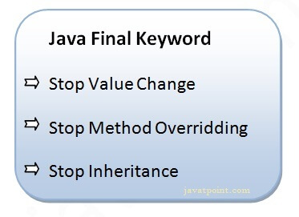
Final Keyword In Java
The final keyword in java is used to restrict the user. The java final keyword can be used in many context. Final can be:
variable
method
class

Slide 41
Java final variable: If you make any variable as final, you cannot change the value of final variable(It will be constant).
Final Variable value cannot be changed
class Bike
{ final int speedlimit=90;//final variable
void run()
{ speedlimit=400; } // compile tile error
public static void main(String args[])
{
Bike obj=new Bike();
obj.run();
}
}//end of class

Slide 42
Java final method: If you make any method as final, you cannot override it. Final methods cannot be Overridden
class Bike{
final void run(){System.out.println("running");}
}
class Honda extends Bike{
void run(){System.out.println("running safely with 100kmph");}
public static void main(String args[]){
Honda honda= new Honda();
honda.run();
}
}

Slide 43
Java final class: If you make any class as final, you cannot extend it. Final class cannot be extended
final class Bike{
void print()
{ ; }
}
class Honda1 extends Bike{
void run()
{ System.out.println("running safely with 100kmph"); }
public static void main(String args[])
{ Honda1 honda= new Honda1();
honda.run();
}
}

Slide 44
Is final method inherited? Yes
Yes, final method is inherited but you cannot override it. For Example:
class Bike{
final void run(){System.out.println("running...");}
}
class Honda2 extends Bike{
public static void main(String args[]){
new Honda2().run();
}
}

Slide 45
What is final parameter? If you declare any parameter as final, you cannot change the value of it.
class Bike11{
int cube(final int n){
n=n+2;//can't be changed as n is final
n*n*n;
}
public static void main(String args[]){
Bike11 b=new Bike11();
b.cube(5);
}
}

Slide 46
Can we declare a constructor final? No, because constructor is never inherited.

