Slide 1
Enumerations, Autoboxing, and Annotations

Slide 2
Enumerations
Enum is short for "enumerations",
which means "specifically listed".

Slide 3
Introduction
Enumeration is a list of named constants that define a new data type and its legal values.
enumeration object can hold only a value that was declared in the list.
Enumerations are commonly used to define a set of values that represent a collection of items.
For example, an enumeration to represent the error codes that can result from some operation, such as success, failed, or pending; or a list of the states that a device might be in, such as running, stopped, or paused

Slide 4
Enumeration Fundamentals
// An enumeration of apple varieties.
enum Apple
{
Jonathan, GoldenDel, RedDel, Winesap, Cortland
}

Slide 5
You can also have an enum inside class:
public class EnumDemo11 {
enum Level { LOW, MEDIUM, HIGH } public static void main(String[] args)
{
Level myVar = Level.MEDIUM; System.out.println(myVar);
}
}

Slide 6
Switch staement
enum Level
{ LOW, MEDIUM, HIGH }
public class EnumDemo12
{ public static void main(String[] args)
{ Level myVar = Level.MEDIUM;
switch(myVar)
{
case LOW: System.out.println("Low level"); break;
case MEDIUM: System.out.println("Medium level"); break;
case HIGH: System.out.println("High level"); break;
}
}
}

Slide 7
Difference between Enums and Classes
An enum can, just like a class, have attributes and methods.
The only difference is that enum constants are public, static and final (unchangeable - cannot be overridden).
An enum cannot be used to create objects, and it cannot extend other classes (but it can implement interfaces).
Why And When To Use Enums?
Use enums when you have values that you know aren't going to change, like month days, days, colors, deck of cards, etc.

Slide 8
The values( ) and valueOf( ) Methods
All enumerations automatically contain two predefined methods: values( ) and valueOf( ).
Their general forms are shown here:
public static enum-type [ ] values( )
public static enum-type valueOf(String str )
The values( ) method returns an array that contains a list of the enumeration constants.
The valueOf( ) method returns the enumeration constant whose value corresponds to the string passed in str.
In both cases, enum-type is the type of the enumeration

Slide 9
// An enumeration of apple varieties.
enum Apple {
Jonathan, GoldenDel, RedDel, Winesap, Cortland
}
class EnumDemo {
public static void main(String args[])
{ Apple ap;
ap = Apple.RedDel;
// Output an enum value.
System.out.println("Value of ap: " + ap);
System.out.println();
ap = Apple.GoldenDel;
// Compare two enum values.
if(ap == Apple.GoldenDel)
System.out.println("ap contains GoldenDel.\n");
// Use an enum to control a switch statement.

Slide 10
switch(ap)
{
case Jonathan: System.out.println("Jonathan is red.");
break;
case GoldenDel:
System.out.println("Golden Delicious is yellow.");
break;
case RedDel: System.out.println("Red Delicious is red.");
break;
case Winesap: System.out.println("Winesap is red.");
break;
case Cortland: System.out.println("Cortland is red.");
break;
}
}
}

Slide 12
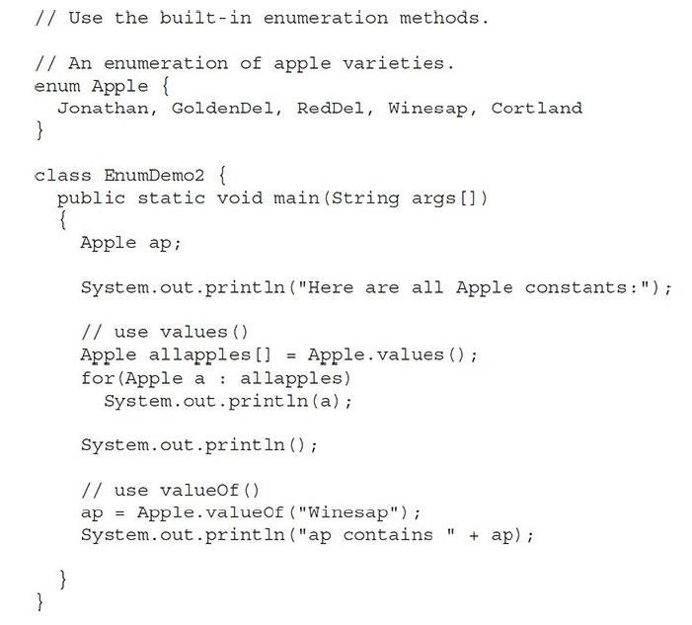
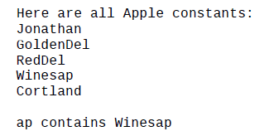

Slide 13
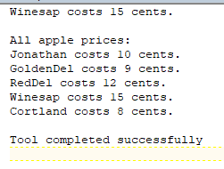
Java Enumerations Are Class Types
// Use an enum constructor, instance
variable, and method.
enum Apple {
Jonathan(10), GoldenDel(9), RedDel(12),
Winesap(15), Cortland(8);
private int price; // price of each apple
// Constructor
Apple(int p) { price = p; }
int getPrice() { return price; }
}
class EnumDemo3 {
public static void main(String args[])
{
Apple ap;
// Display price of Winesap. System.out.println("Winesap costs " + Apple.Winesap.getPrice() +
" cents.\n");
// Display all apples and prices. System.out.println("All apple prices:"); for(Apple a : Apple.values()) System.out.println(a + " costs " +
a.getPrice() +
" cents.");
}
}

Slide 14
Autoboxing

Slide 15
Introduction
Beginning with JDK 5, Java added two important features: autoboxing and auto- unboxing.
Autoboxing is the process by which a primitive type is automatically encapsulated (boxed) into its equivalent type wrapper whenever an object of that type is needed.
There is no need to explicitly construct an object.
Auto-unboxing is the process by which the value of a boxed object is
automatically extracted (unboxed) from a type wrapper when its value is needed.
With autoboxing, it is no longer necessary to manually construct an object in order to wrap a primitive type. You need only assign that value to a type-wrapper reference.
Java automatically constructs the object

Slide 16
Demonstrate autoboxing/unboxing
class AutoBox
{ public static void main(String args[])
{ Integer iOb = 100; // autobox an int\
int i = iOb; // auto-unbox
System.out.println(i + " " + iOb); // displays 100
}
}

Slide 17
Autoboxing and Methods
class AutoBox2 {
// Take an Integer parameter and return an int value; static int m(Integer v) {
return v ; // auto-unbox to int
}
public static void main(String args[]) {
// Pass an int to m() and assign the return value to an Integer. Here, the
//argument 100 is autoboxed into an Integer. The return value is also
//autoboxed into an Integer.
Integer iOb = m(100);
System.out.println(iOb);
}
}

Slide 18
Annotations (Metadata)
Since JDK 5, Java has supported a feature that enables you to embed supplemental information into a source file.
This information, called an annotation, does not change the actions of a program.
An annotation leaves the semantics of a program unchanged

Slide 19
Annotation Basics
An annotation is created through a mechanism based on the interface.
Let’s begin with an example. Here is the declaration for an annotation called
MyAnno:
// A simple annotation type. @interface MyAnno {
String str(); int val();
}
First, notice the @ that precedes the keyword interface.
This tells the compiler that an annotation type is being declared.
Next, notice the two members str( ) and val( ).
All annotations consist solely of method declarations
All annotation types automatically extend the Annotation interface.
Annotation is a super-interface of all annotations. It is declared within the
java.lang.annotation package.

Slide 20
The Built-In Annotations
Java defines many built-in annotations. Most are specialized, but nine
are general purpose.
Of these, four are imported from java.lang.annotation:
@Retention, @Documented, @Target, and @Inherited.
Five - @Override, @Deprecated, @FunctionalInterface, @SafeVarargs,
and @SuppressWarnings are included in java.lang

Slide 21
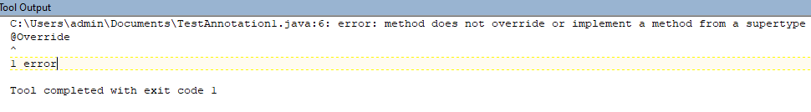
class Animal{
void eatSomething(){System.out.println("eating something");}
}
class Dog extends Animal{ @Override
void eatsomething(){System.out.println("eating foods");}//should be eatSomething
}
class TestAnnotation1{
public static void main(String args[]){ Animal a=new Dog(); a.eatSomething();
}}

Slide 22
I/O Basics
Java does provide strong, flexible support for I/O as it relates to files and networks. Java’s I/O system is cohesive and consistent.
In fact, once you understand its fundamentals, the rest of the I/O system is easy to master.
A general overview of I/O is presented here. Streams
Java programs perform I/O through streams.
A stream is an abstraction that either produces or consumes information.
A stream is linked to a physical device by the Java I/O system.
An input stream can abstract many different kinds of input: from a disk file, a keyboard, or a network socket.
An output stream may refer to the console, a disk file, or a network connection. Streams are a clean way to deal with input/output without having every part of your code understand the difference between a keyboard and a network, for example.
Java implements streams within class hierarchies defined in the java.io package.

Slide 23
The Predefined Streams
System also contains three predefined stream variables: in, out, and err.
These fields are declared as public, static, and final within System.
This means that they can be used by any other part of your program and without reference to a specific System object.
System.out refers to the standard output stream.
Console. System.in refers to standard input, which is the keyboard by default.
System.err refers to the standard error stream, which also is the console by default

Slide 24
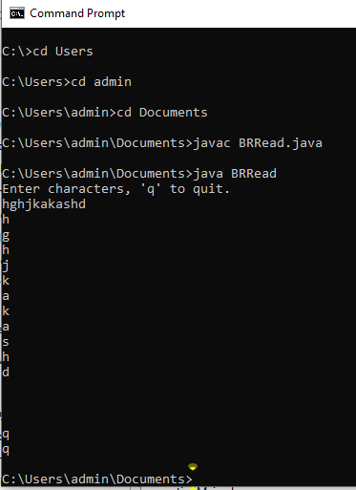
BufferedReader to read characters from the console
import java.io.*; class BRRead {
public static void main(String args[]) throws IOException
{
char c;
BufferedReader br = new
BufferedReader(new InputStreamReader(System.in)); System.out.println("Enter characters, 'q' to quit.");
// read characters do {
c = (char) br.read();
System.out.println(c);
} while(c != 'q');
}
}

Slide 25
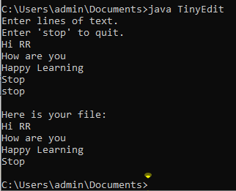
// A tiny editor. import java.io.*; class TinyEdit {
public static void main(String args[]) throws IOException
{
// create a BufferedReader using System.in BufferedReader br = new BufferedReader(new InputStreamReader(System.in));
String str[] = new String[100]; System.out.println("Enter lines of text."); System.out.println("Enter 'stop' to quit."); for(int i=0; i<100; i++) {
str[i] = br.readLine();
if(str[i].equals("stop")) break;
}
System.out.println("\nHere is your file:");
// display the lines
for(int i=0; i<100; i++) { if(str[i].equals("stop")) break; System.out.println(str[i]);

Slide 26
Writing Console Output
class WriteDemo {
public static void main(String args[]) {
int b; b = 'A';
System.out.write(b); System.out.write('\n');
}
}

Slide 27

Generics

Slide 28
It is possible to create classes, interfaces, and methods that will work with various kinds of data.
Eg: Collections Framework.
Generics means parameterized types.

Slide 29
Using generics, it is possible to create a single class, that automatically works with different types of data.
A class, interface, or method that operates on a parameterized type is called generic.

Slide 30
A Simple Generics Example
// A simple generic class.
// Here, T is a type parameter that
// will be replaced by a real type
// when an object of type Gen is created. class Gen<T> {
T ob; // declare an object of type T
// Pass the constructor a reference to
// an object of type T. Gen(T o) {
ob = o;
}

Slide 31
// Return ob. T getob() {
return ob;
}
// Show type of T. void showType() {
System.out.println("Type of T is " +
ob.getClass().getName());
}
}

Slide 32
// Demonstrate the generic class.
class GenDemo {
public static void main(String args[]) {
// Create a Gen reference for Integers. Gen<Integer> iOb;
// Create a Gen<Integer> object and assign its
// reference to iOb. Notice the use of autoboxing
// to encapsulate the value 88 within an Integer
object.
iOb = new Gen<Integer>(88);
// Show the type of data used by iOb. iOb.showType();

Slide 33
// Get the value in iOb. Notice that
// no cast is needed. int v = iOb.getob();
System.out.println("value: " + v); System.out.println();
// Create a Gen object for Strings. Gen<String> strOb = new
Gen<String>("Generics Test");
// Show the type of data used by strOb. strOb.showType();

Slide 34
// Get the value of strOb. Again, notice
// that no cast is needed. String str = strOb.getob();
System.out.println("value: " + str);
}
}

Slide 35
Output:
Type of T is java.lang.Integer value: 88
Type of T is java.lang.String value: Generics Test

Slide 36

A Generic Class with Two Type Parameters
We can declare more than one type parameter in a generic type.
To specify two or more type parameters, simply use a comma-separated list.

Slide 37
// A simple generic class with two type
// parameters: T and V.
class TwoGen<T, V> { T ob1;
V ob2;
// Pass the constructor a reference to
// an object of type T and an object of type V. TwoGen(T o1, V o2) {
ob1 = o1; ob2 = o2;
}

Slide 38
// Show types of T and V. void showTypes() {
System.out.println("Type of T is " +
ob1.getClass().getName()); System.out.println("Type of V is " +
ob2.getClass().getName());
}
T getob1() {
return ob1;
}
V getob2() {
return ob2;
}
}

Slide 39
// Demonstrate TwoGen. class SimpGen {
public static void main(String args[]) { TwoGen<Integer, String> tgObj =
new TwoGen<Integer, String>(88, "Generics");
// Show the types. tgObj.showTypes();
// Obtain and show values.
int v = tgObj.getob1(); System.out.println("value: " + v); String str = tgObj.getob2(); System.out.println("value: " + str);
}
}

Slide 40
Output:
Type of T is java.lang.Integer Type of V is java.lang.String value: 88
value: Generics

Slide 41

The General Form of a Generic Class
The syntax for declaring a generic class:
class class-name<type-param-list> { // ...
The syntax for declaring a reference to a generic class:
class-name<type-arg-list> var-name =
new class-name<type-arg-list>(cons-arg-list);

Slide 42
String Handling

Slide 43
String class
String is probably the most commonly used class in Java’s class library.
The reason for this is that strings are a very important part of programming.
The first thing to understand about strings is that every string you create is actually
an object of type String.
Even string constants are actually String objects. For example, in the statement
System.out.println("This is a String, too");
the string “This is a String, too” is a String constant.
objects of type String are immutable; once a String object is created, its contents cannot be altered.
While this may seem like a serious restriction, it is not, for two reasons:
If you need to change a string, you can always create a new one that contains the
modifications.
Java defines a peer class of String, called StringBuffer, which allows strings to be altered, so all of the normal string manipulations are still available in Java.
Strings can be constructed a variety of ways. The easiest is to use a statement like this:
String myString = "this is a test";

Slide 44
Creating Strings
String str = "abc"; is equivalent to:
char data[] = {'a', 'b', 'c'};
String str = new String(data);
If data array in the above example is modified after the string object str is created,
then str remains unchanged.
Construct a string object by passing another string object. String str2 = new String(str);

Slide 45
String Operations(1)
public char charAt(int index)
Returns the character at the specified index. An index ranges from 0 to length() - 1. The first character of the sequence is at index 0, the next at index 1, and so on, as for array indexing.
getChars() - Copies characters from this string into the destination character array. public void getChars(int srcBegin, int srcEnd, char[] dst, int dstBegin)
srcBegin - index of the first character in the string to copy.
srcEnd - index after the last character in the string to copy.
dst - the destination array.
dstBegin - the start offset in the destination array.
startsWith() – Tests if this string starts with the specified prefix. public boolean startsWith(String prefix)
“Figure”.startsWith(“Fig”); // true
endsWith() - Tests if this string ends with the specified suffix.
public boolean endsWith(String suffix) “Figure”.endsWith(“re”); // true

Slide 46
String Operations(2)
compareTo() - Compares two strings lexicographically.
The result is a negative integer if this String object lexicographically precedes the argument string.
The result is a positive integer if this String object lexicographically follows the argument string.
The result is zero if the strings are equal.
compareTo returns 0 exactly when the equals(Object) method would return true.
public int compareTo(String anotherString)
public int compareToIgnoreCase(String str)

Slide 47
String Operations(3)
indexOf – Searches for the first occurrence of a character or substring.
Returns -1 if the character does not occur.
public int indexOf(int ch)
Returns the index within this string of the first occurrence of the specified character.
public int indexOf(String str)
Returns the index within this string of the first occurrence of the specified substring.
String str = “How was your day today?”;
str.indexof(‘t’);
str(“was”);

Slide 48
String Operations(4)
toLowerCase(): Converts all of the characters in a String to lower case.
toUpperCase(): Converts all of the characters in this String to upper case.
public String toLowerCase() public String toUpperCase()
Eg: “HELLO THERE”.toLowerCase(); “hello there”.toUpperCase()

Slide 49
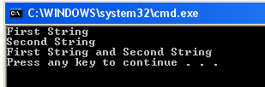
Program on String class
class StringDemo {
public static void main(String args[]) { String strOb1 = "First String";
String strOb2 = "Second String";
String strOb3 = strOb1 + " and " + strOb2; System.out.println(strOb1); System.out.println(strOb2); System.out.println(strOb3);
}
}

Slide 50
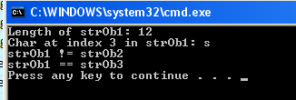
String methods
class StringDemo2 {
public static void main(String args[]) {
String strOb1 = "First String"; String strOb2 = "Second String"; String strOb3 = strOb1;
System.out.println("Length of strOb1: " + strOb1.length()); System.out.println("Char at index 3 in strOb1: " + strOb1.charAt(3));
if(strOb1.equals(strOb2)) System.out.println("strOb1 == strOb2"); else
System.out.println("strOb1 != strOb2"); if(strOb1.equals(strOb3)) System.out.println("strOb1 == strOb3"); else
System.out.println("strOb1 != strOb3");
}
}

Slide 51
StringBuffer
A StringBuffer is like a String, but can be modified.
The length and content of the StringBuffer sequence can be changed through
certain method calls.
StringBuffer defines three constructors:
StringBuffer()
StringBuffer(int size)
StringBuffer(String str)

Slide 52
StringBuffer Operations(1)
The principal operations on a StringBuffer are the append and insert methods,
which are overloaded so as to accept data of any type.
Here are few append methods: StringBuffer append(String str) StringBuffer append(int num)
The append method always adds these characters at the end of the buffer

Slide 53
StringBuffer Operations(2)
The insert method adds the characters at a specified point.
Here are few insert methods:
StringBuffer insert(int index, String str) StringBuffer append(int index, char ch)
Index specifies at which point the string will be inserted into the invoking StringBuffer object.

Slide 54
StringBuffer Operations(3)
delete() - Removes the characters in a substring of this StringBuffer. The substring begins at the specified start and extends to the character at index end - 1 or to the end of the StringBuffer if no such character exists. If start is equal to end, no changes are made.
public StringBuffer delete(int start, int end)

Slide 55
StringBuffer Operations(4)
replace() - Replaces the characters in a substring of this
characters in the specified String.
StringBuffer with
public StringBuffer replace(int start, int end, String str)
substring() - Returns a new String that contains a subsequence of characters currently contained in this StringBuffer. The substring begins at the specified index and extends to the end of the StringBuffer.
public String substring(int start)

Slide 56
StringBuffer Operations(5)
reverse() - The character sequence contained in this string buffer is replaced by
the reverse of the sequence.
public StringBuffer reverse()
length() - Returns the length of this string buffer.
public int length()

Slide 57
StringBuffer Operations(6)
capacity() - Returns the current capacity of the String buffer. The capacity is the
amount of storage available for newly inserted characters.
public int capacity()
charAt() - The specified character of the sequence currently represented by the
string buffer, as indicated by the index argument, is returned.
public char charAt(int index)

Slide 58
StringBuffer Operations(7)
getChars() - Characters are copied from this string buffer into the destination character array dst. The first character to be copied is at index srcBegin; the last character to be copied is at index srcEnd-1.
public void getChars(int srcBegin, int srcEnd, char[] dst, int dstBegin)
setLength() - Sets the length of the StringBuffer. public void setLength(int newLength)

Slide 59
Example : StringBuffer
StringBuffer sb = new StringBuffer(“Hello”);
sb.length(); // 5
sb.capacity(); // 21 (16 characters room is added if no size is specified) sb.charAt(1); // e
sb.setCharAt(1,’i’); // Hillo
sb.setLength(2); // Hi
sb.append(“l”).append(“l”); // Hill
sb.insert(0, “Big “); // Big Hill
sb.replace(3, 11, “”); // Big sb.reverse(); // gib

Slide 60


