Slide 1
Object Oriented Programming with Java Course Code : BCS306A
Dr. Ganga Holi,
Professor and Head, Dept of CSE-ICB
Notes:
Notes for title slide

Slide 2
Course Information
Object Oriented Programming with JAVA Semester
Course Code BCS306A CIE Marks 50 SEE Marks 50
Total Hours of Pedagogy 28 Hours of Theory + 20 Hours of Practical
Total Marks : 100
Credits 03 Exam Hours 03
Examination type (SEE) Theory

Slide 3
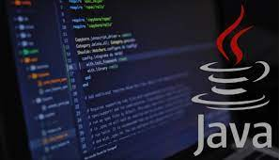
Course objectives:
To learn primitive constructs JAVA programming language.
To understand Object Oriented Programming fundamental Features of JAVA.
To gain knowledge on: Class, Objects, Inheritance and packages, multithreaded programming and exceptions.

Slide 4
Module-1
An Overview of Java: Object-Oriented Programming (Two Paradigms, Abstraction, The Three OOP Principles), Using Blocks of Code, Lexical Issues (Whitespace, Identifiers, Literals, Comments, Separators, The Java Keywords).
Data Types, Variables, and Arrays: The Primitive Types (Integers, Floating-Point Types, Characters, Booleans), Variables, Type Conversion and Casting, Automatic Type Promotion in Expressions, Arrays, Introducing Type Inference with Local Variables.

Slide 5
Module-1
Operators: Arithmetic Operators, Relational Operators, Boolean Logical Operators, The Assignment Operator, The ? Operator, Operator Precedence, Using Parentheses.
Control Statements: Java’s Selection Statements (if, The Traditional switch), Iteration Statements (while, do-while, for, The For-Each Version of the for Loop, Local Variable Type Inference in a for Loop, Nested Loops), Jump Statements (Using break, Using continue, return).
Chapters 2, 3, 4, 5

Slide 6
Module-2
Introducing Classes: Class Fundamentals, Declaring Objects, Assigning Object Reference Variables,
Introducing Methods, Constructors, The this Keyword, Garbage Collection.
Methods and Classes: Overloading Methods, Objects as Parameters, Argument Passing, Returning Objects, Recursion, Access Control, Understanding static, Introducing final, Introducing Nested and Inner Classes.
Chapter 6, 7

Slide 7
Module-3
Inheritance: Inheritance Basics, Using super, Creating a Multilevel Hierarchy, When Constructors Are Executed, Method Overriding, Dynamic Method Dispatch, Using Abstract Classes, Using final with Inheritance, Local Variable Type Inference and Inheritance, The Object Class.
Interfaces: Interfaces, Default Interface Methods, Use static Methods in an Interface, Private Interface
Methods.
Chapter 8, 9

Slide 8
Module- 4
Packages: Packages, Packages and Member Access, Importing Packages.
Exceptions: Exception-Handling Fundamentals, Exception Types, Uncaught Exceptions, Using try and catch, Multiple catch Clauses, Nested try Statements, throw, throws, finally, Java’s Built-in Exceptions,
Creating Your Own Exception Subclasses, Chained Exceptions.
Chapter 9, 10

Slide 9
Module-5
Multithreaded Programming: The Java Thread Model, The Main Thread, Creating a Thread, Creating Multiple Threads, Using isAlive() and join(), Thread Priorities, Synchronization, Interthread Communication, Suspending, Resuming, and Stopping Threads, Obtaining a Thread’s State.
Enumerations, Type Wrappers and Autoboxing: Enumerations (Enumeration Fundamentals, The values() and valueOf() Methods), Type Wrappers (Character, Boolean, The Numeric Type Wrappers), Autoboxing (Autoboxing and Methods, Autoboxing/Unboxing Occurs in Expressions, Autoboxing/Unboxing Boolean and Character Values).
Chapter 11, 12

Slide 10
Chapter 2 Overview of Java
Java Features
Simple
Object Oriented
Robust
Multithreaded
Architecture Neutral
Interpreted and High Performance
Distributed
Dynamic

Slide 11
Some Salient Characteristics of Java
Java is platform independent: the same program can run on any correctly implemented Java system
Java is object-oriented:
Structured in terms of classes, which group data with operations on that data
Can construct new classes by extending existing ones
Java designed as
A core language plus
A rich collection of commonly available packages
Java can be embedded in Web pages

Slide 12
Java Processing and Execution
Begin with Java source code in text files: Model.java
A Java source code compiler produces Java byte code
Outputs one file per class: Model.class
May be standalone or part of an IDE
A Java Virtual Machine loads and executes class files
May compile them to native code (e.g., x86) internally

Slide 13
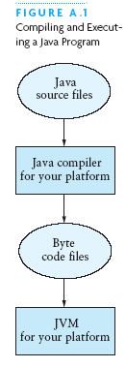
Compiling and Executing a Java Program

Slide 14
Classes and Objects
The class is the unit of programming
A Java program is a collection of classes
Each class definition (usually) in its own .java file
The file name must match the class name
A class describes objects (instances)
Describes their common characteristics: is a blueprint
Thus all the instances have these same characteristics
These characteristics are:
Data fields for each object
Methods (operations) that do work on the objects

Slide 15
Grouping Classes: The Java API
API = Application Programming Interface
Java = small core + extensive collection of packages
A package consists of some related Java classes:
Swing: a GUI (graphical user interface) package
AWT: Application Window Toolkit (more GUI)
util: utility data structures (important to CS 187!)
The import statement tells the compiler to make available classes and methods of another package
A main method indicates where to begin executing a class (if it is designed to be run as a program)

Slide 16
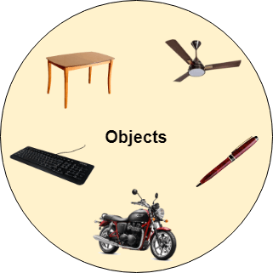
OOP Concepts

Slide 17
Class & Object
Object
Any entity that has state and behavior is known as an object. For example, a chair, pen, table, keyboard, bike, etc. It can be physical or logical.
Class
Collection of objects is called class. It is a logical entity.
A class can also be defined as a blueprint from which you can create an individual object. Class doesn't consume any space.

Slide 18
OOP Concepts
Object-Oriented Programming is a methodology or paradigm to design a program using classes and objects.
It provides many concepts, such as inheritance, data binding, polymorphism, etc.
Abstraction
Inheritance
Polymorphism

Slide 19
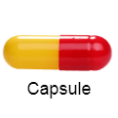
OOP Concepts
Abstraction
Hiding internal details and showing functionality is known as abstraction. For example phone call, we don't know the internal processing.
Encapsulation
Binding (or wrapping) code and data together into a single unit are known as encapsulation. For example, a capsule, it is wrapped with different medicines.
A java class is the example of encapsulation. Java bean is the fully encapsulated class because all the data members are private here.

Slide 20
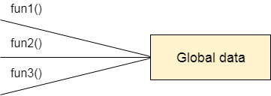
Procedure-Oriented Programming
Data Representation in Procedure-Oriented Programming

Slide 21
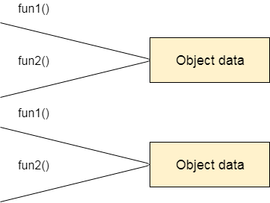
Object-Oriented Programming
Data Representation in Object-Oriented Programming

Slide 22
Inheritance
When one object acquires all the properties and behaviors of a parent object, it is known as inheritance. It provides code reusability. It is used to achieve runtime polymorphism.
Polymorphism
If one task is performed in different ways, it is known as polymorphism. For example: to convince the customer differently, to draw something, for example, shape, triangle, rectangle, etc.
In Java, we use method overloading and method overriding to achieve polymorphism.

Slide 23
Abstraction
Hiding internal details and showing functionality is known as abstraction. For example phone call, we don't know the internal processing.
Encapsulation
Binding (or wrapping) code and data together into a single unit are known as encapsulation. For example, a capsule, it is wrapped with different medicines.

Slide 24
Advantage of OOPs over Procedure-oriented programming language
) OOPs makes development and maintenance easier, whereas, in a procedure-oriented programming language, it is not easy to manage if code grows as project size increases.
2) OOPs provides data hiding, whereas, in a procedure-oriented programming language, global data can be accessed from anywhere.
3) OOPs provides the ability to simulate real-world event much more effectively. We can provide the solution of real word problem if we are using the Object-Oriented Programming language.

Slide 25
References and Primitive Data Types
Java distinguishes two kinds of entities
Primitive types
Objects
Primitive-type data is stored in primitive-type variables
Reference variables store the address of an object

Slide 26
Primitive Data Types
Represent numbers, characters, boolean values
Integers: byte, short, int, and long
Real numbers: float and double
Characters: char

Slide 27
Primitive Data Types
Data type | Range of values
byte | -128 .. 127 (8 bits)
short | -32,768 .. 32,767 (16 bits)
int | -2,147,483,648 .. 2,147,483,647 (32 bits)
long | -9,223,372,036,854,775,808 .. ... (64 bits)
float | +/-10⁻³⁸ to +/-10⁺³⁸ and 0, about 6 digits precision
double | +/-10⁻³⁰⁸ to +/-10⁺³⁰⁸ and 0, about 15 digits precision
char | Unicode characters (generally 16 bits per char)
boolean | True or false

Slide 28
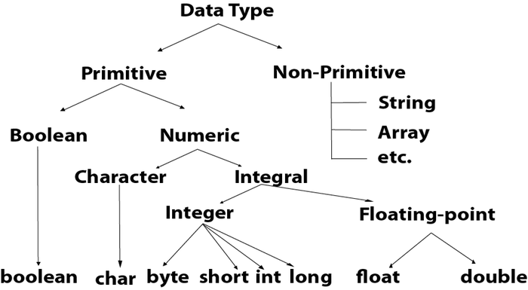
Primitive Data Types

Slide 29
Comments
// single line comment
/* */ multiline comment

