Slide 1
OOPs with Java Chapter 3 Data Types, Variables, & Arrays
Dr. Ganga Holi
Professor & Head, Dept of CSE(ICB)

Slide 2
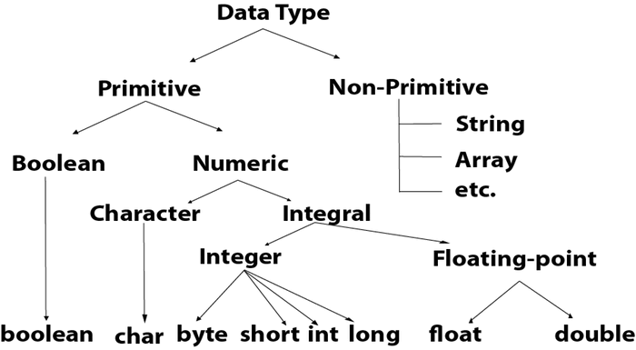
Data Types, Variables, and Arrays
Java Is a Strongly Typed Language

Slide 3
Data type | Range of values
byte | -128 .. 127 (8 bits)
short | -32,768 .. 32,767 (16 bits)
int | -2,147,483,648 .. 2,147,483,647 (32 bits)
long | -9,223,372,036,854,775,808 .. ... (64 bits)
float | +/-10⁻³⁸ to +/-10⁺³⁸ and 0, about 6 digits precision
double | +/-10⁻³⁰⁸ to +/-10⁺³⁰⁸ and 0, about 15 digits precision
char | Unicode characters (generally 16 bits per char)
boolean | True or false

Slide 4
// Compute distance light travels using long variables.
class Light {
public static void main(String args[]) {
int lightspeed;
long days; long seconds;
long distance;
// approximate speed of light in miles per second
lightspeed = 186000;
days = 1000; // specify number of days here
seconds = days * 24 * 60 * 60; // convert to seconds
distance = lightspeed * seconds; // compute distance
System.out.print("In " + days);
System.out.print(" days light will travel about ");
System.out.println(distance + " miles.");
}
}

Slide 5
Floating point Numbers
Float specifies a single-precision value that uses 32 bits of storage.
Double precision, as denoted by the double keyword, uses 64 bits to store a value.

Slide 6
// Compute the area of a circle.
class Area {
public static void main(String args[]) {
double pi, radius, area;
radius = 10.8; // radius of circle
pi = 3.1416; // pi, approximately
area = pi * radius * radius; // compute area
System.out.println("Area of circle is " + area);
}
}

Slide 7
Character Data Types
// program that demonstrates char variables:
// Demonstrate char data type.
class CharDemo {
public static void main(String args[]) {
char ch1, ch2;
ch1 = 88; // code for X
ch2 = 'Y’;
System.out.print("ch1 and ch2: ");
System.out.println(ch1 + " " + ch2);
}
}

Slide 8
Can add unicodes values, increment, decremet.
// char variables behave like integers.
class CharDemo2 {
public static void main(String args[]) {
char ch1;
ch1 = 'X’;
System.out.println("ch1 contains " + ch1);
ch1++; // increment ch1
System.out.println("ch1 is now " + ch1);
}
}

Slide 9
Booleans
Java has a primitive type, called boolean, for logical values.\
It can have only one of two possible values, true or false.
This is the type returned by all relational operators, as in the case of a < b. boolean is also the type required by the conditional expressions that govern the control statements such as if and for.

Slide 10
// Demonstrate boolean values.
class BoolTest {
public static void main(String args[]) {
boolean b; b = false;
System.out.println("b is " + b);
b = true;
System.out.println("b is " + b);
// a boolean value can control the if statement
if(b) System.out.println("This is executed.");
b = false;
if(b) System.out.println("This is not executed.");
// outcome of a relational operator is a boolean value
System.out.println("10 > 9 is " + (10 > 9));
}
}

Slide 11
Three interesting things about Boolean value
When a boolean value is output by println( ), "true" or "false" is displayed.
Second, the value of a boolean variable is sufficient, by itself, to control the if statement. There is no need to write an if statement like this:
if(b == true) …
Third, the outcome of a relational operator, such as <, is a boolean value. This is why the expression 10>9 displays the value "true." Further, the extra set of parentheses around 10>9 is necessary because the + operator has a higher precedence than the >.

Slide 12
Literals
Integer Literals
Int a=18388;
Long a=488844988;
An integer literal can always be assigned to a long variable.
However, to specify a long literal, you will need to explicitly tell the compiler that the literal value is of type long.
You do this by appending an upper- or lowercase L to the literal. For example, 0x7ffffffffffffffL or 9223372036854775807L is the largest long. An integer can also be assigned to a char as long as it is within range.
Beginning with JDK 7, you can also specify integer literals using binary. To do so, prefix
the value with 0b or 0B. For example, this specifies the decimal value 10 using a binary
literal:
int x = 0b1010;

Slide 13
You can embed one or more underscores in an integer literal. Doing so makes it easier to read large integer literals. When the literal is compiled, the underscores are discarded. For example, given
int x = 123_456_789;
the value given to x will be 123,456,789. The underscores will be ignored.
Underscores can only be used to separate digits. They cannot come at the beginning or the end of a literal. It is, however, permissible for more than one underscore to be used between two digits.
For
example, this is valid:
int x = 123___456___789;

Slide 14
Floating-Point Literals
Scientific notation uses a standard-notation, floating-point number plus a suffix that specifies a power of 10 by which the number is to be multiplied.
The exponent is indicated by an E or e followed by a decimal number, which can be positive or negative. Examples include 6.022E23, 314159E–05, and 2e+100.
Floating-point literals in Java default to double precision.
To specify a float literal, you must append an F or f to the constant. You can also explicitly specify a double literal by appending a D or d.

Slide 15
Character Literals
Printable characters are represented by single quotes ‘ ‘
Non printable quotes are by using \
For octal notation, use the backslash followed by the three-digit number. For example, ‘\141’ is the letter ‘a’.
\ddd Octal character (ddd)
\uxxxx Hexadecimal Unicode character (xxxx)
\' Single quote
\" Double quote
\\Backslash
For example, ‘\u0061’is the ISO-Latin-1 ‘a’ because the top byte is zero.

Slide 16
String Literals
String literals in Java are specified like they are in most other languages—by enclosing a sequence of characters between a pair of double quotes. Examples of string literals are
“Hello World”
“two\nlines”
One important thing to note about Java strings is that they must begin and end on the same line. There is no line-continuation escape sequence as there is in some other languages.

Slide 17
Dynamic Initialization
Java allows variables to be initialized dynamically, using any expression valid at the time the variable is declared.
class DynInit {
public static void main(String args[]) {
double a = 3.0, b = 4.0;
// c is dynamically initialized
double c = Math.sqrt(a * a + b * b);
System.out.println("Hypotenuse is " + c);
}
}

Slide 18
The Scope and Lifetime of Variables:
A block defines a scope.

Slide 19
class Scope
{ public static void main(String args[])
{ int x; // known to all code within main x = 10;
if(x == 10)
{ // start new scope
int y = 20; // known only to this block
System.out.println(“x : "+x);
System.out.println(“y : "+y);
x = y * 2;
}
y = 100; // Error! y not known here
System.out.println("x is " + x); //
}
}

Slide 20
Type Conversion and Casting
We can assign a value of one type to a variable of another type.
If the two types are compatible, then Java will perform the conversion automatically.
For example, it is always possible to assign an int value to a long variable.
However, not all types are compatible, and thus, not all type conversions are implicitly allowed.
For instance, there is no conversion defined from double to byte. But it is possible for conversion between incompatible types. To do so, you must use a cast, which performs an explicit conversion between incompatible types.

Slide 21
Java‘s Automatic Conversions
When one type of data is assigned to another type of variable, an automatic type conversion will take place if the following two conditions are satisfied:
The two types are compatible.
The destination type is larger than the source type.
When these two conditions are met, a widening conversion takes place.
For example, the int type is always large enough to hold all valid byte values, so no explicit cast statement is required. For widening conversions, the numeric types, including integer and floating-point types, are compatible with each other.
However, the numeric types are not compatible with char or boolean. Also, char and boolean are not compatible with each other.
Java also performs an automatic type conversion when storing a literal integer constant into variables of type byte, short, or long.

Slide 22
Casting Incompatible Types
The automatic type conversions are helpful, they will not fulfil all needs. For example, if we want to assign an int value to a byte variable.
This conversion will not be performed automatically, because a byte is smaller than an int.
This kind of conversion is sometimes called a narrowing conversion, since you are explicitly making the value narrower so that it will fit into the target type.
To create a conversion between two incompatible types, you must use a cast. A cast is simply an explicit type conversion. It has this general form:
target-type) value
Here, target-type specifies the desired type to convert the specified value to.
Example: int a;
byte b;
b = (byte) a;

Slide 23
A different type of conversion will occur when a floating-point value is assigned to an integer type: truncation. As integers do not have fractional components so, when a floating-point value is assigned to an integer type, the fractional component is lost.
class Conversion
{ public static void main(String args[])
{ byte b; int i = 257; double d = 323.142;
System.out.println("\nConversion of int to byte.");
b = (byte) i;
System.out.println("i and b " + i + " " + b);
System.out.println("\nConversion of double to int.");
i = (int) d;
System.out.println("d and i " + d + " " + i);
System.out.println("\nConversion of double to byte.");
b = (byte) d;
System.out.println("d and b " + d + " " + b);
}
}

Slide 24
Arrays:
An array is a group of similar-typed variables that are referred to by a common name. Arrays of any type can be created and may have one or more dimensions. A specific element in an array is accessed by its index.
Arrays offer a convenient means of grouping related information.
datatype var-name[ ] = new datatype[size]
int arr[]= new int[10];
int month [];
Month = new int[12]; or int month[]= new int[10];

Slide 25
Arrays
Arrays can be initialized when they are declared.
The process is much the same as that used to initialize the simple types. An array initializer is a list of comma-separated expressions surrounded by curly braces.
The commas separate the values of the array elements.
The array will automatically be created large enough to hold the number of elements you specify in the array initializer.
There is no need to use new.
int month[] = { 31, 28, 31, 30, 31, 30, 31, 31, 30, 31,30, 31 };

Slide 26
// Average an array of values.
class Average
{ public static void main(String args[])
{ double nums[] = {10.1, 11.2, 12.3, 13.4, 14.5};
double result = 0;
int i;
for(i=0; i<5; i++)
result = result + nums[i];
System.out.println("Average is " + result / 5);
}
}

Slide 27
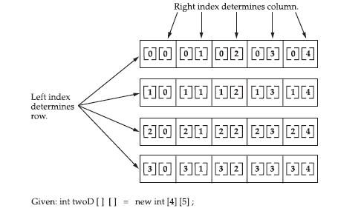
Multidimensional Arrays
Multidimensional arrays are actually arrays of arrays.
To declare a multidimensional array variable, specify each additional index using another set of square brackets.
For example, the following declares a two-dimensional array variable called twoD.
int twoD[][] = new int[4][5];

Slide 28
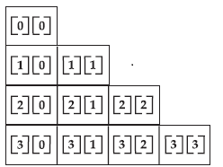
You can allocate the remaining dimensions separately. We can allocates the second dimension manually.
int twoD[][] = new int[4][];
twoD[0] = new int[5];
twoD[1] = new int[5];
twoD[2] = new int[5];
twoD[3] = new int[5];
we can creates a two dimensional array in which the sizes of the second dimension are unequal.

Slide 29
3 D array
A three-dimensional array can be created where first index specifies the number of tables, second one number o0f rows and the third number of columns.

Slide 30
// Demonstrate a three-dimensional array. class threeDMatrix
{ public static void main(String args[])
{ int threeD[][][] = new int[3][4][5]; int i, j, k;
for(i=0; i<3; i++)
for(j=0; j<4; j++)
for(k=0; k<5; k++)
threeD[i][j][k] = i * j * k;
for(i=0; i<3; i++)
{ for(j=0; j<4; j++)
{ for(k=0; k<5; k++)
System.out.print(threeD[i][j][k] + " ");
System.out.println();
}
System.out.println();
}
}
}

Slide 31
Output:
0 0 0 0 0
0 0 0 0 0
0 0 0 0 0
0 0 0 0 0
0 0 0 0 0
0 1 2 3 4
0 2 4 6 8
0 3 6 9 12
0 0 0 0 0
0 2 4 6 8
0 4 8 12 16
0 6 12 18 24

Slide 32
Alternative Array Declaration Syntax
There is a second form that may be used to declare an array:
type[ ] var-name;
Here, the square brackets follow the type specifier, and not the name of the array variable. For example, the following two declarations are equivalent:
int al[] = new int[3];
int al[] = new int[3];
int[] a2 = new int[3];
The following declarations are also equivalent:
char twod1[][] = new char[3][4];
char[][] twod2 = new char[3][4];

