Slide 1
OOPs with Java Chapter 6 Class and Objects
Dr. Ganga Holi
Professor & Head, Dept of CSE(ICB)

Slide 2
Object-oriented programming (OOP)
OOPs involves programming using objects.
An object represents an entity in the real world that can be distinctly identified. For example, a student, a desk, a circle, a button, and even a loan can all be viewed as objects.
State of an object (also known as its properties or attributes) is represented by data fields with their current values.
A circle object, for example, has a data field radius, which is the property that characterizes a circle.
A rectangle object has the data fields width and height, which are the properties that characterize a rectangle

Slide 3
Methods
Behavior of an object (also known as its actions) is defined by methods.
To invoke a method on an object is to ask the object to perform an action.
For example, you may define methods named getArea() and getPerimeter() for circle objects. A circle object may invoke getArea() to return its area and getPerim- eter() to return its perimeter.

Slide 4
Objects of the same type are defined using a common class.
A class is a template, blueprint, or contract that defines what an object’s data fields and methods will be.
An object is an instance of a class. You can create many instances of a class. Creating an instance is referred to as instantiation.
The terms object and instance are often interchangeable.
The relationship between classes and objects is analogous to that between an apple-pie recipe and apple pies: You can make as many apple pies as you want from a single recipe.

Slide 5
Objects
An object has both a state and behavior. The state defines the object, and the behavior defines what the object does.

Slide 6
General Form of a Class
A class is declared by use of the class keyword. The classes that have been used up to this point are actually very limited examples of its complete form. Classes can (and usually do) get much more complex.
A simplified general form of a class definition is shown here:
class classname {
type instance-variable1; type instance-variable2;
// ... type instance-variableN;
type methodname1(parameter-list) {
// body of method
}
type methodname2(parameter-list) {
// body of method
}
// ...
Type methodnameN(parameter-list) {
// body of method
}
}

Slide 7
An example of a class
Variable
class Person { String name; int age;
void birthday ( ) { age++; System.out.println (name + ' is now ' + age); } }
Method

Slide 8
Class Box
Here is a class called Box that defines three instance variables: width, height, and depth.
class Box {
double width;
double height;
double depth;
}
To actually create a Box object, you will use a statement like the following:
Box mybox = new Box();
// create a Box object called mybox
mybox.width = 100;

Slide 9
/* A program that uses the Box class.
Call this file BoxDemo.java
*/
class Box {
double width;
double height;
double depth;
}
// This class declares an object of type Box.
class BoxDemo {
public static void main(String args[]) {
Box mybox = new Box();
double vol;
// assign values to mybox's instance variables
mybox.width = 10;
mybox.height = 20;
mybox.depth = 15;
// compute volume of box
vol = mybox.width * mybox.height * mybox.depth;
System.out.println("Volume is " + vol);
}
}

Slide 10
class BoxDemo2 {
public static void main(String args[]) {
Box mybox1 = new Box();
Box mybox2 = new Box();
double vol;
// assign values to mybox1's instance variables
mybox1.width = 10;
mybox1.height = 20;
mybox1.depth = 15;
/* assign different values to mybox2’s
instance variables */
mybox2.width = 3;
mybox2.height = 6;
mybox2.depth = 9;
// compute volume of first box
vol = mybox1.width * mybox1.height * mybox1.depth;
System.out.println("Volume is " + vol);
// compute volume of second box
vol = mybox2.width * mybox2.height * mybox2.depth;
System.out.println("Volume is " + vol);
}
}

Slide 11
Declaring Objects
Box mybox; // declare reference to object
mybox = new Box(); // allocate a Box object
The first line declares mybox as a reference to an object of type Box. At this point, mybox does not yet refer to an actual object.
The next line allocates an object and assigns a reference to it to mybox. After the second line executes, you can use mybox as if it were a Box object.
But in reality, mybox simply holds, in essence, the memory address of the actual
Box object.

Slide 12
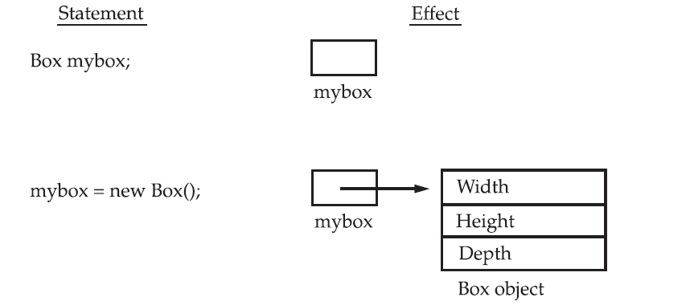

Slide 13
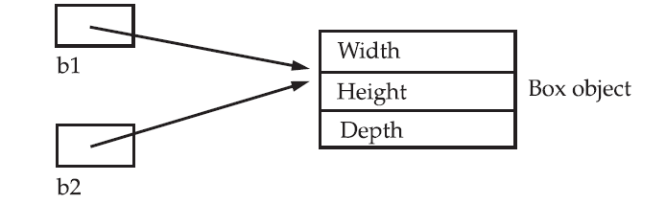
Assigning Object Reference Variables
Box b1 = new Box();
Box b2 = b1;
// ...
b1 = null;
Here, b1 has been set to null, but b2 still points to the original object.

Slide 14
Adding a Method That Takes Parameters
While some methods don’t need parameters, most do. Parameters allow a method to be generalized.
That is, a parameterized method can operate on a variety of data and/or be used in a number of slightly different situations.
int square()
{ return 10 * 10;
}
However, if you modify the method so that it takes a parameter, as shown next, then you can make square( ) much more useful.
int square(int i)
{ return i * i;
}

Slide 15
Method Overloading
int y= square(7);
int x= square();

Slide 16
Constructors
A constructor initializes an object immediately upon creation.
It has the same name as the class in which it resides and is syntactically similar to a method.
Once defined, the constructor is automatically called when the object is created, before the new operator completes.
Constructors have no return type, not even void. This is because the implicit return type of a class’ constructor is the class type itself.
It is the constructor’s job to initialize the internal state of an object so that the code creating an instance will have a fully initialized, usable object immediately.

Slide 17
class Box {
double width;
double height;
double depth;
// This is the constructor for Box.
Box() {
System.out.println("Constructing Box");
width = 10;
height = 10;
depth = 10;
}
// compute and return volume
double volume() {
return width * height * depth;
}
}

Slide 18
Parameterized Constructors
// This is the constructor for Box.
Box(double w, double h, double d) {
width = w;
height = h;
depth = d;
}

Slide 19
The this Keyword
Sometimes a method will need to refer to the object that invoked it.
To allow this, Java defines the this keyword. this can be used inside any method to refer to the current object.

Slide 20
// A redundant use of this.
Box(double width, double height,double depth) {
this.width = width ;
this.height = height;
this.depth = depth;
}

Slide 21
It is illegal in Java to declare two local variables with the same name inside the
same or enclosing scopes.
Interestingly, you can have local variables, including formal
parameters to methods, which overlap with the names of the class’ instance variables.
However, when a local variable has the same name as an instance variable, the local variable hides the instance variable.
this lets you refer directly to the object, you can use it to resolve any
namespace collisions that might occur between instance variables and local variables.

Slide 22
Garbage Collection
Since objects are dynamically allocated by using the new operator, you might be wondering
how such objects are destroyed and their memory released for later reallocation.
Java takes a different approach; it handles deallocation for you automatically.
The technique that accomplishes this is called garbage collection. It works like this: when no
references to an object exist, that object is assumed to be no longer needed, and the memory
occupied by the object can be reclaimed

Slide 23
The finalize( ) Method
To add a finalizer to a class, you simply define the finalize( ) method.
The Java run time calls that method whenever it is about to recycle an object of that class. Inside the finalize( ) method, you will specify those actions that must be performed before an object is destroyed.
The garbage collector runs periodically, checking for objects that are no longer referenced
by any running state or indirectly through other referenced objects.
Right before an asset is freed, the Java run time calls the finalize( ) method on the object.
The finalize( ) method has this general form:
protected void finalize( )
{
// finalization code here
}
Here, the keyword protected is a specifier that limits access to finalize( ).
It is important to understand that finalize( ) is only called just prior to garbage collection.
It is not called when an object goes out-of-scope, for example. This means that you cannot
know when—or even if—finalize( ) will be executed.

