Slide 1
Module-2
Classes and Objects

Slide 2
Class: A class is a collection of methods and
Data variables.
It is a user defined data type.
It is a collection of heterogeneous data.

Slide 3
Object: It is an instance of the class.
It is used to instantiate a class.
To access the members of the class an object is to be created for that class.

Slide 4
Class
It is a user-defined data type, which holds its own data members and member functions, which can be accessed and used by creating an instance of that class.
A class is like a blueprint for an object.
An Object is an instance of a Class.
When a class is defined, no memory is allocated but when it is instantiated (i.e. an object is created) memory is allocated.

Slide 5
General form of class
class class_name
{
type instance_variable1;
type instance_variable2;
type instance_variablen;
type method_name1(param_list)
{
body of method
}
type method_namen(param_list)
{
body of method
}
}
}

Slide 6
The data, or variables, defined within a class are called instance variables.
The code is contained within methods.
Collectively, the methods and variables defined within a class are called members of the class.

Slide 7
Syntax for creating an object
Class_name obj_name=new Class_name(set_of_parameters)
Ex:
Demo ob=new Demo();
Demo ob=new Demo(10);
Demo ob=new Demo(“xyz”);

Slide 8
Constructor
In Java, a constructor is a block of codes similar to the method. It is called when an instance of the class is created.
At the time of calling constructor, memory for the object is allocated.
It is a special type of method which is used to initialize the object.
Every time an object is created using the new keyword, at least one constructor is called.

Slide 9
It calls a default constructor if there is no constructor available in the class. In such case, Java compiler provides a empty default constructor by default.
There are two types of constructors in Java:
no-arg constructor, and parameterized constructor.
Note: It is called constructor because it constructs the values at the time of object creation.

Slide 10
Rules for creating Java constructor
Constructor name must be the same as its class name.
A Constructor must have no explicit return type.

Slide 11
this keyword
In java, this is a reference variable that refers to the current object.
That is, this is always a reference to the object on which the method was invoked.

Slide 12
Usage of java this keyword
this can be used to refer current class instance variable.
this can be used to invoke current class method (implicitly)
this() can be used to invoke current class constructor.
this can be passed as an argument in the method call.
this can be passed as argument in the constructor call.
this can be used to return the current class instance from the method.

Slide 13
static keyword
The static keyword in Java is used for memory management mainly.
We can apply java static keyword with variables, methods, blocks.
When a class member is declared as static, object is not required to access the member.

Slide 14
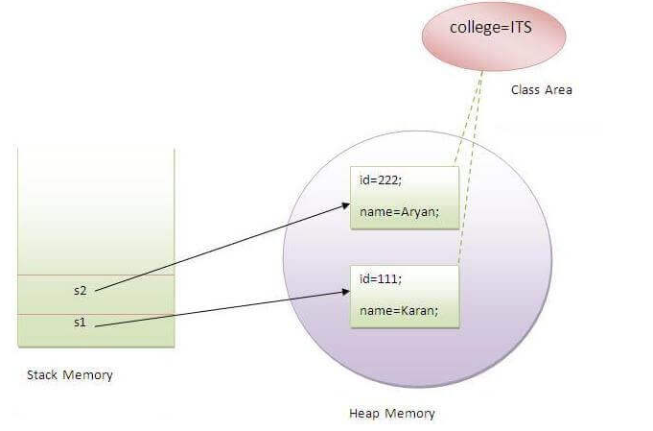

Slide 15
Garbage Collection
Garbage Collection is process of reclaiming the runtime unused memory automatically.
In other words, it is a way to destroy the unused objects.
Advantage of Garbage Collection
It makes java memory efficient because garbage collector removes the unreferenced objects from heap memory.
It is automatically done by the garbage collector(a part of JVM) so we don't need to make extra efforts.

Slide 16
How can an object be unreferenced?
By nullifying the reference
By assigning a reference to another
By anonymous object etc.

Slide 17
finalize method()
The finalize() method is invoked each time before the object is garbage collected.
This method can be used to perform cleanup processing.
This method is defined in Object class
The gc() method is used to invoke the garbage collector to perform cleanup processing.

Slide 18
Overloading
If a class has multiple methods having same name but different in parameters, it is known as Method Overloading.
Method overloading is one of the ways that Java supports polymorphism.

Slide 19
Advantage of method overloading
Method overloading increases the readability of the program.
Different ways to overload the method
There are two ways to overload the method in java
By changing number of arguments
By changing the data type
Note: In java, Method Overloading is not possible
by changing the return type of the method only.

Slide 20
Parameter Passing
Objects as parameters
Objects as returned values

Slide 21
Recursion
Java supports recursion.
Recursion is the process of defining something in terms of itself.
As it relates to Java programming, recursion is the attribute that allows a method to call itself.
A method that calls itself is said to be recursive.

Slide 22
Varargs: Variable-Length Arguments
Feature that simplifies the creation of methods that need to take a variable number of arguments.
A method that takes a variable number of arguments is called a variable-arity method, or simply a varargs method.
A variable-length argument is specified by three periods (…).
For example, here is how vaTest( ) is written using a vararg: static void vaTest(int ... v)

Slide 23
Inheritance
Inheritance in Java is a mechanism in which one object acquires all the properties and behaviors of a parent object.
The idea behind inheritance in Java is that you can create new classes that are built upon existing classes.
Inheritance represents the IS-A relationship which is also known as a parent-child relationship.

Slide 24
Why Inheritance?
For Method Overriding (so runtime polymorphism can be achieved).
For Code Reusability.
Syntax
class Subclass-name extends Superclass-name
{
//methods and fields
}

Slide 25
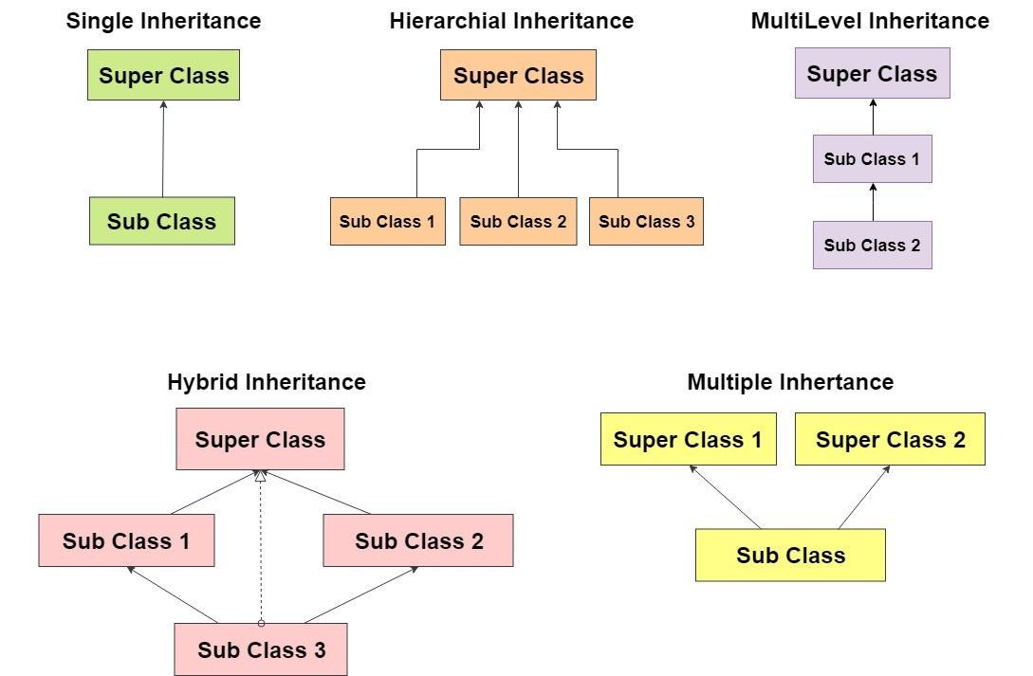
Types of Inheritance

Slide 26
Access Modifiers
Private: The access level of a private modifier is only within the class. It cannot be accessed from outside the class.
Default: The access level of a default modifier is only within the package. It cannot be accessed from outside the package. If you do not specify any access level, it will be the default.
Protected: The access level of a protected modifier is within the package and outside the package through child class. If you do not make the child class, it cannot be accessed from outside the package.
Public: The access level of a public modifier is everywhere. It can be accessed from within the class, outside the class, within the package and outside the package.

Slide 27
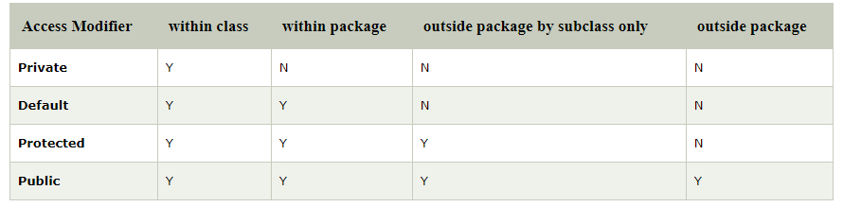

Slide 28
Super Keyword in Java
super can be used to refer immediate parent class instance variable.
super can be used to invoke immediate parent class method.
super() can be used to invoke immediate parent class constructor.

Slide 29
Method Overriding
In a class hierarchy, when a method in a subclass
has the same name and type signature as a
method in its superclass, then the method in the
subclass is said to override the method in the
superclass.

Slide 30
Rules for Java Method Overriding
The method must have the same name as in the parent class.
The method must have the same parameter as in the parent class.
There must be an IS-A relationship (inheritance).

Slide 31
Dynamic Method Dispatch
Dynamic method dispatch is the mechanism by which a call to an overridden method is resolved at run time, rather than compile time.
Dynamic method dispatch is important because this is how Java implements run-time polymorphism.
A Superclass Variable Can Reference a Subclass Object
Parent_class ob=new Child_class();

Slide 32
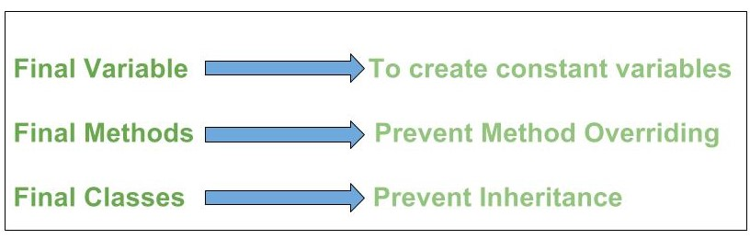
Uses of final keyword

Slide 33
Abstract classes
A class which is declared with the abstract keyword is known as an abstract class in Java. It can have abstract and non-abstract methods (method with the body).
It needs to be extended.
It cannot be instantiated.(cannot create object for abstract class)

Slide 34
A method which is declared as abstract and does not have implementation is known as an abstract method.
Example of abstract method
abstract void show();
//no method body and abstract

