Slide 1
Module-3 part-1 Interfaces and Packages

Slide 2
Using interface, you can specify what a class must do, but not how it does it.
It is a pure abstract class.
An interface must be implemented by a class.
Many classes can implement an interface. Also, one class can implement any number of interfaces.

Slide 3
Methods are abstract in interface
Variables are static and final in interface.(they must be initialized)
Both the variables and methods are implicitly public.

Slide 4
General form of interface
interface <interface_name>
{
// declare constant fields
// declare methods that abstract
// by default.
}

Slide 5
Implementing Interfaces
class classname extends superclass implements interface1 ,interface…
{
// class-body
}

Slide 6
If a class includes an interface but does not
fully implement the methods defined by that
interface, then that class must be declared as
Abstract.

Slide 7
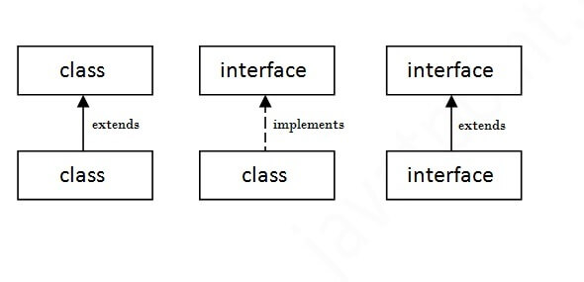

Slide 8
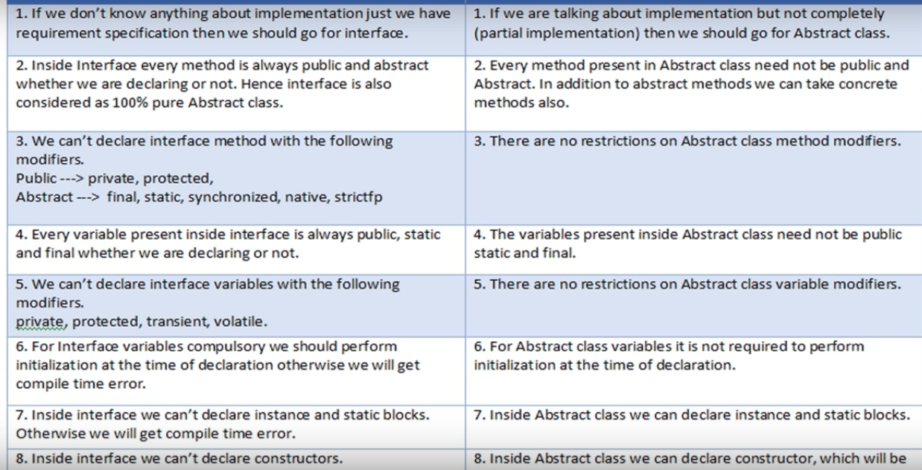

Slide 9
JAVA PACKAGES

Slide 10
A java package is a group of similar types of classes, interfaces and sub-packages.
Package in java can be categorized in two form, built-in package and user-defined package.
There are many built-in packages such as lang, awt, javax, swing, net, io, util, sql etc.

Slide 11
Advantage of Java Package
Java package is used to categorize the classes and interfaces so that they can be easily maintained.
2) Java package provides access protection.
3) Java package removes naming collision.

Slide 12
The package keyword is used to create a package in java.
To compile following syntax is used
javac -d directory javafilename .java
You need to use fully qualified name to run the program.
To Compile: javac -d . Simple.java
To Run: java mypack.Simple

Slide 13
ClassPath
By default, the Java run-time system uses the current working directory as its starting point.
Thus, if your package is in a subdirectory of the current directory, it will be found.
Second, you can specify a directory path or paths by setting the CLASSPATH environmental variable.
Third, you can use the -classpath option with java and javac to specify the path to your classes.

Slide 14
Exception Handling
Dictionary Meaning: Exception is an abnormal condition.
The Exception Handling in Java is one of the powerful mechanism to handle the runtime errors so that normal flow of the application can be maintained.

Slide 15
Advantage of Exception Handling
The core advantage of exception handling is to maintain the normal flow of the application.
Statement-1;
Statement-2;
Statement-3;
Statement-4;
Statemen-5;//exception occurs
Statement-6;
Statement-7;
Statement-8;
Statement-9;

Slide 16
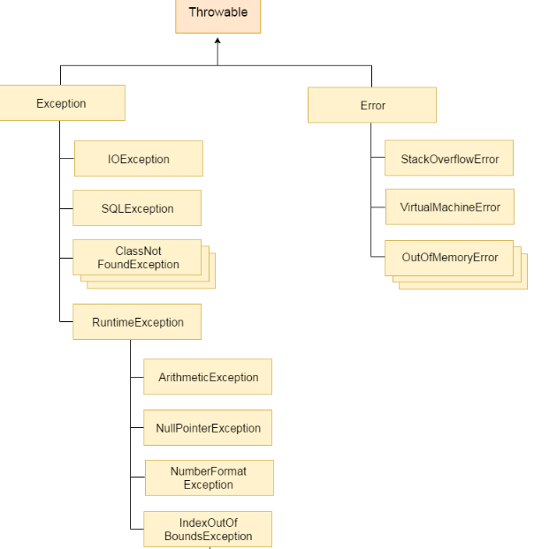

Slide 17
Difference between Checked and Unchecked Exceptions
Checked Exception
The classes which directly inherit Throwable class except RuntimeException and Error are known as checked exceptions e.g. IOException, SQLException etc. Checked exceptions are checked at compile-time.
2) Unchecked Exception
The classes which inherit RuntimeException are known as unchecked exceptions e.g. ArithmeticException, NullPointerException, ArrayIndexOutOfBoundsException etc. Unchecked exceptions are not checked at compile-time, but they are checked at runtime.
3) Error
Error is irrecoverable e.g. OutOfMemoryError, VirtualMachineError, AssertionError etc.

Slide 18
Built-In Exceptions
Arithmetic Exception
NumberFormat Exception
Null Pointer Exception
ArrayIndex Out of Bounds Exception
String Index Out of Bounds Exception

Slide 19
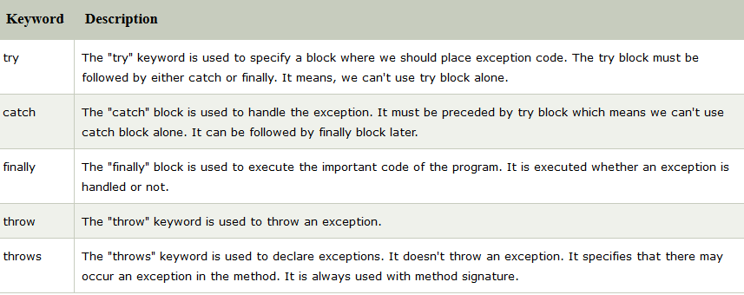
Java Exception Keywords

Slide 20
Custom Exceptions
If you are creating your own Exception that is known as custom exception or user-defined exception.
Java custom exceptions are used to customize the exception according to user need.
By the help of custom exception, you can have your own exception and message.

