Slide 1
C++ was introduced by Bjarne Stroustup.
C++ is a general-purpose programming language that was developed as an enhancement of the C language to include object-oriented paradigm.

Slide 2
Applications of C++:
C++ finds varied usage in applications such as:
Operating Systems & Systems Programming. e.g. Linux-based OS (Ubuntu etc.)
Browsers (Chrome & Firefox)
Graphics & Game engines (Photoshop)
Database Engines (MySQL, MongoDB, Redis etc.)

Slide 3
Class
It is a user-defined data type, which holds its own data members and member functions, which can be accessed and used by creating an instance of that class.
A C++ class is like a blueprint for an object.
An Object is an instance of a Class.
When a class is defined, no memory is allocated but when it is instantiated (i.e. an object is created) memory is allocated.

Slide 4
Constructor
A constructor is a member function of a class which initializes members(objects) of a class.
In C++, Constructor is automatically called when object(instance of class) is created.
It is special member function of the class.

Slide 5
How constructors are different from a normal member function?
Constructor has same name as the class itself.
Constructors don’t have return type.
A constructor is automatically called when an object is created.
If we do not specify a constructor, C++ compiler generates a default constructor for us (expects no parameters and has an empty body).

Slide 6
Destructor
Destructor is a member function which destructs or deletes an object.
A destructor function is called automatically when the object goes out of scope
Destructors have same name as the class preceded by a tilde (~).
Destructors don’t take any argument and don’t return anything

Slide 7
Principles of OOP’s
Abstraction: Hiding internal details and showing functionality is known as abstraction.
(or)
Hiding irrelevant details and displaying only relevant details.

Slide 8
Encapsulation
Encapsulation is the mechanism that binds together code and the data it manipulates, and keeps both safe from outside interference and misuse.
One way to think about encapsulation is as a protective wrapper that prevents the code and data.

Slide 9
Inheritance
Inheritance is the process by which one object acquires the properties of another object.
Code Reusability.

Slide 10
Polymorphism
Polymorphism (from Greek, meaning “many forms”) is a feature that allows one interface to be used for a general class of actions.

Slide 11
Object Oriented Programming in JAVA

Slide 12
JAVA Basics

Slide 13
Why Java is Important
Two reasons :
Trouble with C/C++ language is that they are not portable and are not platform independent languages.
Emergence of World Wide Web, which demanded portable programs
Portability and security necessitated the invention of Java

Slide 14
History
James Gosling - Sun Microsystems
Oak - Java, May 20, 1995, Sun World
JDK Evolutions
– JDK 1.0 (January 23, 1996)
– JDK 1.1 (February 19, 1997)
– J2SE 1.2 (December 8, 1998)
– J2SE 1.3 (May 8, 2000)
– J2SE 1.4 (February 6, 2002)
– J2SE 5.0 (September 30, 2004)
Java SE 6 (December 11, 2006)
Java SE 7 (July 28, 2011)
.
.
.
Java SE 14(March17,2020

Slide 15
Cont..
Java Editions.
J2SE(Java 2 Standard Edition)
- to develop
client-side standalone applications or applets.
J2ME(Java 2 Micro Edition ) - to develop applications for mobile devices such as cell phones.
J2EE(Java 2 Enterprise Edition ) - to develop server-side applications such as Java servlets and Java ServerPages.

Slide 16
What is java?
A general-purpose object-oriented language.
Write Once Run Anywhere (WORA).
Designed for easy Web/Internet applications.
Widespread acceptance.

Slide 17
How is Java different from C…
C Language:
Major difference is that C is a structure oriented language and Java is an object oriented language and has mechanism to define classes and objects.
Java does not support an explicit pointer type

Slide 18
Characteristics of Java
Java is simple
Java is object-oriented
Java is distributed
Java is interpreted
Java is robust
Java is architecture-neutral
Java is portable
Java’s performance
Java is multithreaded
Java is dynamic
Java is secure

Slide 19
Java Environment
Java includes many development tools, classes and methods
Development tools are part of Java Development Kit (JDK) and
The classes and methods are part of Java Standard Library (JSL), also known as Application Programming Interface (API).
JDK constitutes
of tools like java compiler, java
interpreter and many.
API includes hundreds of classes and methods grouped into several packages according to their functionality.

Slide 20
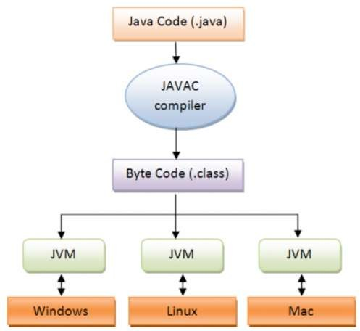
Java is architecture-neutral
JAVA Program Execution
9/15/2011
Object Oriented Programming using JAVA
17

Slide 21
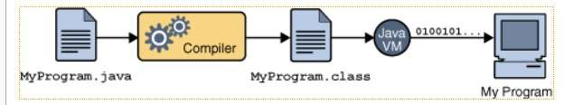
WORA(Write Once Run Anywhere)
9/15/2011
Object Oriented Programming using JAVA
18

Slide 22
Steps to execute Java Program
Create a directory(folder) to save all java files.
Open text editor(notepad) type the java source code and save the file with .java extension.(Ex: Sample.java)
Open command prompt and move to the directory where the source file is saved using cd command.
Compile the file using javac command.
(javac filename.java)(javac Sample.java)
Execute the file using java command.
(java filename)(Java Sample)

Slide 23
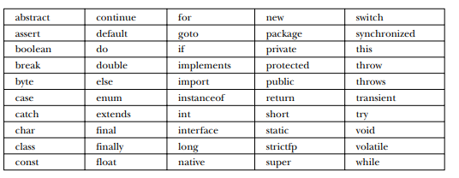
Identifiers
Literals
Comments

Slide 24
Data types specify the different sizes and values that can be stored in the variable. There are two types of data types in Java:
Primitive data types: The primitive data types include boolean, char, byte, short, int, long, float and double.
Non-primitive data types: The non-primitive data types include Classes, Interfaces, and Arrays.

Slide 25
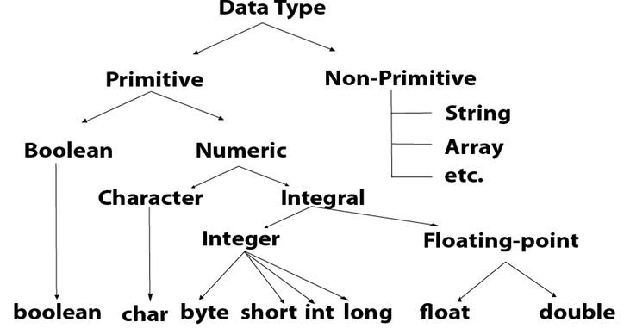

Slide 26
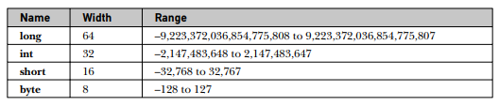


Slide 27
Char Data Type
The char data type is a single 16-bit Unicode character. Its value-range lies between 0 and 65535.
The char data type is used to store characters.
Example: char ch = 'A'
Why char uses 2 byte in java?
It is because java uses Unicode system not ASCII code system.

Slide 28
int a = 101; // decimal-form literal
int b = 0100; // octal-form literal
0*8^0+0*8^1+1*8^2+0*8^3=64
int c = 0xF8; // Hexa-decimal form literal
8*16^0+15*16^1=248
int d = 0b111; // Binary literal
1*2^0+1*2^1+1*2^2=7

Slide 29
Reading Input at Runtime
Use Scanner class of util package to read input.
First import util packge.
Create an instance of Scanner class.
Scanner sc=new Scanner(System.in)
With sc object any method of Scanner class can be used.
sc.nextInt() → to read integer value
sc.nextDouble() → to read double value
sc.next() → to read string value

Slide 30
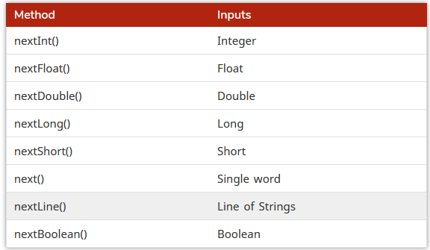

Slide 31
Scope and Life Time of a Variable
The scope of a variable defines the section of the code in which the variable is visible.
As a general rule, variables that are defined within a block are not accessible outside that block.
The lifetime of a variable refers to how long the variable exists before it is destroyed.

Slide 32
Arrays
Syntax to Declare an Array in Java
dataType[] arr; (or)
dataType []arr; (or)
dataType arr[];
Instantiation of an Array in Java
arrayRefVar=new datatype[size];
int a[]={33,3,4,5};//declaration, instantiation and initialization

Slide 33
Multi Dimensional Arrays
Syntax to Declare Multidimensional Array in Java
dataType[][] arrayRefVar; (or)
dataType [][]arrayRefVar; (or)
dataType arrayRefVar[][]; (or)
dataType []arrayRefVar[];
Example to instantiate Multidimensional Array in Java
int[][] arr=new int[3][3];//3 row and 3 column

Slide 34
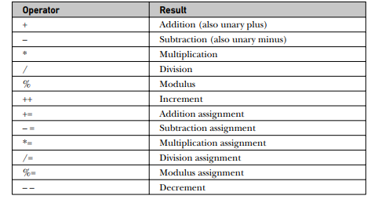
Operators
Arithmetic Operators

Slide 35
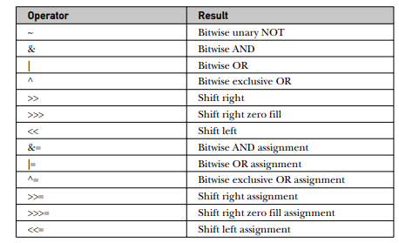
Bitwise Operators

Slide 36
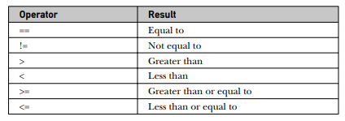
Relational Operators

Slide 37
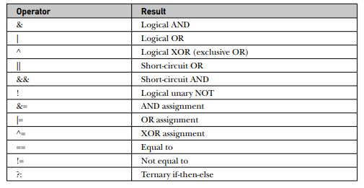
Logical Operators

Slide 38
Type Promotion Rules
All byte, short, and char values are promoted to int.
If one operand is a long, the whole expression is promoted to long.
If one operand is a float, the entire expression is promoted to float.
If any of the operands is double, the result is double.

Slide 39
Control Statements

Slide 40
Selection Statements
Simple If
If-else
Nested If
if-else-if Ladder
Switch

Slide 41
Iteration Statements
While
Do-while
For
For-each version of for loop

Slide 42
Jump Statements
Break
Continue
Return
Using break as a form of goto

Slide 43
Type Conversion and Casting
When one type of data is assigned to another type of variable, an automatic type conversion will take place if the following two conditions are met:
• The two types are compatible.
• The destination type is larger than the source type.
When these two conditions are met, a widening conversion takes place.
For example, the int type is always large enough to hold all valid byte values, so no explicit cast statement is required.

Slide 44
Casting Incompatible Types
If you want to assign an int value to a byte variable? This conversion will not be performed automatically, because a byte is smaller than an int.
This kind of conversion is sometimes called a narrowing conversion, since you are explicitly making the value narrower so that it will fit into the target type.
To create a conversion between two incompatible types, you must use a cast. A cast is simply an explicit type conversion.
It has this general form: (target-type) value

Slide 45
String class
It is available in java.lang package.
Methods
int length()
char charAt(int)
boolean equals(String)
int compareTo(String)

