Slide 1
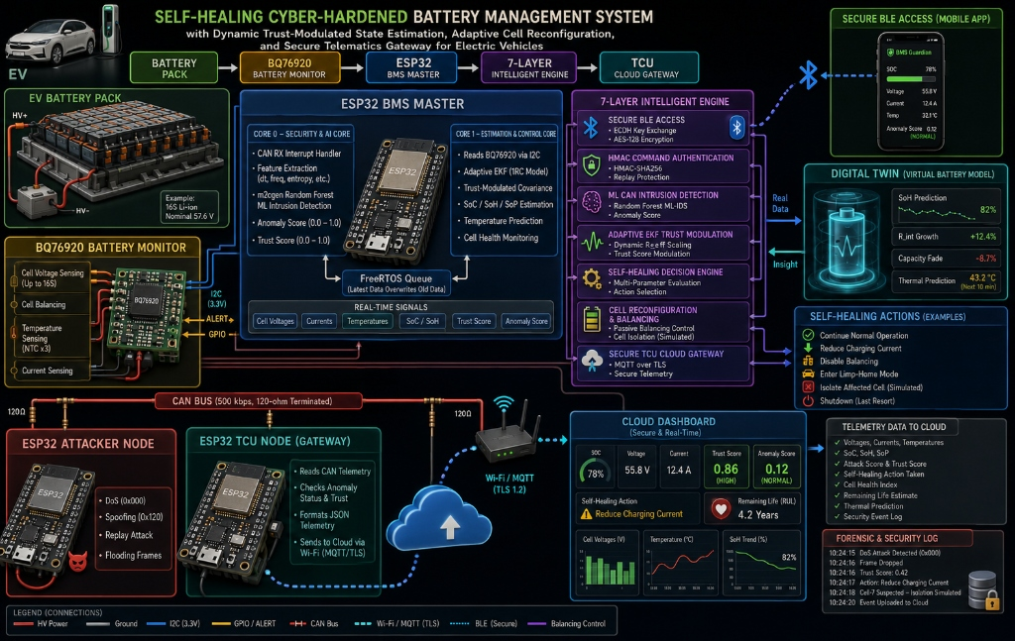
SLIDE 1 OF 3 • 7-LAYER SELF-HEALING ARCHITECTURE BLUEPRINT
Self-Healing Cyber-Hardened BMS & Digital Twin Blueprint
References & Specs: TI BQ76920 AFE Datasheet | ESP32 TWAI CAN Specification | ISO 11898-1:2015 | Indian Patent Provisional 2026
Slide 1 / 3

Slide 2
SLIDE 2 OF 3 • HARDWARE & DIGITAL TWIN ENGINEERING
Hardware Implementation, BOM & Digital Twin Synchronization
ESP32 Microcontrollers (x3)
TI BQ76920 AFE IC
SN65HVD230 Transceivers (x3)
BMS Master + Attacker + TCU Gateway Dual-core 240MHz Xtensa LX6
Voltage/Current/Temp sensing (Up to 16S) Hardware OVP/UVP Protection
3.3V CAN Transceivers (ISO 11898-2) 500 kbps differential bus
Rs. 1,140
Rs. 520
Rs. 360
Battery Pack (16S Li-ion)
Cell Balancing & Reconfig
Digital Twin & Telematics
57.6V Nominal Pack (55.8V / 12.4A live) Local 4S prototype sub-module
IRLML2502 N-ch MOSFETs (45mΩ) Passive balancing & isolation switches
Virtual battery model predicting SoH MQTT over TLS to Cloud Dashboard
Rs. 1,050
Rs. 75
Rs. 180
PROTOTYPE COST: Rs. 3,879 ( ≈ $46 USD ) | DIGITAL TWIN & HARDWARE METRICS:
• Digital Twin Virtual Model: SoH Prediction = 82% | R_int Growth = +12.4% | Capacity Fade = -8.7% | Thermal Pred = 43.2 °C (10 min) • Embedded Resource Profile: Core 0 CPU = 14.2% avg • Core 1 CPU = 8.6% avg • SRAM = 38.4 KB / 520 KB (7.4%) • Latency = 0.35 ms • Cloud Dashboard Telemetry: Voltage = 55.8 V, Current = 12.4 A, Trust Score = 0.86 (HIGH), Anomaly Score = 0.12 (NORMAL), RUL = 4.2 Yrs.
References & Specs: Prices verified on ElectroPi.in & Robu.in | Software Digital Twin & Hardware Bench Profiling on ESP32 & MATLAB
Slide 2 / 3

Slide 3
SLIDE 3 OF 3 • SELF-HEALING ACTIVE RECOVERY & VERIFIED RESULTS
How It Works — Active Recovery & Self-Healing Decision Engine
Step 1: Sensor & Twin
Step 2: Core 0 ML-IDS
Step 3: Adaptive EKF
Step 4: Self-Healing & TCU
BQ76920 senses V, I, T. Digital Twin compares real data vs virtual model predictions.
Core 0 extracts dt, freq, var, & entropy. Random Forest computes Anomaly Score S in <0.35 ms.
Dynamic R-Scaling: R_new = R_base * exp(10*S). Under attack (S->1), Gain K->0, ignoring corrupt inputs.
L5 Engine executes: Reduce charge / Limp-home / Isolate cell. TCU ESP32 streams forensic log to MQTT Cloud.
Twin Sync (82% SoH)
Score S < 0.35ms
Gain K -> 0
Active Recovery
VERIFIED METRICS, SELF-HEALING ACTIONS & FORENSIC LOG NOTICE:
• Accuracy: 99.20% | Precision: 98.82% | Recall: 99.51% | F1-Score: 99.16% | Macro ROC-AUC: 0.9942 | PR-AUC: 0.9931 • Self-Healing Actions: Continue Normal • Reduce Charge Current • Disable Balancing • Limp-Home Mode • Cell Isolation • Forensic Log Sample: [10:24:15] DoS Detected (0x000) -> [10:24:16] Frame Dropped (Trust: 0.42) -> [10:24:17] Action: Reduce Charge Current -> [10:24:18] Cell-7 Isolated -> [10:24:20] Uploaded to Cloud • PROACTIVE NOTICE: FreeRTOS C++ code, ML models, & MATLAB sims are 100% verified; physical bench trials are 'To Be Tested'.
References & Specs: Taborelli & Onori (2014) IEEE ITEC | Plett G.L. Battery Management Systems Vol II | Scikit-Learn Multiclass Evaluation
Slide 3 / 3

