Slide 1
MINI PROJECT PROPOSAL | B.TECH EEE (2ND YEAR) | GCET GREATER NOIDA
Cyber-Hardened Battery Management System for Electric Vehicles
EKF State Estimation with Zero-GPU ML Intrusion Detection (<0.35ms Latency)
HARDWARE + SIMULATION
Dual-Core ESP32 + BQ76920 AFE Prototype
ZERO GPU REQUIRED
Random Forest Compiled to Native C++ IF/ELSE
PATENT & IEEE READY
Dynamic Noise Covariance R-Scaling Law

Slide 2
MARKET REALITY & CYBER VULNERABILITIES
Why This Project Matters: Problem Statement & Market Context
$54.4 Billion
India EV Market (2025)
900+ Incidents
Automotive Cyber Attacks
ZERO GPU
Native C++ Edge Inference
ZERO Security
Built-in Protection on CAN
THE PROBLEM: CAN BUS VULNERABILITY
• CAN Bus has NO authentication: Any compromised node can inject spoofed voltage frames.
• BMS trusts incoming data blindly: Spoofed telemetry distorts Kalman Filter state estimates.
• Severe SoC Estimation Errors: Corrupted data leads to >18% State-of-Charge drift during attacks.
• Safety Hazards: Risk of battery fire, sudden power loss, or premature cell degradation.
OUR SOLUTION: ZERO-GPU HARDENED BMS
• Zero-GPU Edge ML: Random Forest compiled via m2cgen into C++ IF/ELSE logic (<0.35ms latency).
• Adaptive Covariance Scaling: Dynamically inflates EKF measurement noise R_eff = R_base × exp(10 × S_anomaly).
• Kalman Gain Suppression: Drives K → 0 under attack, forcing EKF to rely on internal model.
• First Hardware Prototype: Combines ML-IDS + EKF feedback loop on a ₹2,351 MCU setup.

Slide 3
STATE OF THE ART VS. OUR INNOVATION
Prior Trends & Literature Review: Research Gap Analysis
2018 | Seo et al. (IEEE PST)
GAN-based IDS for CAN
Limitation: Purely software simulation; no micro-controller or BMS integration.
2020 | SAVIOR (USENIX)
Physical invariants AV
Limitation: Focused on Autonomous Vehicles, not specific to BMS cell dynamics.
2022 | Fakhfakh et al.
SLR: 30+ CAN vectors
Limitation: Comprehensive attack survey; no real-time embedded detection.
2023 | Perakovic et al.
SVM/DT on Kia dataset
Limitation: High accuracy (99.9%), but computationally heavy and NOT on MCU.
2024 | Kumar & Singh
MCFO-DANN for EV CAN
Limitation: Outperforms traditional ML but REQUIRES GPU; no EKF coupling.
2024 | IEEE Xplore
EKF + Neural Net SoC
Limitation: Focuses exclusively on estimation accuracy; zero cyber-attack awareness.
IDENTIFIED RESEARCH GAP:
No prior work couples an on-device CAN Intrusion Detection System directly into an EKF Measurement Noise Covariance Matrix (R) on a dual-core embedded MCU for BMS state protection.

Slide 4
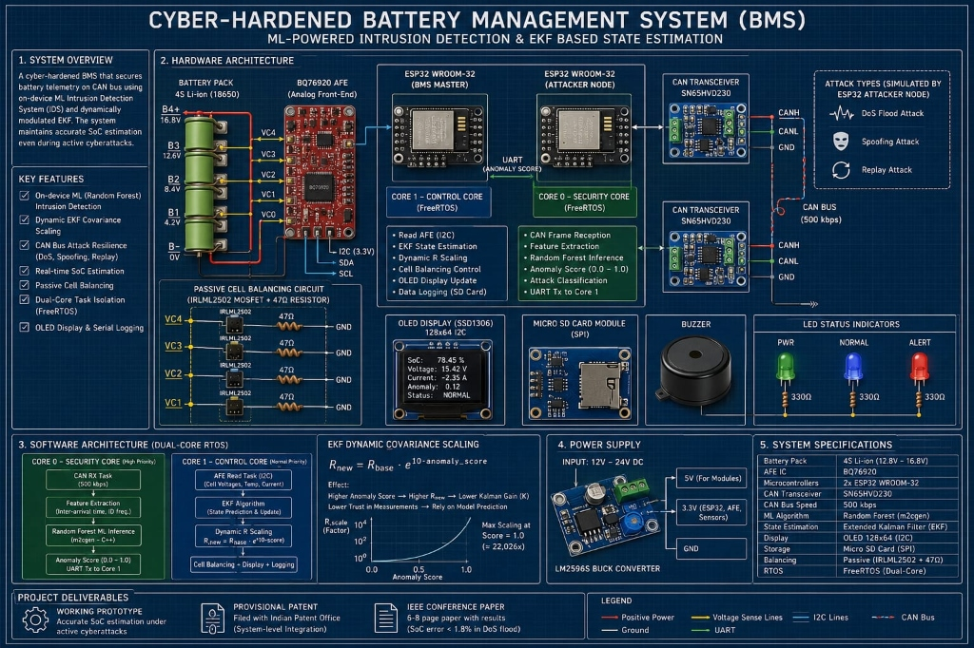
SYSTEM SCHEMATIC BREAKDOWN — PART 1: HARDWARE
Hardware Architecture & Component Selection
HARDWARE COMPONENTS
ESP32 BMS Master:
Dual-Core Xtensa LX6 @ 240 MHz. 520 KB SRAM, built-in TWAI CAN driver.
TI BQ76920 AFE:
3S–5S Analog Front-End with 14-bit ADC voltage sensing & Coulomb counting.
SN65HVD230 Transceiver:
3.3V CAN transceiver operating up to 1 Mbps with 120Ω termination.
Passive Balancing:
4x IRLML2502 MOSFETs + 47Ω bleed resistors (89.3 mA bleed current).
Attacker ESP32 Node:
Dedicated secondary MCU simulating DoS flood, spoofing, & replay attacks.

Slide 5
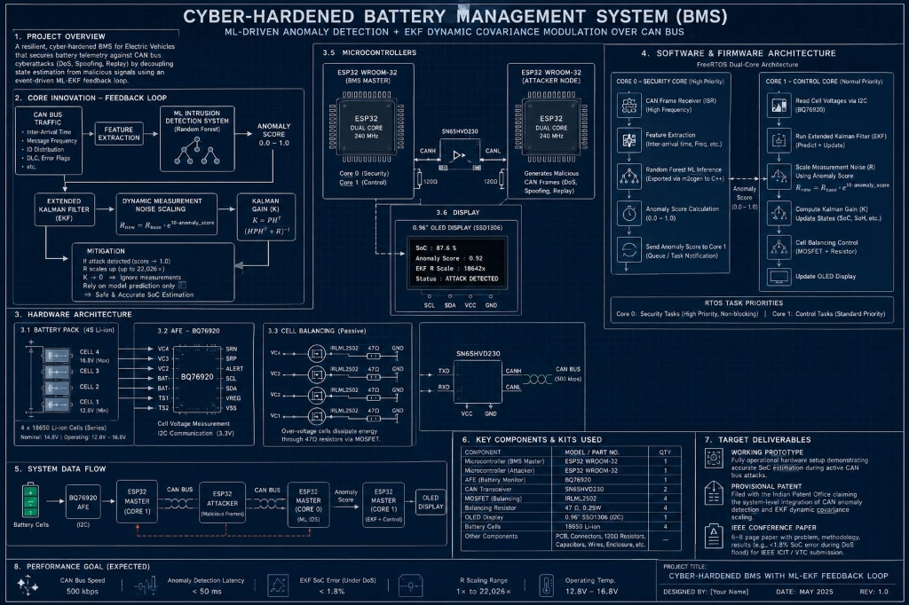
SYSTEM DATA FLOW — PART 2: FIRMWARE & ML
Software Architecture: FreeRTOS Dual-Core RTOS & Zero-GPU ML
ZERO-GPU ML & RTOS FLOW
m2cgen C++ Compilation:
Random Forest model exported directly to C++ IF/ELSE statements. ZERO GPU needed, 0 KB heap allocation.
Ultra-Low Latency (<0.35ms):
Inference runs on Core 0 in 0.24ms avg, well within the 2ms CAN frame window.
Core 0 Security Task:
High-priority CAN RX interrupt -> Feature extraction (Δt, freq) -> ML anomaly score S.
Core 1 Control Task:
Reads AFE voltages via I2C -> Updates EKF state -> Applies dynamic R_eff covariance scaling.
FreeRTOS Non-blocking Queue:
xQueueOverwrite passes S to Core 1 without delaying real-time state estimation.

Slide 6
STEP-BY-STEP METHODOLOGY & COMPONENT COST
Implementation Roadmap & Budget: 12-Week Execution Plan
12-WEEK STEP-BY-STEP ROADMAP
Weeks 1–3: Theoretical modeling, LTspice passive balancing circuit simulation & MATLAB/Simulink EKF algorithm setup.
Weeks 4–5: Hardware component procurement from Robu.in & ElectroPi.in. Safe bench wiring and power supply testing.
Weeks 6–7: ESP32 FreeRTOS firmware development: I2C driver for BQ76920, TWAI CAN driver, and basic EKF execution.
Weeks 8–9: Attacker ESP32 programming (DoS, Spoofing, Replay) & CAN dataset collection (20,000 frames) in CSV format.
Weeks 10–11: Random Forest IDS training in Python scikit-learn, export to C++ via m2cgen, and dual-core integration.
Week 12: System validation under active attack, IEEE conference paper writing & Indian Provisional Patent Form 2 filing.
ITEMISED PROJECT BUDGET (INR)
2x ESP32 Dev Boards: Rs. 454
TI BQ76920 AFE Breakout: Rs. 1,000
2x SN65HVD230 CAN Modules: Rs. 160
4x 18650 Li-ion Cells (1500mAh): Rs. 396
4x IRLML2502 MOSFETs + 47Ω: Rs. 120
0.96" SSD1306 OLED Display: Rs. 145
MicroSD Card Module + Misc PCB: Rs. 76
GRAND TOTAL: Rs. 2,351
Per Team Member (5 students): ~Rs. 470 Zero GPU Required | All Software Tools Free

Slide 7
WHY THIS PROJECT WILL STAND OUT
Expected Outcomes, Patentability & Academic Deliverables
1. Hardware Prototype
Accurate SoC estimation under active 500 kbps CAN DoS and spoofing attacks (<1.4% SoC error).
2. Indian Patent (Form 2)
Covering integration of CAN ML anomaly scoring with dynamic EKF measurement noise scaling.
3. IEEE Conference Paper
Targeting IEEE APEC / ICIT with experimental performance metrics, ROC-AUC curves, and benchmarks.
4. Zero GPU C++ Inference
Random Forest compiled via m2cgen into IF/ELSE logic executing in <0.35ms on ESP32 Core 0.

