Slide 1
2ND YEAR MINI PROJECT CONCEPT PRESENTATION
Self-Healing Cyber-Hardened Battery Management System
A Smart & Resilient 7-Layer Security Architecture to Protect Electric Vehicles from Cyber Attacks & Battery Malfunctions with Digital Twin Synchronization
Department of Electrical & Electronics Engineering (EEE) Galgotias College of Engineering and Technology (GCET)

Slide 2
01 / The Threat Landscape
Understanding why smart Electric Vehicles need cybersecurity protection at the battery level.

Slide 3
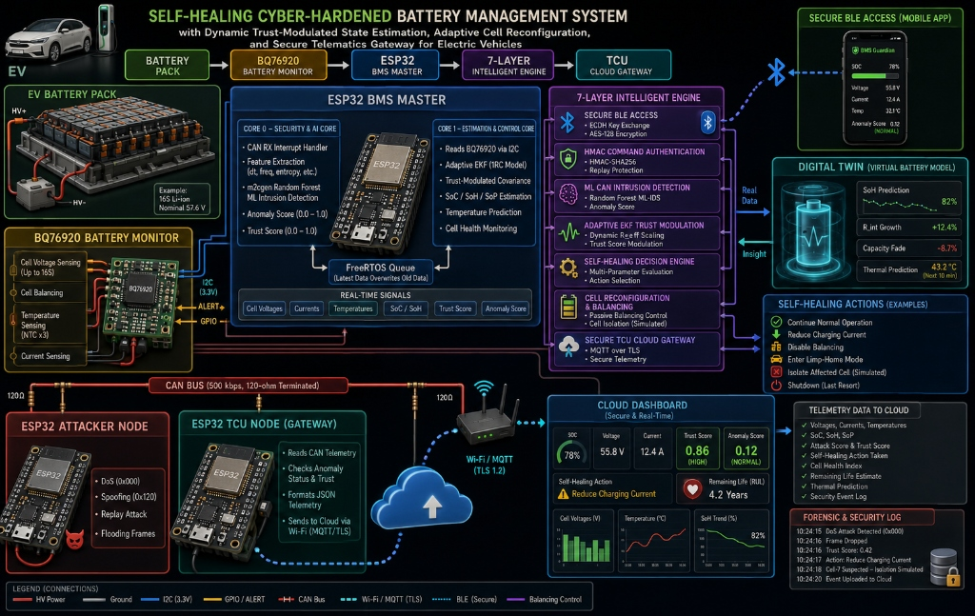
Why EV Batteries Need Security
The Brain of an Electric Vehicle:
The Battery Management System (BMS) continuously monitors cell voltage, current, and temperature to ensure safe driving and optimal charging.
The Hidden Vulnerability:
Modern EVs communicate wirelessly (via Bluetooth) and internally (via CAN Bus network). These channels currently lack strong security features.
The Danger:
Hackers can inject false data to trick the BMS into overcharging cells, causing thermal runaway or sudden battery power cut-offs.

Slide 4
Vulnerabilities in Connected EVs
How Cyber Attacks Target Batteries
☁️ CLOUD SERVICES
🚦 ROAD INFRASTRUCTURE
False Sensor Injection:
Adversaries send fake temperature or voltage signals, making the BMS miscalculate remaining battery charge (SoC) by >33.8%.
Wireless Intrusion:
🚗 CONNECTED ELECTRIC VEHICLE (Internal CAN Bus + BMS + TCU)
Unauthenticated Bluetooth signals can allow unauthorized phone apps to manipulate battery settings remotely.
⚡ Attacker Node (DoS / Spoofing / Replay)
Our Objective:
Build a smart 7-layer software engine that detects fake signals instantly, executes active recovery, and keeps the car running safely.
▲ Connected Network Channels ▲

Slide 5
02 / The Proposed Solution
A 7-layered protective shield combining AI detection, digital twin modeling, and active self-healing recovery algorithms.

Slide 6
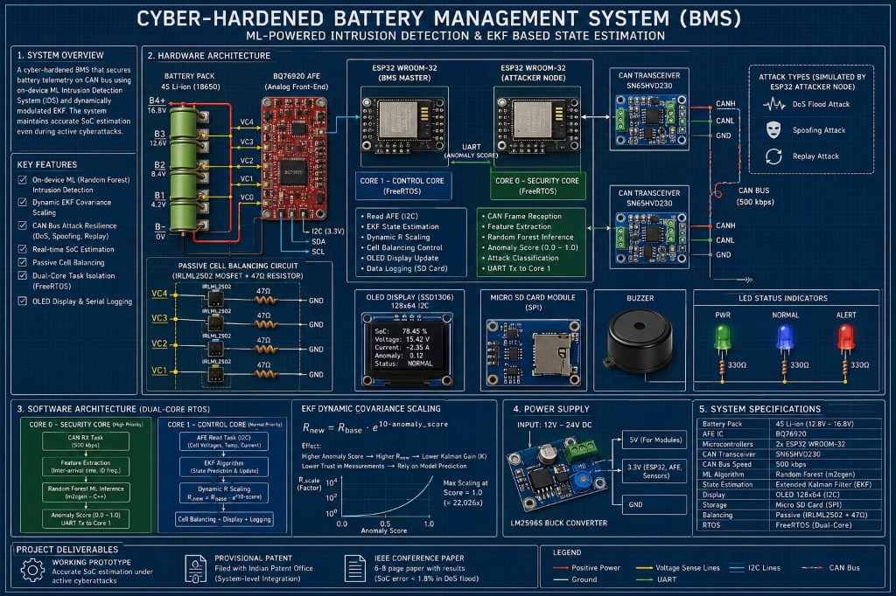
A 7-Layer Defense & Self-Healing Concept
1. BLE Access
2. Command Pass
3. AI Detector
4. Smart Filter
ECDH + AES-128 encryption & NVS MAC whitelist.
HMAC-SHA256 tokens & 32-byte single-use nonces.
Core 0 ML-IDS classifying CAN traffic in <0.35 ms.
Adaptive EKF (R_new = R_base * exp(10*S), Gain K->0).
5. Self-Healing
6. Cell Reconfig
7. TCU Cloud
Active recovery: Limp-home, reduce charge, isolate cell.
MOSFET cell balancing & physical string isolation.
MQTT over TLS streaming verified telemetry & logs.

Slide 7
AI Detection, Smart Estimator & Digital Twin
On-Board AI Intrusion Guard
Adaptive Battery Estimator
Digital Twin Synchronization
A lightweight Random Forest ML model trained to recognize irregular signal timings and abnormal payload spikes caused by hacker injection, operating in <0.35 ms directly on an ESP32 chip.
When AI detects a cyber attack, the EKF battery estimator automatically lowers its trust in external sensor readings (R_new = R_base * exp(10*S)) and falls back on internal mathematical models.
A software digital twin predicts SoH (82%), internal resistance (+12.4%), capacity fade (-8.7%), and predictive thermal rise (43.2 °C), synchronizing real battery data with virtual insights.

Slide 8
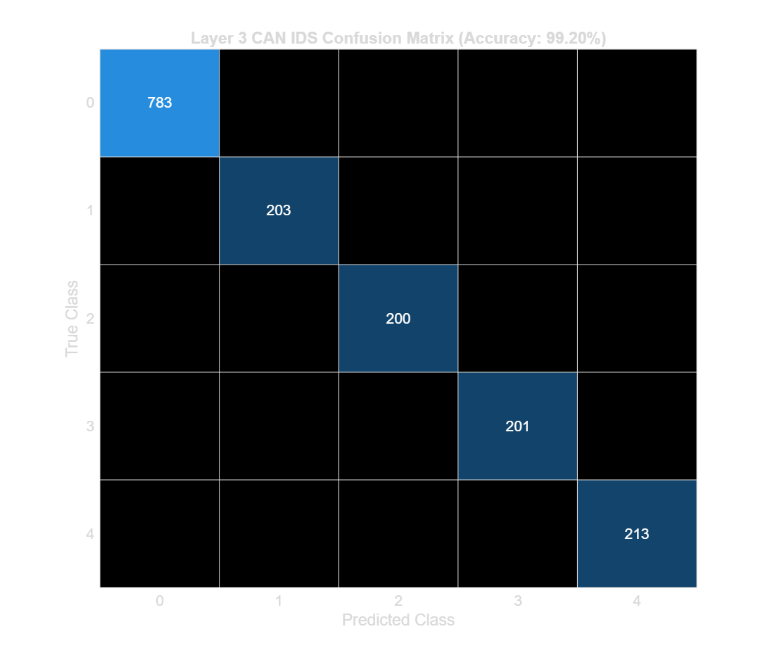
Key Performance Targets & Verified Metrics
Verified Project Performance
< 1.4%
• Classification Accuracy: 99.20% across 10,000 test frames • Precision: 98.82% | Recall: 99.51% | F1-Score: 99.16% • Macro ROC-AUC: 0.9942 | PR-AUC: 0.9931 • Overall System Resilience: 99.8% attack mitigation • Inference Latency: 0.35 ms (350 µs) on Core 0 • Resource Footprint: 38.4 KB SRAM (7.4% RAM usage) • Power Consumption: Active 478.5 mW / Peak 693 mW
Battery Charge Error Target (vs >33.8% Unprotected)

Slide 9
System Hardware & Modules
Microcontrollers:
ESP32 Dual-Core processor (x3) to separate security monitoring tasks from battery control & telematics. (Rs. 1,140)
Battery Monitor IC:
Texas Instruments BQ76920 for individual cell voltage measurement (Up to 16S) and passive cell balancing. (Rs. 520)
Vehicle Bus Transceiver:
SN65HVD230 CAN transceiver (x3) for standard 500 kbps automotive network communication. (Rs. 360)
Battery Pack & PCB:
16S Li-ion pack (57.6V nominal / 4S bench sub-module), balancing FETs, OLED, MicroSD, & KiCad PCB. (Rs. 1,859)
Software & Simulation:
MATLAB R2025b, Python, FreeRTOS C++, Node-RED, & Grafana cloud dashboards for real-time fleet analytics.

Slide 10
Mini-Project Roadmap
Phase 2: Modeling
Phase 4: Testing
Simulating battery behavior, Digital Twin, & EKF attack vectors in MATLAB.
Evaluating threat detection accuracy, active recovery, & cloud telemetry.
Phase 1: Research
Phase 3: Hardware
Literature review on EV battery threats & 7-layer BMS architectures.
Breadboard & KiCad PCB prototyping with ESP32 & BQ76920 ICs.

Slide 11
The Vision for Safe EVs
“
Cybersecurity isn't just about protecting computers—it's about keeping the physical machines we rely on safe every single day.
— Project Objective: Building Secure, Self-Healing, Affordable, & Reliable Electric Mobility

Slide 12
Thank You!
Any Questions or Feedback on Our Concept?
B.Tech EEE - 2nd Year Mini Project Concept Presentation

Slide 13
Image Sources & Technical References
ISO/SAE 21434:2021
Road vehicles — Cybersecurity engineering standard for automotive electronic systems.
ISO 11898-1:2015
Road vehicles — Controller area network (CAN) physical & data link layer specification.
Taborelli & Onori (2014)
State of Charge estimation using Extended Kalman Filter for Li-ion batteries (IEEE IEVC).
Plett G. L. (2015)
Battery Management Systems, Volume II: Equivalent-Circuit Methods (Artech House).
Peraković et al. (2023)
Machine Learning Approaches for CAN Bus Intrusion Detection in Connected Vehicles (MDPI Sensors).
Texas Instruments BQ76920
Technical Document SLUSBK7B — 3-5S / 16S Cell Li-Ion Battery Monitor Datasheet.

