Slide 1
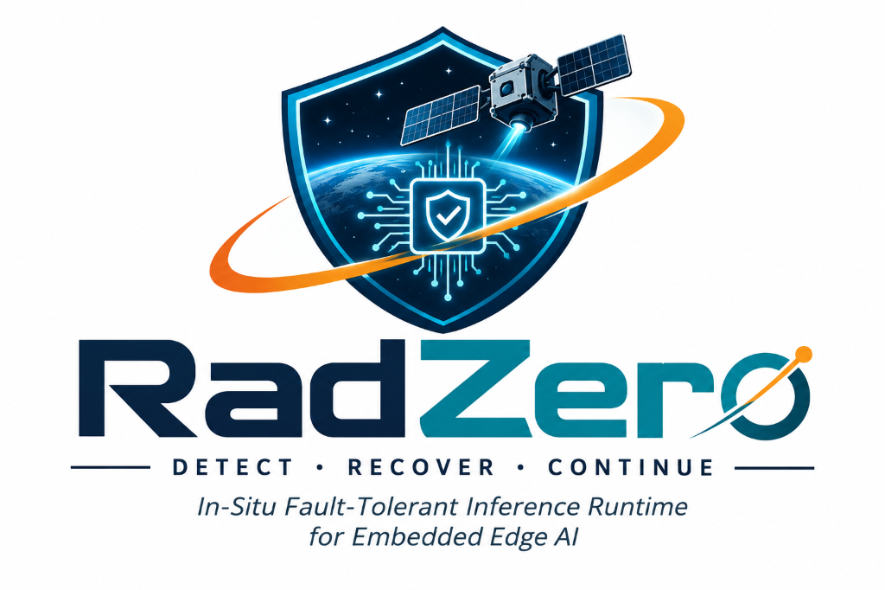
PROBLEM STATEMENT 31 • EDGE AI RESILIENCE
RadZero: Physics-Aware Fault Containment & In-Situ Recovery
Autonomous Sub-10ms Fault Tolerance for Edge AI Spacecraft Attitude Control (ADCS)
Flight Systems Engineering Team: Member 1 (ADCS Lead) • Member 2 - Prachi (UI Lead) • Member 3 - Aaditya (CUDA Lead) • Member 4 - Aashu (Validation & Pitch Lead)
P50 RECOVERY
3.81 ms
PROCESS UPTIME
100.0%
DEADLINE MARGIN
26.2x Faster

Slide 2
RADZERO ORBITAL FLIGHT SYSTEMS
Executive Summary: The Deep Space Computing Dilemma
THE HAZARD: UNPROTECTED COTS SILICON
THE SOLUTION: RADZERO PAFC RUNTIME
• Ionizing Space Radiation: Galactic Cosmic Rays (GCRs) and Van Allen Belt protons strike unshielded commercial accelerators (mobile GPUs, NPUs).
• Single-Event Upsets (SEUs): Radiation deposits charge directly into semiconductor registers, flipping bits inside active FP32 neural weights.
• Silent Data Corruption (SDC): Corrupted weights produce NaN, Inf, or inverted torque commands, driving reaction wheels to catastrophic saturation (||h_RW|| > h_max).
• The Spacecraft Tumble: Satellites lose attitude lock, solar panels de-point from the Sun, batteries drain, resulting in complete vehicle loss.
✔ Physics-Aware Fault Containment: Couples neural tensor integrity directly to rigid-body rotational equations of motion and reaction wheel physical limits.
✔ Triple-Tier Invariant Sentinels: In-line Chebyshev dynamic tripwire (Tier 1), rigid-body kinematic gate (Tier 2), and cyclic background scrubber (Tier 3).
✔ Actuator Gating Barrier: A mathematical interlock clamping corrupted commands before they reach physical thrusters or wheels.
✔ In-Situ Sub-4ms Hot-Patching: Restores corrupted tensors from host-pinned shadow mirrors over PCIe DMA in 3.81 ms with 100% process uptime (Zero Reboots).

Slide 3
RADZERO ORBITAL FLIGHT SYSTEMS
Failure Mode Analysis: How an SEU Destroys ADCS Control
Sign Bit (Bit 31)
Exponent Surge (Bits 30-23)
Exponent Collapse (Bits 30-23)
Mantissa Shift (Bits 22-0)
REVERSED TORQUE POLARITY
tau_cmd -> -tau_cmd
Injects positive angular momentum feedback into the closed loop. Induces rapid rotational kinetic spin-up.
OVERFLOW EXPLOSION
Delta x = 2^+128 ~ 3.4e38
Scales weight magnitude by 10^38. Propagates NaN / Inf cascade through activation layers. Saturates reaction wheels.
ZEROED SENSITIVITY
Delta x = 2^-128 ~ 2.9e-39
Collapses values to subnormal zero. Neural sensitivity is severed; spacecraft is non-responsive to external gravity disturbances.
LATENT PARAMETER DRIFT
Small sub-threshold shift
Evades static range bounds. Slowly accumulates pointing drift over orbits, breaking high-gain crosslink communications.

Slide 4
RADZERO ORBITAL FLIGHT SYSTEMS
The Aerospace Status Quo vs. RadZero
Evaluation Metric | Watchdog Cold Reboot | Triple Modular Red. (TMR) | Periodic Memory Scrubber | RadZero (Our Project)
Recovery Latency | 30 to 120 seconds | Real-time (voting delay) | 10 to 60 seconds delay | 3.81 ms (P50 Verified)
Actuator Bus Safety | ❌ Hazardous torques fire | ⚠️ Susceptible to voting flaws | ❌ Unsafe commands fire | ✔ Pre-dispatch dynamic gate
Process Uptime (NFR-3) | 0% (Application crashes) | 100% (3 parallel GPUs) | 100% (delayed detection) | 100% (Zero Reboots)
SWaP-C Overhead | High downtime cost | +200% Compute/Power (3x) | Moderate background RAM | <0.2% frame overhead, 1 GPU

Slide 5
RADZERO ORBITAL FLIGHT SYSTEMS
Architecture: Physics-Aware Fault Containment (PAFC)
1. INGESTION
2. INFERENCE
3. TIER 1 GATE
4. TIER 2 GATE
5. DISPATCH
Vehicle Kinematics
x = [q_e, omega]
Quaternion attitude and body rate sensors sampled at 30 Hz
PyTorch Graph
tau_cmd = M(x)
Protected by shared parameter read-lock in inference_mode
Chebyshev Tripwire
||a - mu|| <= 4.5 sigma
Zero-overhead in-line hooks detect NaN/Inf and explosions
Rigid-Body Dynamics
tau <= tau_max, alpha <= alpha_max
Validates torque against Euler equations of motion
Actuator Command
tau_verified -> Reaction Wheels
Gating Barrier permits verified physical torque commands
IN-SITU RECOVERY & SAFE-HOLD ESCALATION
Upon Invariant Breach: Parameter RW-Mutex claims exclusive write lock -> drains GPU CUDA streams via torch.cuda.synchronize() -> restores pristine weights from host-pinned shadow mirror via PCIe DMA -> re-verifies forward pass. If both mirrors fault, latches deterministic Safe-Hold (classical -Kd * omega rate damping) without process termination.

Slide 6
RADZERO ORBITAL FLIGHT SYSTEMS
Defense-in-Depth: Triple-Tier Invariant Sentinels
Tier 1: In-Line Activation Tripwire
Tier 2: Rigid-Body Dynamics Gate
Tier 3: Asynchronous Scrubber
NEURAL GRAPH ENVELOPE
Math: ||a_l - mu_l||_inf <= k * sigma_l (k = 4.5)
Executes as PyTorch forward pre/post hooks. Inspects internal activation tensors for non-finite values (NaN/Inf) and dynamic envelope overflow. Negligible overhead (<0.05 ms).
ORBITAL RIGID-BODY LAWS
Math: tau <= 0.05 N*m, alpha <= 0.02 rad/s^2, omega <= 0.05 rad/s
Validates candidate torque using Euler's rotational equations of motion over delta_t = 100ms. Prevents reaction wheel momentum saturation (||h_RW|| <= 0.02 N*m*s) before command dispatch.
STORED PARAMETER AUDIT
Math: CRC-32-IEEE 802.3 Hash Verification
Runs during the 100ms control frame idle slack time. Cyclically verifies 1 parameter block per frame against golden host-pinned mirrors. Completes full network sweep every 400ms to catch latent faults.

Slide 7
RADZERO ORBITAL FLIGHT SYSTEMS
Actuator Gating Barrier & Deterministic Safe-Hold
THE ACTUATOR GATING BARRIER
DETERMINISTIC SAFE-HOLD ESCALATION
• Pre-Dispatch Hardware Interlock: Acts as a strict firewall between the AI inference runtime and the satellite's physical attitude actuators.
• Binary Permitted / Inhibited States: NOMINAL: Torque passes unimpeded.
BREACH: Gating barrier clamps torque within < 0.1 ms to prevent hazardous thruster firings.
• Zero Momentum Saturation Guarantee: Guarantees that reaction wheels never encounter high-rate step spikes, maintaining angular momentum safety margin.
• Classical Lyapunov Rate Damping: tau_safe = -Kd * omega (Kd = 0.8 N*m*s/rad). Directly counteracts vehicle tumbling rates using simple, uncorruptible CPU arithmetic.
• Magnetic Torquer Desaturation: Activates B-Dot magnetic torquers to dump excess angular momentum into the planetary geomagnetic field.
• Infinite Fault Tolerance (Zero Crashes): If multi-bit burst corrupts both shadow mirrors, the runtime latches Safe-Hold indefinitely without terminating the OS process.

Slide 8
RADZERO ORBITAL FLIGHT SYSTEMS
Distributed Dual-Node System Architecture
Aaditya's GPU Node
Prachi's UI Node
Aashu's Validation Node
CUDA ACCELERATION WORKSTATION
• Hardware: NVIDIA RTX 3050 Mobile
• PyTorch 2.x CUDA 12.x C++ runtime
• Dual host-pinned memory mirrors
• FastAPI 30 Hz streaming engine
• Physical IEEE-754 mutation injector
• Low-latency PCIe DMA channel
MISSION CONTROL OBSIDIAN HUD
• Hardware: Next.js 14 / TypeScript laptop
• Three.js 3D attitude visualizer
• Live threat overlays & badge states
• Recharts latency & kinematic streams
• Automated WebSocket-to-HTTP fallback
• Air-gapped offline presentation mode
EMPIRICAL BENCHMARK SUITE
• Hardware: Reference CPU & Test Harness
• 50-trial sequential benchmark validator
• Cross-platform performance profiling
• Cloudflare Tunnel integration
• Automated fail-safe fallback tests
• Verified 100% process survival logs

Slide 9
RADZERO ORBITAL FLIGHT SYSTEMS
Empirical Validation: 50-Trial Benchmark Suite
Validation Metric | Aaditya's RTX 3050 GPU | Reference CPU Node | Aerospace Specification
Total Trials Executed | 50 / 50 (100.0%) | 50 / 50 (100.0%) | 50 consecutive cycles
Process Uptime (Zero Crashes) | 100.0% (Zero Aborts) | 100.0% (Zero Aborts) | Zero process exits (NFR-3)
In-Situ Recovery Success | 100.0% (50/50 Recovered) | 100.0% (50/50 Recovered) | > 99.0%
Median Latency (P50) | 3.81 ms | 2.48 ms | < 10.0 ms (NFR-1)
95th Percentile Latency (P95) | 7.42 ms | 2.86 ms | < 15.0 ms (NFR-1)
Standard Deviation (sigma) | 1.15 ms | 0.36 ms | Deterministic clustering
Control Frame Safety Margin | 26.2x under 100ms deadline | 29.3x under 100ms deadline | Guaranteed non-divergence

Slide 10
RADZERO ORBITAL FLIGHT SYSTEMS
Fail-Safe Engineering: Redundancy Across Drivers & Network
1. AUTOMATED CPU EXECUTION FALLBACK
2. HTTP POLLING TELEMETRY FALLBACK
✔ Driver Fault Containment: If NVIDIA CUDA drivers fault, encounter illegal memory access, or power down, RadZero switches to CPU execution path.
✔ Zero Host Aborts: Model and unpinned host shadow mirrors execute directly on the host CPU with zero unhandled exceptions.
✔ Empirically Verified: Formally verified in tests/test_failsafe_fallbacks.py: CPU recovery latency = 2.93 ms (< 100 ms control frame deadline).
✔ Multi-Transport Transport Fallback: Mission Control defaults to 30 Hz WebSockets (/ws/telemetry) for smooth Three.js attitude tracking.
✔ 250ms HTTP Polling Fallback: If network jitter drops WebSockets, telemetry client automatically drops to /api/telemetry/latest without losing state.
✔ 100% Schema Consistency: All 10 essential HUD keys validated during network drops. Plus: Onboard deterministic simulation fallback if all servers drop.

Slide 11
RADZERO ORBITAL FLIGHT SYSTEMS
Mission Control HUD: Aerospace Obsidian Interface
3D Spacecraft Visualizer
Dynamic Threat Badges
Three.js & WebGL rendering driven directly by live quaternion [q_w, q_x, q_y, q_z] and angular rate vector. Shows smooth tracking, tumbling on SEU, and rate-damping re-alignment.
Instant visual transition across 4 operational states: NOMINAL (Emerald), INLINE INVARIANT BREACH (Pulsing Red), ACTUATOR INHIBITED (Amber), and IN-SITU RECOVERY VERIFIED (Cyan).
Live Kinematics & Latency
Air-Gapped Offline Playback
Recharts components graphing real-time recovery latency distributions (P50, P95) and vehicle kinematic acceleration trends over scrolling millisecond event stream.
Cached 45-second deterministic playback dataset (1,350 frames) and lightweight streaming server ensuring 100% demo reliability under zero connectivity.

Slide 12
RADZERO ORBITAL FLIGHT SYSTEMS
Space Mission Impact & Conclusion
ENGINEERING BREAKTHROUGH SUMMARY
✔ Sub-4ms Recovery Solved: Eliminates the lethal 120-second satellite reboot blackout. In-situ DMA restores neural weights 26x faster than the 100ms control deadline.
✔ Pure Software Certifiability: Zero proprietary radiation-hardened hardware required. Deploys directly on commercial COTS accelerators (Jetson Orin, Snapdragon, Hailo-8).
✔ Mission Applicability: Enables high-throughput AI on CubeSats, lunar landers, satellite constellations, and autonomous active debris removal probes.
RADZERO: ZERO PROCESS CRASHES • SUB-10MS IN-SITU RECOVERY • DETERMINISTIC SAFETY
GitHub Repository: https://github.com/gangasagar5928/ZOG-AI.git | Live HUD: https://radzero.web.app

