Slide 1
Vehicle Violation Detection System using Deep Learning
-Anusha Gangasani

Slide 2
Introduction
Reason to implement the system
Components implemented in the system

Slide 3
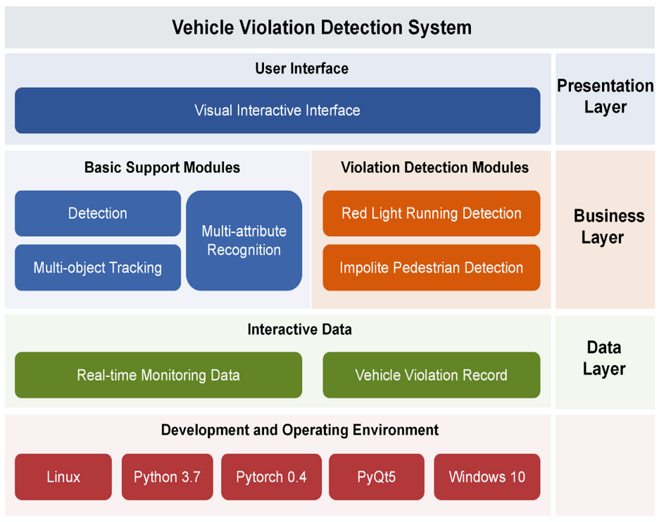
SYSTEM DESIGN AND ARCHITECTURE
Presentation Layer
Business Layer
Data Layer

Slide 4
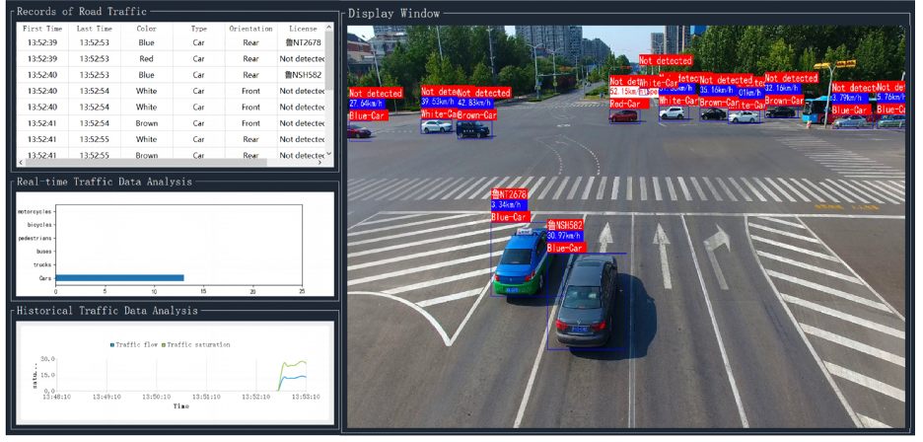
VEHICLE VIOLATION DETECTION SYSTEM:
Basic Support Modules:
Detection and Tracking modules
Multi-attribute Recognition modules

Slide 5
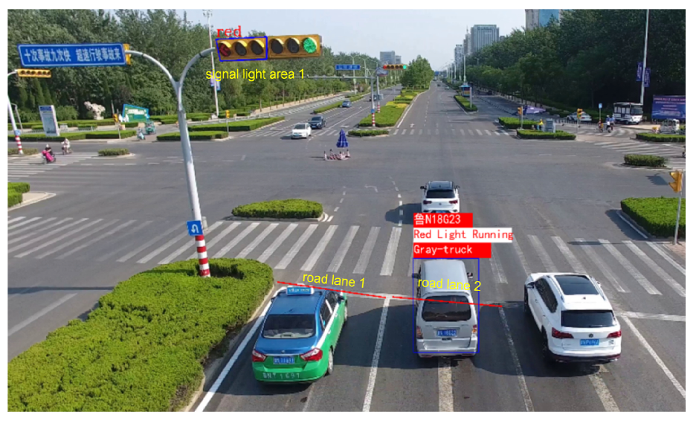
VEHICLE VIOLATION DETECTION SYSTEM:
Violation Detection Modules:
Red-Light running detection

Slide 6
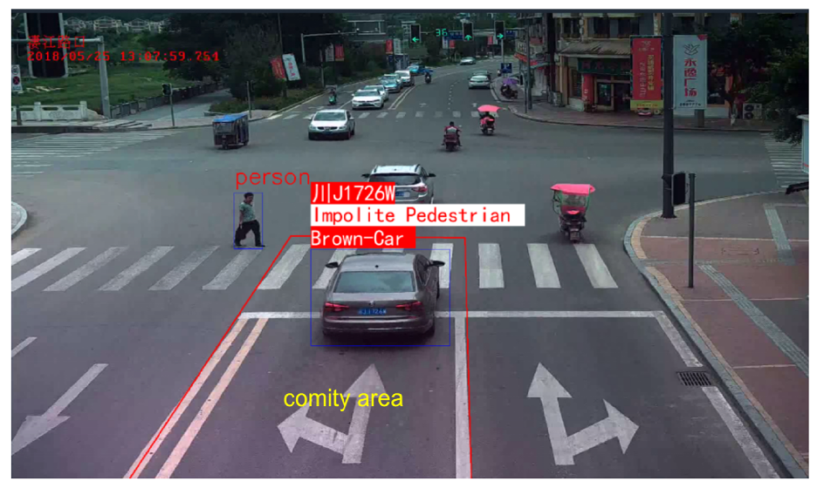

VEHICLE VIOLATION DETECTION SYSTEM:
Violation Detection Modules:
Impolite Pedestrian detection
A novel strategy is defined to measure whether
the vehicle is slowing down, and we calculate
the speeds as follows:

Slide 7
CONCLUSION:
This paper gives us a detailed design and implementation of vehicle violation detection system based on the deep learning technology, which combines several popular function modules. This system provides effective technical support for the development of intelligent traffic management.

Slide 8
THANK YOU

