Slide 1
Introduction to Programming
Introduction to the C programming language
Dr. Ming NI (niming@genomics.cn)
Dr. Gang CHEN (chengang@genomics.cn)
Sep 13th, 2014

Slide 2
Introduction to Programming
Assignment of Lecture 2 and Lecture 3:
Download and install Code::Blocks;
Write a program to print Fibonacci sequence.The length of output sequence is specified by the first command line parameter. (fibonacci.c)
Implement Smith-Waterman algorithm in C. Given that the cost of GAP, MATCH and MISMATCH is -1, 2 and 0.5, separately. Calculate the alignment of “ACGTGGCCTTGTGA” and “GGTGGGTCTTGTCG”.

Slide 3
Introduction to Programming
Outline of Lecture 2
1. Overview
2. Quick Get Started
3. Syntax, libraries and tools
4. Demo Case

Slide 4
Introduction to Programming
Outline
1. Overview
2. Quick Get Started
3. Syntax, libraries and tools
4. Demo Case

Slide 5
Introduction to Programming
1973, Bell Lab
Dennis Ritchie
#include <stdio.h>
main()
{
printf(“hello, world\n”);
}
----The C Programming Language

Slide 6
Introduction to Programming
C is widely used in various environments, including network programming, operating systems, implementing programming language, embedded devices, high performance numerical computing and so on.
In this course, all other programming languages, Java, Python, Perl and R, are based on the C programming language.
C is fundamental to modern computer software, including bioinformatics software.

Slide 7
Introduction to Programming
Outline
1. Overview
2. Quick Get Started
3. Syntax, libraries and tools
4. Demo Case

Slide 8
Introduction to Programming
Get Started
Download and Install Code::Block;
Input source codes;
Build, Compile and Run;

Slide 9
Introduction to Programming
Get Started
Download and Install Code::Blocks;
Official Website: www.codeblocks.org
Download: http://www.codeblocks.org/downloads/binaries
Mac OS: needs XCodes from app store.
Windows: see instructions online.

Slide 10
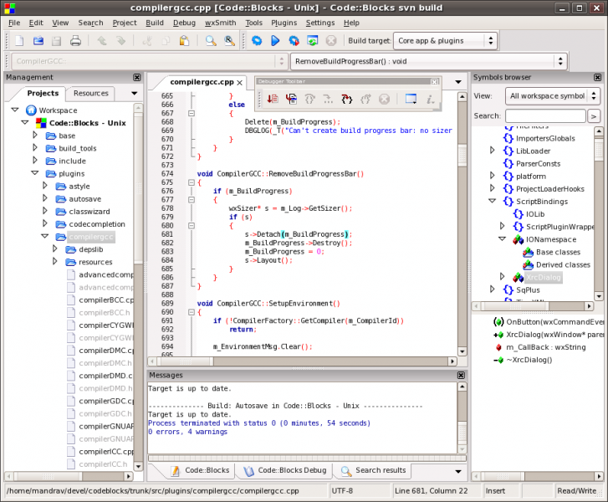
Introduction to Programming
Get Started
Download and Install Code::Blocks;
Linux: Ubuntu

Slide 11
Introduction to Programming
Get Started
2. Input source codes;
#include <stdio.h>
int main(){
printf("Hello!\n");
int a = 1, b = 2;
printf("The sum of a and b is %i\n", a+b);
return 0;
}

Slide 12
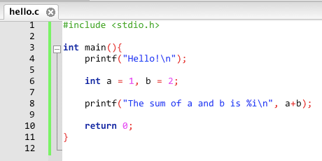
Introduction to Programming
Get Started
2. Input source codes;
hello.c
Notes:
new->File..->C/C++ Source -> hello.c

Slide 13


Introduction to Programming
Get Started
3. Build, Compile and Run;

Slide 14
Introduction to Programming
Get Started
Back to the source codes
#include <stdio.h> // import library for I/O
int main(){ // define main function
printf(“Hello!\n”); // print something to the screen
int a = 1, b = 2; // define two variables and assign values
printf(“The sum of a and b is %i\n”, a+b);
// print the sum of the two variables to the screen
return 0; // return 0 to system
}

Slide 15
Introduction to Programming
Outline
1. Overview
2. Quick Get Started
3. Syntax and libraries
4. Demo Case

Slide 16
Introduction to Programming
Syntax
Variable and Data Type
char
int
float
double
array
pointer
(variables.c)

Slide 17
Introduction to Programming
Syntax
Operation
+, - , *, /, %
>, >=, <, <=
==, !=
++, --
!
&&, ||
(operations.c)
A puzzle:
1.3 - 0.7 = 0.600000
1.3 - 0.7 == 0.6 is false
1.3 - 0.7 != 0.6 is true

Slide 18
Introduction to Programming
Syntax
Flow Control: conditional statement
if-else
switch
(flow.c)

Slide 19
Introduction to Programming
Syntax
Flow Control: loop statement
while
for
break and continue
(flow.c)

Slide 20
Introduction to Programming
Syntax
Function
int add(int a, int b){
return a+b;
}
(function.c)

Slide 21
Introduction to Programming
Syntax
Struct
struct point{
int x;
int y;
};

Slide 22
Introduction to Programming
Syntax
Input/Output: stdio.h
printf
scanf
fopen
fprintf and fscanf

Slide 23
Introduction to Programming
Library
math.h
sin, cos, tan, asin …
exp, log, log10 …
pow, sqrt …
floor, ceil, fabs …
(math.c)

Slide 24
Introduction to Programming
Library
string.h
strcpy
strcat
strcmp
strlen

Slide 25
Introduction to Programming
Outline
1. Overview
2. Quick Get Started
3. Syntax and libraries
4. Demo Case

Slide 26
Introduction to Programming
Demo Case
yes command:
http://web.mit.edu/~mkgray/afs/bar/afs/sipb/project/gnu/src/sh-utils-1.12/src/yes.c

Slide 27
Introduction to Programming
Summary
C is fundamental to modern computer software.
Almost everything is based on C, including most programming languages.
C is a simple, cross-platform and efficient programming language.
C is widely used the development of various software, from small tools and big data systems.

Slide 28
Introduction to Programming
Thanks!

