Slide 1
Predicting the breed of a dog based on an image using machine vision.
Michael Roman

Slide 2
Introduction
For my capstone project I built a supervised learning model to predict a dog's breed out of 120 breeds based on an image.
Supervised learning requires training your model on labeled data and then testing it on data it’s never “seen” before to measure its performance.
In this case, I trained my model on roughly 10,000 images of dogs (labels were one of 120 breeds) and tested the model’s performance on 2,000 images.

Slide 3
Goals/Problem Statement
The goals of this project were three-fold:
1) To build a working supervised machine learning model that could predict the breed of a dog with an accuracy score of at least 50%.
2) To build an interface in Jupyter Notebook that allows the user to test the model on an image of her choice in a way that's pleasurable and reinforces an understanding of the steps required, mainly: image acquisition, image processing (deep feature extraction), conversion of deep feature arrays to individual columns (one feature per column) for modeling, model training and model prediction.
3) To report metrics back to the user on other, high predicted probability dog breeds from the model.

Slide 4
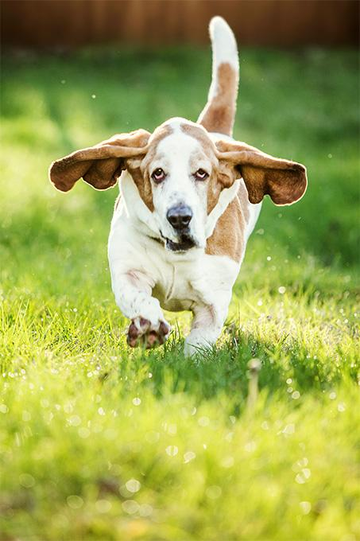
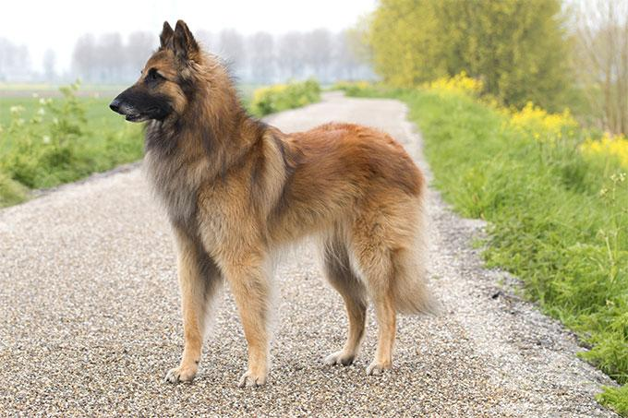
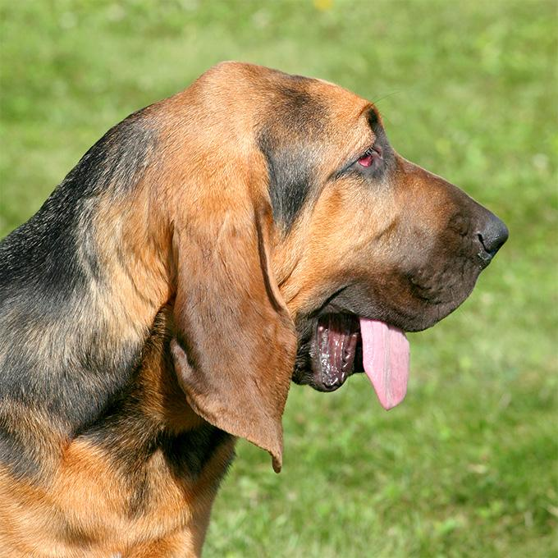
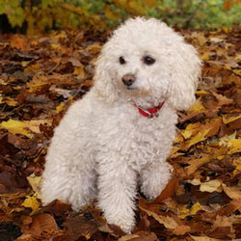
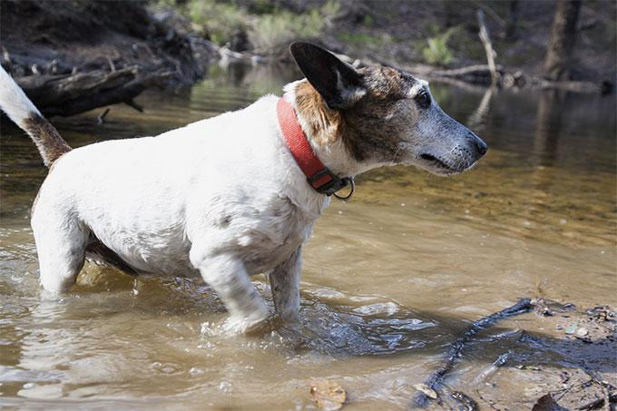
The Data
The train and test images were sourced from Stanford's dog dataset (http://vision.stanford.edu/aditya86/ImageNetDogs/).
The corpus of images I used totaled 12,000 images (roughly 80 train, 20 test per breed)

Slide 5
The Tools
VANILLA PYTHON & PANDAS: I used Python and Pandas for all data manipulation and DataFrame creation.
GRAPHLAB: I used GraphLab's off-the-shelf neural network to extract the deep features from the images.
SCIKIT-LEARN:I tested a number of scikit-learn's machine learning classifiers to predict the breed, ultimately settling upon their support vector machine classifier for it's superior performance (best accuracy score) on this classification task.

Slide 6
The Approach
There were three core steps required to spin up this vision project end to end. I was delighted to learn that these three core steps were not radically dissimilar from the steps a data scientist would carry out on other, non-vision related problems. These three steps are:
1) Data Collection. Labeled images obtained from the Stanford Dogs Dataset.
2) Feature Extraction/Engineering. From these images, we needed to extract the features held within the images. In image processing and machine vision, every pixel is a feature of that image. However, before a pixel can be used as a feature in a model we must perform a linear transformation on the pixel's RGB value. Once we retrieve this linearly transformed value, we can then use this value as a feature in our model.
3) Modeling. Once the features were extracted, I split the data into an 80%/20% train, test split. I then fit a number of models to my training data using Scikit-learn's linear and ensemble classification models to see which returned the highest accuracy score. Specifically, I used: Ada Boost (on a decision tree), Gradient Boost, Random Forest, Extra Trees, XG Boost, Logistic Regression and a Support Vector Machine.

Slide 7
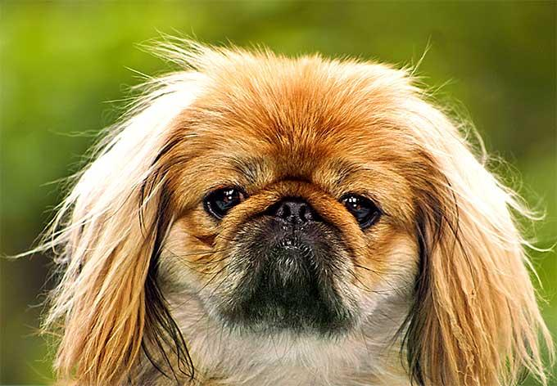
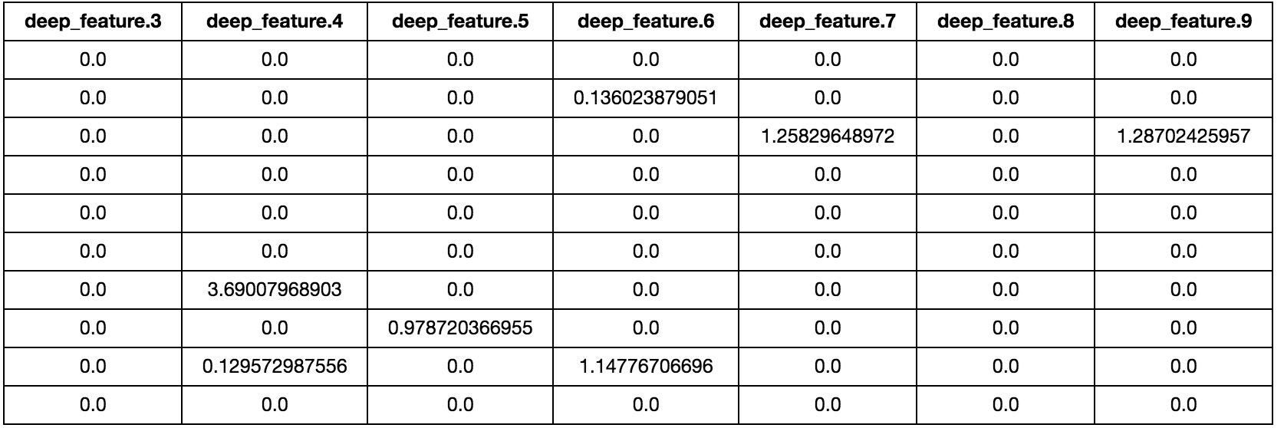
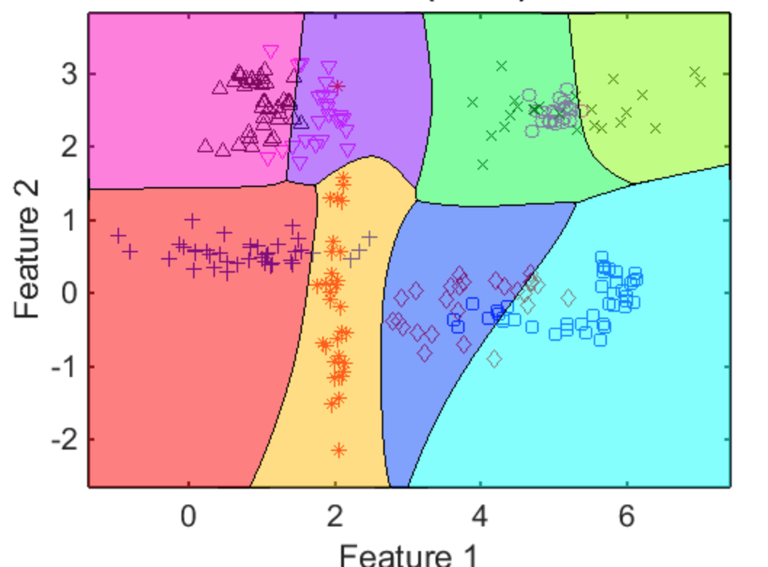
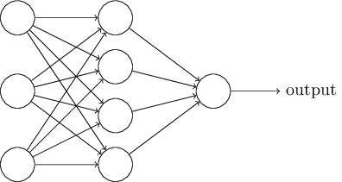
Workflow
Step 1: Raw Image
Step 2 Output: Deep Features
Step 3 Output:
PEKINGESE!
Step 3: Model (Multiclass SVM)
Step 2: Deep Feature Extraction

Slide 8
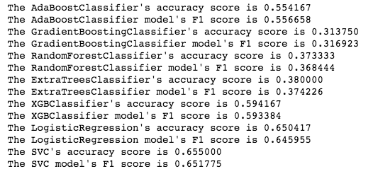
Discussion of Results
I ultimately ended up sticking with sci-kit learn’s support vector machine classifier for it's superior accuracy score performance on this classification task, 65.5%.
The accuracy score is defined as:
(True Positives + True Negatives)/(True Positives + True Negatives + False Positives + False Negatives)
Here’s a complete list of accuracy scores (and f1 scores) across the machine learning classifiers I experimented with:

Slide 9
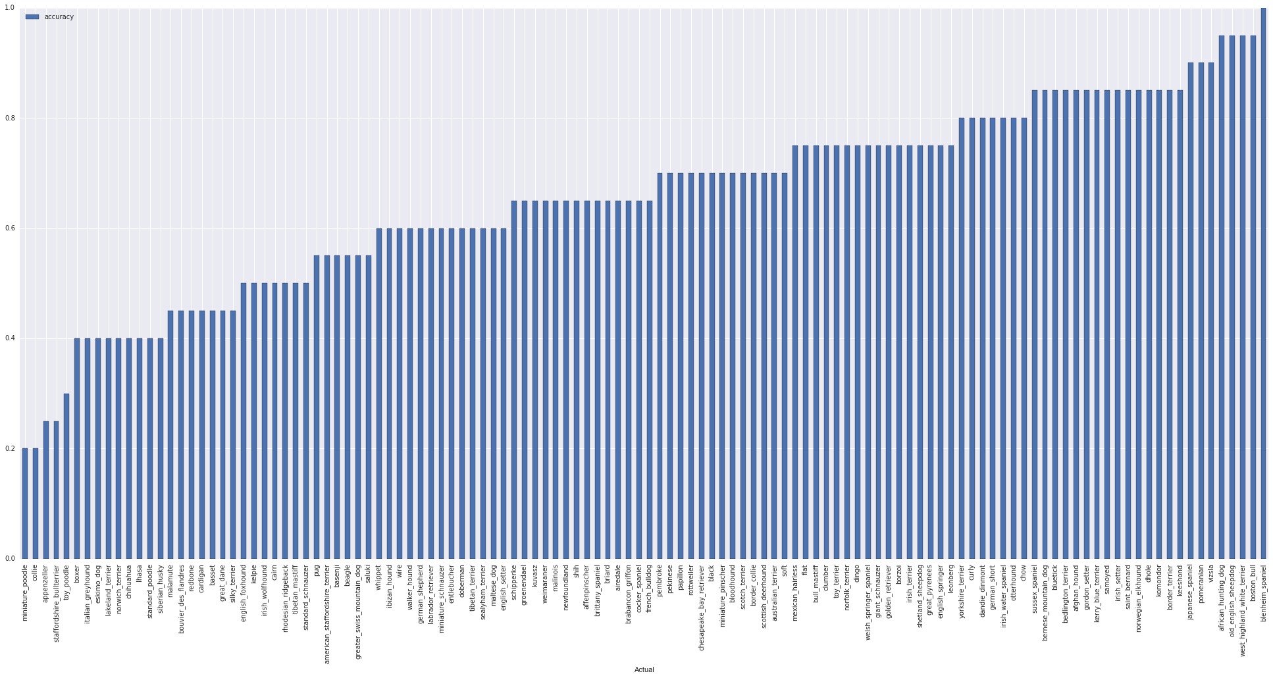
Breakdown by breed of model’s accuracy in classifying images from the test set.

Slide 10
Demo

Slide 11
I was able to build a model using Graphlab and scikit-learn that was 65.5% accurate at this classification task. Additionally, I built a function that allows the user to experiment with the model and get feedback on what the model's top predictions are for an image of her choosing.
CONCLUSION

