Slide 1
Detection and Filtering of Political Misinformation in Social Media
TATA COMMUNICATION HACKATHON DAKSH’24

Slide 2
AGENDA
Abstract
Problem Statement
Solution
Technologies Used
Workflow
Key Features
Pipeline

Slide 3

WHY POLITICAL MISINFORMATION ?
The prevalence of misinformation in politics is alarmingly high.
Unlike other illegitimate or fake information, political misinformation can be identified through scientific facts.
The significant social impact it generates often contributes to a transformation in the entire system of a country.

Slide 4
DATASET CREATION
The datasets available on the web are often outdated and irrelevant to Indian politics.
To address this, we undertook the task of creating a new dataset by scraping years of political information from news sites such as Indian Express and India Today.
Through web scraping these news sites, we were able to generate a legitimate news dataset.
For the creation of a fake news dataset, we utilized OpenAI's capabilities to generate fake news by providing it with the legitimate news from our dataset.
This process also allowed us to obtain an illegitimate news dataset.

Slide 5
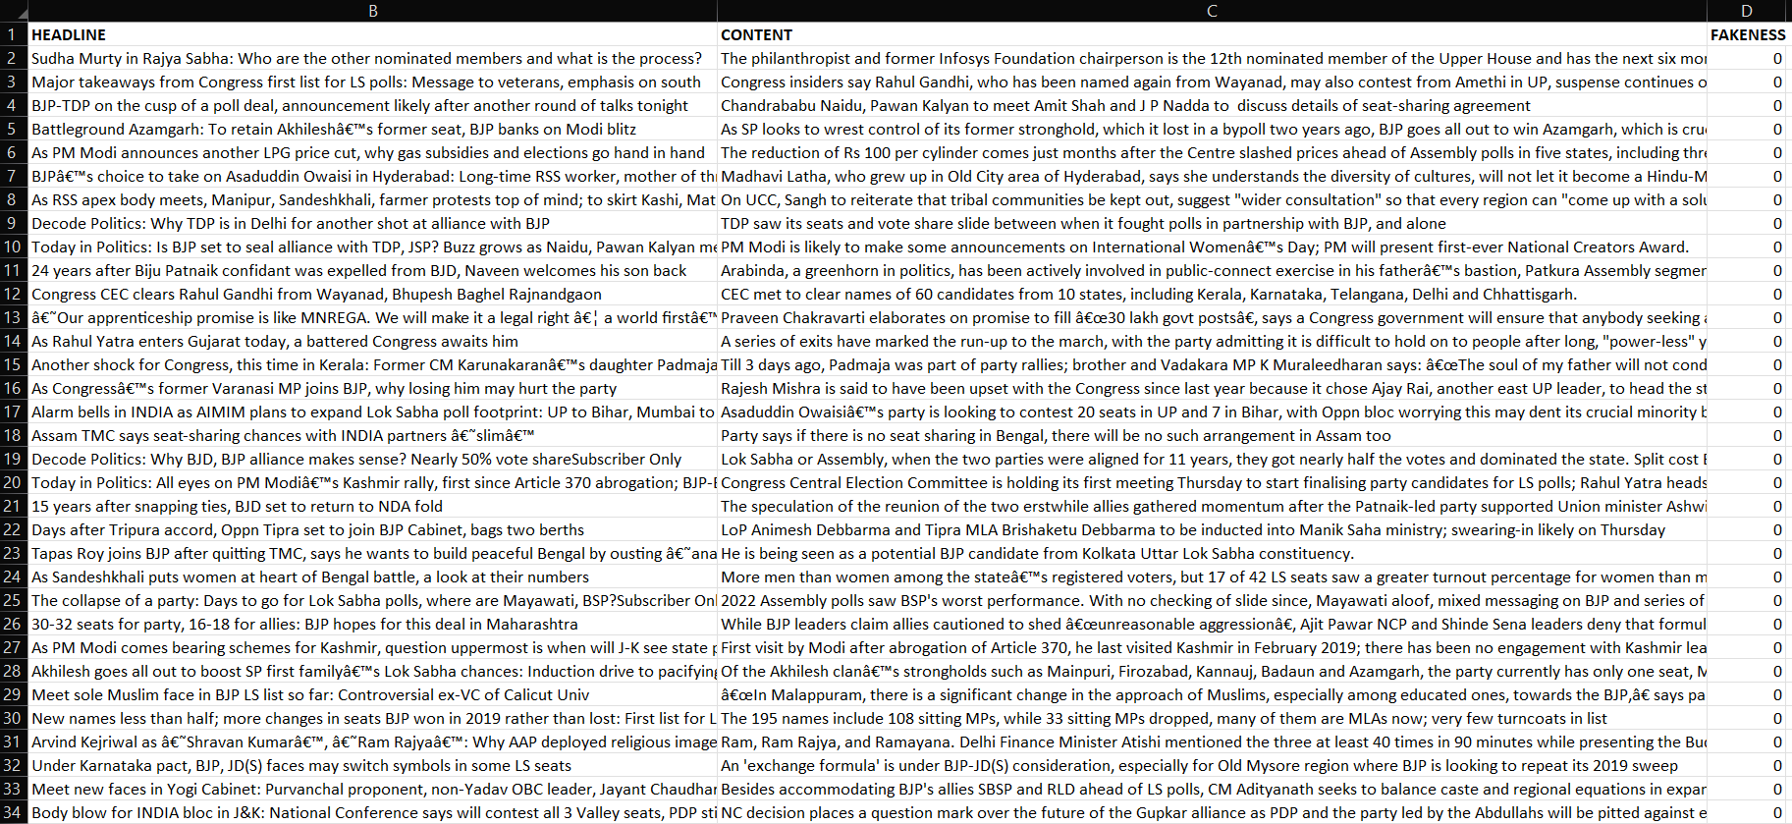
LEGITIMATE NEWS - DATASET

Slide 6
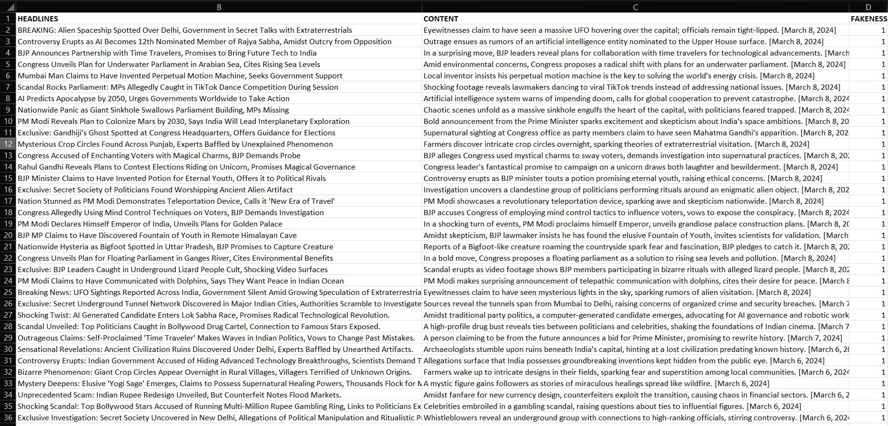
ILLEGITIMATE NEWS - DATASET

Slide 7
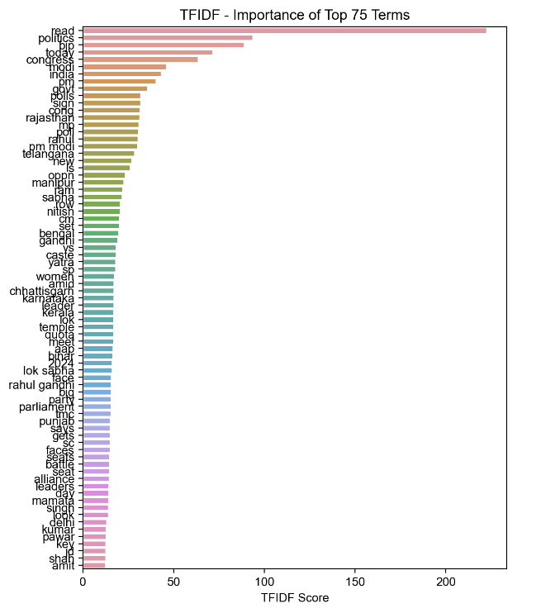
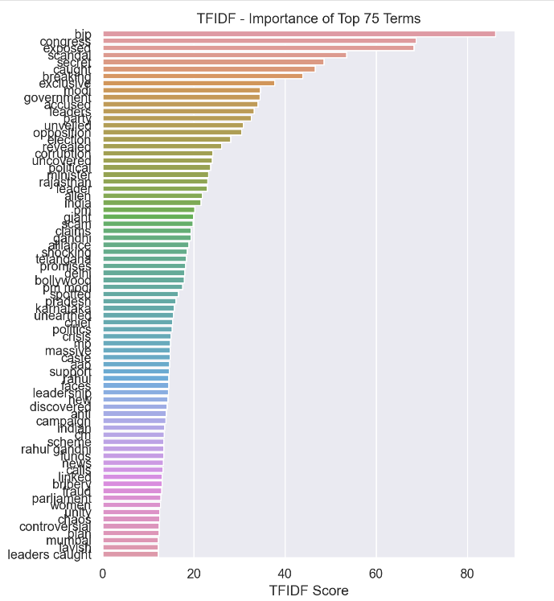

Slide 8
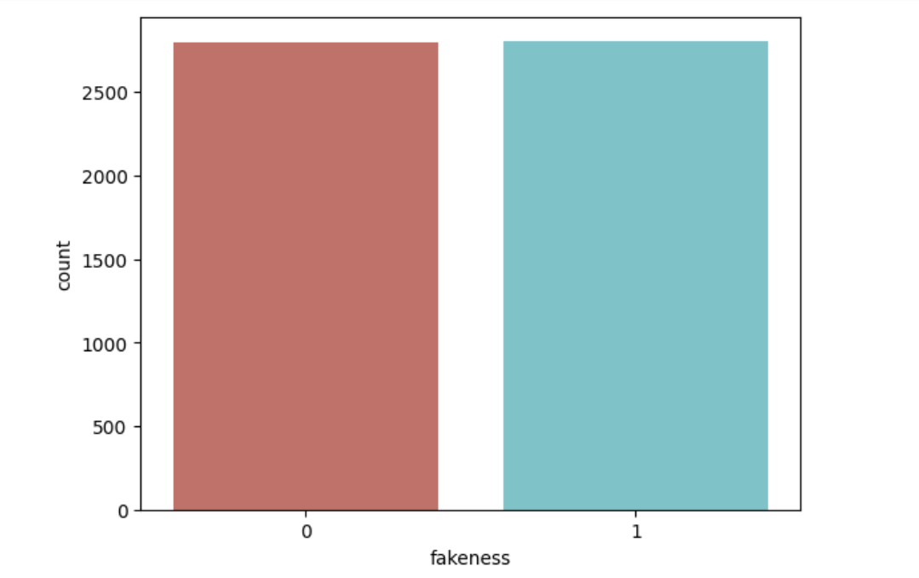
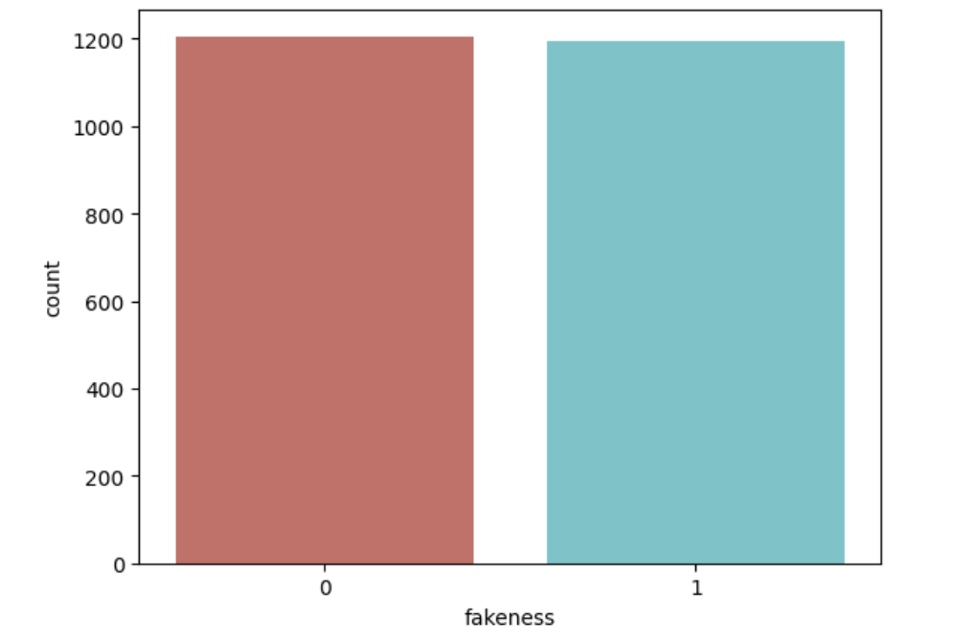
TRAIN TEST SPLIT
Train Data
Test Data

Slide 9
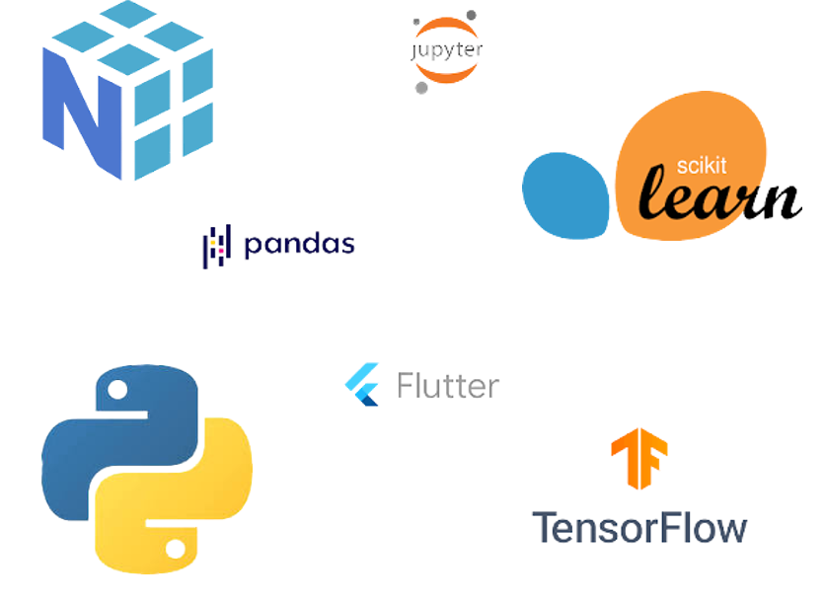
TECHNOLOGIES USED
NLP Toolkit
Streamlit
Jupyter Notebook
Google News API
Scikit
Numpy
Web Scraping
Numpy

Slide 10

APPROACH
In this project an unique dataset has been created and has been proposed dedicatedly for child labour detection. This issue must be solved to ensure children's rights in developing countries like India. To help the researchers in similar fields, we open-sourced the dataset.
Using deep learning techniques, image classification has brought massive effectiveness in human activity recognition and real-time video classification. In recent years, divergent activity detection from live video streams has become a vital research segment of Computer Vision. Transfer learning has become a convenient deep-learning technique in Computer Vision and NLP.
For this project, two approaches will be used to train and test the data. At first, a Convolutional Neural Network (CNN) model for our unique dataset was built. Later, we used the transfer learning technique, adopting two well-known models, VGG16 and Xception, to train and test the data and compare the performance with our model. However, we will focus on developing the models and getting good accuracy.

Slide 11
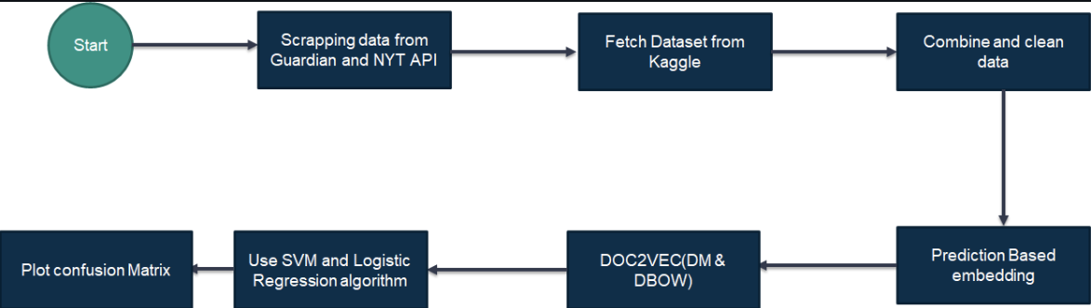
WORKFLOW

Slide 12
PIPELINE
Trust Score
By verifying the source information from various,websites we will calculate a trust score which will provide the user with a standard metric
Community Voting
We will allow certain distinguished and unbiased individuals to vote on the genuineness of the information
Our next objective will be to improve our dataset and expand our ROI, to help combat misinformation across various categories
Expanding the Dataset

Slide 13
Thank You

