Slide 1

HOTEL BOOKING AND
OCCUPANCY MANAGER
GANGESH CHANDRA2620030426
AJAY SIDDARTH2620030181
15-10-2026
1

Slide 2
Abstract
The Hotel Booking and Occupancy Manager is a software application designed to simplify and automate hotel room booking, guest registration, and occupancy management. Traditional hotel management methods often rely on manual records, which can result in booking errors, delays, and difficulty in tracking room availability. This system provides a centralized platform for managing hotel operations efficiently.
The application enables hotel staff to add, update, search, and manage room details such as room number, type, price, and availability. It also maintains guest information and supports room booking, check-in, and check-out processes. The system automatically updates room occupancy status, preventing double bookings and ensuring accurate room allocation. Users can quickly search for available rooms and access booking details whenever required.
By automating routine hotel operations, the system reduces paperwork, minimizes human errors, saves time, and improves customer service. It provides a secure and organized method for maintaining guest records, booking history, and occupancy information. Future enhancements may include online booking, payment integration, billing generation, email notifications, and role-based access control.
Overall, the Hotel Booking and Occupancy Manager provides a simple, efficient, and user-friendly solution for managing hotel reservations and room occupancy while improving operational efficiency and enhancing the guest experience.
Keywords: Hotel Management, Room Booking, Occupancy Management, Guest Registration, Reservation System, Java.
15-10-2026
2

Slide 3
Understanding Problem Statement
1
The Problem
2
Our Solution
3
The Benefit
Traditional hotel management relies on manual records
Manual work causes booking errors and delays
Room availability is difficult to track
A centralized platform to manage hotel operations efficiently
Add, update, search and manage rooms: number, type, price, availability
Guest registration, room booking, check-in and check-out
Occupancy status updates automatically, preventing double bookings
Less paperwork and fewer human errors
Saves time and improves customer service
Secure, organized guest records, booking history and occupancy information
15-10-2026
3

Slide 4
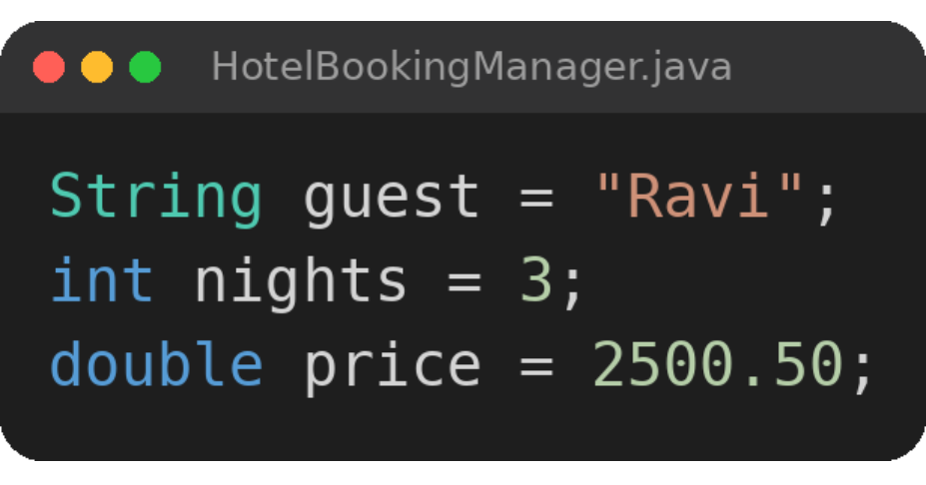
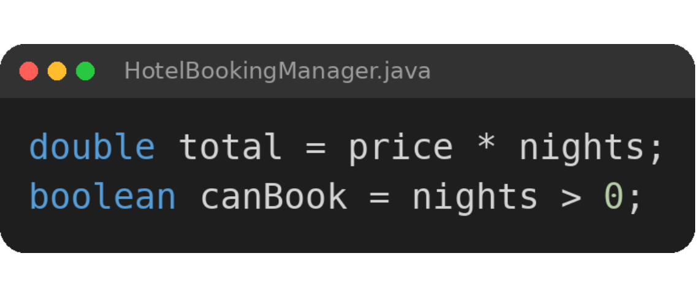
CO 1 Topics
1
Basics
2
Operators
Datatypes
Variables
Arithmetic operators
Relational operators
15-10-2026
4

Slide 5
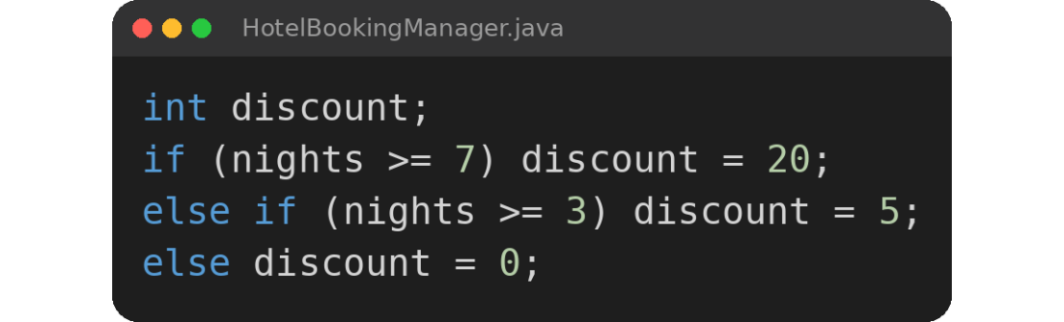
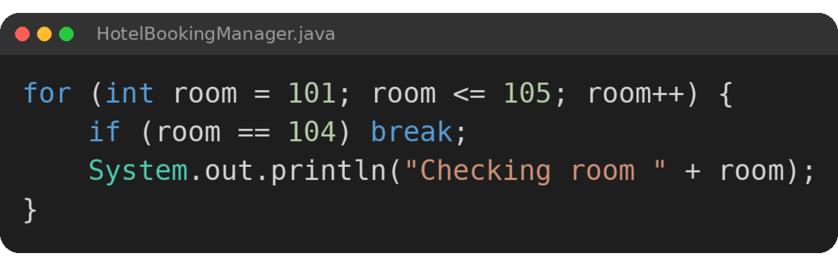
CO 2 Topics
1
Decision Making
2
Loops
if-else ladder
for loop
break
15-10-2026
5

Slide 6
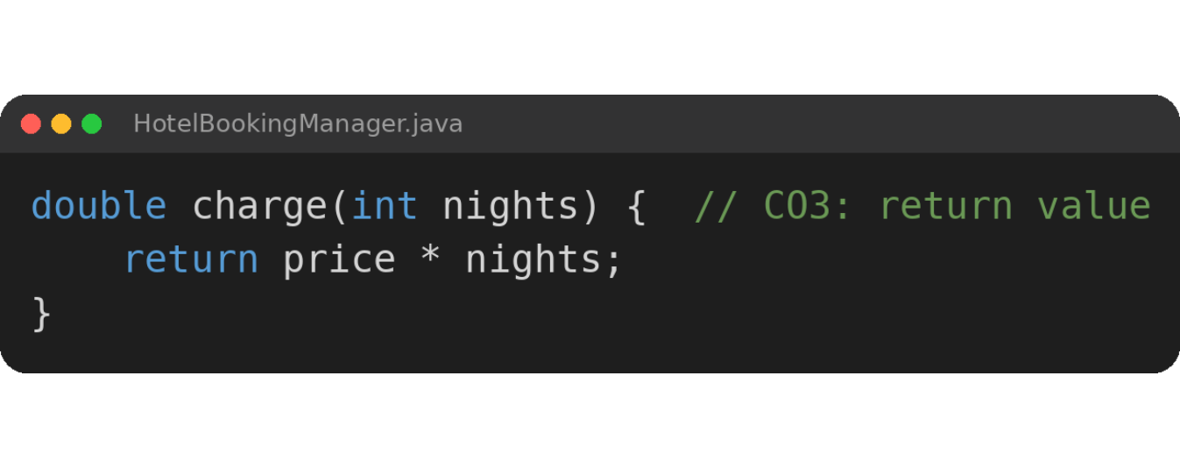
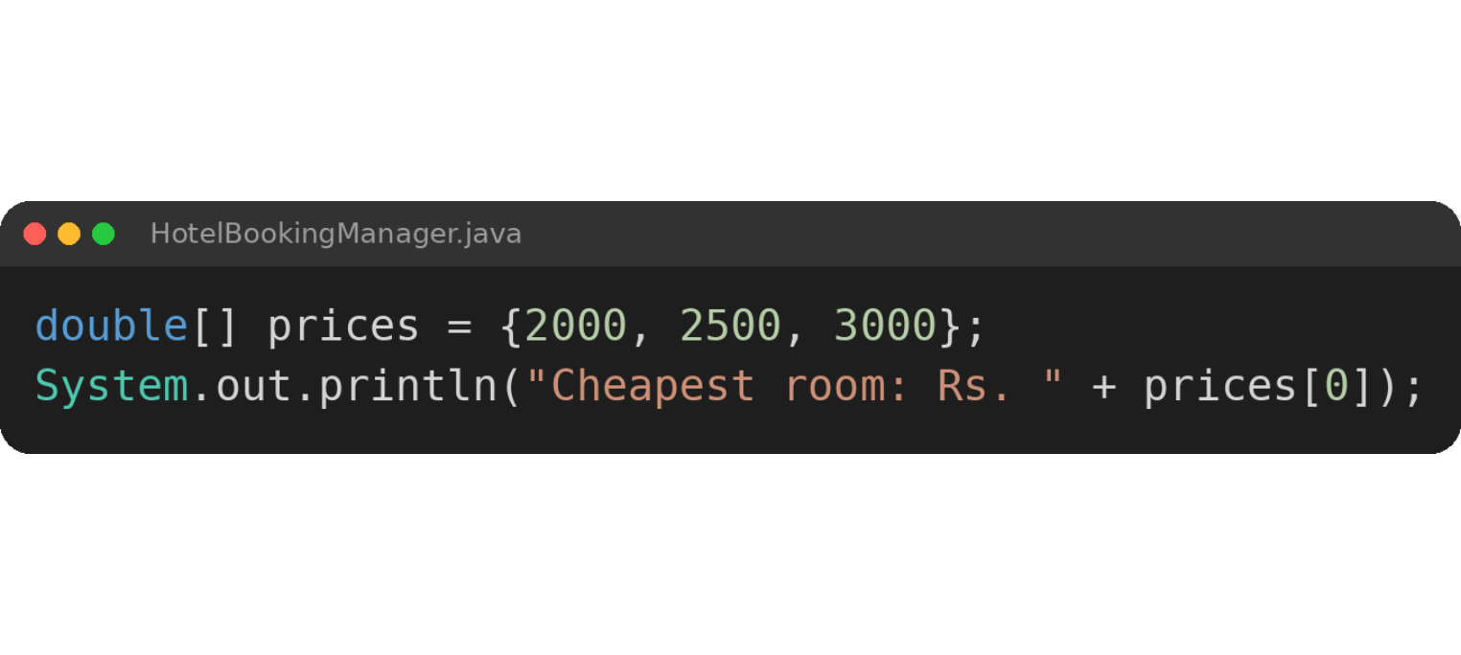
CO 3 Topics
1
Methods
2
Arrays
Return value
1D array
15-10-2026
6

Slide 7
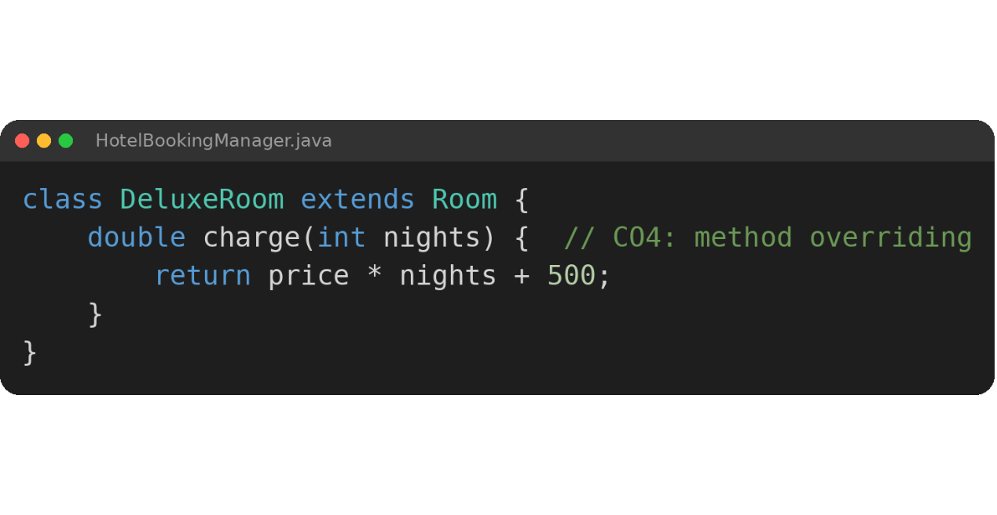
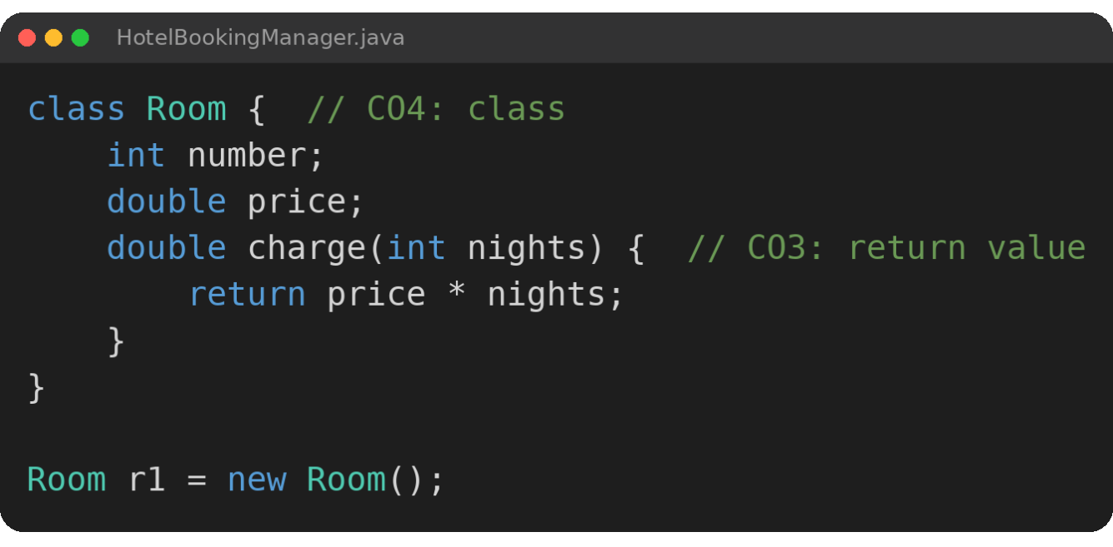
CO 4 Topics
1
Classes and Objects
2
Polymorphism
Class and object
Method overriding
15-10-2026
7

Slide 8
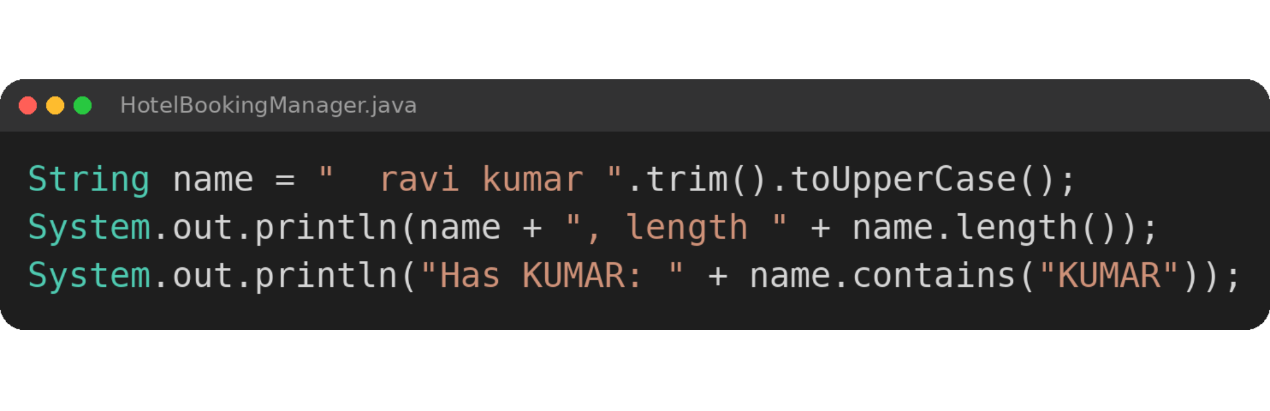
CO 5 Topics
1
Strings
String methods
15-10-2026
8

Slide 9
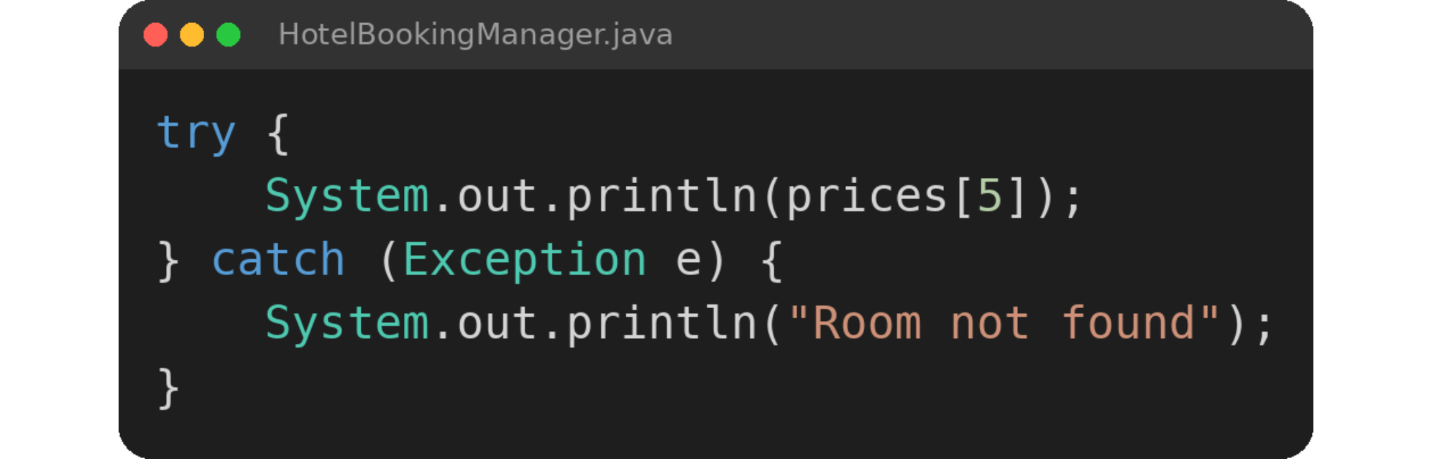
CO 6 Topics
1
Exception Handling
try-catch
15-10-2026
9

Slide 10
Conclusion
1
What We Built
2
Concepts Used
3
The Outcome
A simple Java Hotel Booking and Occupancy Manager
Stores room number and price
Calculates room charges for normal and deluxe rooms
CO1: datatypes, variables, operators
CO2: if-else ladder, for loop, break
CO3: return value, 1D array
CO4: class and object, method overriding
CO5: string methods
CO6: exception handling
A simple, efficient and user-friendly way to manage hotel rooms and bookings
Less paperwork and fewer human errors
Future scope: online booking, payment integration, billing, email notifications
15-10-2026
10

Slide 11
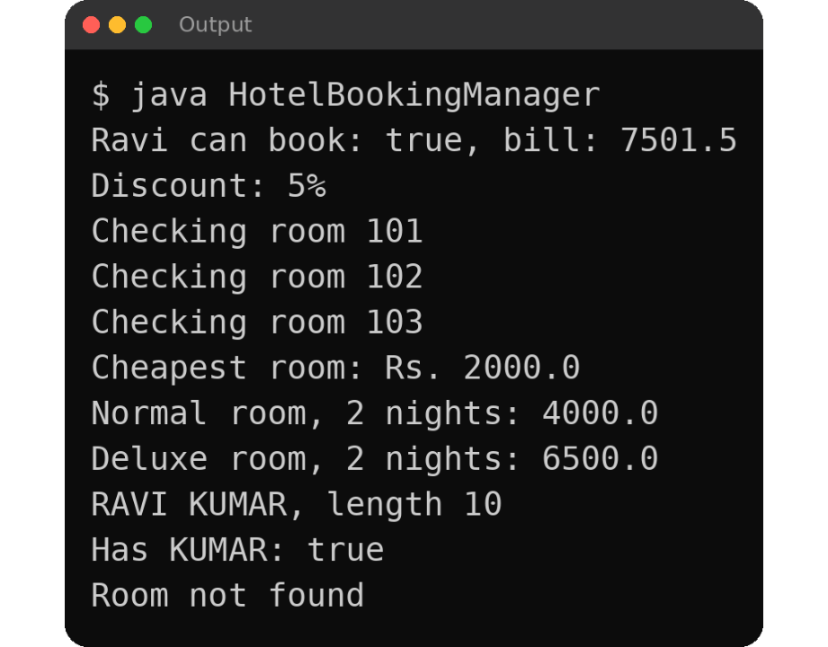
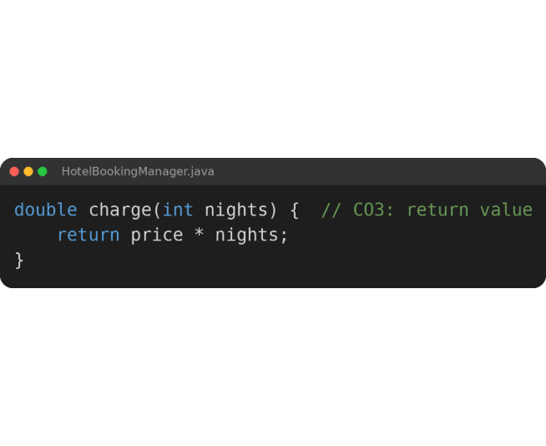
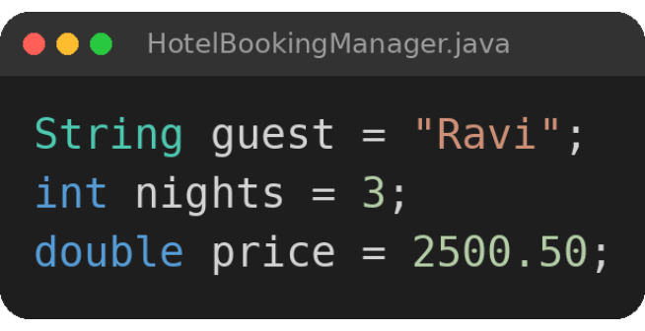
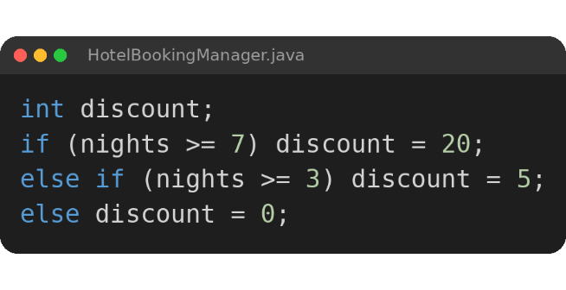
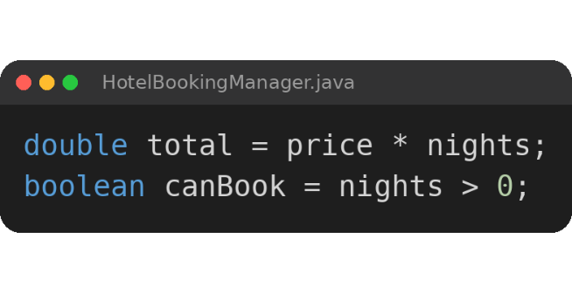
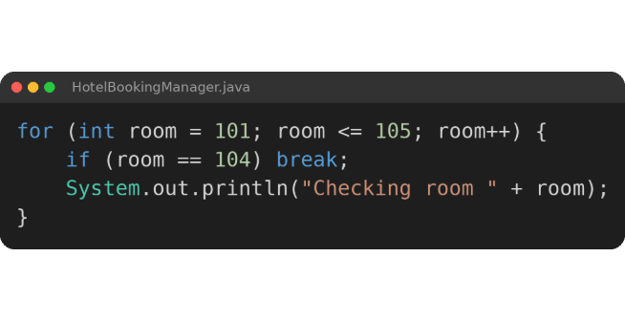
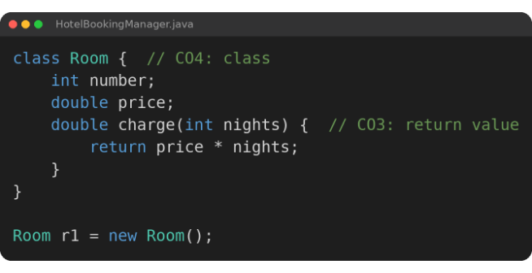
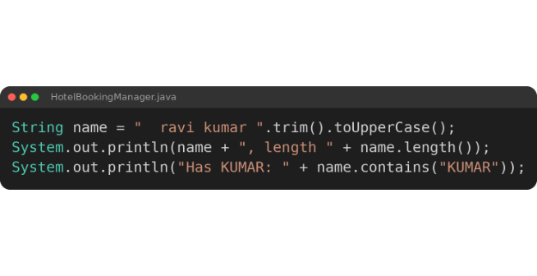
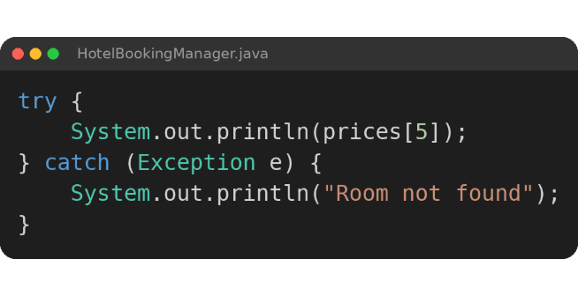
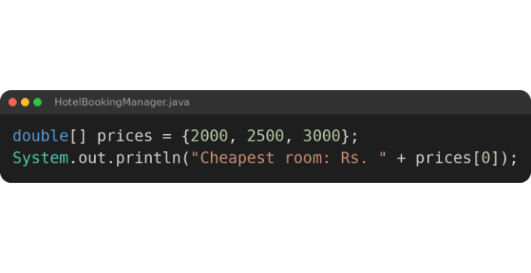
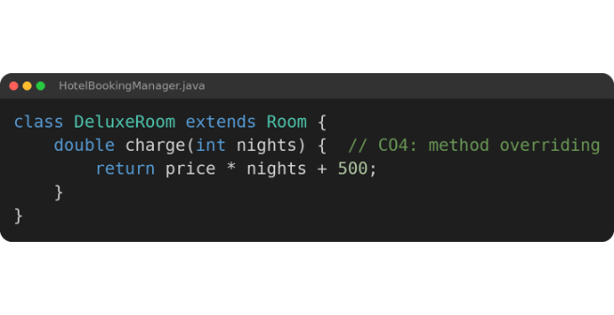
Screen Shots
i
What the Output Shows
Discount: ladder picks 5% for 3 nights (CO1, CO2)
Checking room: for loop stops at 104 with break (CO2)
Cheapest room: first value of the 1D array (CO3)
Normal and Deluxe room: objects, return value, overriding (CO3, CO4)
RAVI KUMAR: string methods (CO5)
Room not found: try-catch handles the wrong index (CO6)
15-10-2026
11

Slide 12
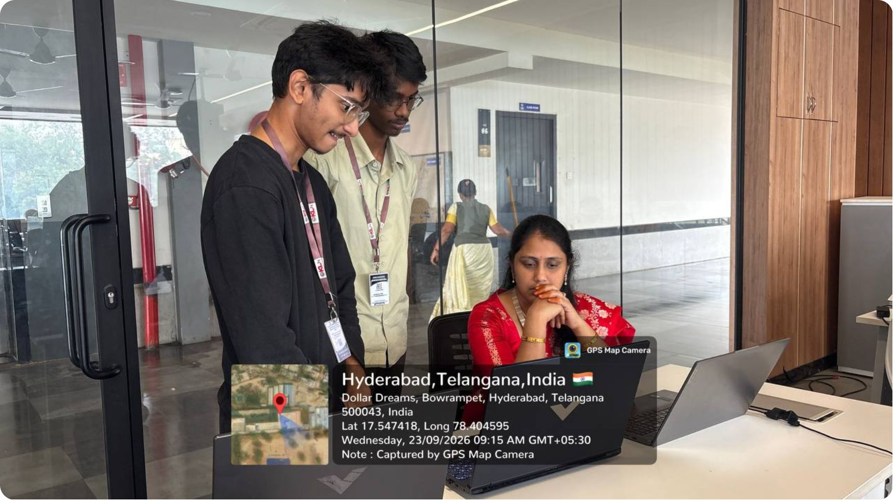
Geo Tag Photo and GitHub Links
GANGESH CHANDRA
Roll No: 2620030426
GitHub
https://github.com/gangeshchandra
AJAY SIDDARTH
Roll No: 2620030181
GitHub
https://github.com/siddarth901
https://github.com/gangeshchandra/HOTEL-BOOKING-AND-OCCUPANCY-MANAGER--team18
15-10-2026
12

