Slide 1
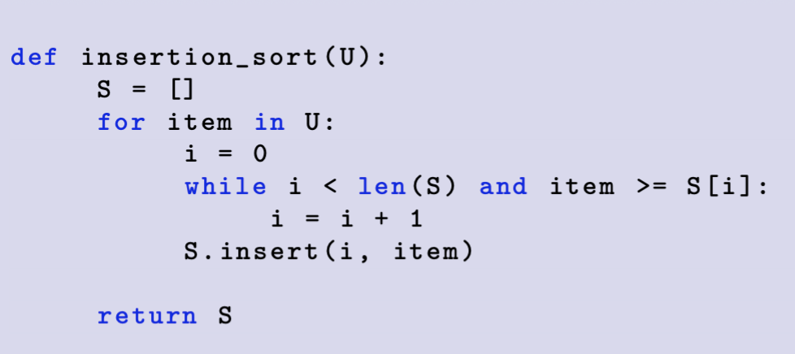
Ex1 Insertion Sort
0
1
2
3
4
5
6
U:
10
0
-10
-29
10
-31
-25
Iteration #
S[0] | S[1] | S[2] | S[3] | S[4] | S[5] | S[6]
S:

Slide 2
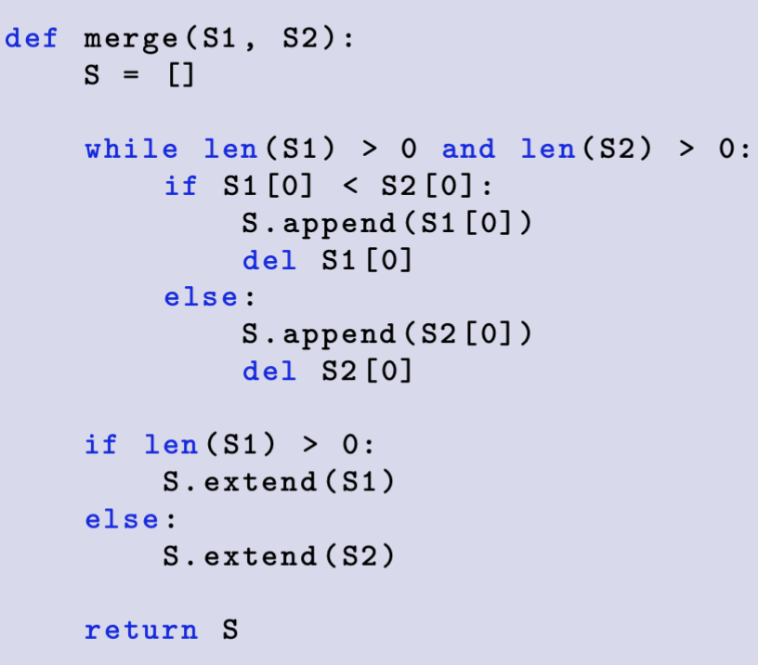
Demo1Merge
S1, S2 are sorted sequences
0
1
2
0
1
2
S1:
-99
10
74
S2:
-93
-49
23
Iteration #
S[0] | S[1] | S[2] | S[3] | S[4] | S[5] | S[6]
S:

Slide 3
Ex2 Merge sort recursion tree divide step
0
1
2
3
4
5
6
7
U:
-24
21
-45
-71
14
-41
50
7

Slide 4
Ex2 Merge sort recursion tree conquer step
S:

Slide 5
Ex4 Quick sort recursion tree divide step
Use last item as pivot
0
1
2
3
4
5
6
7
U:
94
21
51
35
-95
98
8
11

Slide 6
Ex4 Merge sort recursion tree conquer step
pivot
S:

